Slide 1
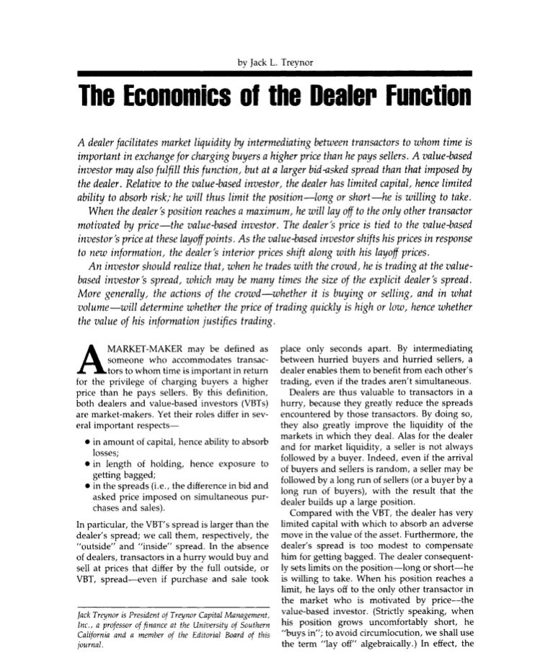

The Economics of Dealer Function:
How Securities Prices are Determined
Treynor Model:
The Economics of Dealer Function
Securities Markets
Copyright © 2019, Princeton University Press, Inc. All Rights Reserved.
Notes:
If this PowerPoint presentation contains mathematical equations, you may need to check that your computer has the following installed:
1) MathType Plugin
2) Math Player (free versions available)
3) NVDA Reader (free versions available)

Slide 2
Market Maker (1 of 2)
Market maker may be defined as someone who:
  accommodates transactors to whom time is important in return for the privilege of charging buyers a higher price than he pays sellers.
In securities market, they are two important kinds of market makers:
  Security dealers, and
  Value-based investors or traders (VBTs)

Slide 3
Market Maker (2 of 2)
Security dealers and value-based investors’ role differ in important aspects:
  Amount of capital, hence ability to absorb losses;
  Length of holding, hence exposure to getting bagged.
  In the spreads (i.e., the difference in bid and asked price imposed on simultaneous purchases and sales).
In particular, the VBT's spread is larger than the dealer's spread; we call them, respectively, the "outside" and "inside" spread.

Slide 4
Security Dealers (1 of 4)
In the absence of dealers, transactors in a hurry would buy and sell at prices that differ by the full outside, or VBT, spread, even if the sell and purchase happens almost simultaneously.
By intermediating between buyers and sellers, dealers:
  Greatly reduce the spreads encountered by those transactors.
  Greatly improve the liquidity of the markets in which they deal.

Slide 5
Security Dealers (2 of 4)
Without dealers we have two important problems:
  Time
  Price
In standard supply and demand mechanism, we assume that prices are always continuous- we are assuming perfect liquidity:
  There is always a market-clearing price and interest rates.
  In doing so, they are assuming liquidity is a free good and therefore abstracting liquidity providers (aka dealers) from their models.

Slide 6
Security Dealers (3 of 4)
There are two types of security dealers:
  One-sided dealers
    A security dealer who acts as an agent in a primary issue of corporate securities (IPO) buys the securities from the corporate clients at one price (wholesale) and then sells them at a higher price to its retail clients.

Slide 7
Security Dealers (4 of 4)
  Two-sided dealers
    They are willing to make-market both ways: they trade securities for money and trade money for securities.
Security dealers quote two prices--a lower bid (to buy) and a higher ask or offer (to sell)
    In money markets prices are quoted as yields, so the bid is a higher number than the ask.

Slide 8
Treynor Model’s Essential Elements
Treynor Model is an analytical tool to understand the economics of dealer’s function.
This model has 4 major elements:
  Inventories
  Finance Limits
  Inside Spread
  Outside Spread

Slide 9
Trade Imbalance
Unfortunately for the dealer and for market liquidity, a seller is not always followed by a buyer.
Indeed, even if the arrival of buyers and sellers is random, a seller may be followed by a long run of sellers (or a buyer by a long run of buyers),
  with the result that the dealer builds up a large position.
In other words, dealers absorb trade imbalances in their own balance sheets.
.

Slide 10
Inventories ( 1 of 4)
The position that dealers have in the instruments they trade are their inventories.
Dealers are absorbing fluctuations in demand in their balance sheet (inventories):
  The result is that imbalances in the time pattern of demand and supply show up as balance sheet changes, not price changes.
Our dealer has inventories of cash and securities, and uses those inventories to absorb fluctuations in demand and supply.
Any increase in one inventory is matched by a decrease in another:
  As people sell them securities, they are depleting cash holdings and vice versa.

Slide 11
Inventories ( 2 of 4)
Imbalances in the time pattern of demand and supply show up as balance sheet changes, not price changes.
Capital
Inventories
Cash
Securities
Time

Slide 12
Inventories ( 3 of 4)
However, compared with the VBT, the dealer has very limited capital, thus:
  It is exposed to price risk.
      Capital absorb an adverse move in the value of the asset.
Furthermore, the dealer's spread is too modest to compensate for huge losses.

Slide 13
Inventories ( 4 of 4)
Hypothetical Dealer Balance Sheet (capital funded dealer)
Asset Liabilities
Securities Capital
Cash
Inventories

Slide 14
Finance Limit (1 of 3)
Positions can be funded either from capital or more generally from dealer’s ability to borrow- typically loan from bank.
There is a financing limit since:
  Capital is expensive and therefore its quantity is limited.
  There is a limit to how much banks are willing to lend to dealers.
  Sometimes dealers no not want to borrow more than a certain amount.
  Regulatory limit such as leverage ratio, capital ratios and etc.

Slide 15
Finance Limit (2 of 3)
Further, dealers lose money when market conditions force them to sell at low prices (max long position) and buy at high prices (max short position).
when her position reaches a limit, he lays off to the only other transactor in the market who is motivated by price- the value-based investor:
  Max short position: when the dealer’s position grows uncomfortably short, she "buys in“; i.e. forced to buy the securities in much higher prices.
  Max long position: when her position grows uncomfortably long, she “sells in“; i.e. forced to liquidate (or firesale) its assets at a very low price.
The dealer consequently sets limits on the short and long positions that she is willing to take.
In effect, the value-based investor is the market-maker (or dealer) of last resort.

Slide 16
Finance Limit (3 of 3)
Positive quantity of securities Long Positions
Negative quantity of securities Short Positions
  Short position means that the dealer “borrows” the securities from her broker and sells it in the market. On settlement date, the dealer with short position should “clear” the short.
 | Long Position | Short Position
Price Increases | Capital Gain | Capital Loss
Price Falls | Capital Loss | Capital Gain

Slide 17
Who’s Who in Finance
 | Buyer of a Futures Contract | Seller of a Futures Contract
This is called the | Long position | Short position
Obligation of the party | Buy the commodity or asset on the settlement date | Deliver the commodity or asset on the settlement date
What happens to this person’s margin account after a rise in the market price of the commodity or asset? | Credited | Debited
Who takes this position to hedge? | The user of the commodity or buyer of the asset who needs to insure against the price rising | The producer of the commodity or owner of the asset who needs to insure against the price falling
Who takes this position to speculate? | Someone who believes that the market price of the commodity or asset will rise | Someone who believes that the market price of the commodity or asset will fall
This table is from Money, Banking and Financial Markets, Cecchetti and Schoenholtz, Fifth Edition, Chapter 9

Slide 18
Securities Dealer Profit: Inside Spread (1 of 2)
The bid/ask spread is the price impatient traders pay for immediacy.
Dealers provide buy (or bid)- sell (or asked) prices or inside (dealer) spread (the dashed line in Treynor Diagram).
Inside spread is prices we see in the financial market.
Spreads can't be too thin because there isn't much revenue in turning over the inventory.
They can't be too wide because then no one would trade with them.

Slide 19
Securities Dealer Profit: Inside Spread (2 of 2)
Inside spread determinants:
  Transaction cost component
    Is the part of bid/ask spread that compensates dealers for their normal costs of doing business.
  Adverse selection spread component*
    Dealers watch their inventory and their order flow.
    This is the part of the bid/ask spread that compensates dealers for the losses they suffer when trading with well-informed traders.
    Asymmetric information is extremely important in trading.
  Price Volatility component.
    Inside spread is wider for securities that historically have volatile prices.

Slide 20
Value-Based Traders Profit: Outside Spread (1 of 3)
Value traders are speculators who form opinions about instrument values by using all information available to them.
Value traders are ultimate suppliers of liquidity. They supply market depth.
Dealers often trade with value traders when they want to restore their target inventories (i.e. when they get to max long or max short positions).
Dealer therefore have mixed feelings about value traders:
  On the one hand, they compete with them to provide liquidity.
  On the other hand, they depend upon them for liquidity when they are unwilling to carry large inventory problems.

Slide 21
Value-Based Traders Profit: Outside Spread (2 of 3)
The prices at which a value trader is willing to trade is his or her outside spread.
Value traders face two serious risks when they trade : adverse selection and winners curse.
Adverse selection:
  Value traders are subjected to adverse selection risk because they offer liquidity in response to other traders who demand it.
They must be particularly careful that they do not trader with news traders
The outside spread of value traders is typically more than dealer’s spread.

Slide 22
Value-Based Traders Profit: Outside Spread (3 of 3)
Value based traders suffer the winner's curse since they are one-sided dealer in each security market.
Winner’s curse happen when they pay more for an item than it is worth.
There is no significant winner's curse for securities dealers since they are two sided dealers.
Outside spread is, therefore, significantly wider than inside spread since:
  value based traders suffer from adverse selection and winners curse and hence widen their spreads.
  while securities dealer’s major risk is adverse selection problem.
Value traders can afford to take large positions only by being the best informed traders in the market.

Slide 23
Funding Liquidity
Funding liquidity is the ability to raise money when, to replace funds.
Treynor model shows that dealers are demanders of funding liquidity and suppliers of market liquidity.
Banks, and other money market institutions such as money market funds, have the main inventory of cash and the main supplier of funding liquidity.

Slide 24
Market Liquidity
Market liquidity is the ability to trade large size quickly, at low cost, when you want to trade it. It has three elements;
  immediacy, size, width.
Everyone (Traders, Exchanges, Regulators) likes liquidity.
Everyone (Dealers, Impatient traders, speculators) has some affect on liquidity.
Surprisingly (given its importance), liquidity means different things to different people. The confusion is mainly due to many dimensions of liquidity.
Liquidity is the object of bilateral search, in which buyers and sellers look for each other.

Slide 25
Dimensions of Liquidity
Immediacy refers to how quickly trades of a given size can be arranged at a given cost. Traders generally use market orders to demand immediate traders
Width refers to the cost of doing a trade of a given size. Width is the cost per unit of liquidity.
Depth refers to the size of a trader that can be arranged at a given cost. Depth is measured in units available at a given price of liquidity.
Impatient trades focus primarily on immediacy and its cost,
  which for small traders is represented by width. Large traders focus on depth.

Slide 26
The Who, How and Why of Liquidity
Liquidity offering traders - Market makers, block dealers (offer depth), buy-side institutions, individual investors.
Passive liquidity suppliers – Dealers (supply immediacy).
Value traders (supply depth).
Arbitrageurs connect liquidity suppliers and providers in different markets.

Slide 27
Treynor Diagram
Dealers Mean Price
VB Ask
Outside Spread
Inside Spread
Market Liquidity
Matched Book
VB Bid
Max Short
0
Max Long
Inventories
Funding Liquidity

Slide 28
Treynor Model Main Assumptions
Treynor Model’s main assumptions:
  The value-based investor's bid and asked price is given.
  The standard size of orders coming to the dealer for accommodation is given.
  We also take as given the maximum position-long or short-the dealer is willing to assume.

Slide 29
Leveraged Dealer Basics (1 of 3)
Leveraged dealers have long positions in securities and therefore exposed to the price risk:
  Price risk is a risk that the value of stock is gets lower that dealer lose money.
Dealer business is a very competitive business. One way to beat the competition is to deal with lower level of capital and higher level of borrowed money (leverage).
One of the definitions of leverage is the ratio of debt to capital.
The only capital-funded dealers are value based dealers. Retail dealers are leveraged dealers.

Slide 30
Leveraged Dealer Basics (2 of 3)
Leveraged dealers’ inventory of cash is their credit line with the bankers.
They finance their security positions by borrowing from banks.
Long dealers use the new securities as collateral to borrow from banks.
The demand fluctuations for securities will be absorbed by changed in dealers balance sheets:
  Leveraged dealer is completely exposed to the “price risk” and “interest rate risk.”
Real world dealers, however, are more “hedged” than leveraged dealers.

Slide 31
Leveraged Dealer Basics (3 of 3)
Long on Securities Short on Securities
Asset Liabilities Asset Liabilities
Securities Bank Loans Cash Securities
(+Securities) (+ Loan)
Use securities as collateral

Slide 32
Repurchase Agreements (Repo)
A repurchase agreement is a collateralized overnight loan, legally constructed as two security transactions one day apart.
  The agent who “repos securities” (sells securities for repurchase) is the borrower of money.
  The agent who “reverses in securities” (buys securities for resale) the lender of money.
  It is the lender of securities who is said to “do repo,” meaning to invest in overnight loans.
  On the first leg of the repo, money flows from the lender to the borrower and securities flow the other way.
  On the second leg of the repo, the securities flow back to the borrower, and somewhat more money flows back to the lender.

Slide 33
Securities Dealers and Repo (1 of 2)
In practice a security dealer is on the other side of most repo transactions.
  She is either borrowing money by using her securities as collateral or lending money by taking in securities as collateral.
Corporations such as pension funds invest in repo (make overnight secured loans to security dealers) as a way of earning interest on their money balances, and banks repo their security holdings because it is often the cheapest way to finance them.
In the balance sheet, we treat borrowing of money as a liability and lending of money as an asset.
Asset | Liability
Lending Money (Reverse) | Borrowing Money (Repo)

Slide 34
Securities Dealers and Repo (1 of 2)
As these transactions take place,
  Collateral flows from left to right, from the bank through the dealer to the pension fund.
  And money flows from right to left, from the pension fund to the dealer to the bank.
Note that a repo is called a reverse when it is an asset of the dealer, in line with reporting conventions. But it is important to emphasize that it is the exact same instrument, just the opposite side of the exact same instrument.

Slide 35
Haircuts (1 of 2)
The legal construction as paired security transactions is important because it means that the transaction is more symmetric than an ordinary collateralized loan would be.
  For repo, in contrary to standard collateralized loans, the lender of money does often have the right to sell the securities.
  They may then sell those securities to establish short positions in securities.
But the transaction is not completely symmetric because the price at which the security is transferred is lower than its market price.
  This means that the money lender gets control over more securities than a clean purchase would allow.

Slide 36
Haircuts (2 of 2)
The difference between market price and repo value of a securities is referred to as margin.
The problem is that the price of the security could go up or down, so giving incentive for default to either the money lender or the money borrower, respectively.
  Thus, traditionally on a repo transaction, the lender of money, because it is lending the more liquid asset, receives margin.

Slide 37
Haircuts: An Example
The way that margin works is that the price of a security that is used as repo collateral is less than its market price by an amount called the “haircut”.
For example, assume there is a 10 year Treasury Bond trading at 100 plus accrued interest is used as collateral for an overnight repo.
The haircut is 2%, so the borrower gets only 99.228 for his collateral.
The agreed overnight interest rate is 4.92%, which means that the borrower has to pay 99.2280*(1+.0492/360)=99.2416 the next day in order to repurchase his securities.
The overnight interest on an approximately million dollar loan is about $135.

Slide 38
Real-World Dealers (1 of 3)
Real world dealers have more sophisticated trading strategies:
  They have long positions in some securities and short positions in other securities that are correlated, i.e. move in the same directions.
Additionally, they hedge their position (through repo market) and are less exposed to the price risk.
  Thus, real world dealer’s balance sheet looks like the securities dealer’s balance sheet in repo market.

Slide 39
Real-World Dealers (2 of 3)
Assets Liabilities
Reverse Repo
Inventory of Cash; Banks, MMFs, etc.
Inventory of Securities; Pension funds, asset managements, etc.
Cash In
Securities Out
Cash In
Securities Out

Slide 40
Term Spread (Premium) (1 of 2)
Hedged dealers have a large gross position but much smaller net position:
  Gross position is size of the balance sheet
  Net position (exposure) is long positions minus short positions.
Typically, dealers have net exposures that is exposure to term spread (i.e. long in long term bonds and short in short term bonds).
      They are borrowing short and lending long.
Gross position exposes dealers to liquidity risk as they should still fund their gross exposures.

Slide 41
Term Spread (Premium) (2 of 2)
Dealers are borrowing (short) short-term securities and they are lending (long) on long-term bonds.
  They are exposing themselves to price risk.
  But exposing to price risk is a “profitable” business to do (i.e. failure of expectations hypothesis of term structure).

Slide 42
Dealers’ Profit and Price Risk
(1 of 2)
Treynor model is all about net exposure (price risk).
Gross risk is liquidity risk.
According Treynor model, dealers willingness to provide market liquidity depends on their willingness to take price risk and manage price risk.

Slide 43
Dealers’ Profit and Price Risk
(2 of 2)
Dealers are able to make profit in market-making business by having access to a large inventories of securities and cash:
  If dealers can easily have access to inventories whenever they want, they do not need to hold these inventories in their own balance sheet.
  Thus, they will reduce their price risk.

Slide 44
Asset Managers Provide Inventory of Securities
There are inventory of securities in the financial market:
  Pension funds, money managers, etc.
Banks are the main inventory of cash.

Slide 45
Trading and Exchanges: Market Microstructure for Practitioner by Larry Harris
Suggested Reading:
Harris used Treynor Model to explain how market practitioner think about securities prices. Prof. Harris is currently professor of finance at USC.

Slide 46
Appendix

Slide 47
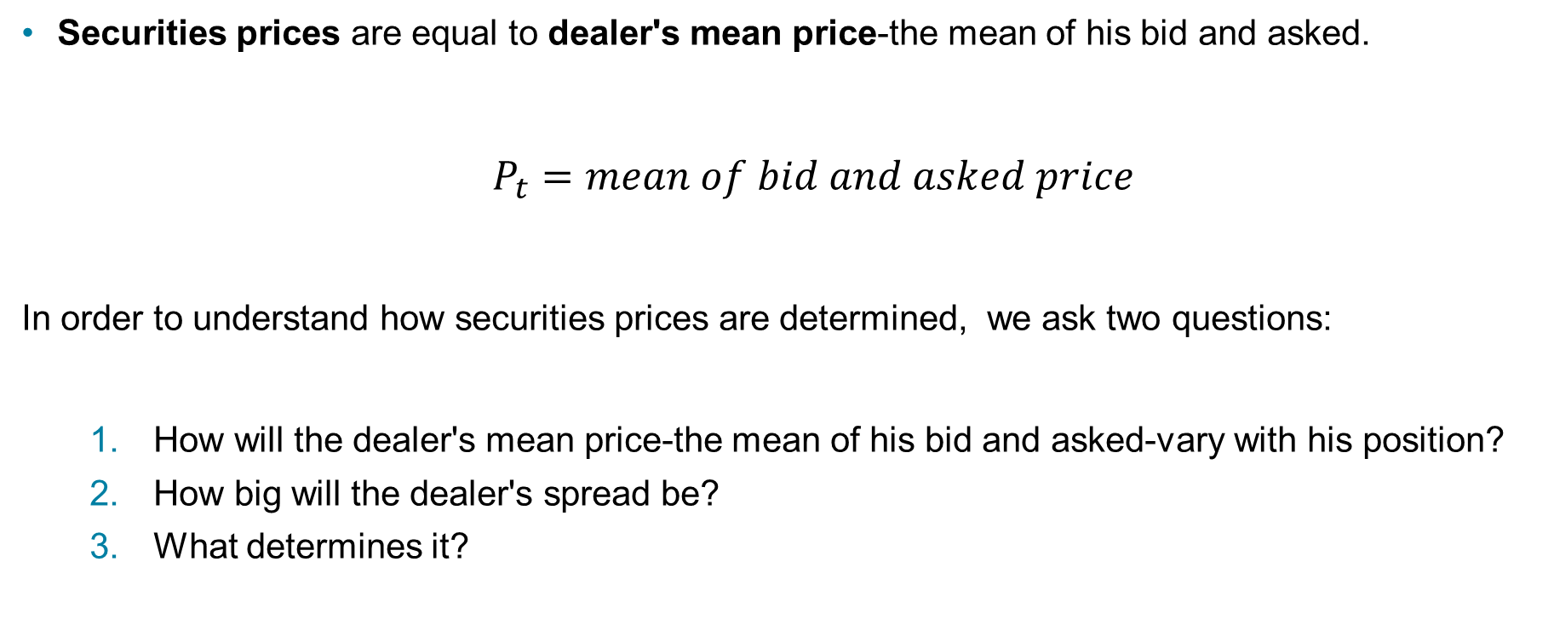
Treynor Model: Securities Prices (1 of 2)
Securities prices are equal to dealer's mean price-the mean of his bid and asked.
$P_{t}=mean of bid and asked price$
In order to understand how securities prices are determined, we ask two questions:
  How will the dealer's mean price-the mean of his bid and asked-vary with his position?
  How big will the dealer's spread be?
  What determines it?

Slide 48
Treynor Model: What Determines Securities Prices (2 of 2)
In general, therefore, dealer prices are responding to two different forces
  Cost of Making Market: dealers change their spread in line with changes in the VBT's estimate of value (it is their main cost of doing business), and
  Risk of Making Market: dealers spread change in response to changes in the dealer's position (price risk is the main risk of making market).
Because the dealer's price is tied to the VBT bid and ask at his layoff points, his prices move along with the VBT prices.

Slide 49
Inventory Control:
How Will Dealer’s Mean Price Vary with Her Position?
Dealers control their inventories primarily by influencing the buying and selling decisions of their clients through the price they offer.
When dealers want to decrease inventories (as they are getting closer to max long position), they decrease their bid-ask. When dealers want to increase inventories, the increase the bid-ask levels.
Dealers must control their inventories to trade profitably. Large positions are difficult to finance. They expose dealers to inventory (or price) risk.
Dealers set prices so as to obtain two sided order flows. The search for prices that produce a two sided order flow is called price discovery process.

Slide 50
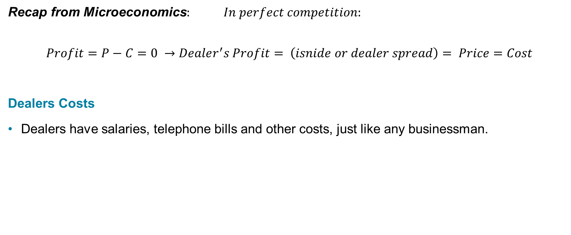
Determining the Dealer's Spread (1 of 3)
Recap from Microeconomics$: In perfect competition:$
$$Profit=P−C=0 →Dealer^{′}s Profit= \left(isnide or dealer spread\right)= Price=Cost$$
Dealers Costs
Dealers have salaries, telephone bills and other costs, just like any businessman.

Slide 51
Determining the Dealer's Spread (2 of 3)
Unless these costs have a significant variable component, however, a dealer's dominant variable cost will be the:
  The cost of “buying in”: paying an asking price to the VBT above his own asking price when the dealer is in its max-short position (value based ask) and
  The cost of “selling in” or laying off: “liquidating” and selling her positions to VBT at a bid price below his own bid when the dealer is in max-long position (value based bid).
Thus every share (every unit) laid off represents a loss to the dealer.

Slide 52
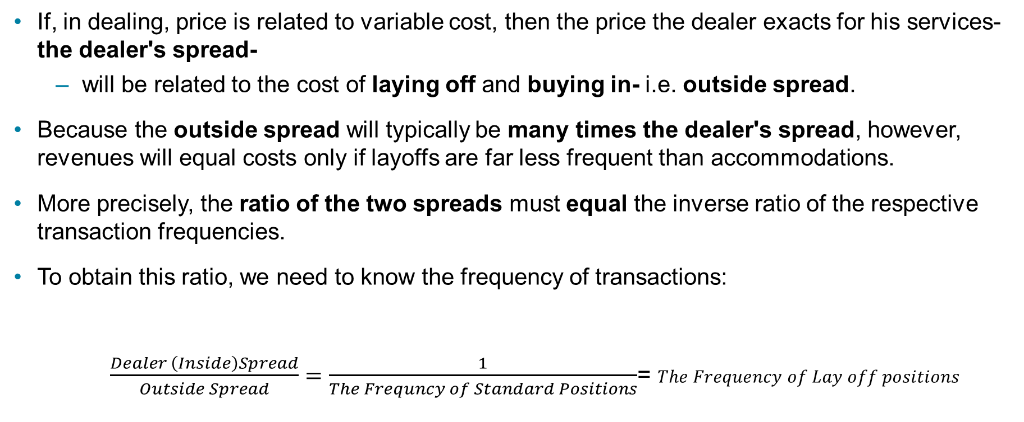
Determining the Dealer's Spread (3 of 3)
If, in dealing, price is related to variable cost, then the price the dealer exacts for his services-the dealer's spread-
  will be related to the cost of laying off and buying in- i.e. outside spread.
Because the outside spread will typically be many times the dealer's spread, however, revenues will equal costs only if layoffs are far less frequent than accommodations.
More precisely, the ratio of the two spreads must equal the inverse ratio of the respective transaction frequencies.
To obtain this ratio, we need to know the frequency of transactions:
$\frac{Dealer \left(Inside\right)Spread}{Outside Spread}=\frac{1}{The Frequncy of Standard Positions}$= $The Frequency of Lay off positions$

Slide 53
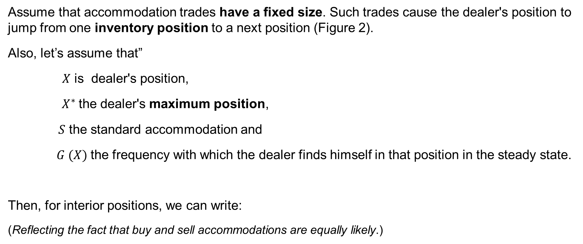
The Frequency of Layoffs (1 of 5)
Assume that accommodation trades have a fixed size. Such trades cause the dealer's position to jump from one inventory position to a next position (Figure 2).
Also, let’s assume that”
$X$ is dealer's position,
$X^{∗}$the dealer's maximum position,
$S$ the standard accommodation and
$G (X)$the frequency with which the dealer finds himself in that position in the steady state.
Then, for interior positions, we can write:
(Reflecting the fact that buy and sell accommodations are equally likely.)

Slide 54
Figure 2: Dealer’s String of Transactions

Slide 55
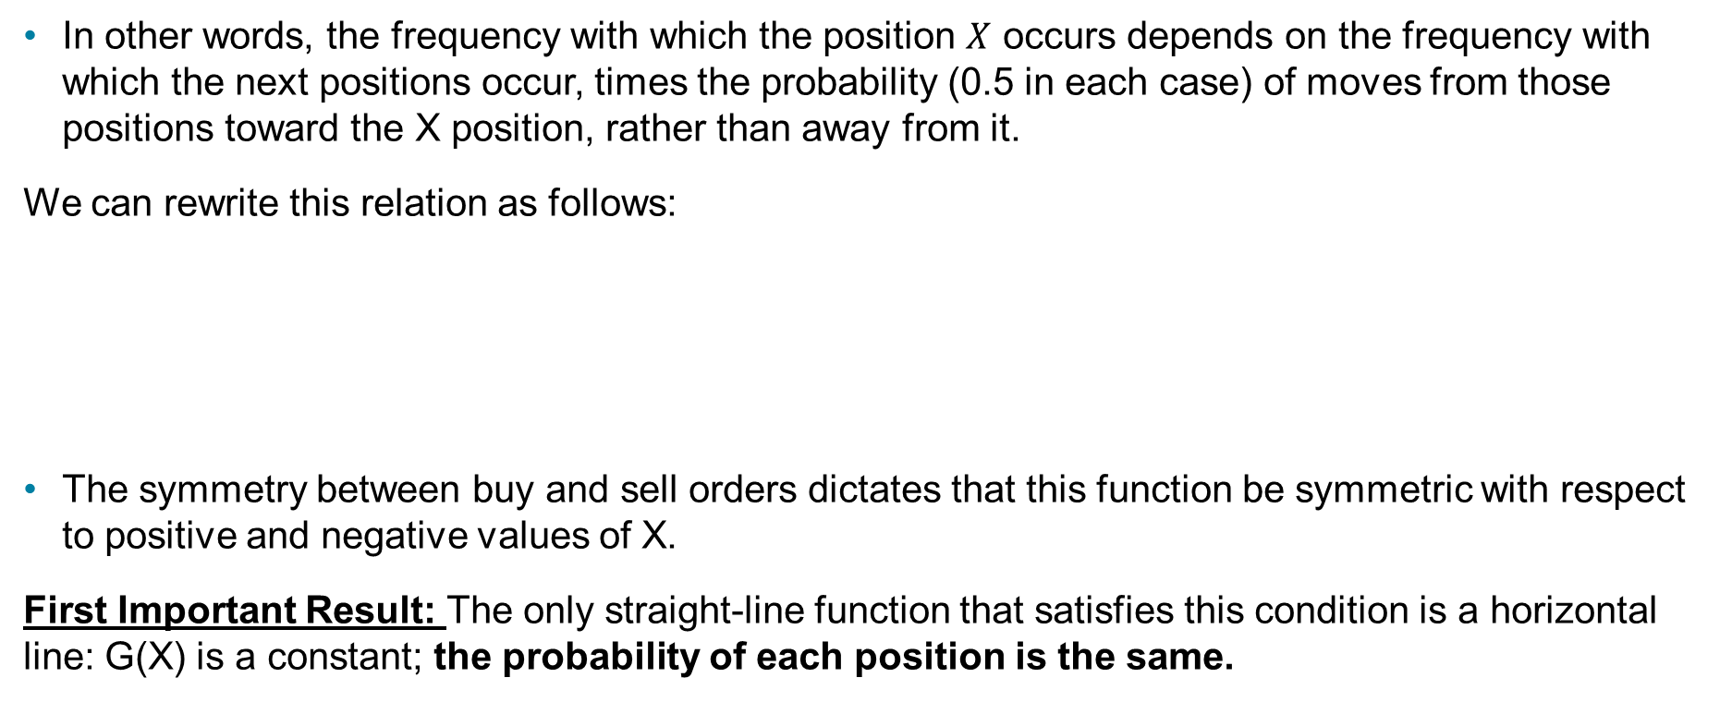
The Frequency of Layoffs (2 of 5)
In other words, the frequency with which the position $X$ occurs depends on the frequency with which the next positions occur, times the probability (0.5 in each case) of moves from those positions toward the X position, rather than away from it.
We can rewrite this relation as follows:
The symmetry between buy and sell orders dictates that this function be symmetric with respect to positive and negative values of X.
First Important Result: The only straight-line function that satisfies this condition is a horizontal line: G(X) is a constant; the probability of each position is the same.

Slide 56
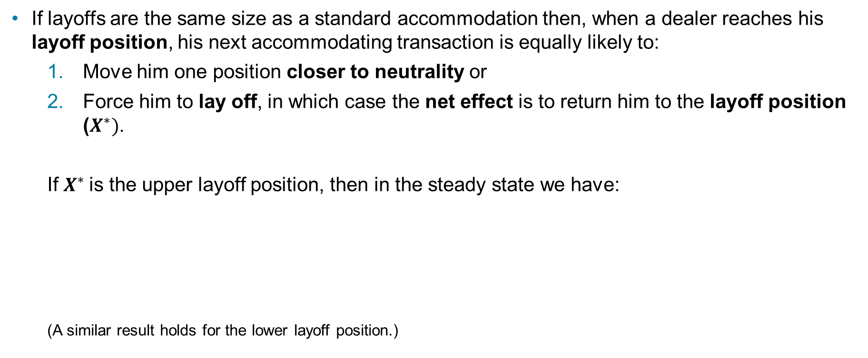
The Frequency of Layoffs (3 of 5)
If layoffs are the same size as a standard accommodation then, when a dealer reaches his layoff position, his next accommodating transaction is equally likely to:
  Move him one position closer to neutrality or
  Force him to lay off, in which case the net effect is to return him to the layoff position ($X^{∗})$.
  If $X^{∗}$is the upper layoff position, then in the steady state we have:
  (A similar result holds for the lower layoff position.)

Slide 57
The Frequency of Layoffs (4 of 5)
If all possible positions, including layoff positions, occur with the same frequency,
  then layoff positions occur with a frequency equal to the standard accommodation divided by twice the dealer's layoff position; times two, because there are two layoff positions.
  But layoff positions actually lead to layoffs only half the time. Thus layoffs occur with a frequency equal to the standard accommodation divided by twice the dealer's layoff position:

Slide 58
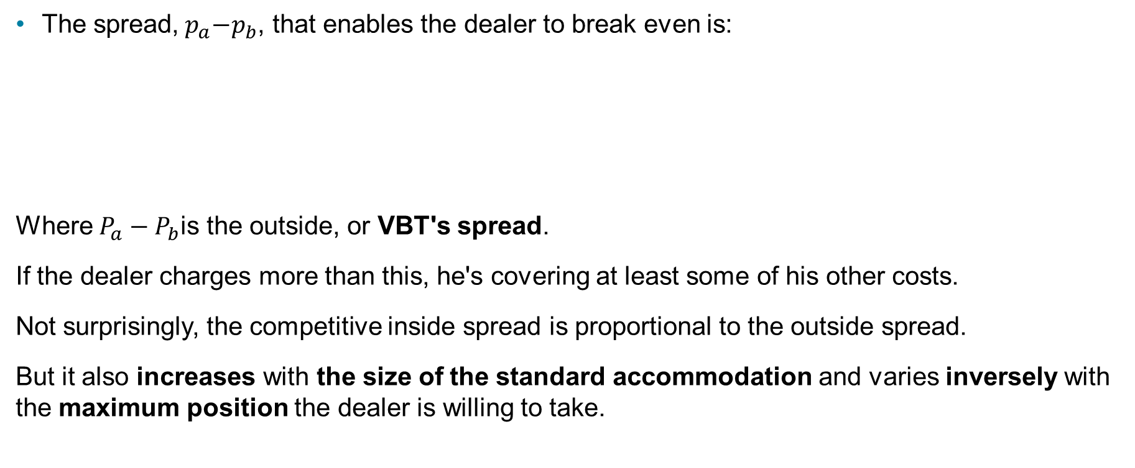
The Frequency of Layoffs (5 of 5)
The spread,${ p}_{a}−p_{b}$, that enables the dealer to break even is:
Where $P_{a}−P_{b}$is the outside, or VBT's spread.
If the dealer charges more than this, he's covering at least some of his other costs.
Not surprisingly, the competitive inside spread is proportional to the outside spread.
But it also increases with the size of the standard accommodation and varies inversely with the maximum position the dealer is willing to take.

