Slide 1
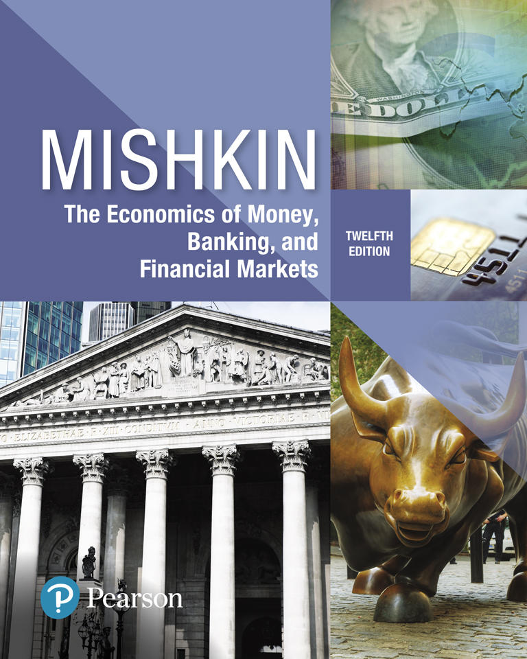
The Economics of Money, Banking, and Financial Markets
Twelfth Edition
Chapter 7
The Stock Market, the Theory of Rational Expectations,
and the Efficient Market Hypothesis
Copyright © 2019, 2016, 2013 Pearson Education, Inc. All Rights Reserved.
Notes:
If this PowerPoint presentation contains mathematical equations, you may need to check that your computer has the following installed:
1) MathType Plugin
2) Math Player (free versions available)
3) NVDA Reader (free versions available)

Slide 2
Preview
In this chapter, we examine the theory of rational expectations. When this theory is applied to financial markets, the outcome is the efficient market hypothesis, which has some general implications for how markets in other securities besides stocks operate.

Slide 3
Learning Objectives (1 of 2)
Calculate the price of common stock.
Recognize the impact of new information on stock prices.
Compare and contrast adaptive and rational expectations.
Explain why arbitrage opportunities imply that the efficient market hypothesis holds.

Slide 4
Learning Objectives (2 of 2)
Identify and explain the implications of the efficient market hypothesis for financial markets.
Summarize the reasons why behavioral finance suggestions that the efficient market hypothesis may not hold.

Slide 5
Stocks (1 of 3)
Stocks, also known as common stock or equity, are shares in a firm’s ownership. A firm that issues stock sells part of itself, so that the buyer becomes a part owner.
These early stocks had two important characteristics that we take for granted today:
  First, the shares were issued in small denominations, allowing investors to buy as little or as much of the company as they wanted; and
  Second, the shares were transferable, meaning that an owner could sell them to someone else.

Slide 6
Stocks (2 of 3)
Today, the vast majority of large companies issue stock that investors buy and sell regularly. (The hidden assumption here is that there is always market liquidity.)
The shares normally are quite numerous, each one representing only a small fraction of a company’s total value:
  The large number and small size of individual shares—prices are usually below $100 per share—make the purchase and sale of stocks relatively easy.

Slide 7
Stocks (3 of 3)
Today, most stockholders no longer receive certificates; the odds are that you will never see one.
Instead, the information they bear is computerized, and the shares are registered in the names of brokerage firms that hold them on investors’ behalf.

Slide 8
Stock Holders’ Rights
The ownership of common stock conveys a number of rights:
  Right to participate in the profits of the enterprise (residual claimant)
  Limited Liability
  Entitled to vote at firms’ annual meetings

Slide 9
Residual Claimant
  First and most importantly, a stockholder is entitled to participate in the profits of the enterprise.
  Importantly, however, the stockholder is merely a residual claimant, meaning If the company runs into financial trouble, only after all other creditors have been paid what they are owed will the stockholders receive what is left, if anything.
  Stockholders get the leftovers!

Slide 10
Bankruptcy and Limited Liability
The possibility of bankruptcy brings up an interesting questions:
What happens if a company’s revenue is insufficient to cover its obligations to nonstockholders?
If the company does very poorly, will the stockholders have to pay the firm’s creditors?
It would appear that the stockholders’ promised participation in the firm’s profits would yield a liability rather than a payment.
An arrangement in which the stockholders are held liable for the firm’s losses is very unappealing and would surely discourage people from buying stock.

Slide 11
Limited Liability
  2. Stockholders bore that risk until the early 19th century. It ended with the introduction of the legal concept of limited liability.
Limited liability means that, even if a company fails completely, the maximum amount that shareholders can lose is their initial investment.
Liability for the company’s losses is limited at zero:
  meaning that investors can never lose more than they have invested.
Clearly, buying stock is much more attractive if you know that your maximum potential loss is the price you pay for the stock in the first place.

Slide 12
Right to Vote
  3. Beyond participating in the firm’s profits, owners of common stock are entitled to vote at the firm’s annual meeting.
  Though managers supervise a firm’s day-to-day activities, the shareholders elect the board of directors, which meets several times per year to oversee management.
  Ultimately, the shareholders’ ability to dislodge directors and managers who are performing poorly is crucial to their willingness to purchase shares.
  This ability to elect and remove directors and managers varies with a country’s legal structure. In places where shareholders’ legal rights are weak, stock ownership is less appealing, and equities are a less important form of corporate financing.

Slide 13
Why Stock Market is So Popular? (1 of 2)
Today, stock ownership is immensely popular. Investors want to own stocks and companies want to issue them.
Over the past century, markets have developed in which people buy and sell billions of shares every day.
This thriving financial trade is possible because:
  An individual share represents only a small fraction of the value of the company that issued it.
  A large number of shares are outstanding.
  Prices of individual shares are low, allowing individuals to make relatively small investments.

Slide 14
Why Stock Market is So Popular? (2 of 2)
  As residual claimants, stockholders receive the proceeds of a firm’s activities only after all other creditors have been paid.
  Because of limited liability, investors’ losses cannot exceed the price they paid for the stock.
  Shareholders can replace managers who are doing a bad job

Slide 15
Measuring the Value of Stock Markets (1 of 4)
Stocks are one way in which we choose to hold our wealth:
When stock values rise, we get richer; when they fall, we get poorer.
These changes affect our consumption and saving patterns, causing general economic activity to fluctuate.
We need to understand the dynamics of the stock market, both to manage our personal finances and to see the connections between stock values and economic conditions.

Slide 16
Measuring the Value of Stock Markets (2 of 4)
From a macroeconomic point of view, we need to be able to measure the level of fluctuation in all stock values.
We will refer to this concept as the value of the stock market and to its measures as stock market indexes.
The purpose of an index number is to give a measure of scale so that we can compute percentage changes. Stock market indexes are the same.

Slide 17
Measuring the Value of Stock Markets (3 of 4)
Stock indexes are designed to give us a sense of the extent to which things are going up or down.
Saying that the Dow Jones Industrial Average is at 10,000 doesn’t mean anything on its own:
  But if you know that the Dow index rose from 10,000 to 11,000, that tells you that stock prices (by this measure) went up 10 percent.

Slide 18
Measuring the Value of Stock Markets (4 of 4)
Stock indexes can tell us:
  how much the value of an average stock has changed
  how much total wealth has gone up or down.
  Beyond that, stock indexes provide benchmarks for performance of money managers, allowing us to measure whether a particular manager has done better or worse than “the market” as a whole.
The three most well-known U.S. indexes are the Dow Jones Industrial Average, the Standard & Poor’s 500 Index, and Nasdaq Composite Index.

Slide 19
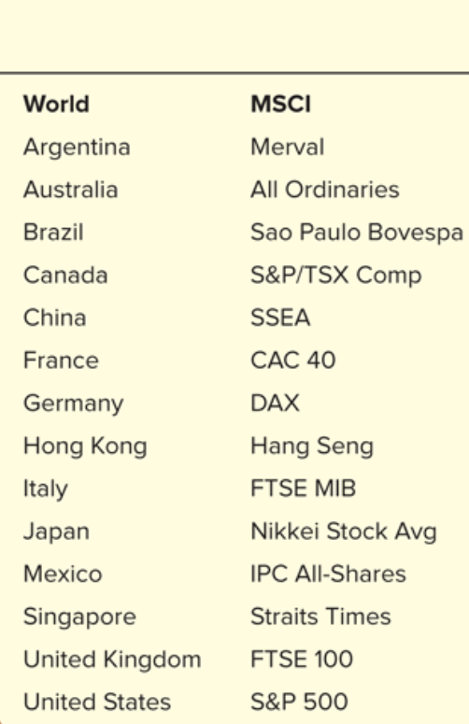
World Stock Indexes

Slide 20
Recap: Few Definitions
Common stock is the principal medium through which corporations raise equity capital.
Stockholders—those who hold stock in a corporation—own an interest in the corporation equal to the percentage of outstanding shares they own.
This ownership interest gives them the right to vote and to be a residual claimant of all funds flowing into the firm (known as cash flows).
Dividends: stockholders may receive dividends from the net earnings of the corporation. Dividends are payments made periodically, usually every quarter, to stockholders.
The stockholder has the right to sell the stock.

Slide 21
Valuing Stocks (1 of 2)
Chartists:
Some believe they can predict changes in a stock’s price by looking at patterns in its past price movements. Because these people study charts of stock prices
Behavioralists:
Some estimate the value of stocks based on their perceptions of investor psychology and behavior

Slide 22
Valuing Stocks (2 of 2)
Still others estimate stock values based on a detailed study of companies’ financial statements.
In their view, the value of a firm’s stock depends both on:
  Its current assets and
  On estimates of its future profitability—what they call the fundamentals.
Thus, the fundamental value of a stock is based on the timing and uncertainty of the returns it brings.

Slide 23
Stock Market Bubbles
The chartists and behavioralists question the usefulness of fundamentals in understanding the level and movement of stock prices.
They focus instead on estimates of the deviation of stock prices from those fundamental values. These deviations can create short-term bubbles and crashes.

Slide 24
Class Discussion
Get Into Stocks
https://www.stlouisfed.org/education/no-frills-money-skills-video-series/episode-3-get-into-stocks
Questions:
  For what two purposes do people generally buy stocks?
  What are some reasons company owners might decide to “go public” and issue stock?
  What is a major cost a company incurs by selling stock?
  What are some differences between owning common stock and preferred stock?

Slide 25
Fundamental Value (1 of 2)
We can use our toolbox for valuing financial instruments, i.e. present value, to compute the fundamental value of stocks in two steps:
  Based on the size and timing of the promised payments (aka future cash flows), we can use the present-value formula to assess how much a stock is worth in the absence of any risk.
The cash flows that a stockholder might earn from stock are:
    dividends,
    the sales price,
    or both.

Slide 26
Fundamental Value (2 of 2)
  Then, realizing that the payments are uncertain in both their size and timing, we can adjust our estimate of the stock’s value to accommodate those risks.
Together, these two steps give us the fundamental value.

Slide 27
Present Value
Let i = .10
In one year: $100 × (1 + 0.10) = $110
In two years: $110 × (1 + 0.10) = $121
or $100 × (1 + 0.10)²
In three years: $121 × (1 + 0.10) = $133
or $100 × (1 + 0.10)³
In n years
$100 × (1 + i)^{n}

Slide 28
Simple Present Value (1 of 2)
Today 0
Year 1
Year 2
Year 3
..
..
Year n
$100
$110
$121
$133
$$\$100×{(1+i)}^{n}$$
PV = today’s (present) value
CF = future cash flow (payment)
i = the interest rate

Slide 29
Simple Present Value (2 of 2)
The process of calculating today’s value of dollars received in the future, as we have done in previous slide, is called discounting the future.
We cannot directly compare payments scheduled in different points in the time line

Slide 30
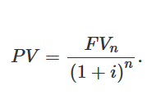
Present Value
The concept of present value is the single important concept in understanding the valuation of financial instruments:
  Present value is the value today (in the present) of a payment that is promised to be made in the future.
    Put another way, present value is the amount that must be invested today in order to realize a specific amount on a given future date.

Slide 31
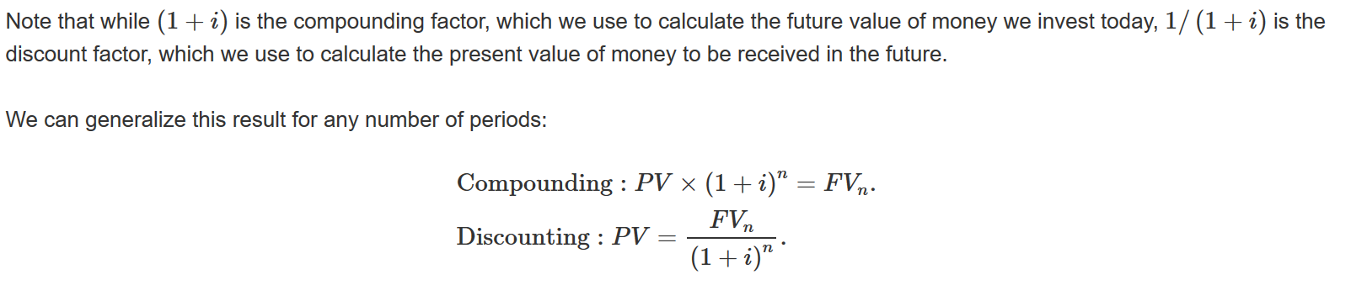
Compounding versus Discounting:
Future Value Vs. Present Value

Slide 32
Some Important Points about Discounting
(1 of 5)
Present value is sometimes called “present discounted value.”
  This terminology emphasizes that in converting dollars received in the future into their equivalent value in dollars today, we are discounting, or reducing, the value of the future dollars.

Slide 33
Time Value of Money (1 of 2)
The time value of money refers to the way that the value of a payment changes depending on when the payment is received.
Why are funds in the future worth less than funds in the present? For the same three reasons that lenders charge interest on loans:
  Compensation for inflation:
  Dollars in the future will usually buy less than dollars can today because the price level usually increases over time.

Slide 34
Time Value of Money (2 of 2)
  2. Compensation for default risk:
  Dollars that are promised to be paid in the future may not actually be received because a borrower may default by failing to make promised payments.
  3. Compensation for the opportunity cost of waiting to spend your money:
  There is an opportunity cost in waiting to receive a payment because you cannot get the benefits of the goods and services you could have bought if you had the money today.

Slide 35
Some Important Points about Discounting
(2 of 5)
2. The further in the future a payment is to be received, the smaller its present value.
We can see that this point is true by examining the discounting formula:
At any fixed interest rate, an increase in the time until a payment is made reduces its present value.
The larger the value of n, the larger the value of the denominator in the fraction and the smaller the present value.

Slide 36
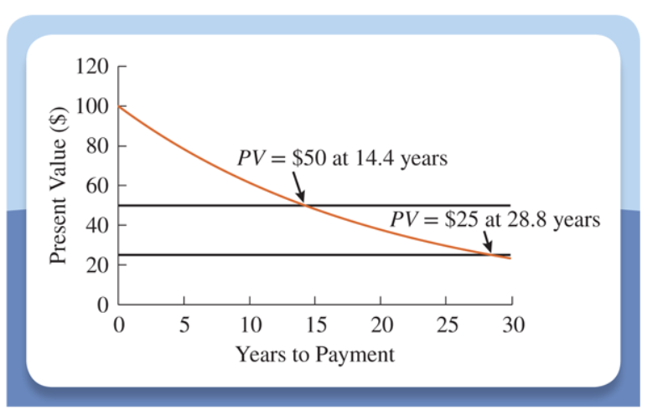
Present Value of $100 at 5 Percent Interest

Slide 37
Some Important Points about Discounting
(3 of 5)
3. The higher the interest rate we use to discount future payments, the smaller the present value of the payments:
Because the interest rate appears in the denominator of the fraction, the larger the interest rate, the smaller the present value.

Slide 38
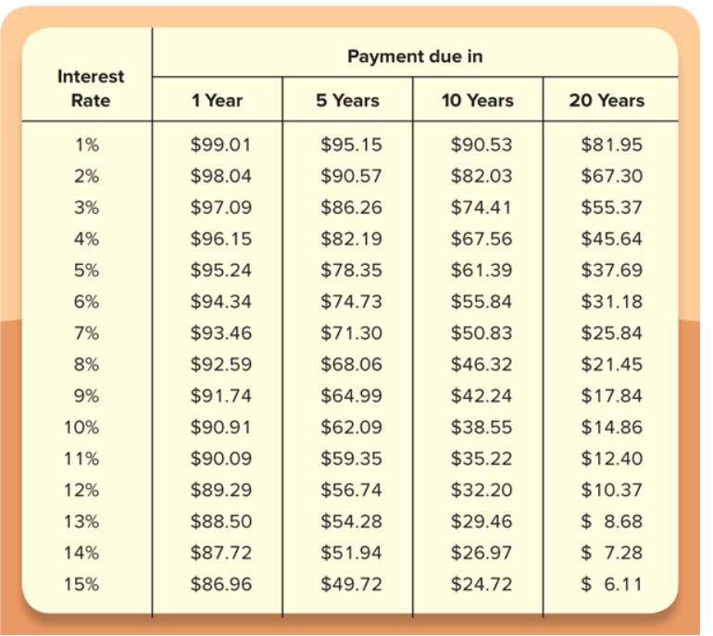
Present Value of a $100 Payment

Slide 39
Some Important Points about Discounting
(4 of 5)
From an economic perspective, if you require a higher interest rate in order to be willing to lend your money, you are saying that:
  a larger number of dollars in the future is worth as much to you as a dollar today.
The table shows that if the payment is to be made in one year (column 2), as the interest rate increases from 1 percent to 5 percent, the present value falls from $99.01 to $95.24.
  This is a drop of $3.77, or just under 4 percent.

Slide 40
Some Important Points about Discounting
(5 of 5)
4. The present value is higher, the higher the future value of the payment.
5. The present value of a series of future payments is simply the sum of the discounted value of each individual payment.

Slide 41
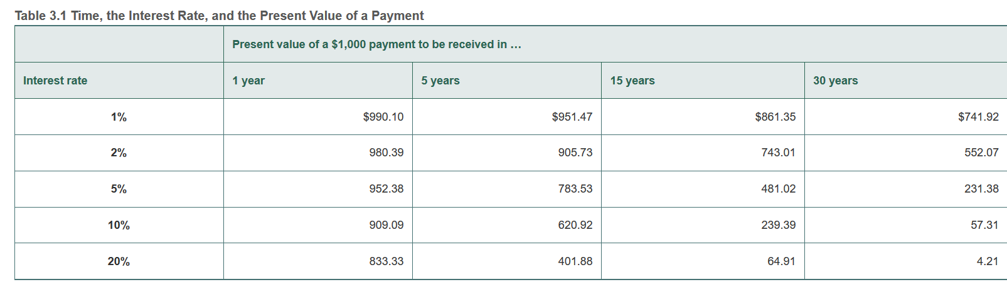
The Relationship Between Time, Interest Rate and Present Value

Slide 42
Class Discussion:
How Do You Value a College Education?
According to the Census Bureau’s Current Population Survey, at age 22, the typical college graduate makes about $7,200 more per year than does the typical high school graduate who has not attended college. The earnings gap between high school graduates and college graduates grows until about age 42.
Consider the following data on the gap between earnings by college graduates and high school graduates (for the sake of simplicity, suppose that the additional income received by a college graduate is all received at the end of the year):
Age 22: $7,200
Age 23: $7,200
Age 24: $7,300
Age 25: $7,300

Slide 43
Class Discussion:
How Do You Value a College Education?
  Considering just ages 22 to 25, what is the present value of the higher earnings from a college education? Assume an interest rate of 5%.
  Suppose you are 18 years old and considering whether to enter the labor force by taking a job immediately after graduating from high school or to attend college and enter the labor force at age 22. Briefly explain how you might calculate the present value to you of a college education. (Hint: Are there costs and other factors beyond just the earnings gap between all high school graduates and all college graduates you should take into account?)

Slide 44
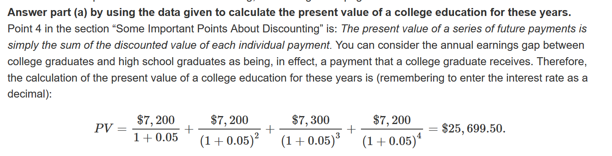
Class Discussion: Solution

Slide 45
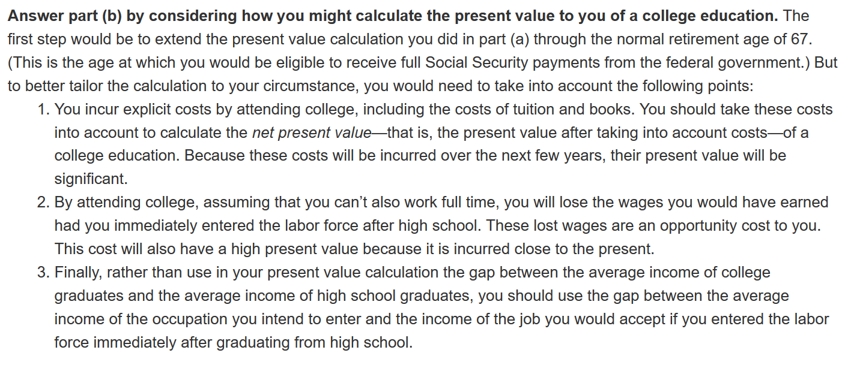
Class Discussion: Solution

Slide 46
Dividend- Discount Model:
Calculating the Price in the Absence of Risk
The first step in calculating the fundamental value is:
  to use the present-value formula
  to assess how much a stock is worth in the absence of any risk,
  based on the size and timing of the promised payments.
Like all financial instruments, a stock represents a promise to make monetary payments on future dates, under certain circumstances.
With stocks, the payments are usually in the form of dividends, or distributions made to the owners of a company when the company makes a profit.

Slide 47

Calculating the Price in the Absence of Risk:
One-Period Model
Let’s begin with an investor who plans to buy a stock today and sell it in one year.
The principle of present value tells us that the price of the stock today should equal the present value of the payments the investor will receive from holding the stock.
  This is equal to the selling price of the stock in one year’s time plus the dividend payments received in the interim.

Slide 48


Calculating the Price in the Absence of Risk:
Two-Period Model
What if the investor plans to hold the stock for two years?
To figure out the answer, start by using present value to calculate the price next year which is equals:
  The price in two years plus
  Next year’s dividend payment.
Substituting above equation into previous equation, we get that the current price is the present value of the price in two years plus two dividend payments, one each year, or

Slide 49

Calculating the Price in the Absence of Risk:
General Model
Extending this formula over an investment horizon of n years, the result is

Slide 50
Calculating the Price in the Absence of Risk:
How to Think About Dividends?
At this point, you may be asking:
  What about companies that do not pay dividends?
  How do we figure out their stock price?
The answer is that:
we estimate when they will start paying dividends and then use the present-value framework.
So if we figure that the company will start paying dividends in 10 years, we just set the first 9 years’ worth of dividends equal to zero, and compute the present discounted value of dividend payments starting in year 10.

Slide 51

Calculating the Price in the Absence of Risk:
How to Think About Dividends?
Returning to our baseline case, we can see that unless we know something more about the annual dividend payments, we are stuck.
To proceed, we will assume that dividends grow at a constant rate of g per year.
That is, the dividend next year will equal the dividend today multiplied by one plus the growth rate:

Slide 52


Calculating the Price in the Absence of Risk:
How to Think About Dividends?
Following the procedure for computing present value in n years, we can see that the dividend n years from now will be
Therefore, the equation for stock price is as following:

Slide 53
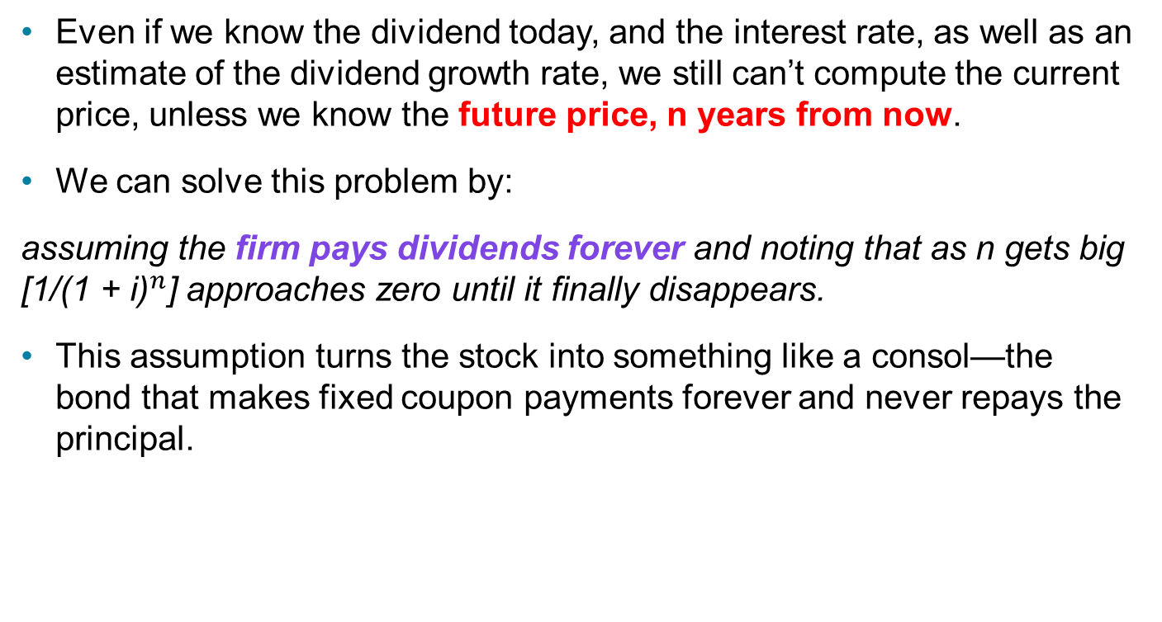
Calculating the Price in the Absence of Risk:
How to Think About Future Prices?
Even if we know the dividend today, and the interest rate, as well as an estimate of the dividend growth rate, we still can’t compute the current price, unless we know the future price, n years from now.
We can solve this problem by:
assuming the firm pays dividends forever and noting that as n gets big [1/(${\text{1 + }\text{i}\text{)}}^{n}$] approaches zero until it finally disappears.
This assumption turns the stock into something like a consol—the bond that makes fixed coupon payments forever and never repays the principal.

Slide 54

Calculating the Price in the Absence of Risk:
Dividend- Discount Model
This assumption converts the equation for computing stock prices to the following:
This relationship is the dividend-discount model.

Slide 55
Calculating the Price in the Absence of Risk:
Dividend- Discount Model
Using the concept of present value, together with the assumptions that:
  The firm’s dividends will grow at a constant rate g, and
  Firms pay dividends forever
we have discovered that the “fundamental” price of a stock is simply:
the current dividend divided by the interest rate, minus the dividend growth rate.

Slide 56
Calculating the Price in the Absence of Risk:
Dividend- Discount Model
The model tells us that stock prices should be high :
  When dividends are high,
  When dividend growth (g) is rapid (that is, when g is large),
  Or when the interest rate (i) is low.

Slide 57
Calculating the Price by Accounting for Risk
The next step in calculating stock prices is to adjust our estimate of the stock’s value to accommodate for risks.

Slide 58
Why Stocks are Risky? (1 of 2)
Recall that stockholders are the firm’s owners, so they receive the firm’s profits.
But their profits come only after the firm has paid everyone else, including bondholders.
It is as if the stockholders bought the firm by putting up some of their own wealth and borrowing the rest.
This borrowing creates leverage, and leverage creates risk.

Slide 59
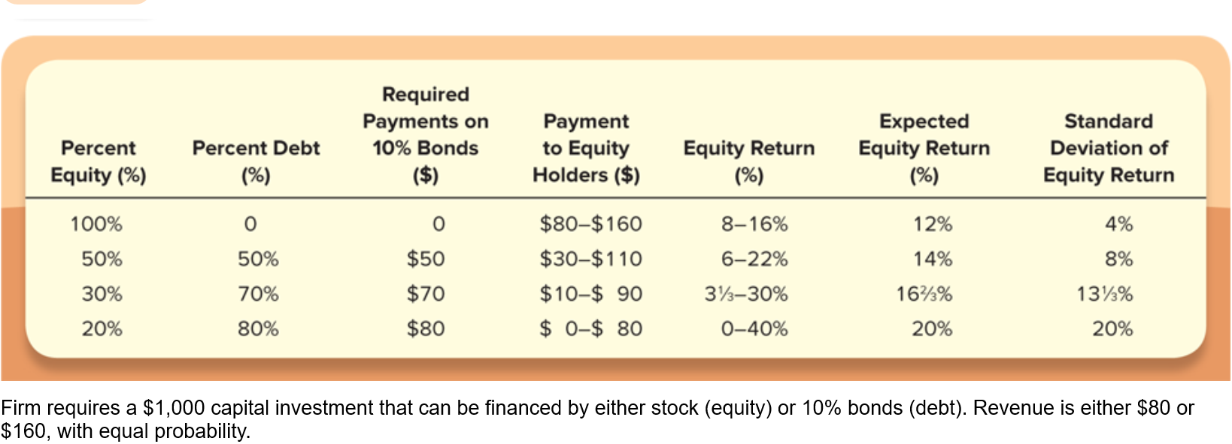
Why Stocks are Risky? (2 of 2)
Table 8.3 shows what happens to the company’s equity returns as its level of debt changes. The more debt, the more leverage and the greater the owners’ risk (as measured by the standard deviation of the equity return).

Slide 60
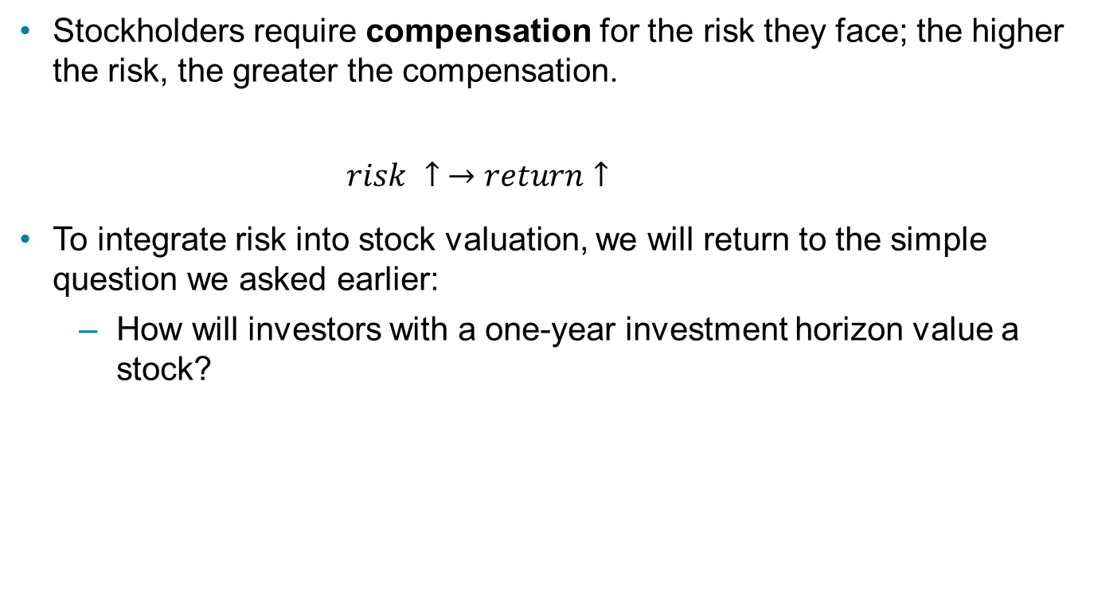
Risk and the Value of Stocks (1 of 7)
Stockholders require compensation for the risk they face; the higher the risk, the greater the compensation.
          $$risk ↑ →return↑$$
To integrate risk into stock valuation, we will return to the simple question we asked earlier:
  How will investors with a one-year investment horizon value a stock?

Slide 61
Risk and the Value of Stocks (2 of 7)
One answer is that the stock price equals the present value of the price of the stock in one year’s time plus the dividend payments received in the interim.
But once we recognize the risk involved in buying stock, the answer to this question changes.
The new answer is that an investor will buy a stock with the idea of obtaining a certain return, which includes compensation for the stock’s risk.

Slide 62
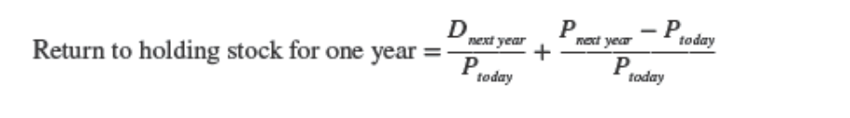
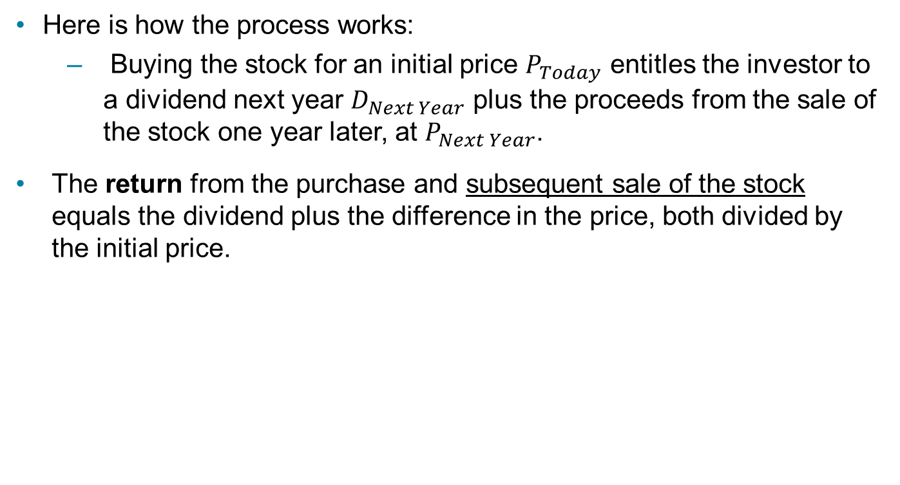
Risk and the Value of Stocks (3 of 7)
Here is how the process works:
  Buying the stock for an initial price $P_{Today}$ entitles the investor to a dividend next year $D_{Next Year}$ plus the proceeds from the sale of the stock one year later, at $P_{Next Year}$.
The return from the purchase and subsequent sale of the stock equals the dividend plus the difference in the price, both divided by the initial price.

Slide 63
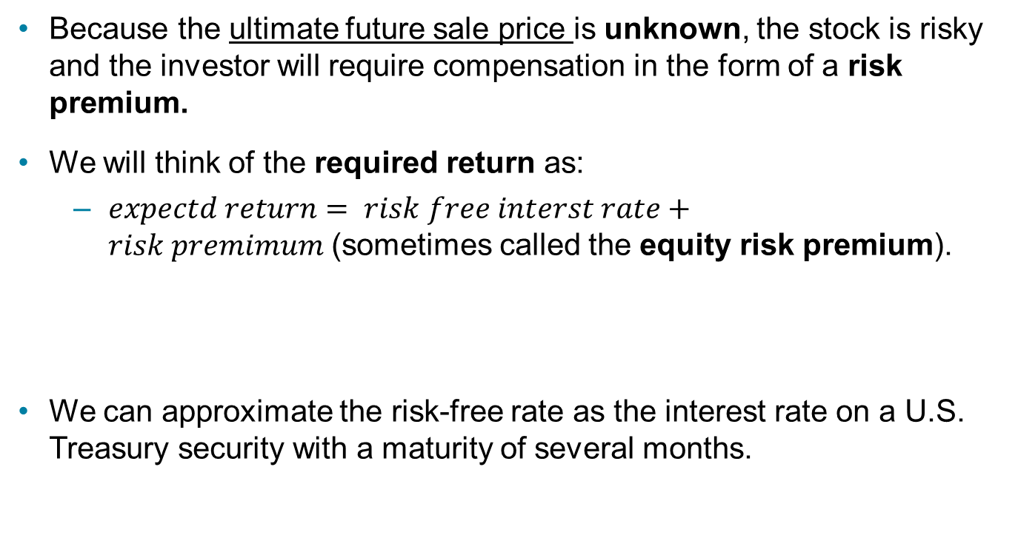
Risk and the Value of Stocks (4 of 7)
Because the ultimate future sale price is unknown, the stock is risky and the investor will require compensation in the form of a risk premium.
We will think of the required return as:
  $expectd return= risk free interst rate+risk premimum$(sometimes called the equity risk premium).
We can approximate the risk-free rate as the interest rate on a U.S. Treasury security with a maturity of several months.

Slide 64
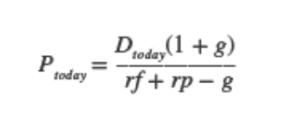
Risk and the Value of Stocks (6 of 7)
Combining this equation with our earlier analysis is straightforward.
All we need to do is recognize that the interest rate used for the present-value calculation in the dividend-discount model is the sum of the risk-free return and a risk premium.
Using this insight, we can rewrite equation as

Slide 65
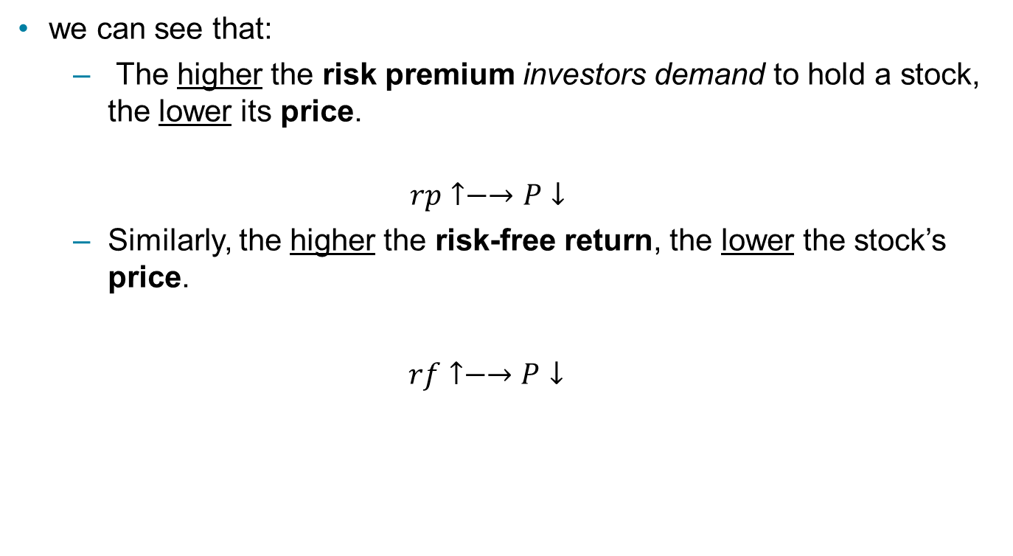
Risk and the Value of Stocks (7 of 7)
we can see that:
  The higher the risk premium investors demand to hold a stock, the lower its price.
  $$rp↑−→P↓$$
  Similarly, the higher the risk-free return, the lower the stock’s price.
  $$rf↑−→P↓$$

Slide 66
Dividend- Discount Model: Intuition
The generalized dividend model states that the price of a stock is determined only by the present value of the dividends and that nothing else matters.
Many stocks do not pay dividends, so how is it that these stocks have value? Buyers of the stock expect that the firm will pay dividends someday.
Most of the time a firm institutes dividends as soon as it has completed the rapid growth phase of its life cycle.
In this scenario, the generalized dividend valuation model requires that we compute the present value of an infinite stream of dividends.

Slide 67
Stock Price versus Present Value of Future Cash Flows
If stock is currently priced per share at less than the present value of all cash flows from the stock, you would choose to buy it.
However, you should be aware that the stock may be selling for less than the present value, because other investors have placed a greater risk on the cash flows or estimated the cash flows to be less than you did.

Slide 68
How the Market Sets Stock Prices (1 of 2)
The price is set by the buyer willing to pay the highest price.
The market price will be set by the buyer who can take best advantage of the asset.
Superior information about an asset can increase its value by reducing its perceived risk.

Slide 69
How the Market Sets Stock Prices (2 of 2)
Information is important for individuals to value each asset.
When new information is released about a firm, expectations and prices change.
Market participants constantly receive information and revise their expectations, so stock prices change frequently.

Slide 70
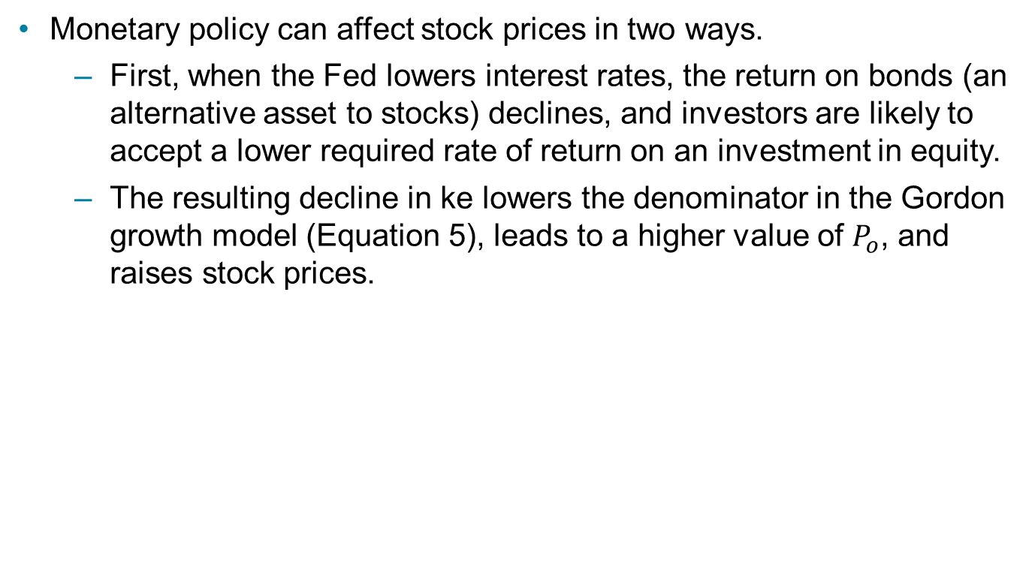
Application: Monetary Policy and Stock Prices (1 of 2)
Monetary policy can affect stock prices in two ways.
  First, when the Fed lowers interest rates, the return on bonds (an alternative asset to stocks) declines, and investors are likely to accept a lower required rate of return on an investment in equity.
  The resulting decline in ke lowers the denominator in the Gordon growth model (Equation 5), leads to a higher value of $P_{o}$, and raises stock prices.

Slide 71

Application: Monetary Policy and Stock Prices (2 of 2)
  Second, a lowering of interest rates is likely to stimulate the economy, so the growth rate in dividends, g, is likely to be somewhat higher.
  This rise in g also causes the denominator in Equation 5 to decrease, which also leads to a higher $P_{o}$ and a rise in stock prices.

Slide 72
Application: The Global Financial Crisis and the Stock Market
The financial crisis that started in August 2007 led to one of the worst bear markets in 50 years.
Downward revision of growth prospects: ↓g
Increased uncertainty about the U.S. economy and the widening credit spreads caused by the subprime crisis also raised the required return on investment in equity: ↑k_{e}
Gordon model predicts a drop in stock prices.

Slide 73
Expectations and Asset Pricing
The analysis of stock price evaluation we outlined in the previous section depends on people’s expectations—especially expectations of cash flows.
It is difficult to think of any sector of the economy in which expectations are not crucial; this is why it is important to examine how expectations are formed.
We do so by outlining the theory of rational expectations, currently the most widely used theory to describe the formation of business and consumer expectations.

Slide 74
Adaptive Expectations (1 of 3)
Expectations are formed from past experience only.
Changes in expectations will occur slowly over time as data for the variable evolve:
  For instance, if inflation had formerly been steady at a 5% rate, expectations of future inflation would be 5%, too.
  If inflation rose to a steady rate of 10%, expectations of future inflation would rise toward 10%, but slowly: In the first year, expected inflation might rise only to 6%; in the second year, to 7%; and so on.

Slide 75
Adaptive Expectations (2 of 3)
However, the adaptive expectations hypothesis has been faulted on the grounds that people use more information than just past data on a single variable to form their expectations of that variable.
For instance, heir expectations of inflation will almost surely be affected by their predictions of future monetary policy, as well as by current and past monetary policy.
In addition, people often change their expectations quickly in the light of new information.

Slide 76
Adaptive Expectations (3 of 3)
To address these objections to the validity of adaptive expectations, John Muth developed an alternative theory of expectations, called rational expectations, which can be stated as follows:
  Expectations will be identical to optimal forecasts (the best guess of the future) using all available information.

Slide 77
Rational Expectations (1 of 4)
The Gordon growth model shows that investors’ expectations of the future profitability of firms play a crucial role in determining stock prices
Today, most economists are critical of the adaptive expectations approach because it assumes that people ignore information that would be useful in making forecasts

Slide 78
Rational Expectations (2 of 4)
For example, in the late 1970s, the rate of inflation increased each year from 1976 through 1980. Anyone forecasting inflation by looking only at its past values would have expected inflation to be lower than it turned out to be. The rate of inflation declined each year from 1980 through 1983.
During this period, anyone forecasting inflation by looking only at its past values would have expected inflation to be higher than it actually was.
Taking into account additional information, such as Federal Reserve policy, movements in oil prices, or other factors that affect inflation rather than relying only on past values of inflation would have enabled someone to make a more accurate forecast.

Slide 79
Rational Expectations (3 of 4)
In 1961, John Muth of Carnegie Mellon University proposed a new approach he labeled rational expectations.
  With rational expectations, people make forecasts using all available information
Muth argued that someone who did not use all available information would not be acting rationally.
  That is, the person would not be doing his or her best to achieve the goal of an accurate forecast.

Slide 80
Rational Expectations (4 of 4)
For example, in forecasting the price of a firm’s stock, investors should use not just past prices of the stock but also any other information that is helpful in forecasting the future profitability of the firm.
Such information include the quality of the firm’s management, new products the firm might be developing, and so on.

Slide 81
Rational Expectations: Optimal Forecast
If sufficient number of investors and traders in the stock market have rational expectations, the market price of a stock should equal the best estimate (optimal forecast) of the present value of expected future dividends, which is the stock’s fundamental value.

Slide 82
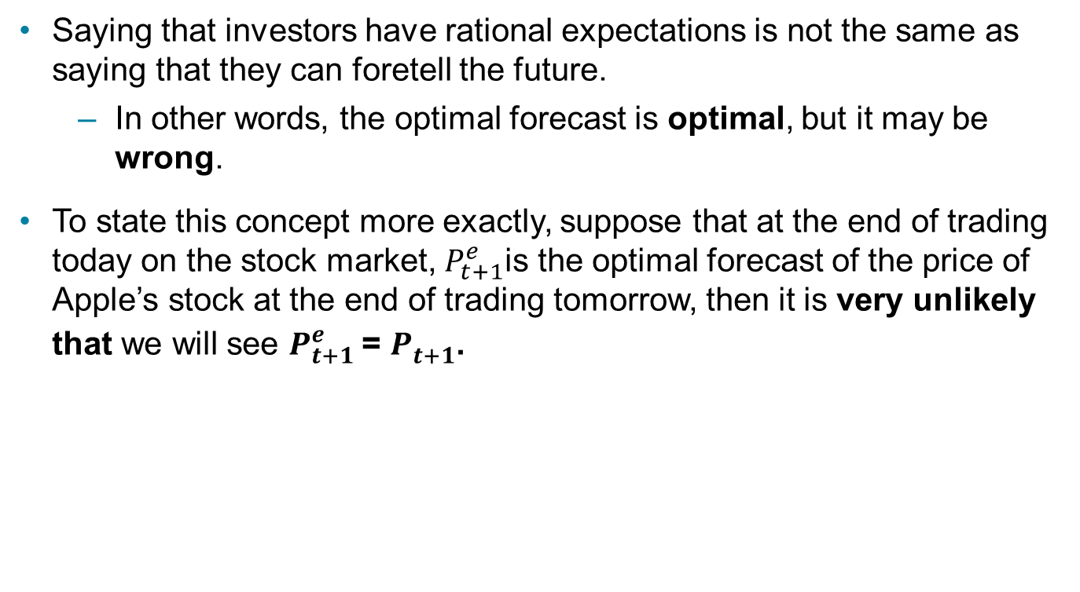
Rational Expectations: Forecast Error (1 of 4)
Saying that investors have rational expectations is not the same as saying that they can foretell the future.
  In other words, the optimal forecast is optimal, but it may be wrong.
To state this concept more exactly, suppose that at the end of trading today on the stock market, $P_{t+1}^{e}$is the optimal forecast of the price of Apple’s stock at the end of trading tomorrow, then it is very unlikely that we will see $P_{t+1}^{e}$= $P_{t+1}^{}$.

Slide 83
Rational Expectations: Forecast Error (2 of 4)
Why?
Because tomorrow, investors and traders are likely to obtain additional information about Apple—perhaps sales of the iPhones during the previous month are below what was forecast—that will change their view of the fundamental value of Apple’s stock.
So, there is likely to be a forecast error, which is the difference between the forecast price of Apple’s stock and the actual price of Apple’s stock.

Slide 84
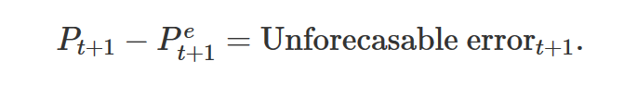
Rational Expectations: Forecast Error (3 of 4)
But no one can accurately forecast the size of that error ahead of time because
  the error is caused by new information that is not available when the forecast is made.
  If the information had been available, rational expectations tell us that it would have been incorporated into the forecast of the stock price.
Therefore, the forecast error is unforecastable and follows random walk. To state the point more formally:

Slide 85
Rational Expectations: Forecast Error (4 of 4)
So, when a forecast is made, we can be fairly sure that the forecast will turn out to be lower or higher than the actual value of the variable being forecast.
But forecast errors follow random walk:
  we have no way of telling how large the error will be or even whether it will be positive (that is, our forecast was too low) or negative (that is, our forecast was too high).

Slide 86
The Efficient Markets Hypothesis (1 of 4)
The application of rational expectations to financial markets is known as the efficient markets hypothesis
With respect to the stock market, the efficient markets hypothesis states that
  when investors and traders use all available information in forming expectations of future dividend payments, the equilibrium price of a stock equals the market’s optimal forecast—the best forecast given available information—of the stock’s fundamental value.

Slide 87
The Efficient Markets Hypothesis (2 of 4)

Slide 88
The Efficient Markets Hypothesis (3 of 4)
At the beginning of the period, we know P_{t} and C.
P_{t+1} is unknown and we must form an expectation of it.
The expected return then is
Expectations of future prices are equal to optimal forecasts using all currently available information so
Supply and Demand analysis states R^{e} will equal the equilibrium return R*, so R^{of} = R*

Slide 89
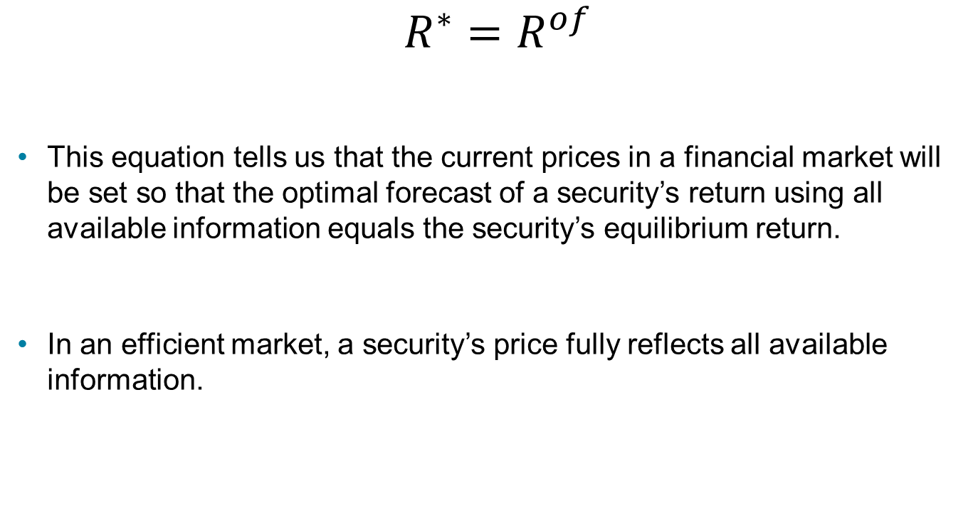
The Efficient Markets Hypothesis (4 of 4)
$$R^{∗}=R^{of}$$
This equation tells us that the current prices in a financial market will be set so that the optimal forecast of a security’s return using all available information equals the security’s equilibrium return.
In an efficient market, a security’s price fully reflects all available information.

Slide 90
An Example of the Efficient Markets Hypothesis: Microsoft (1 of 2)
Suppose that it is 10:14 Monday morning, and the price of Microsoft stock is $32.10 per share, the company is currently paying an annual dividend of $0.90 per share, and its dividend is expected to grow at a rate of 7% per year.
At 10:15, Microsoft releases new sales information indicating that sales of its latest version of Windows have been much higher than expected, and the firm expects higher sales to continue into the future.

Slide 91
An Example of the Efficient Markets Hypothesis: Microsoft (2 of 2)
This news causes you and other investors to revise upward your forecast of the growth rate of Microsoft’s annual dividend from 7% to 8%.
At this higher growth rate and assuming an RoE of 10%, the present value of Microsoft’s future dividends rises from $32.10 to $48.60.
So, this new information causes you and other investors to buy shares of Microsoft.
This increased demand will cause the price of Microsoft’s shares to keep rising until they reach $48.60, which is the new fundamental value of the stock.

Slide 92
Financial Arbitrage (1 of 5)
Does the efficient markets hypothesis require that all investors and traders have rational expectations?
  Actually, it does not- due to arbitrage.
The process of buying and reselling securities to profit from price changes over a brief period of time is called financial arbitrage.
The profits made from financial arbitrage are called arbitrage profits.

Slide 93
Financial Arbitrage (2 of 5)
Investors who have rational expectations can profit by buying or selling a stock when its market price is higher or lower than the optimal forecast of the stock’s fundamental value.
In this way, self-interested actions of even a few informed traders cause available information to be incorporated into market prices.

Slide 94
Financial Arbitrage (3 of 5)
In competing to buy securities where earning arbitrage profits is possible, traders will force prices to the level where investors can no longer earn arbitrage profits.
As long as there are some traders with rational expectations, the arbitrage profits provided by new information will give these traders the incentive to push stock prices to their fundamental values.

Slide 95
Financial Arbitrage (4 of 5)
For instance, in the example just discussed, once the new information on Microsoft becomes available, traders can earn arbitrage profits equal to $16.50 per share.
  Arbitrage profit is the difference between the old fundamental value and the new fundamental value.
Competition among even a few well-informed traders will be enough to quickly drive the price up to its new fundamental value.

Slide 96
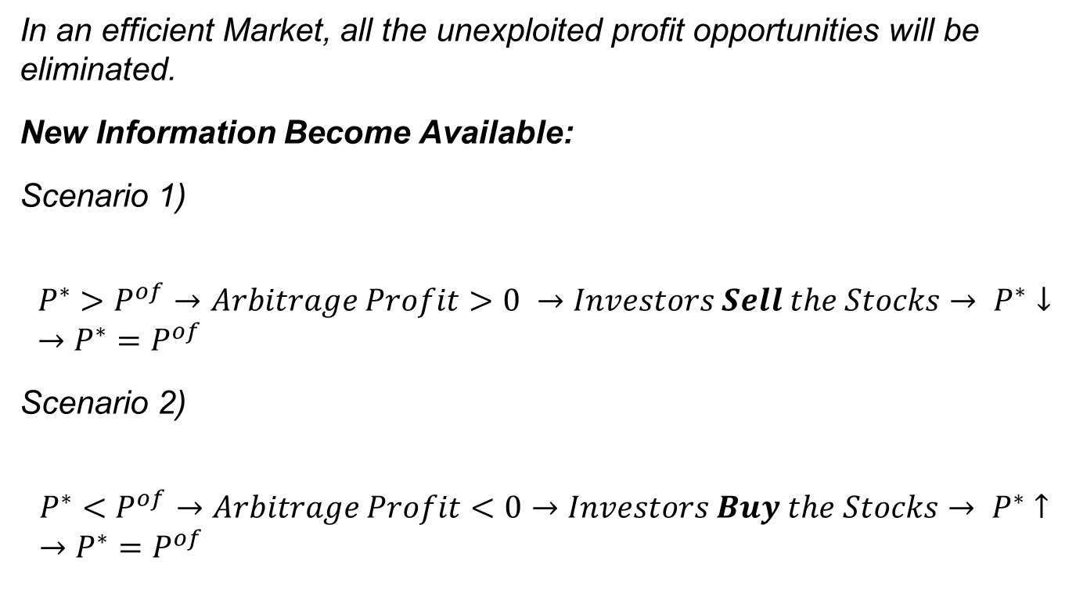
Financial Arbitrage (5 of 5)
In an efficient Market, all the unexploited profit opportunities will be eliminated.
New Information Become Available:
Scenario 1)
$$P^{∗}>P^{of}→Arbitrage Profit>0 →Investors Sell the Stocks→ P^{∗}↓ →P^{∗}=P^{of}$$
Scenario 2)
$$P^{∗}<P^{of}→Arbitrage Profit<0→Investors Buy the Stocks→ P^{∗}↑ →P^{∗}=P^{of}$$

Slide 97
Stock Prices Are Very Volatile (1 of 2)
Although the efficient markets hypothesis indicates that the price of a share of stock is based on all available information, our Microsoft example shows that the prices of stocks will change day-to-day, hour-to-hour, and minute-to-minute.
Stock prices constantly change as news that affects fundamental values becomes available.
Note that anything that affects the willingness of investors to hold a stock or another financial asset affects the stock’s fundamental value.

Slide 98
Stock Prices Are Very Volatile (2 of 2)
Therefore, we would expect that if new information leads investors to change their opinions about the risk, liquidity, information costs, or tax treatment of the returns from owning a stock, the price of the stock will change because the desired level of RoE will change.

Slide 99
Are Stock Prices Predictable? (1 of 4)
Key implication of the efficient markets hypothesis is that stock prices are not predictable.
To see why, suppose that it is 4:00 p.m., stock trading has closed for the day, Apple stock has closed at a price of $95, and you are trying to forecast the price of Apple’s stock at the close of trading tomorrow.
What is your optimal forecast?
The efficient markets hypothesis indicates that it is $95.

Slide 100
Are Stock Prices Predictable? (2 of 4)
In other words, the best forecast of the price of a stock tomorrow is its price today. Why?
  Because the price today reflects all relevant information that is currently available.
While the price of Apple’s stock is unlikely to actually be $95 at the close of trading tomorrow, you have no information today that will allow you to forecast whether it will be higher or lower.

Slide 101
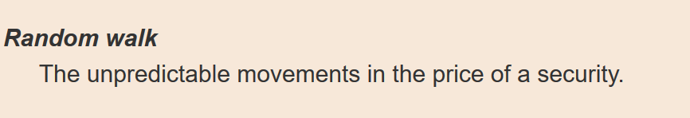
Are Stock Prices Predictable? (3 of 4)
Rather than being predictable, stock prices follow a random walk, which means that
  on any given day, they are as likely to rise as to fall.

Slide 102
Are Stock Prices Predictable? (4 of 4)
We can certainly observe stocks that rise for a number of days in a row, but this does not contradict the idea that stock prices follow a random walk.
  Even though when we flip a coin it is equally likely to come up heads or tails, we may still flip a number of heads or tails in a row.

Slide 103
Potential Answers to Discussion Questions
People generally buy stocks to earn capital gains or to receive dividends. Capital gains are the money earned when an asset increases in value from the time it is purchased to the time it is sold. That is, when you sell an asset for more than you paid for it, you earn capital gains.
A company owner may issue stock to raise money for expansion because the money could be difficult to obtain from another source.
When a company sells stock, it gives up sole ownership of the company and therefore must share the profit and control (management) of the company with its stockholders.
Common stockholders are considered company owners and may vote in matters affecting the company. Preferred stockholders do not have voting rights in the company but receive dividends before any return is paid to common stockholders.

