Slide 1
Week 0: Monetary Theory: ECON 161-1
Money and the Financial System: An Overview
Copyright © 2018, 2014, 2012, Pearson Education, Inc. All Rights Reserved.
Notes:
If this PowerPoint presentation contains mathematical equations, you may need to check that your computer has the following installed:
1) MathType Plugin
2) Math Player (free versions available)
3) NVDA Reader (free versions available)

Slide 2
Learning Objectives
After this class, you should be able to:
1.1 Identify the key components of the financial system
1.2 Provide an overview of the financial crisis of 2007–2009
1.3 Explain the key issues and questions concerning the financial system

Slide 3
You Get a Bright Idea … but Then What?
Suppose that you have an idea for a company: A smartphone app that will deliver a textbook chapter to a student’s phone for a limited time for a low price.
To get your company off the ground, you will have to spend a lot of money before you receive any revenue from sales of this app.
The role of the financial system is to channel funds from savers to businesses like you.
But the financial crisis that began in 2007 cut off the flow funds that large parts of the U.S. economy needed to thrive.
The result was the worst economic recession since the Great Depression of the 1930s.
Notes:
Many students have become more interested in the financial system due to the financial crisis of 2007–2009. However, many have also formed opinions based on incomplete or erroneous information. Discussion of the financial crisis at the beginning of the semester can help make the topic appealing while at the same time highlighting the need to grasp fundamental concepts underlying the system, including financial assets, financial institutions and the regulatory players and process.

Slide 4
1.1 Learning Objective
Identify the key components of the financial system.

Slide 5
Key Components of the Financial System
Three major components of the financial system:
Financial assets
An asset is anything of value owned by a person or a firm.
A financial asset is an asset that represents a claim on someone else for a payment.
Financial institutions
The Federal Reserve and other financial regulators

Slide 6
Financial Assets (1 of 8)
One key component of financial assets includes securities.
A security is a financial asset that can be bought and sold in a financial market.
Financial markets are places or channels for buying or selling stocks, bonds, and other securities.
Notes:
If you have a checking account at Citibank or Wells Fargo, you can’t sell it. So, your checking account is an asset but not a security.

Slide 7
Financial Assets (2 of 8)
Five key categories of financial assets:
Money
Stocks
Bonds
Foreign exchange
Securitized loans

Slide 8
Financial Assets (3 of 8)
Money
Money is anything that is generally accepted in payment for goods and services or to pay off debts.
The money supply is the total quantity of money in the economy.

Slide 9
Financial Assets (4 of 8)
Stocks
Stocks are financial securities that represent partial ownership of a firm; also called equities- it’s a form of financial capital.
Financial capital is the sum of funds available to the firm.
Dividends are payments that a corporation makes to its shareholders after keeping some of its profits- retained earnings.

Slide 10
Financial Assets (5 of 8)
Bonds
A bond is a financial security issued by a corporation or a government that represents a promise to repay a fixed amount of money.
The interest rate is the cost of borrowing funds (or the payment for lending funds), usually expressed as a percentage of the amount borrowed. (Example)
However, bonds typically pay interest in fixed dollar amounts called coupons. When a bond matures, the seller of the bond repays the principal.(Example)

Slide 11
Financial Assets (6 of 8)
A bond that matures in one year or less is a short-term bond.
A bond that matures in more than one year is a long-term bond
Bonds can be bought and sold in financial markets, so bonds are securities just as stocks are.

Slide 12
Financial Assets (7 of 8)
Foreign Exchange
Foreign exchange refers to units of foreign currency.
To buy foreign goods and services or foreign assets, a domestic business or a domestic investor must first exchange domestic currency for foreign currency.
Banks are the largest buyers and sellers of foreign exchange.
Banks engage in foreign currency transactions on behalf of investors and business firms.

Slide 13
Financial Assets (8 of 8)
Securitized Loans
Historically banks made loans with the intention to collect interest payments.
It wasn’t possible to sell most loans in financial markets, so loans were financial assets but not securities.
Banks have begun to sell loans on financial markets through a process called securitization.
Securitization is the process of converting loans and other financial assets that are not tradable into tradable securities. (Example)
Notes:
A loan is an asset from the viewpoint of the bank and a liability from the viewpoint of the borrower.

Slide 14
Financial Institutions (1 of 2)
The financial system matches savers and borrowers through two channels:
Banks and other financial intermediaries
Financial intermediary is a financial firm, such as a bank, that borrows funds from savers and lends them to borrowers.
Financial markets
Financial markets facilitate two types of flow of funds:
Indirect Finance – Funds flow from lenders to borrowers indirectly through financial intermediaries, such as banks.
Direct Finance – Funds flow directly from savers to borrowers through financial markets such as NYSE.

Slide 15
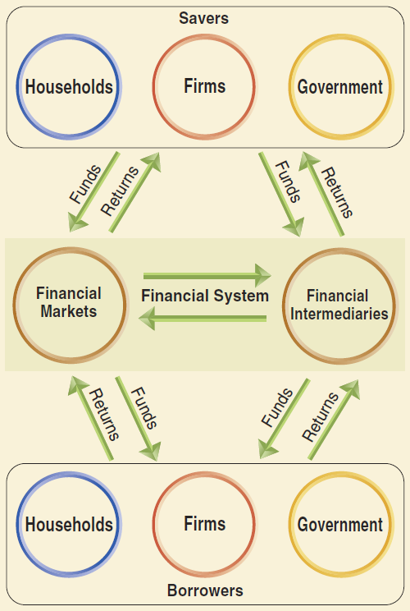
Figure 1.1 Moving Funds Through the Financial System
The financial system sends funds from savers to borrowers. Borrowers send returns back to savers through the financial system.
Savers receive their returns in various forms, including dividend payments on stock, coupon payments on bonds, and interest payments on loans.
Funds also flow between financial intermediaries and financial markets as, for example, when a commercial bank buys a bond in a financial market.
Notes:
This figure is intended to give an overview of how funds flow through the financial system. We will explain some of the key concepts below, but most of the discussion will be in later chapters.

Slide 16
Financial Institutions (2 of 2)
Financial Intermediaries
The most important financial intermediaries are commercial banks.
Commercial banks take in deposits and invest them either by making loans or buying securities from financial market.
Many firms rely on bank loans to meet their short-term needs for credit, such as funds to pay for inventories or to meet their payrolls.
Some firms also rely on bank loans to meet their long-term credit needs, such as funds they require to physically expand the firm.
Notes:
Inventories are goods firms have produced or purchased but not yet sold.

Slide 17
Nonbank Financial Intermediaries (1 of 3)
Investment Banks
Investment banks, such as Goldman Sachs and Morgan Stanley, differ from commercial banks in that they do not take in deposits and until very recently rarely lent directly to households.*
Instead, they concentrate on:
Consulting firms issuing stocks and bonds or considering mergers and acquisition (M&A) with other firms.
Underwriting i.e. guarantee a price to a firm issuing stocks or bonds and make a profit by selling the stocks or bonds at a higher price.
Notes:
* In late 2016, Goldman Sachs began engaging in fintech online lending (MARCUS), offering loans of up to $30,000 to households with high credit card balances but good credit histories.

Slide 18
Nonbank Financial Intermediaries (2 of 3)
In the late 1990s, investment banks increased their importance as financial intermediaries by becoming heavily involved in the securitization of loans, particularly mortgage loans.
Investment banks also began to engage in proprietary trading, which involves earning profits by buying and selling securities.
Insurance companies
Insurance companies collect premiums from customers and then invest the premiums to obtain the funds necessary to pay claims and other costs.

Slide 19
Nonbank Financial Intermediaries (3 of 3)
Pension funds
Pension funds collect contributions from workers and firms and make benefit payments during workers’ retirements.* Example, Annual CalPERS Financial Report (2016-17)
Mutual funds
A mutual fund obtains money by selling shares to investors and invests the money in a portfolio of financial assets.
A portfolio is a collection of assets, such as stocks and bonds.
Hedge funds
Hedge funds are similar to mutual funds but typically have very few wealthy investors and make riskier investments.
Notes:
With over $18 trillion in assets in 2016, private and state and local government pension funds are an important source of demand for financial securities.*

Slide 20
Financial Markets
Today, most securities trading takes place electronically linked by computers and is called “over-the-counter” trading.
Stocks and bonds sold in a particular market are “listed” on that market.
Primary markets are financial markets in which securities are sold for the first time via “Initial Public Offering” or IPO.
Secondary markets are financial markets in which investors buy and sell existing securities.
Primary and secondary markets can be in the same physical—or virtual—place.

Slide 21
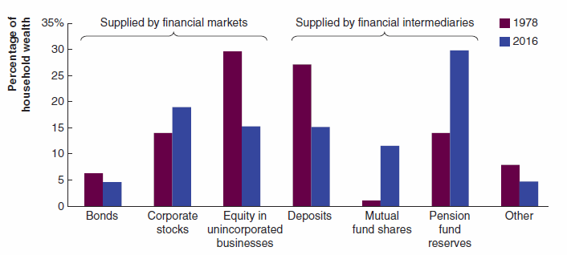
Making the Connection: What Do People Do With Their Savings?
Source: Board of Governors of the Federal Reserve, Flow of Funds Accounts of the United States, various issues.
Notes:
Some assets, such as stocks and bonds, are supplied by financial markets. Other assets, such as bank deposits and mutual fund shares, are supplied by financial intermediaries.
The figure shows significant changes in household’s holdings of financial assets between 1978 and 2016. Households have increased their holdings of corporate stocks, mutual fund shares and pension fund reserves. On the other hand, they have decreased their holdings of bonds, equity in unincorporated businesses, such as partnerships and sole proprietorships, and bank deposits.

Slide 22
The Federal Reserve and Other Financial Regulators (1 of 2)
Federal agencies that regulate the financial system:
Securities and Exchange Commission (SEC)
regulates financial markets
The Federal Deposit Insurance Corporation (FDIC)
insures deposits in banks
Office of the Comptroller of the Currency
regulates federally chartered banks
The Federal Reserve System
the central bank of the United States

Slide 23
The Federal Reserve and Other Financial Regulators (2 of 2)
Federal agencies that regulate the financial system:
The Consumer Finance Protection Bureau (CFPB)
protect consumers from fraud or deceptive practices in financial markets

Slide 24
What Is the Federal Reserve?
The Federal Reserve is the central bank of the United States; usually referred to as “the Fed.”
Established by Congress in 1913 to deal with banking problems.
Original role: lender of last resort:
The Fed provides short-term “liquidity”, i.e. loans, that provide banks with funds to pay out their depositors.

Slide 25
What Does the Federal Reserve Do? (1 of 3)
The Fed is responsible for monetary policy, which refers to the actions to manage the money supply and interest rates to pursue macroeconomic policy objectives including:
High levels of employment;
Low rates of inflation;
High rates of growth and;
Stability in financial system

Slide 26
What Does the Federal Reserve Do? (2 of 3)
The Fed is divided into 12 districts.
The Fed is run by the Board of Governors, which has seven members.
The board members are appointed by the U.S. Presidents and confirmed by the U.S. Senate.
One member of the board is designated as Chair:
Jerome H. Powell, proceeding Janet Yellen, has been the chair of the Board of Governors since Feb, 2018.

Slide 27
What Does the Federal Reserve Do? (3 of 3)
The main policymaking body is Federal Open Market Committee (FOMC).
The FOMC consists of:
• The seven members of the Board of Governors
• The president of the Federal Reserve Bank of New York
• Four presidents from the other 11 Federal Reserve District Banks
The FOMC meets 8 times per year to make decisions on a target for the federal funds rate. (FOMC statement, Sep 26th)
The federal funds rate is the interest rate that banks charge each other on short-term loans.
(Note: federal funds rate is a market rate. Fed only sets the fed fund target.)

Slide 28
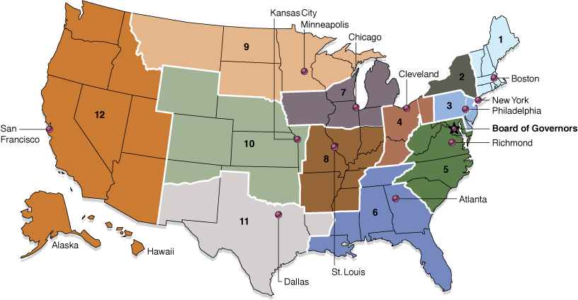
Figure 1.2 The Federal Reserve System
Source: Board of Governors of the Federal Reserve System.
The Federal Reserve System is divided into 12 districts, each of which has a District Bank located in the city shown on the map.

Slide 29
What Does the Financial System Do? (1 of 5)
The financial system provides three services to savers and borrowers: risk sharing, liquidity, and information.
Risk Sharing
Risk is the chance that the value of financial assets will change relative to what you expect.
Two ways to reduce a saver’s risk:
Diversification is the splitting wealth among many different assets to reduce risk.
Risk sharing allows savers to spread and transfer risk by holding different assets along with other savers.

Slide 30
What Does the Financial System Do? (2 of 5)
Liquidity
Liquidity is the ease with which an asset can be exchanged for money.
More liquid assets can be quickly and easily exchanged for money, while less liquid—or illiquid—assets can be exchanged for money only after a delay or by incurring costs (Example).

Slide 31
What Does the Financial System Do? (3 of 5)
Liquidity (cont’)
Financial markets and intermediaries help make financial assets more liquid.
By holding financial claims on a factory—such as stocks or bonds issued by the firm that owns the factory—individual investors have more liquid savings than they would if they owned the machines in the factory.
In general, we can say that assets created by the financial system, such as stocks, bonds, or checking accounts, are more liquid than are physical assets, such as cars, machinery, or real estate.

Slide 32
What Does the Financial System Do? (4 of 5)
Liquidity (cont’)
The financial system has increased the liquidity of many other assets besides stocks and bonds:
The process of securitization has made it possible to buy and sell securities based on loans such as mortgages, make them a more desirable assets for savers to hold.
Savers are willing to accept lower interest rates on assets with greater liquidity, which reduces the costs of borrowing for many households and firms.
One measure of the efficiency of the financial system is the extent to which it can transform illiquid assets into the liquid assets that savers want to buy (liquidity transformation).

Slide 33
What Does the Financial System Do? (5 of 4)
Information
The 3rd function is the collection and communication of information:
(In financial markets, information is facts about borrowers and expectations of returns on financial assets.)
Collection: Your local bank is a warehouse of information. It collects information on borrowers to forecast their likelihood of repaying loans..
Price Signal: Financial markets convey information to both savers and borrowers by determining the prices of stocks, bonds, and other securities. (Example)

Slide 34
1.2 Learning Objective
Provide an overview of the financial crisis of 2007–2009.

Slide 35
The Financial Crisis of 2007−2009 Origins of the Financial Crisis (1 of 6)
Why was the recession of 2007–2009 so severe, and why did the recovery take much longer than expected?
The simple answer is that unlike any other recession since the Great Depression of the 1930s, the recession of 2007–2009 was accompanied by a financial crisis.
A financial crisis is a significant disruption in the flow of funds from lenders to borrowers.

Slide 36
The Financial Crisis of 2007−2009 Origins of the Financial Crisis (2 of 6)
The financial crisis of 2007−2009 was caused in part by the housing bubble of 2000−2005.
A bubble is an unsustainable increase in the price of a class of assets.
Many economists believe that changes in the market for mortgages played a key role in the housing bubble:
Mortgages were the first loans to be widely securitized.
To promote homeownership, Congress wanted to create a secondary market in mortgages to make it easier for families to borrow money to buy houses.

Slide 37
The Financial Crisis of 2007−2009 Origins of the Financial Crisis (3 of 6)
To reach this goal, in 1968 Congress began relying on government-sponsored enterprises (GSEs):
The Federal National Mortgage Association (“Fannie Mae”) and the Federal Home Loan Mortgage Corporation (“Freddie Mac”) helped homeowners borrow by selling bonds to investors and used the funds to purchase mortgages from banks.
By the 1990s, a large secondary market existed in mortgages, with funds flowing from investors through Fannie Mae and Freddie Mac to banks and, ultimately, to people borrowing money to buy houses.

Slide 38
Origins of the Financial Crisis (4 of 6)
By the 2000s, important changes had taken place in the mortgage market:
First, investment banks also participated in the secondary market for mortgages by bundling and selling mortgage-backed securities. MBS proved to be very popular as they often paid investors higher interest rate than other securities with comparable risks of default.
Second, standards for obtaining loans were greatly loosened, so that many mortgages were being issued to subprime borrowers with flawed credit histories. (Senior Loan Officer Opinion Survey on Bank Lending Practices)
Also, adjustable-rate mortgages allowed borrowers to pay a very low interest rate for the first few years.

Slide 39
Origins of the Financial Crisis (5 of 6)
High Default Risk for Subprime Mortgages
Then, why would borrowers take out mortgages on which they might have trouble making the payments, and why would lenders grant such mortgages?
The simple answer is that both borrowers and lenders anticipated that housing prices would continue to rise.
Higher house prices would reduce the chance of borrowers defaulting on their mortgages and also make it easier for borrowers to convert to more traditional mortgages in the future.
In 2006, housing prices began to decline, leading to rising defaults and a sharp decline in the value of many mortgage-backed securities.

Slide 40
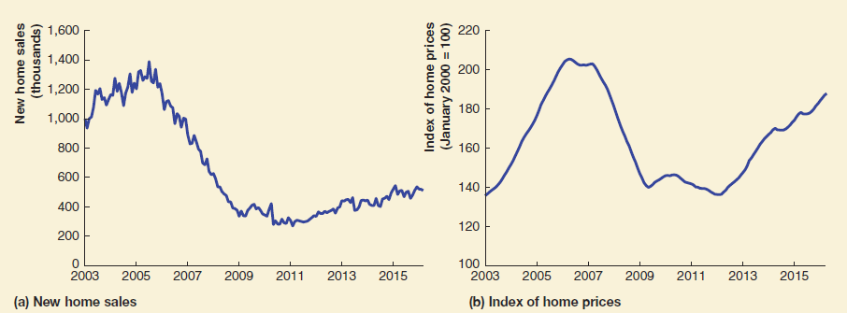
Origins of the Financial Crisis (6 of 6)
Figure 1.3 The Housing Bubble
Panel (a) shows that the housing bubble resulted in rapid increases in sales of new houses between 2000 and 2005, followed by a sharp decrease in sales beginning in July 2005. Panel (b) shows that home prices followed a similar pattern to home sales. Index of home prices, Case-Shiller index, measures changes in the prices of single-family homes. (Source: Federal Reserve Bank of St. Louis.)

Slide 41
The Deepening Crisis and the Response of the Fed and Treasury
In October 2008, Congress passed the Troubled Asset Relief Program (TARP), under which the Treasury provided funds to commercial banks in exchange for stock in those banks.
Many policies of the Fed and Treasury during the recession of 2007–2009 were controversial because they involved:
Partial government ownership of financial firms
Implicit guarantees to large financial firms that they would not be allowed to go bankrupt
Unprecedented intervention in financial markets
Many feared that the Fed’s actions might reduce its independence.

Slide 42
Problem Solving:
Class Discussion on:
Key questions that financial crisis raises
&
The services securitized loans provide

Slide 43
Key Issues and Questions About Money, Banking, and the Financial System
The financial crisis raises a number of questions that we will answer in the following chapters.
The 17 key issues and questions listed on textbook pages 19 – 21 provide a roadmap for the topics in the rest of the book.

Slide 44
Solved Problem 1.1: The Services Securitized Loans Provide (1 of 3)
Briefly discuss the extent to which securitized loans embody the key services of risk sharing, liquidity, and information.
Notes:
Teaching Tips: Encourage students to read the Solved Problems in each chapter because they can help them solve homework problems on their own and develop skills needed to complete exams.

Slide 45
Solved Problem 1.1: The Services Securitized Loans Provide (2 of 3)
Solving the Problem
Step 1 Review the chapter material.
Step 2 Define securitized loans.
Securitized loans are loans that have been bundled with other loans and resold to investors; they are both financial assets and financial securities.

Slide 46
Solved Problem 1.1: The Services Securitized Loans Provide (3 of 3)
Solving the Problem
Step 3 Explain whether securitized loans provide risk sharing, liquidity, and information.
When a mortgage is securitized, the buyers jointly share the risk of a default.
A securitized loan can be resold and so has a secondary market, which makes it liquid.
When loans are securitized, investors rely on the bank to have gathered the necessary information.
So, securitized loans provide all three of these key services.

Slide 47
Making the Connection: The Rise of Peer-to-Peer Lending and Fintech
During the financial crisis of 2007−2009, many borrowers defaulted on their loans.
In response, federal government regulators began pushing banks to tighten their loan guidelines, making it more difficult for businesses and households to qualify for loans.
Peer-to-peer lenders, such as LendingClub, Prosper, and SoFi, began filling the demand for loans with funds from individuals, businesses and financial firms.
Those lenders are examples of financial technology, or fintech, because they relay heavily on smartphone technology in the loan application process.
Notes:
Small businesses cannot sell stocks and bonds and must rely instead on loans from banks. Like banks, peer-to-peer lenders are able to estimate the likelihood that borrowers will pay back loans by using financial data of the borrowers. Many borrowers also find peer-to-peer lending attractive because the interest rates are lower than those on credit cards.

Slide 48
Copyright

