Slide 1
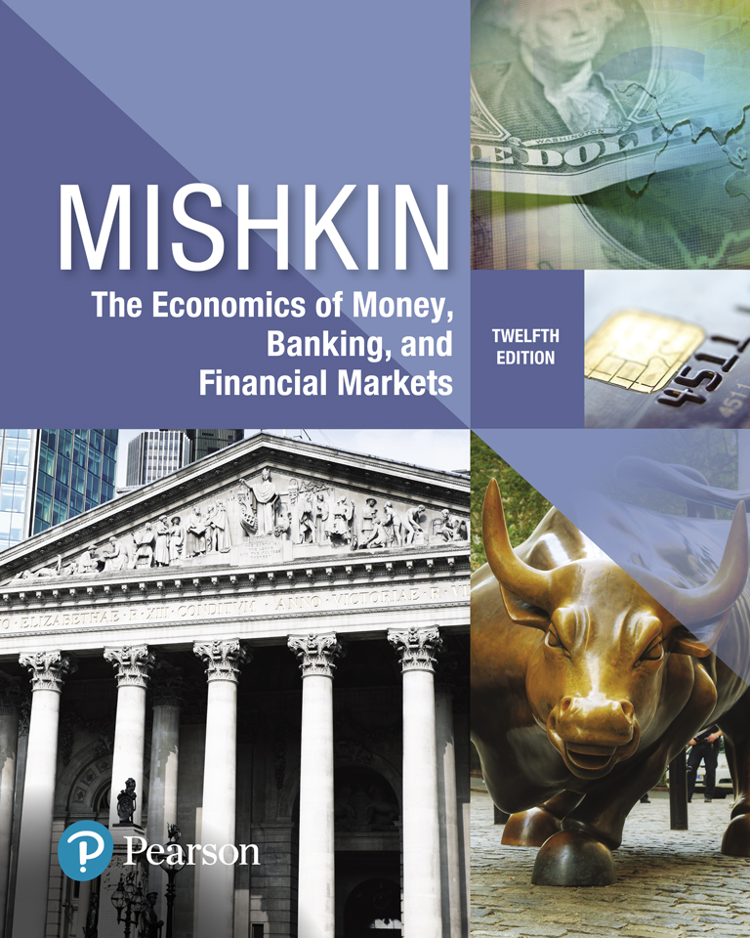
The Economics of Money, Banking, and Financial Markets
Twelfth Edition
Chapter 20
The IS Curve
Copyright © 2019, 2016, 2013 Pearson Education, Inc. All Rights Reserved.
Notes:
If this PowerPoint presentation contains mathematical equations, you may need to check that your computer has the following installed:
1) MathType Plugin
2) Math Player (free versions available)
3) NVDA Reader (free versions available)

Slide 2
Preview
This chapter develops the IS schedule, which describes the relationship between real interest rates and aggregate output when the market for real goods and services is in equilibrium.

Slide 3
Learning Objectives
List the four components of aggregate demand (or planned expenditure).
List and describe the factors that determine the four components of aggregate demand (or planned expenditure).
Solve for the goods market equilibrium.
Describe why the IS curve slopes downward and why the economy heads to a goods market equilibrium.
List the factors that shift the IS curve and describe how they shift the IS curve.

Slide 4
Planned Expenditure and Aggregate Demand (1 of 2)
Planned expenditure is the total amount of spending on domestically produced goods and services that households, businesses, the government, and foreigners want to make.
Aggregate demand is the total amount of output demanded in the economy.
Actual expenditure is the amount that these entities actually do spend, which equals the total amount of output produced in the economy.

Slide 5
Planned Expenditure and Aggregate Demand (2 of 2)
Equilibrium in goods market
When aggregate demand for goods and services is equal to the actual amount of goods and services produced.
The total quantity demanded of an economy’s output is the sum of 4 types of spending:
-Consumption expenditure (C) -Planned investment spending (I )
-Government purchases (G )
-Net exports (NX )

Slide 6
Consumption Expenditure
Consumption Function
the relationship between disposable income and consumption expenditure
$C=\overline{C}+mpc ×Y^{D}$
Autonomous consumption expenditure
Consumer optimism
reflects the change in consumption expenditure that results from an additional dollar of disposable income
It is constant and is between 0 and 1

Slide 7
Planned Investment Spending (1 of 2)
Fixed investment
is planned spending by firms on equipment and structures plus planned spending on new residential housing
Inventory investment
Inventory investment is spending by firms on additional holdings of raw materials, parts, and finished goods
calculated as the change in holdings of these items in a given time period
It can be planned or unplanned
The act of adjusting production to eliminate unplanned inventory investment plays a key role in the determination of aggregate output

Slide 8
Planned Investment Spending (2 of 2)
Real Interest on Investment
Rate of return versus borrowing costs
Opportunity cost (foregone interest earning)
Financial frictions: caused by barriers to the efficient functioning of financial markets
Business Expectations
Animal spirits
Planned Investment Function
$$I= \overline{I} − {dr}_{i}$$

Slide 9
Government Purchases and Taxes
The government affects aggregate demand in two ways: through its purchases and taxes
Government purchases:
Government taxes:

Slide 10
Net Exports
Made up of two components:
autonomous net exports and
the part of net exports that is affected by changes in real interest rates through exchange rate
Net export function:

Slide 11
Goods Market Equilibrium
Keynes recognized that equilibrium would occur in the economy when the total quantity of output produced in the economy equals the total amount of aggregate demand (planned expenditure).
Solving for goods market equilibrium:
Aggregate Output = Consumption Expenditure + Planned Investment Spending + Government Purchases + Net Exports

Slide 12
Understanding the IS Curve
What the IS curve tells us:
For each given level of the real interest rate, the IS curve tells us the level of aggregate output that is necessary for the goods market to be in equilibrium.
IS curve is the relationship between equilibrium aggregate output and the interest rate.
Slope of IS Curve
As the real interest rate rises, planned investment spending and net exports fall, which in turn lowers aggregate demand; aggregate output must be lower if it is to equal aggregate demand and satisfy goods market equilibrium. Hence the IS curve is downward-sloping.

Slide 13
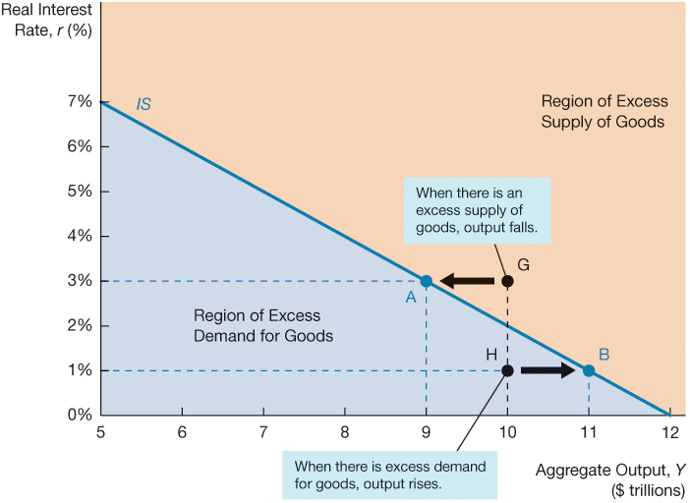
Figure 1 The IS Curve

Slide 14
Why the Economy Heads Toward the Equilibrium
Excess Supply of Goods
When actual output is above aggregate demand, and firms are saddled with unsold inventory. To keep from accumulating unsold goods, firms will continue cutting production.
Excess Demand for Goods
When actual output is below aggregate demand, so firms will want to increase production because inventories are declining more than they desire, and aggregate output will increase.

Slide 15
Factors That Shift the IS Curve (1 of 3)
The IS curve shifts whenever there is a change in autonomous factors (factors independent of aggregate output and the real interest rate).
A change in the real interest rate that affects equilibrium aggregate output causes only a movement along the IS curve. A shift in the IS curve, by contrast, occurs when equilibrium output changes at each given real interest rate.

Slide 16
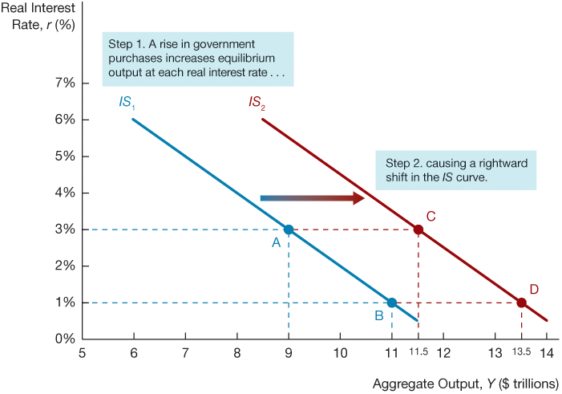
Figure 2 Shift in the IS Curve from an Increase in Government Purchases

Slide 17
Changes in Taxes
At any given real interest rate, a rise in taxes causes aggregate demand and hence equilibrium output to fall, thereby shifting the IS curve to the left.
Conversely, a cut in taxes at any given real interest rate increases disposable income and causes aggregate demand and equilibrium output to rise, shifting the IS curve to the right.

Slide 18
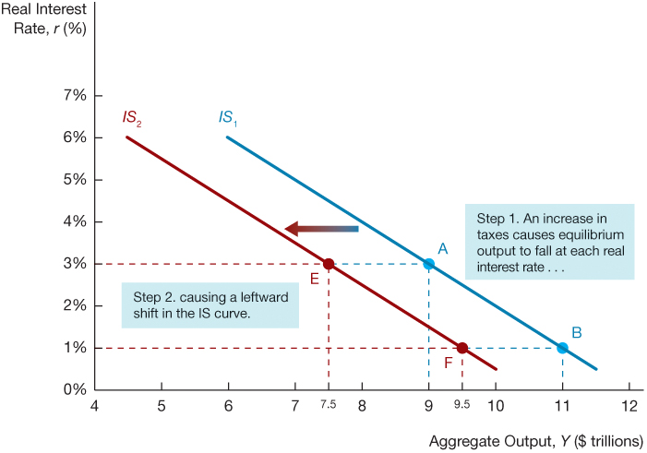
Figure 4 Shift in the IS Curve from an Increase in Taxes
Another example of what shifts the IS curve is changes in taxes, as in Figure 4

Slide 19
Factors That Shift the IS Curve (2 of 3)
Changes in autonomous spending also affect the IS curve:
Autonomous consumption
Autonomous investment spending
Autonomous net exports
An increase in any of these variables has the same impact on the IS curve as an increase in government purchases.

Slide 20
Autonomous Consumption
A rise in autonomous consumption would raise aggregate demand and equilibrium output at any given interest rate, shifting the IS curve to the right.
Conversely, a decline in autonomous consumption expenditure causes aggregate demand and equilibrium output to fall, shifting the IS curve to the left.

Slide 21
Autonomous Investment Spending
An increase in autonomous investment spending increases equilibrium output at any given interest rate, shifting the IS curve to the right.
On the other hand, a decrease in autonomous investment spending causes aggregate demand and equilibrium output to fall, shifting the IS curve to the left.

Slide 22
Autonomous Net Exports
An autonomous increase in net exports leads to an increase in equilibrium output at any given interest rate and shifts the IS curve to the right.
Conversely, an autonomous fall in net exports causes aggregate demand and equilibrium output to decline, shifting the IS curve to the left.

Slide 23
Factors That Shift the IS Curve (3 of 3)
Another factor that shifts the IS curve is changes in financial frictions
An increase in financial frictions, as occurred during the financial crisis of 2007–2009, raises the real cost of borrowing to firms and hence causes investment spending and aggregate demand to fall

Slide 24
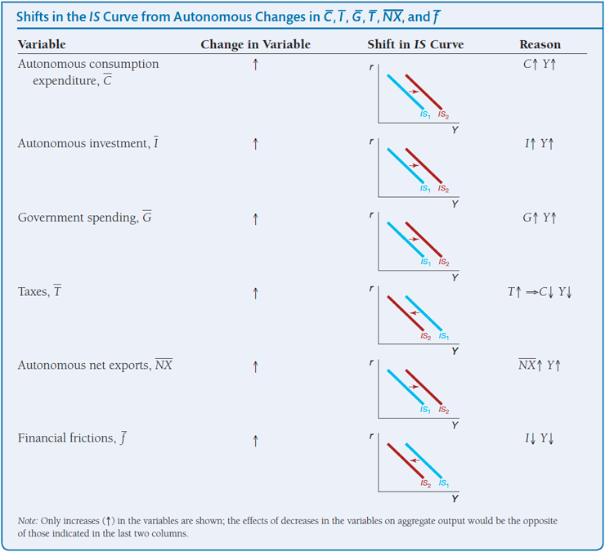
Summary Table 1 Shifts in the IS Curve from Autonomous Changes in C̅, I̅, G̅, T̅, N̅X̅ and f̅

Slide 25
Application: The Vietnam War Buildup, 1964–1969
The United States’ involvement in Vietnam began to escalate in the early 1960s.
Usually during a period when government purchases are rising rapidly, central banks raise real interest rates to keep the economy from overheating.
The Vietnam War period, however, is unusual because the Federal Reserve decided to keep real interest rates constant. Hence, this period provides an excellent example of how policy makers could make use of the IS curve analysis to inform policy.

Slide 26
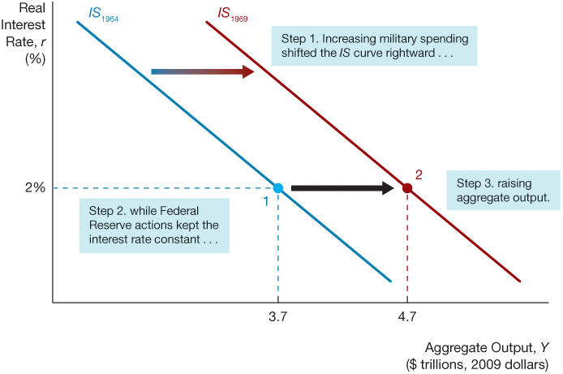
Figure 3 Vietnam War Build Up

Slide 27
Application: The Fiscal Stimulus Package of 2009 (1 of 2)
In the fall of 2008, the U.S. economy was in crisis. By the time the new Obama administration had taken office, the unemployment rate had risen from 4.7% just before the recession began in December 2007 to 7.6% in January 2009.
To stimulate the economy, the Obama administration proposed a fiscal stimulus package that, when passed by Congress, included $288 billion in tax cuts for households and businesses and $499 billion in increased federal spending, including transfer payments.
These tax cuts and spending increases were predicted to increase aggregate demand, thereby raising the equilibrium level of aggregate output at any given real interest rate and so shifting the IS curve to the right.

Slide 28
Application: The Fiscal Stimulus Package of 2009 (2 of 2)
Unfortunately, most of the government purchases did not kick in until after 2010, while the decline in autonomous consumption and investment was much larger than anticipated.
The fiscal stimulus was more than offset by weak consumption and investment, with the result that the aggregate demand ended up contracting rather than rising, and the IS curve did not shift to the right, as hoped.

Slide 29
Copyright

