Slide 1
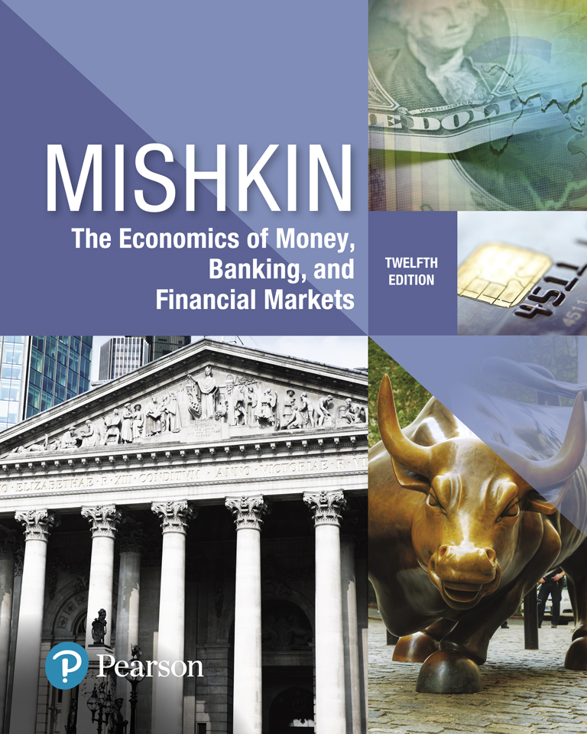
The Economics of Money, Banking, and Financial Markets
Twelfth Edition
Chapter 22
Aggregate Demand and Supply Analysis
Copyright © 2019, 2016, 2013 Pearson Education, Inc. All Rights Reserved.
Notes:
If this PowerPoint presentation contains mathematical equations, you may need to check that your computer has the following installed:
1) MathType Plugin
2) Math Player (free versions available)
3) NVDA Reader (free versions available)

Slide 2
Preview
This chapter develops the aggregate demand-aggregate supply framework, which will allow for an examination of the effects of monetary policy on output and prices.

Slide 3
Learning Objectives (1 of 2)
Summarize and illustrate the aggregate demand curve and the factors that shift it.
Illustrate and interpret the short-run and long-run aggregate supply curves.
Illustrate and interpret shifts in the short-run and long-run aggregate supply curves.
Illustrate and interpret the short-run and long-run equilibria, and the role of the self-correcting mechanism.

Slide 4
Learning Objectives (2 of 2)
Illustrate and interpret the short-run an long-run effects of a shock to aggregate demand.
Illustrate and interpret the short-run and long-run effects of temporary and permanent supply shocks.
Explain business cycle fluctuations in major economies during the 2007–2009 financial crisis.

Slide 5
Aggregate Demand (1 of 2)
Aggregate demand is made up of four component parts:
consumption expenditure: the total demand for consumer goods and services
planned investment spending: the total planned spending by business firms on new machines, factories, and other capital goods, plus planned spending on new homes
government purchases: spending by all levels of government (federal, state, and local) on goods and services
net exports: the net foreign spending on domestic goods and services

Slide 6
Aggregate Demand (2 of 2)

Slide 7
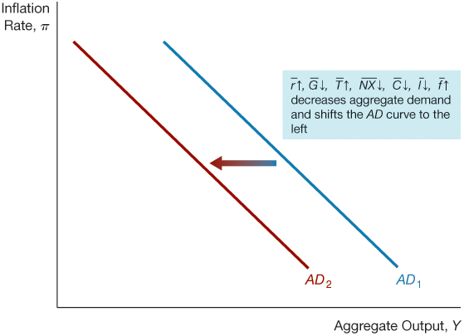
Figure 1 Leftward Shift in the Aggregate Demand Curve

Slide 8
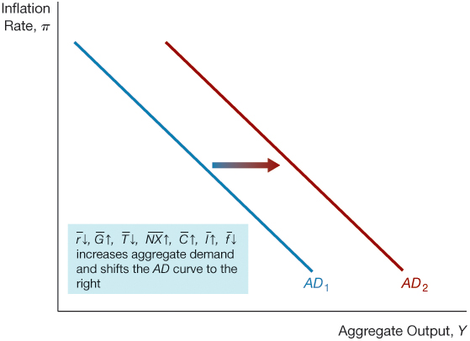
Figure 2 Rightward Shift in the Aggregate Demand Curve

Slide 9
Factors That Shift the Aggregate Demand Curve
An increase in the money supply shifts AD to the right: holding velocity constant, an increase in the money supply increases the quantity of aggregate demand at each price level.
An increase in spending from any of the components C, I, G, NX will also shift AD to the right.

Slide 10
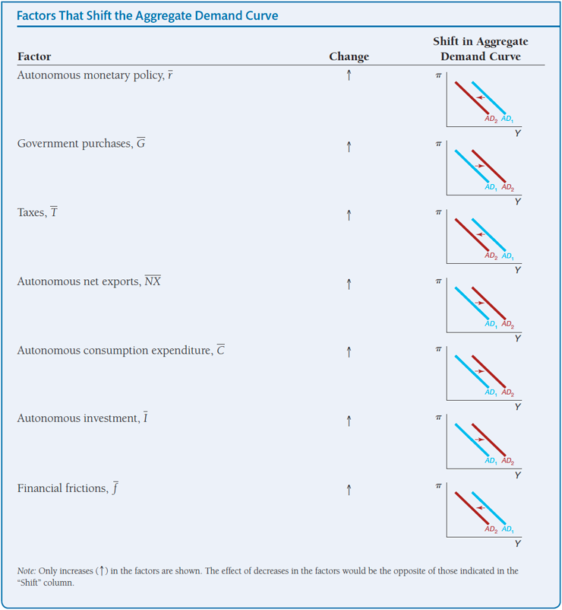
Summary Table 1 Factors That Shift the Aggregate Demand Curve

Slide 11
Aggregate Supply (1 of 2)
Long-run aggregate supply curve:
Determined by the amount of capital and labor and the available technology
Vertical at the natural rate of output generated by the natural rate of unemployment

Slide 12
Aggregate Supply ( 2 of 2)
Short-run aggregate supply curve:
Wages and prices are sticky
Based on the idea that three factors derive inflation:
Expected Inflation ($π^{e}$)
Output Gap $(Y − Y^{P}$)
Inflation (supply) Shock ($ρ$)
Short-Run Aggregate Supply Curve Equation
$π= π^{e}+ δ (Y − Y^{P}$) $+ ρ$
Where $δ is the sensetivity of the inflation to output gap.$

Slide 13
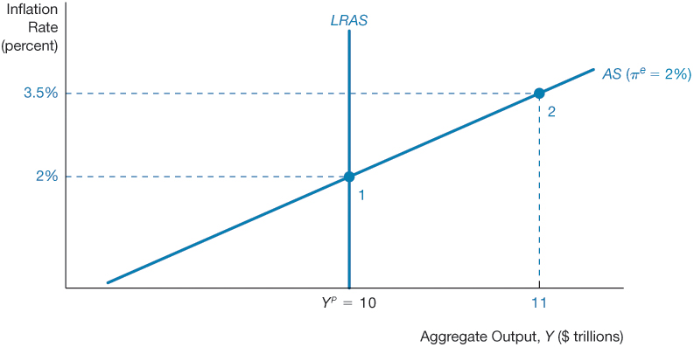
Figure 3 Long- and Short-Run Aggregate Supply Curves

Slide 14
Shifts in Aggregate Supply Curves
Shifts in the long-run aggregate supply curve
The long-run aggregate supply curve shifts to the right from when there is
An increase in the total amount of capital in the economy
An increase in the total amount of labor supplied in the economy
An increase in the available technology, or
A decline in the natural rate of unemployment
An opposite movement in these variables shifts the LRAS curve to the left.

Slide 15
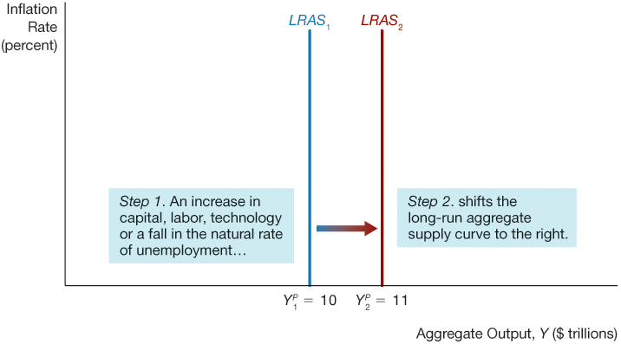
Figure 4 Shift in the Long-Run Aggregate Supply Curve

Slide 16
Shifts in the Short-Run Aggregate Supply Curve
There are three factors that can shift the short-run aggregate supply curve:
Expected inflation
Price shocks
A persistent output gap

Slide 17
Summary Table 2 Factors That Shift the Short-Run Aggregate Supply Curve

Slide 18
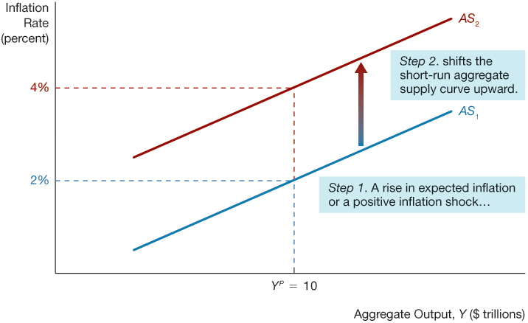
Figure 5 Shift in the Short-Run Aggregate Supply Curve from Changes in Expected Inflation and Price Shocks

Slide 19
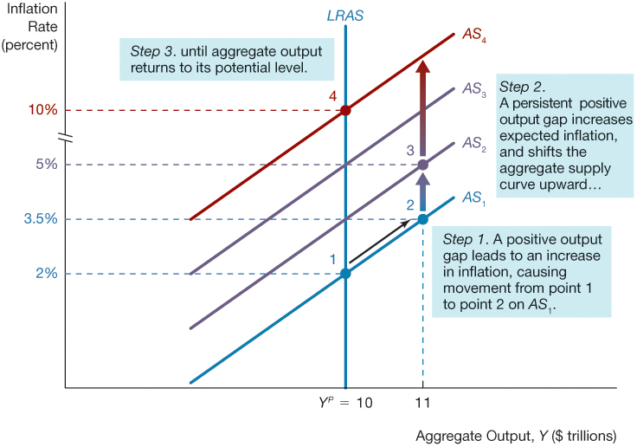
Figure 6 Shift in the Short-Run Aggregate Supply Curve from a Persistent Positive Output Gap

Slide 20
Equilibrium in Aggregate Demand and Supply Analysis
We can now put the aggregate demand and supply curves together to describe general equilibrium in the economy,
when all markets are simultaneously in equilibrium at the point where the quantity of aggregate output demanded equals the quantity of aggregate output supplied.
Two aggregate supply curves: one for the short run and one for the long run.
Consequently, in the context of aggregate supply and demand analysis, there are short-run and long-run equilibriums.

Slide 21
Short-Run Equilibrium
Figure 7 illustrates a short-run equilibrium in which the quantity of aggregate output demanded equals the quantity of output supplied.
In Figure 7, the short-run aggregate demand curve AD and the short-run aggregate supply curve AS intersect at point E with an equilibrium level of aggregate output at Y* and an equilibrium inflation rate at π*.

Slide 22
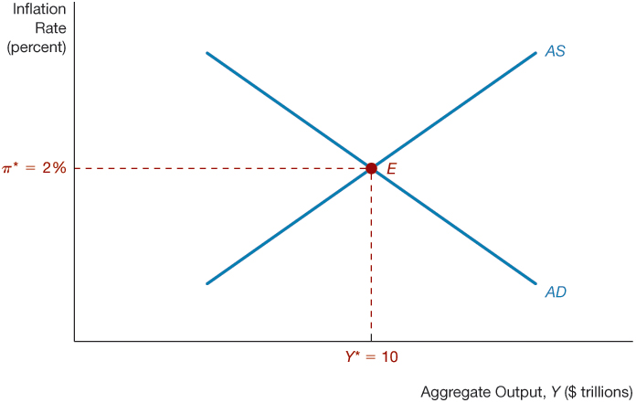
Figure 7 Short-Run Equilibrium

Slide 23
How the Short-Run Equilibrium Moves to the Long-Run Equilibrium over Tim
Output Gap:
Even when the quantity of aggregate output demanded equals the quantity supplied at the intersection of the aggregate demand curve and the short-run aggregate supply curve, if output differs from its potential level- either it is above the $Y^{P}$ or below it.
If the current level of inflation changes from its initial level, the short-run aggregate supply curve will shift as wages and prices adjust to a new expected rate of inflation (Persistent Output Gap).

Slide 24
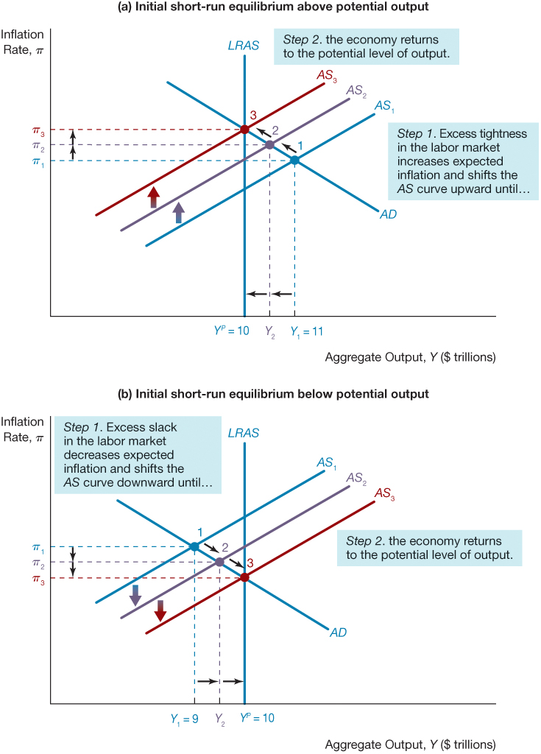
Figure 8 Adjustment to Long-Run Equilibrium in Aggregate Supply and Demand Analysis

Slide 25
Self-Correcting Mechanism
Regardless of where output is initially, it returns eventually to the natural rate.
Slow:
Wages are inflexible, particularly downward
Need for active government policy
Rapid:
Wages and prices are flexible
Less need for government intervention

Slide 26
Changes in Equilibrium: Aggregate Demand Shocks
With an understanding of the distinction between the short-run and long-run equilibria, you are now ready to analyze what happens when there are demand shocks, shocks that cause the aggregate demand curve to shift.
The following scenarios increase the AD:
An autonomous easing of monetary policy ($\overline{r}↓$, a lowering of the real interest rate at any given inflation rate)
An increase in government purchases ($\overline{G}↑$)
A decrease in taxes ($\overline{T}↓$)
An increase in autonomous net exports ($\overline{NX}↑$)
An increase in autonomous consumption expenditure ($\overline{C}↑$)
An increase in autonomous investment ($\overline{I}↑$)
A decrease in financial frictions ($\overline{f}↓$)

Slide 27
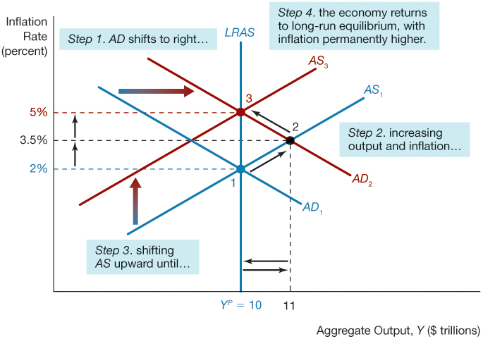
Figure 9 Positive Demand Shock

Slide 28
Changes in Equilibrium: Aggregate Supply (Price) Shocks (1 of 2)
The aggregate supply curve can shift from temporary supply (price) shocks in which the long-run aggregate supply curve does not shift, or from permanent supply shocks in which the long-run aggregate supply curve does shift.

Slide 29
Changes in Equilibrium: Aggregate Supply (Price) Shocks (2 of 2)
Temporary Supply Shocks:
Stagflation: When the temporary shock involves a restriction in supply, we refer to this type of supply shock as a negative (or unfavorable) supply shock, and it results in a rise in commodity prices.
A disruption in oil supplies,
A rise in import prices when a currency declines in value,
A cost-push shock
A temporary positive supply shock shifts the short-run aggregate supply curve downward and to the right, leading initially to a fall in inflation and a rise in output.
a particularly good harvest or a fall in import prices.
In the long run, however, output and inflation will be unchanged (holding the aggregate demand curve constant).

Slide 30
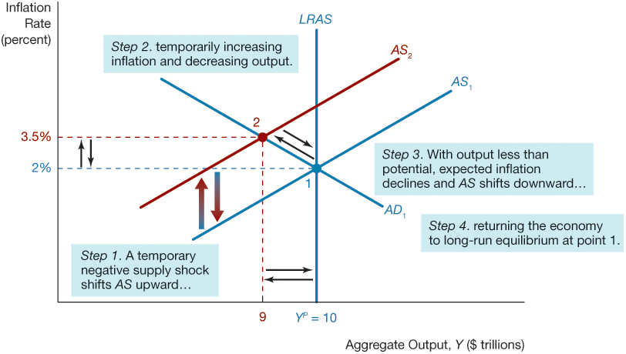
Figure 12 Temporary Negative Supply Shock

Slide 31
Permanent Supply Shocks and Real Business Cycle Theory
A permanent negative supply shock—such as an increase in ill-advised regulations that causes the economy to be less efficient, thereby reducing supply—would decrease potential output and shift the long-run aggregate supply curve to the left.
Because the permanent supply shock will result in higher prices, there will be an immediate rise in inflation and so the short-run aggregate supply curve will shift up and to the left.
One group of economists, led by Edward Prescott of Arizona State University, believe that business cycle fluctuations result from permanent supply shocks alone and their theory of aggregate economic fluctuations is called real business cycle theory.

Slide 32
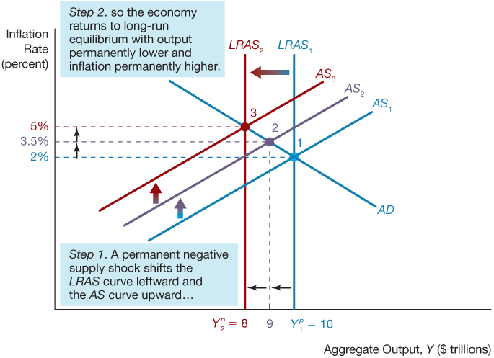
Figure 14 Permanent Negative Supply Shock

Slide 33
Conclusions
Aggregate demand and supply analysis yields the following conclusions:
A shift in the aggregate demand curve affects output only in the short run and has no effect in the long run.
A temporary supply shock affects output and inflation only in the short run and has no effect in the long run (holding the aggregate demand curve constant).
A permanent supply shock affects output and inflation both in the short and the long run.
The economy has a self-correcting mechanism that returns it to potential output and the natural rate of unemployment over time.

Slide 34
Appendix to Chapter 22: The Phillips Curve and the Short-Run Aggregate Supply Curve
The Phillips Curve: the negative relationship between unemployment and inflation.
The idea behind the Phillips curve is intuitive: When labor markets are tight—that is, the unemployment rate is low—firms may have difficulty hiring qualified workers and may even have a hard time keeping their present employees. Because of the shortage of workers in the labor market, firms will raise wages to attract needed workers and raise their prices at a more rapid rate.

Slide 35
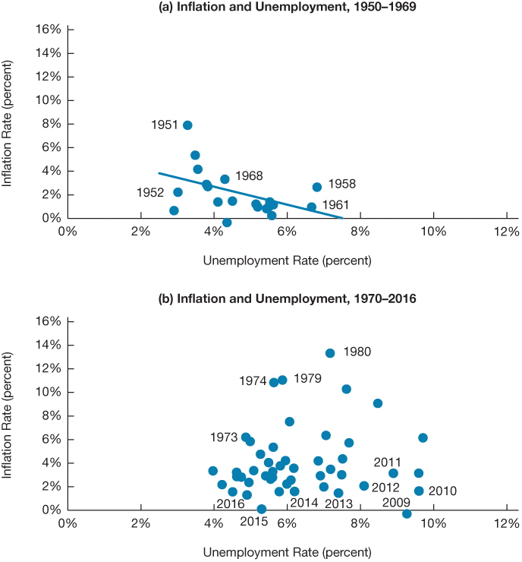
Figure 1 Inflation and Unemployment in the United States, 1950–1969 and 1970–2016
Source: Federal Reserve Bank of St. Louis, FRED database: https://fred.stlouisfed.org/series/UNRATE; https://fred.stlouisfed.org/series/CPIAUCSL

Slide 36
The Friedman-Phelps Phillips Curve Analysis ( 1 of 2)
Real Wages versus Nominal Wages
Phillips curve analysis was inconsistent with the view that workers and firms care about real wages, the amount of real goods and services that wages can purchase, not nominal wages.
Wages and overall inflation will rise on a one-to-one basis with increases in expected inflation, as well as respond to tightness in the labor market.
Natural rate of unemployment
The Friedman-Phelps analysis suggested that in the long run the economy would reach the level of unemployment that would occur if all wages and prices were flexible

Slide 37
The Friedman-Phelps Phillips Curve Analysis ( 2 of 2)
The Friedman-Phelps reasoning suggested a Phillips curve that we can write as follows:
$π=π^{e}−ω(U−U_{n}$)
Expectations-augmented Phillips curve:
indicates that inflation is negatively related to the difference between the unemployment rate and the natural rate of unemployment $(U−U_{n}$), a measure of tightness in the labor markets called the unemployment gap.
implies that long-run unemployment will be equal to the natural rate level.
displays no long-run trade-off between unemployment and inflation.

Slide 38
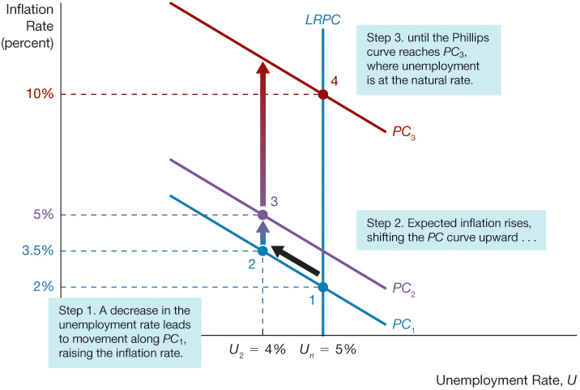
Figure 2 The Short- and Long-Run Phillips Curve

Slide 39
Three Important Conclusions
There is no long-run trade off between unemployment and inflation.
There is a short-run trade off between unemployment and inflation.
There are two types of Phillips curves, long run and short run.

Slide 40
The Phillips Curve After the 1960s
The expectations-augmented Phillips curve shows that the negative correlation between unemployment and inflation breaks down when the unemployment rate remains below the natural rate of unemployment for any extended period of time.

Slide 41
The Modern Phillips Curve with Adaptive (Backward-Looking) Expectations (1 of 4)
Inflation (supply) shock
Inflation jumped up sharply with the sharp rise in oil prices in 1973 and 1979 and Phillips-curve theorists realized that they had to add one more feature to the expectations-augmented Phillips curve; which is supply shock.
$π= π^{e}$-$ω(U−U_{n}$) + $ρ$
These supply shocks translate into inflation shocks that is shifts in inflation that are independent of the tightness of the labor markets or of expected inflation.
Wages and prices stickiness: if wages and prices are completely flexible, then $ω$ becomes so large that the short-run Phillips curve is vertical and identical to the long-run Phillips curve.

Slide 42
The Modern Phillips Curve with Adaptive (Backward-Looking) Expectations (2 of 4)
Adaptive Expectations (Backward-looking Expectations)
To complete our analysis of the Phillips curve, we need to understand how firms and households form expectations about inflation.
One simple model assumes that expectations are formed by looking at the past inflation and therefore change only slowly over time:
$π^{e}$ = $π_{−1}$
The backward-looking expectations Philips curve:
$π= π_{−1}$ - $ω (U−U_{n}$) + $ρ$

Slide 43
The Modern Phillips Curve with Adaptive (Backward-Looking) Expectations (3 of 4)
Advantages
First, it takes on a very simple mathematical form that is convenient to use.
Second, it provides two additional, realistic reasons why inflation might be sticky.
Sticky inflation expectation: inflation expectations adjust only slowly as inflation changes over time. Inflation expectations are therefore sticky, which results in some inflation stickiness.
Backward looking contracts: the presence of past inflation in the Phillips curve formulation can reflect the fact that some wage and price contracts might be backward-looking, that is, tied to past inflation, and so inflation might not fully adjust to changes in inflation expectations in the short run.

Slide 44
The Modern Phillips Curve with Adaptive (Backward-Looking) Expectations (4 of 4)
Weakness
It takes a very mechanical view of how inflation expectations are formed. More sophisticated analysis of expectations formation has important implications for the conduct of macroeconomic policy.
An accelerationist Phillips curve:
$∆π=π−π_{−1}$ = $−ω(U−U_{n}$) + $ρ$
The Phillips curve indicates that a negative unemployment gap (tight labor market) causes the inflation rate to rise, or accelerate.
Since inflation stops accelerating (changing) when the unemployment rate is at Un, we can refer to this term as the nonaccelerating inflation rate of unemployment or, more commonly, NAIRU.

Slide 45
The Short-Run Aggregate Supply Curve
To complete our aggregate demand and supply model, we need to use our analysis of the Phillips curve to derive a short-run aggregate supply curve, which represents the relationship between the total quantity of output that firms are willing to produce and the inflation rate.
We can translate the modern Phillips curve into a short-run aggregate supply curve by replacing the unemployment gap ($U−U_{n}$) with the output gap, the difference between output and potential output ($Y−Y^{P}$).

Slide 46
Okun’s Law
Okun’s law describes the negative relationship between the unemployment gap and the output gap.
Okun’s law states that for each percentage point that output is above potential, the unemployment rate is one-half of a percentage point below the natural rate of unemployment.
Alternatively, for every percentage point that unemployment is above its natural rate, output is two percentage points below potential output.
$U−U_{n}$= - $0.5 ×(Y− Y^{P}$)

Slide 47
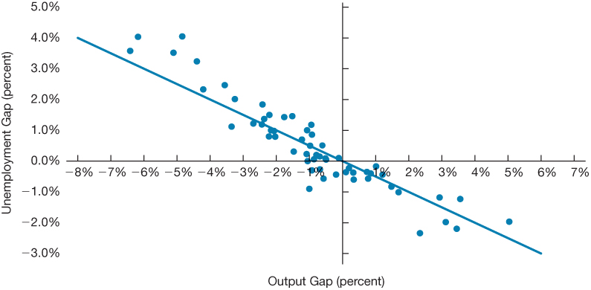
Figure 3 Okun’s Law, 1960–2016
Source: Federal Reserve Bank of St. Louis, FRED database: https://fred.stlouisfed.org/series/UNRATE; https://fred.stlouisfed.org/series/GDPC1; https://fred.stlouisfed.org/series/GDPPOT.

Slide 48
Copyright

