Slide 1
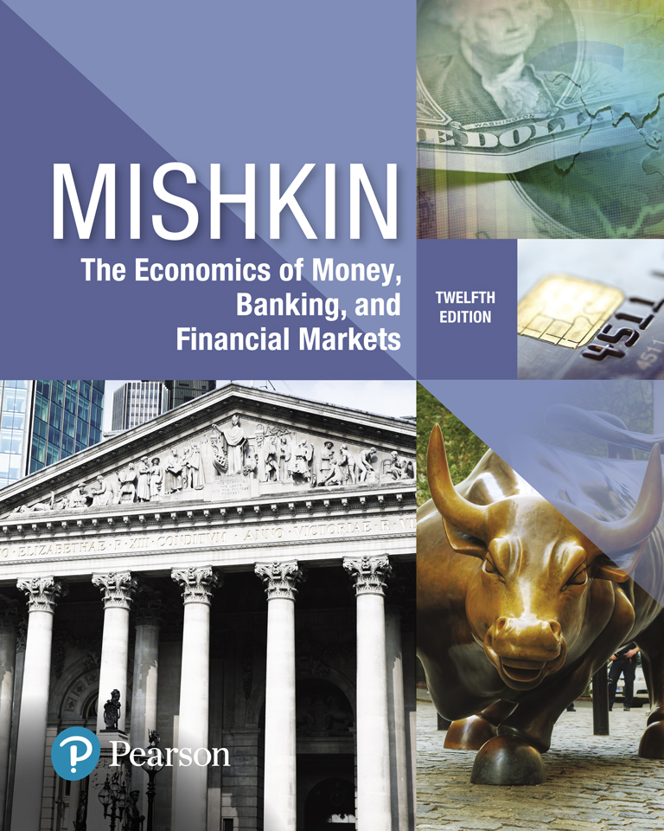
The Economics of Money, Banking, and Financial Markets
Twelfth Edition
Chapter 18
The International Financial System (Part 1 & 2)
Instructor:
Elham Saeidinezhad
elham@ucla.edu
Copyright © 2019, 2016, 2013 Pearson Education, Inc. All Rights Reserved.
Notes:
If this PowerPoint presentation contains mathematical equations, you may need to check that your computer has the following installed:
1) MathType Plugin
2) Math Player (free versions available)
3) NVDA Reader (free versions available)

Slide 2
Preview
As U.S. economy and the rest of the economies of the rest of the world becoming more interconnected, a country’s monetary policy can no longer be conducted without considering international factors.
This chapter examines how international financial transactions and the structure of the international financial system affect monetary policy.

Slide 3
Learning Objectives (1 of 2)
Use graphs and T-accounts to illustrate the distinctions between the effects of sterilized and unsterilized interventions on foreign exchange markets.
Interpret the relationships among the current account and the capital account.
Identify the mechanisms for maintaining a fixed exchange rate and assess the challenges faced by fixed exchange rate regimes.
Summarize the advantages and disadvantages of capital controls.

Slide 4
Learning Objectives (2 of 2)
Assess the role of the IMF as an international lender of last resort.
Identify the ways in which international monetary policy and exchange rate arrangements can affect domestic monetary policy operations.
Summarize the advantages and disadvantages of exchange-rate targeting.

Slide 5
Intervention in the Foreign Exchange Market (1 of 7)
In Chapter 17, we analyzed the foreign exchange market as if it were a completely free market that responds to all conventional market pressures.
Foreign exchange interventions: central banks regularly engage in international financial transactions, the purchase and sale of their currencies, to influence exchange rates.
This type of transaction is conducted at the foreign exchange desk at the Federal Reserve Bank of New York.

Slide 6
Intervention in the Foreign Exchange Market (2 of 7)
Impact on exchange rate: the first step is to explore the impact of the central banks’ sale/purchase of international reserves on monetary base (or money supply).
Recap: the monetary base equals currency in circulation plus the total reserves in banking system.
International reserves: central banks’ holdings of assets denominated in a foreign currency.
Example: suppose that the Fed decides to sell $1 billion of its foreign assets in exchange for $1 billion of U.S. currency:

Slide 7
Intervention in the Foreign Exchange Market (3 of 7)
Foreign exchange intervention and the money supply
(Federal Reserve System)
Assets | Blank | Liabilities | Blank
Foreign Assets | −$1B | Currency in Circulation | −$1B
(International Reserves) | Blank | Blank | Blank
Assets | Blank | Liabilities | Blank
Foreign Assets | −$1B | Deposits with the Fed | −$1B
(International Reserves) | Blank | (reserves) | Blank
Notes:
A T-account is a simplified balance sheet, with lines in the form of a T, that lists only the changes that occur in balance sheet items starting from some initial balance sheet position.

Slide 8
Intervention in the Foreign Exchange Market (4 of 7)
A central bank’s purchase of domestic currency and corresponding sale of foreign assets in the foreign exchange market lead to an equal decline in its international reserves and the monetary base.
A central bank’s sale of domestic currency to purchase foreign assets in the foreign exchange market results in an equal rise in its international reserves and the monetary base.
Assets |  | Liabilities
Foreign Assets | -$1B | Deposits with the Fed | -$1B
(International Reserves) |  | (Reserves)
Assets |  | Liabilities
Foreign Assets | +1B | Deposits with the Fed | +1B
(International Reserves) |  | (Reserves)

Slide 9
Intervention in the Foreign Exchange Market (5 of 7)
Unsterilized foreign exchange intervention- an intervention in which a central bank allows the purchase or sale of domestic currency to have an effect on the monetary base.

Slide 10
Intervention in the Foreign Exchange Market (6 of 7)
Sale of foreign assets and corresponding purchase of domestic currencies
Fall in international reserve and corresponding fall in monetary base
Higher relative expected return on domestic assets
Appreciation of domestic currency
Decrease in money supply
Increase in domestic interest rate
A shift in demand curve to the right

Slide 11
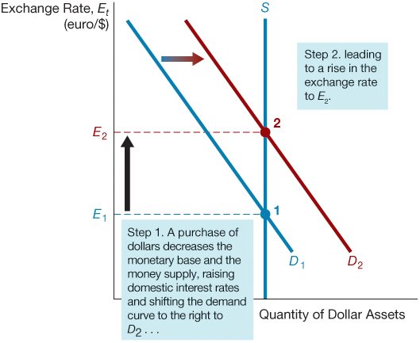
Figure 1 Effect of an Unsterilized Purchase of Dollars and Sale of Foreign Assets

Slide 12
Intervention in the Foreign Exchange Market (7 of 7)
Sterilized foreign exchange intervention: is when central bank does not allow the sale or purchase of domestic currency to affect monetary base.
To counter the effect of the foreign exchange intervention, central bank conduct an offsetting open market operation (OMO).
Federal Reserve System | Blank | Blank | Blank
Assets | Blank | Liabilities | Blank
Foreign Assets (International Reserves) | −$1B | Monetary Base (reserves) | 0
Government Bonds | +$1B | Blank | Blank
OMO
The key point is that there is no effect on the monetary base and therefore no effect on the exchange rate.

Slide 13
Balance of Payments (1 of 6)
Balance of payments records the international financial transactions between a nation (private sector and government) and foreign countries for a given year.
Key components: current account (or use of funds) and financial account (source of funds)
Sum of these two is the official reserve transactions balance or balance of payments.

Slide 14
Balance of Payments (2 of 6)
Current Account
International transactions that involve currently produced goods and services for a given year.
Do not involve the purchase or sale of financial assets.
Current account balance is the sum of
trade balance,
net investment income, and
transfers.

Slide 15
Balance of Payments (3 of 6)
Trade balance: equals total value of exports of goods and services minus total value of imports of goods and services (also called net export)
Trade deficit: negative current account or imports greater than exports.
Trade surplus: positive current account or exports greater than imports.
Net investment income: investment income received from abroad minus investment income paid out to foreigners.
Transfers: funds sent by domestic residents and governments to foreigners such as remittances, pensions, foreign aids.

Slide 16
Balance of Payments (4 of 6)
Current account deficit:
The country is making more payments to foreigners on a current basis than it is receiving from foreigners.
Current account surplus:
The country is receiving more payments from foreigners on a current basis than it is making payments to them.
Finance (capital) account shows:
how a country finances its current account deficit or
how a country uses the surplus money it is receiving from foreigners (for the case of current account surplus).

Slide 17
Balance of Payments (5 of 6)
Capital (Financial) Account (or Source of Funds)
International financial transactions that involves the sale or purchase of financial assets:
Net U.S. acquisition of financial assets: when American increase their net holding of foreign assets.
Net U.S. incurrence of liabilities: when foreigners increase their net holdings of U.S. assets (indicates U.S. indebtedness)
Financial accounts balance: the difference between net U.S acquisition of financial assets and net U.S. incurrence of liabilities.

Slide 18
Balance of Payments (6 of 6)
Negative Capital Account Balance: U.S. increase of liabilities to foreigners in a given year exceeded the increase in U.S. foreign asset holding.
Net Capital Inflows: Financial account balance also shows the amount of net capital inflows
Capital Inflow: When foreigners increase their holdings of U.S. assets, capital has flowed into the U.S.
Capital Outflow: When Americans increase their holdings of foreign assets, capital has flowed out of the U.S.

Slide 19
Intuition behind Balance of Payments
Financial balance and current account balance are equal in absolute value. This equality implies that:
if Americans are spending more than they are taking in on the current account (current account deficit), they must be financing this spending by borrowing an equal amount from foreigners (negative capital account).
In other words, the use of finds should be equal to the source of funds.
The current account deficit, which provides the net use of funds, must equal to the source of funds, which is what the financial account indicates.

Slide 20
Global: Should We Worry About the Large U.S. Current Account Deficit?
Persistent trade deficits are a concern for several reasons.
First, it indicates that, at current exchange rates, foreign demand for U.S. exports is far less than the U.S. demand for foreign goods.
Second, a current account deficit means that foreigners’ claim on U.S. assets is growing.

Slide 21
Exchange Rate Regimes in the International Financial System (1 of 4)
Fixed exchange rate regime
Value of a currency is pegged relative to the value of one other currency (anchor currency)
Exchange rate is fixed in terms of the anchor currency.
Floating exchange rate regime
Value of a currency is allowed to fluctuate against all other currencies
Managed float regime (dirty float)
When countries intervene in Foreign Exchange market to influence exchange rates by buying and selling domestic currencies and foreign assets

Slide 22
Exchange Rate Regimes in the International Financial System (2 of 4)
Gold standard (Before WWI)
Fixed exchange rates
Currencies were convertible directly into gold at fixed rates
Exchange rate between two countries were also fixed
Advantage
Encouraging world trade by eliminating exchange rate risk
Disadvantage
No control over monetary policy
Money supply, and therefore monetary policy, influenced heavily by production of gold and gold discoveries

Slide 23
Exchange Rate Regimes in the International Financial System (3 of 4)
Bretton Woods System (After WWII)
Fixed exchange rates based on U.S. dollar convertibility into gold
International Monetary Fund (IMF)
Promoting world trade by
Setting rules for the maintenance of fixed exchange rates
Making loans to countries experiencing difficulties with their balance of payments
World Bank
Long- term loan to developing countries to foster economic development
World Trade Organization
Monitor rules for the conduct of trade between countries

Slide 24
Exchange Rate Regimes in the International Financial System (4 of 4)
Exorbitant Privilege
The fixed exchange rates were to be maintained by intervention in the foreign exchange market by central banks in countries besides the United States that bought and sold dollar assets, which these countries held as international reserves.
Reserve Currency
U.S. dollars used by other countries to denominate the assets they held as international reserves
Most international financial transactions are conducted in reserve currency

Slide 25
How a Fixed Exchange Rate Regime Works
When the domestic currency is overvalued, the central bank must:
Purchase domestic currency to keep the exchange rate fixed (it loses international reserves), or
Conduct a devaluation
When the domestic currency is undervalued, the central bank must:
Sell domestic currency to keep the exchange rate fixed (it gains international reserves), or
Conduct a revaluation
Perfect capital mobility
If there are no barriers to domestic residents purchasing foreign assets or to foreigners purchasing domestic assets

Slide 26
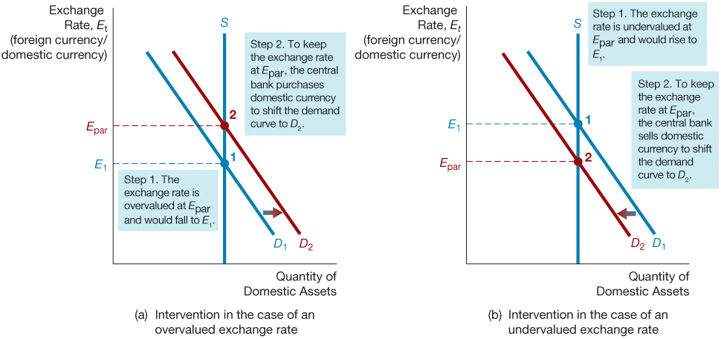
Figure 2 Intervention in the Foreign Exchange Market Under a Fixed Exchange Rate Regime

Slide 27
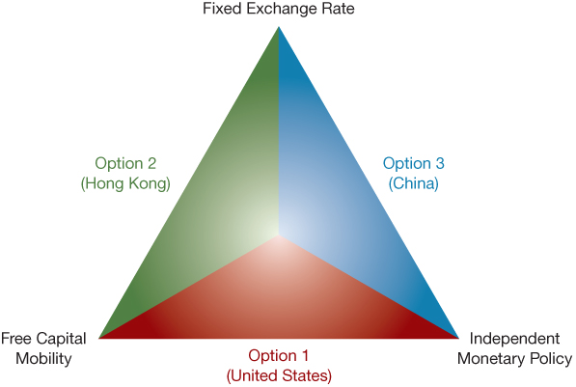
Figure 4 The Policy Trilemma

Slide 28
Monetary Unions
A variant of a fixed exchange rate regime is a monetary (or currency) union
A group of countries decides to adopt a common currency, thereby fixing the countries’ exchange rates in relation to each other.
Advantage
Encourage trade across borders
Disadvantage
Fixed exchange rate and free capital mobility means that each member country lose its control of monetary policy
This means that each country cannot use monetary policy to address the shortfalls of aggregate demand

Slide 29
Managed Float
Hybrid of fixed and flexible
Small daily changes in response to market
Interventions to prevent large fluctuations
Appreciation hurts exporters and employment
Because an appreciation might hurt domestic businesses and increase unemployment, countries with balance-of-payments surpluses often have sold their currencies in the foreign exchange market and acquired international reserves.
Depreciation hurts imports and stimulates inflation

Slide 30
Capital Controls (1 of 2)
Controls on capital outflows:
Capital outflow promote financial instability by forcing a devaluation
Seldom effective and may increase capital flight
Lead to corruption
Lose opportunity to improve the economy
Controls on capital inflows:
Supporters reason that if speculative capital cannot come in, then it cannot go out suddenly.
Capital inflow can lead to a lending boom and excessive risk-taking by financial intermediaries

Slide 31
Capital Controls (2 of 2)
Controls on inflows (cont’d):
Controls may block funds for production uses
Produce substantial distortion and misallocation
Leads to corruption
Strong case for improving bank regulation and supervision

Slide 32
The Role of the IMF
Original Function
help countries deal with balance-of-payments problems
stand by the fixed exchange rates by lending to deficit countries.
International Lender of Last Resort
Financial stability
1990s crises: IMF made huge loans to Mexico and East Asian countries to help them recover financially and to prevent the spread of the crises to other countries (contagion)
2010 crises: the IMF made large loans to Greece, Ireland, and Portugal to help these countries avoid defaults on their government debt.

Slide 33
How Should the IMF Operate?
Moral Hazard problems
Bail out programs: knowing that the IMF is willing to take on this role may encourage governments to be profligate
Austerity programs that force borrowing governments to cut government spending, raise taxes, and raise interest rates.
Safety net: governments use IMF funds to protect depositors and other creditors of banking institutions from losses.
IMF ask countries to implement measures to prevent excessive risk taking by financial institutions.

Slide 34
International Considerations and Monetary Policy (1 of 2)
Direct Effects of the Foreign Exchange Market on Monetary Policy
Foreign Exchange Intervention
Typically, when central banks intervene in the foreign exchange market, their international reserve is affected, and they give up some control of its monetary policy.
U.S. Monetary Base: Because the U.S. dollar has been a reserve currency, the U.S. monetary base has not been greatly affected by developments in the foreign exchange market.
U.S. International Reserve: As long as foreign central banks, rather than the Fed, intervene to keep the value of the dollar from changing, American holdings of international reserves will remain unaffected.

Slide 35
International Considerations and Monetary Policy (2 of 2)
Exchange rate considerations
Overvaluation
A contractionary monetary policy will raise the domestic interest rate and strengthen the currency.
Undervaluation
An expansionary monetary policy will lower interest rates and weaken currency.

Slide 36
To Peg or Not to Peg: Exchange-Rate Targeting as an Alternative Monetary Policy Strategy
Advantages of exchange-rate targeting:
Contributes to keeping inflation under control
Automatic rule for conduct of monetary policy
Simplicity and clarity
Disadvantages of exchange-rate targeting:
Cannot respond to domestic shocks and shocks to anchor country are transmitted
Open to speculative attacks on currency
Weakens the accountability of policy makers as the exchange rate loses value as signal

Slide 37
When Is Exchange-Rate Targeting Desirable for Industrialized Countries?
Exchange-rate targeting for industrialized countries is desirable if
Domestic monetary and political institutions are not conducive to good policy making
Other important benefits such as integration arise from this strategy

Slide 38
When Is Exchange-Rate Targeting Desirable for Emerging Market Countries?
Exchange-rate targeting for emerging market countries is desirable if
Political and monetary institutions are weak (strategy becomes the stabilization policy of last resort).

Slide 39
Currency Boards
Solution to lack of transparency and commitment to target.
Domestic currency is backed 100% by a foreign currency.
Note issuing authority establishes a fixed exchange rate and stands ready to exchange currency at this rate.
Money supply can expand only when foreign currency is exchanged for domestic currency.
Stronger commitment by central bank.
Loss of independent monetary policy and increased exposure to shock from anchor country.
Loss of ability to create money and act as lender of last resort.

Slide 40
Dollarization
Another solution to lack of transparency and commitment
Adoption of another country’s money
Even stronger commitment mechanism
Completely avoids possibility of speculative attack on domestic currency
Lost of independent monetary policy and increased exposure to shocks from anchor country
Inability to create money and act as lender of last resort
Loss of seignorage

Slide 41
Copyright

