Slide 1
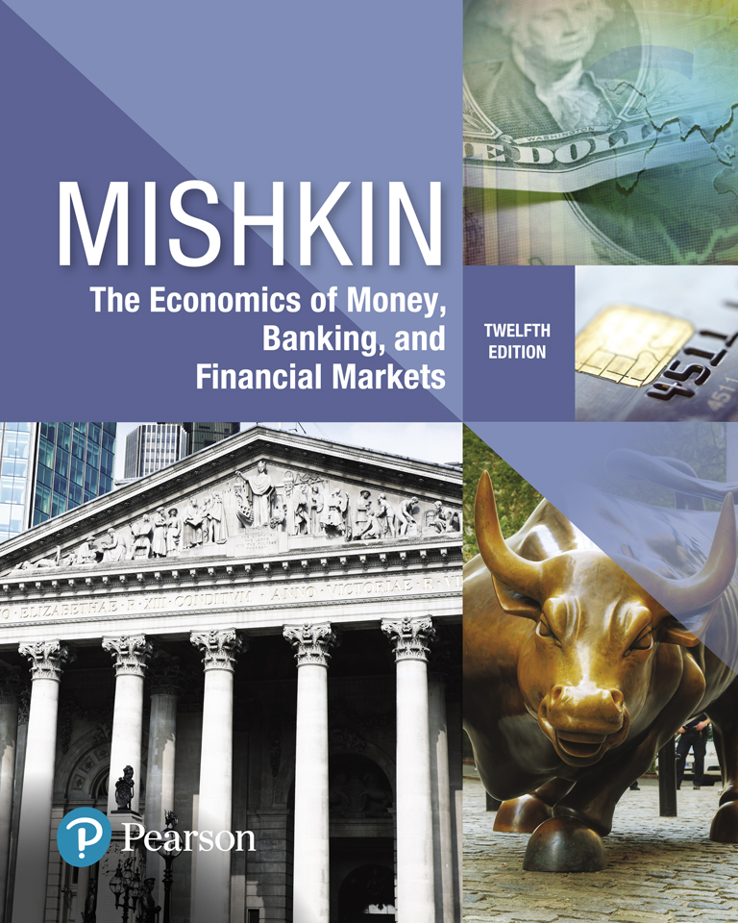
The Economics of Money, Banking, and Financial Markets
Twelfth Edition
Chapter 15
Tools of Monetary Policy
Copyright © 2019, 2016, 2013 Pearson Education, Inc. All Rights Reserved.
Notes:
If this PowerPoint presentation contains mathematical equations, you may need to check that your computer has the following installed:
1) MathType Plugin
2) Math Player (free versions available)
3) NVDA Reader (free versions available)

Slide 2
Preview
This chapter examines the tools used by the Federal Reserve System to control the money supply and interest rates

Slide 3
Learning Objectives
Illustrate the market for reserves and demonstrate how changes in monetary policy can affect the federal funds rate.
Summarize how conventional monetary policy tools are implemented and the advantages and limitations of each tool.
Explain the key monetary policy tools that are used when conventional policy is no longer effective.
Identify the distinctions and similarities between the monetary policy tools of the Federal Reserve and those of the European Central Bank.

Slide 4
The Market for Reserves and the Federal Funds Rate (1 of 6)
Demand and Supply in the Market for Reserves is used to examine the tools of monetary policy used by the Fed to control the money supply and interest rates.
In recent years, the Federal Reserve has increasingly focused on the federal funds rate (the interest rate on overnight loans of reserves from one bank to another) as the primary instrument of monetary policy.

Slide 5
The Market for Reserves and the Federal Funds Rate (2 of 6)
Changes in Federal Funds rate affects interest rate throughout the economy.
To fully comprehend how the Fed uses its tools in the conduct of monetary policy, we must understand:
not only their effect on the money supply but also
their direct effect on the federal funds rate and
how they can be used to help achieve a federal funds rate that is close to the target.

Slide 6
The Market for Reserves and the Federal Funds Rate (3 of 6)
A supply and demand analysis of the market for reserves to explain how the Fed’s settings for the four tools of monetary policy determine the federal funds rate.
Federal Reserve (conventional) tools include:
Open market operations,
Discount policy,
Reserve requirements, and
The interest paid on reserves

Slide 7
The Market for Reserves and the Federal Funds Rate (4 of 6)
The market for reserves is where the federal funds rate is determined.
The quantity of the reserve supplied can be split up into two components:
Nonborrowerd Reserve (through Open Market Operation) and
Borrowed Reserve (through Federal Reserve lending)
The quantity of the reserve demanded can be split up into two components:
Required reserve
Excess reserve

Slide 8
The Market for Reserves and the Federal Funds Rate (5 of 6)
In equilibrium, quantity of reserves demanded are equal to the quantity of the reserve supplied.
$quantity of reserve demanded=excess reserve+required reserve$=
$$quantity of reserve supplied=borrowerd reserve \left(discount lending\right)+nonborrowed reserve(open market operation)$$

Slide 9
The Market for Reserves and the Federal Funds Rate (6 of 6)
Excess reserves are insurance against deposit outflows
The cost of holding these is their opportunity cost.
Opportunity cost of excess reserve: interest rate that could have been earned on lending these reserve $($fed funds rate) out minus the interest rate that is paid on these reserves, i_{or}
$$Opportunity Cost of Holding Excess Reserves=Fed Funds Rate−Interest on exccess Reserve$$

Slide 10
Demand in the Market for Reserves (1 of 3)
What happens to the quantity of reserves demanded by banks, holding everything else constant, as the federal funds rate changes?
Since the fall of 2008, the Fed has paid interest on reserves at a level that is set at a fixed amount below the federal funds rate target.
This means that the opportunity cost of holding excess reserve for the banks rather than lending those reserves out is $>zero.$

Slide 11
Demand in the Market for Reserves (2 of 3)
When the federal funds rate is above the rate paid on excess reserves, i_{or}, as the federal funds rate decreases, the opportunity cost of holding excess reserves falls, and the quantity of reserves demanded rises.
Downward sloping demand curve that becomes flat (infinitely elastic) at i_{or}

Slide 12
Demand in the Market for Reserves (3 of 3)
Think of banks as having two investment options:
Hold excess reserve (and earn $IOER)$ – this decision increase the demand for reserves or
Lend those reserves in the fed funds market (and earn $i_{ff})$- this decision decreases the demand for reserves.
When the federal funds rate falls, the demand for holding the reserve increases, and therefore the willingness to lend in the overnight interbank lending market (fed funds market) falls and vice versa.
When the fed funds rate is very low and falls below the interest on reserve, banks stop lending to each other in the fed funds market altogether and keep accumulating excess reserve instead.

Slide 13
Supply in the Market for Reserves
Two components: nonborrowed and borrowed reserves
Cost of borrowing from the Fed is the discount rate
Borrowing from the Fed is a substitute for borrowing from other banks
If i_{ff} < i_{d}, then banks will not borrow from the Fed and borrowed reserves are zero
The supply curve will be vertical
As i_{ff} rises above i_{d}, banks will borrow more and more at i_{d}, and relend at i_{ff}
The supply curve is horizontal (perfectly elastic) at i_{d}

Slide 14
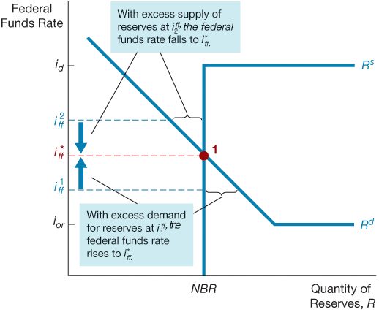
Figure 1 Equilibrium in the Market for Reserves (Corridor System)

Slide 15
Reverse Repo Facility (1 of 3)
As we see after the GFC, the federal funds rate can be slightly below the floor set by the interest rate paid on reserves because:
some big lenders in the federal funds market, particularly Fannie Mae and Freddie Mac:
are not banking institutions
and so cannot keep deposits in the Federal Reserve and get paid the Fed’s interest rate on reserves.
Thus if they have excess funds to lend in the federal funds market, they may have to accept a federal funds rate lower than the interest rate the Fed pays on reserves.

Slide 16
Reverse Repo Facility (2 of 3)
To make sure that the federal funds rate does not fall much below the floor set by the interest rate on reserves, the Federal Reserve uses an overnight reverse repurchase agreement (ON RRP) facility as a supplementary policy tool to help control the federal funds rate and keep it in the target range set by the FOMC.
When the Federal Reserve conducts an overnight RRP, it sells a security to an eligible counterparty and simultaneously agrees to buy the security back the next day.
In other words, nonbank lenders can lend to the Fed and earn an interest rate that is close to the interest rate the Fed pays on reserves.
This interest rate is called ON RRP offering rate.

Slide 17
Reverse Repo Facility (3 of 3)
$$i^{ff}$$
$$i^{d}$$
$$R^{s}$$
$$Fed^{′}s Funds rate intended corridor after the GFC$$
$$i^{FF∗}$$
$$i^{OER}$$
$$R^{D}$$
$$Fed^{′}s Funds rate actual corridor after the GFC$$
$$i^{ON RRP}$$
$$R^{D}$$
$$Quantity of Reserves$$

Slide 18
How Changes in the Tools of Monetary Policy Affect the Federal Funds Rate (1 of 2)
Effects of open market operation depends on whether the supply curve initially intersects the demand curve in its downward sloped section versus its flat section.
An open market purchase causes the federal funds rate to fall whereas an open market sale causes the federal funds rate to rise (when intersection occurs at the downward sloped section).
Open market operations have no effect on the federal funds rate when intersection occurs at the flat section of the demand curve.

Slide 19
How Changes in the Tools of Monetary Policy Affect the Federal Funds Rate (2 of 2)
If the intersection of supply and demand occurs on the vertical section of the supply curve, a change in the discount rate will have no effect on the federal funds rate.
If the intersection of supply and demand occurs on the horizontal section of the supply curve, a change in the discount rate shifts that portion of the supply curve and the federal funds rate may either rise or fall depending on the change in the discount rate.
When the Fed raises reserve requirement, the federal funds rate rises and when the Fed decreases reserve requirement, the federal funds rate falls.

Slide 20
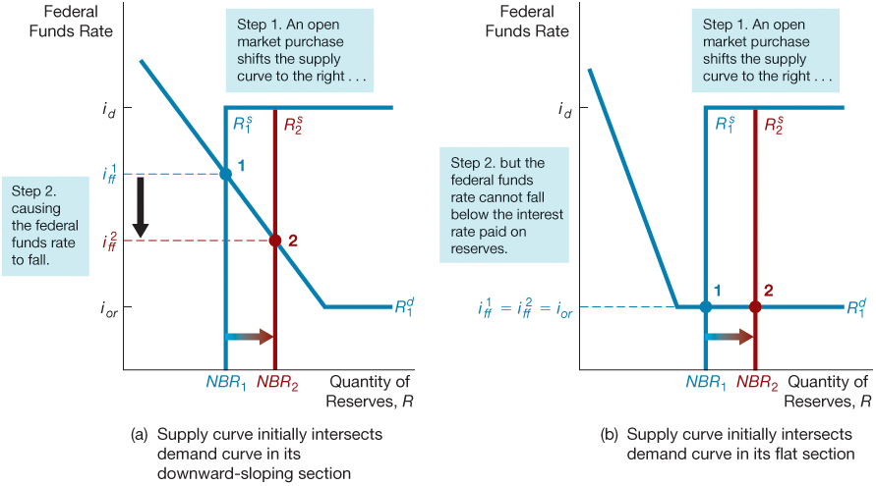
Figure 2 Response to an Open Market Operation

Slide 21
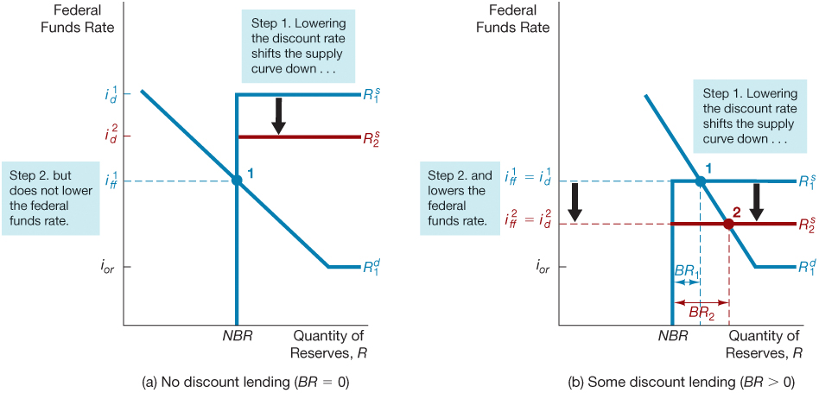
Figure 3 Response to a Change in the Discount Rate

Slide 22
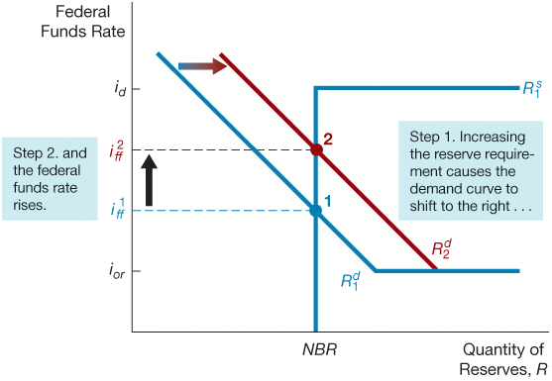
Figure 4 Response to a Change in Required Reserves

Slide 23
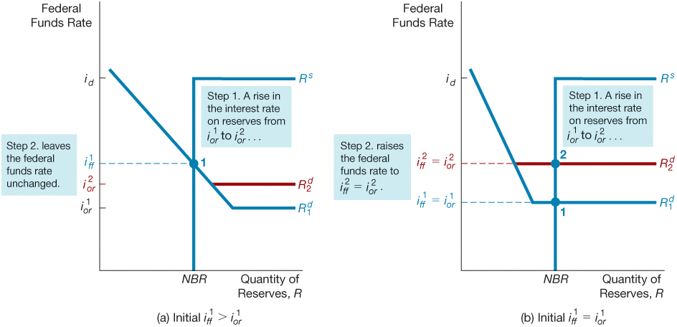
Figure 5 Response to a Change in the Interest Rate on Reserves

Slide 24
Application: How the Federal Reserve’s Operating Procedures Limit Fluctuations in the Federal Funds Rate
Supply and demand analysis of the market for reserves illustrates how an important advantage of the Fed’s current procedures for operating the discount window and paying interest on reserves is that they limit fluctuations in the federal funds rate.

Slide 25
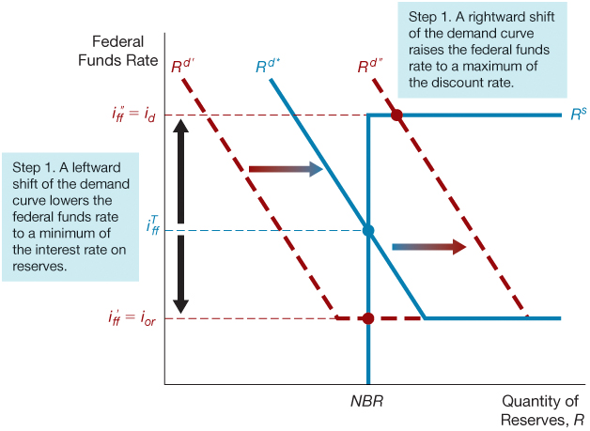
Figure 6 How the Federal Reserve’s Operating Procedures Limit Fluctuations in the Federal Funds Rate

Slide 26
How Fed Views Floor versus Corridor System: Fed versus Textbook (1 of 7)

Slide 27
How Fed Views Floor versus Corridor System: Fed versus Textbook (2 of 7)
In Fed’s view, the advantage of floor system is that Fed can add more reserves in the system to maintain the same Fed Funds target.
For a floor system to work, Fed should set the target for fed funds rate very close to IOER.
In textbook, this is shown as a case in which conventional MP is ineffective.
From Fed’s point of view, however, even though conventional MP is not enough during crisis, it is not ineffective since
during the crisis when there is a liquidity shortage, Fed can inject the extra liquidity to the system in name of “conventional monetary policy”.
In other words, the objective of Fed’s conventional tools of MP changes from affecting interest rate to injecting liquidity during crisis.

Slide 28
How Fed Views Floor versus Corridor System: Fed versus Textbook (3 of 7)
To understand the shape of the demand curve in this figure, suppose first that the supply of reserve balances is very small.
In this case, some banks will have difficulty meeting their reserve requirement. As these banks try to borrow funds, the market interest rate will be pushed up toward the ceiling created by the discount rate.
The market rate may actually rise above the discount rate because of “stigma” effect.

Slide 29
How Fed Views Floor versus Corridor System: Fed versus Textbook (4 of 7)
Once the supply of balances becomes large enough that all banks expect to meet their requirements, the demand curve falls off sharply.
At this point, the value of reserve balances is determined largely by banks’ desire to be able to make payments out of their account as needed without the risk of falling below their requirement.
This part of the curve is labeled the inelastic region in the figure; the term “inelastic” here means that the quantity of balances banks demand is relatively insensitive to changes in the interest rate.

Slide 30
How Fed Views Floor versus Corridor System: Fed versus Textbook (5 of 7)
As the supply of balances increases further, the demand curve flattens out into an elastic region where
the demand for balances is much more sensitive to changes in the interest rate.
In this region, banks have sufficient balances to meet their reserve requirements comfortably while satisfying all payments needs.
The value of reserve balances in this region comes largely from the fact that these balances are a perfectly liquid, interest-bearing asset that banks can hold as part of their general liquidity pools.
The interest-on-reserves rate that banks earn by holding these balances is, therefore, the relevant reference point for the market interest rate.

Slide 31
How Fed Views Floor versus Corridor System: Fed versus Textbook (6 of 7)
The major difference between the Fed’s view and Textbook view of corridor and floor system:
1. The Measure of Effectiveness: Textbook suggests that conventional monetary policy is not effective when the supply for reserve curve intersects with the flat section of demand curve.
According to Fed, however, at this point, even though Federal Funds rate cannot be effected through Fed’s conventional operations, Federal Reserve is still able to inject reserve into the system without creating fluctuations in fed funds rate by lowering it and addressing liquidity problem.
Remember that when the economy hit this point, it is usually as a result of a crisis. Thus, it is important for the Fed to inject liquidity into the system and fight liquidity shortage.

Slide 32
How Fed Views Floor versus Corridor System: Fed versus Textbook (7 of 7)
2. The Instrument of Conventional Monetary Policy: According to the textbook, the main instrument of conventional monetary policy is to affect aggregate demand remains to be interest rate.
From Fed’s point of view, however, during the crisis, the main instrument in conducting conventional monetary policy is providing liquidity to the banking system instead by providing additional reserve without changing interest rate.

Slide 33
Conventional Monetary Policy Tools
During normal times, the Federal Reserve uses three tools of monetary policy—open market operations, discount lending, and reserve requirements—to control the money supply and interest rates, and these are referred to as conventional monetary policy tools.

Slide 34
Open Market Operations (1 of 3)
Dynamic open market operations
Defensive open market operations
Primary dealers
TRAPS (Trading Room Automated Processing System)
Repurchase agreements
Matched sale–purchase agreements

Slide 35
Open Market Operations (2 of 3)
Open market operations are the most important conventional monetary policy tool because
they are the primary determinants of changes in interest rates and the monetary base,
the main source of fluctuations in the money supply.
Open Market Purchase
Increase in Reserve and Monetary Base
Increase in Money Supply
Decrease in Interest Rate (most likely outcome)

Slide 36
Open Market Operations (3 of 3)
Understanding the elements of the Fed’s balance sheet that influence reserves and the monetary base help us examine how the Federal Reserve conducts open market operations with the objective of controlling short-term interest rates and the money supply.
Open market operations fall into two categories:
Dynamic open market operations are intended to change the level of reserves and the monetary base, and
Defensive open market operations are intended to offset movements in other factors that affect reserves and the monetary base, such as changes in Treasury deposits with the Fed or changes in float.

Slide 37
Dynamic Open Market Operation (1 of 4)
The Fed conducts conventional open market operations in U.S. Treasury and government agency securities, especially U.S. Treasury bills.
The Fed conducts most of its open market operations in Treasury securities because:
the market for these securities is the most liquid and has the largest trading volume.
It has the capacity to absorb the Fed’s substantial volume of transactions without experiencing excessive price fluctuations that would disrupt the market.

Slide 38
Dynamic Open Market Operation (2 of 4)
Federal Open Market Committee (FOMC)
Decision Making Authority: for open market operations is the Federal Open Market Committee (FOMC),
FOMC sets a target for the federal funds rate.
Federal Reserve Bank of New York
The actual execution: of these operations, however, is conducted by the trading desk at the Federal Reserve Bank of New York, whose operations are described by the Inside the Fed box, “A Day at the Trading Desk.”

Slide 39
Dynamic Open Market Operation (3 of 4)
Primary Dealers
Open market operations are conducted electronically through a specific set of dealers in government securities, known as primary dealers,
by a computer system called TRAPS (Trading Room Automated Processing System).

Slide 40
Dynamic Open Market Operation (4 of 4)
1st step: A message is electronically transmitted to all the primary dealers simultaneously over TRAPS, indicating the type and maturity of the operation being arranged.
2nd Step: The dealers are given several minutes to respond via TRAPS with their propositions to buy or sell government securities at various prices.
3rd Step: The propositions are then assembled and displayed on a computer screen for evaluation.
4th Step: The desk will select all propositions, beginning with the most attractively priced, up to the point at which the desired amount of securities is purchased or sold, and it will then notify each dealer via TRAPS on which of its propositions have been chosen.
5th Step: The entire selection process is typically completed in a matter of minutes

Slide 41
Defensive Open Market Operations (1 of 2)
Defensive open market operations are of two basic types: Repo and Reverse Repo.
Repurchase Agreement (Repo)
In a repurchase agreement (often called a repo)
the Fed purchases securities with an agreement that the seller will repurchase them in a short period of time, anywhere from one to fifteen days from the original date of purchase.
Because the effects on reserves of a repo are reversed on the day the agreement matures, a repo is actually a temporary open market purchase.

Slide 42
Defensive Open Market Operations (2 of 2)
Repo is an especially desirable way of conducting a defensive open market purchase that will be reversed shortly.
matched sale–purchase transaction (or Reverse Repo)
When the Fed wants to conduct a temporary open market sale, it engages in a matched sale–purchase transaction (sometimes called a reverse repo) in which
the Fed sells securities and
the buyer agrees to sell them back to the Fed in the near future.

Slide 43
Inside the Fed: A Day at the Trading Desk
The manager of domestic open market operations supervises the analysts and traders who execute the purchases and sales of securities in the drive to hit the federal funds rate target.

Slide 44
Discount Policy and the Lender of Last Resort (1 of 10)
Discount window
Primary credit: standing lending facility
Lombard facility
Secondary credit
Seasonal credit
Lender of last resort to prevent financial panics
Creates moral hazard problem

Slide 45
Discount Policy and the Lender of Last Resort (2 of 10)
The discount rate is the interest rate at which the Federal Reserve is willing to lend funds, against collateral (or margin), to banks in good standing.
Bagehot’s rule “Lend freely, to solvent firms, against good collateral, at 'high rates’’
This rate tends to create an upper bound, or ceiling, for the market interest rate by giving banks an option to borrow funds outside of the market.

Slide 46
Discount Policy and the Lender of Last Resort (3 of 10)
There are three kinds of discount loan: primary credit, secondary credit and seasonal credit.
The discount rate is the rate of primary credit.
Primary credit is the discount lending that plays the most important role in monetary policy.
Healthy banks are allowed to borrow all they want at very short maturities (usually overnight) from the primary credit facility,
and it is therefore referred to as a standing lending facility.

Slide 47
Fed Follows Bagehot’s Rule from 2003
The procedures for administering the discount window were changed in January 2003.
The primary credit facility (also called standard lending facility) replaced an adjustment credit facility whose discount rate was typically set below market interest rates, so banks were restricted in their access to this credit.
In contrast, healthy banks now can borrow all they want from the primary credit facility.
This type of standard lending facility is commonly called a Lombard facility in other countries, and the interest rate charged on these loans is often called a Lombard rate.

Slide 48
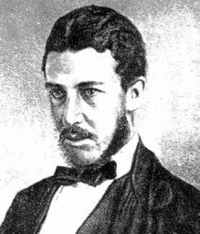
Lombard Street: A Description of the Money Market
Walter Bagehot, a 19th Century British Businessman and journalist, revolutionized central banking through his seminal book.

Slide 49
Discount Policy and the Lender of Last Resort (4 of 10)
The interest rate on these loans is the discount rate:
it is set higher than the federal funds rate target, usually by 100 basis points (one percent-age point)
because the Fed prefers that banks borrow from each other in the federal funds market so that they continually monitor each other for credit risk.
As a result, in most circumstances the amount of discount lending under the primary credit facility is very small.

Slide 50
Discount Policy and the Lender of Last Resort (5 of 10)
Discount Loans have two importance:
They put ceiling (or upper-bound) on the fed fund rate.
The act as lender of last resort during financial crisis.
They do NOT serve as a tool to control reserve in modern central banking though.
Provision of Ceiling
The discount facility is intended to be a backup source of liquidity for solvent banks so that the federal funds rate never rises too far above the federal funds target set by the FOMC
Thus, the primary credit facility has put a ceiling on the federal funds rate at id.

Slide 51
Discount Policy and the Lender of Last Resort (6 of 10)
When the demand for reserves experiences a large unexpected increase,
no matter how far right the demand curve shifts,
the equilibrium federal funds rate i* ff will stay at id
because borrowed reserves will just continue to increase,
and the federal funds rate can rise no further.
The primary credit facility has thus put a ceiling on the federal funds rate at id.

Slide 52
Discount Policy and the Lender of Last Resort (7 of 10)
Secondary credit is given to banks that are in financial trouble and are experiencing severe liquidity problems.
The interest rate on secondary credit is set at 50 basis points (0.5 percentage point) above the discount rate (penalty rate).
Seasonal credit is given to meet the needs of a limited number of small banks in vacation and agricultural areas that have a seasonal pattern of deposits.
The interest rate charged on seasonal credit is tied to the average of the federal funds rate and certificate of deposit rates.

Slide 53
Discount Policy and the Lender of Last Resort (8 of 10)
Lender of Last Resort
In addition to its use as a tool to influence reserves, the monetary base, and the money supply, discounting is important in preventing and coping with financial panics.
to prevent bank failures from spinning out of control, the Fed was to provide reserves to banks when no one else would, thereby preventing bank and financial panics (Bagehot Rule)
Discounting is a particularly effective way to provide reserves to the banking system during a banking crisis because reserves are immediately channeled to the banks that need them most.

Slide 54
Discount Policy and the Lender of Last Resort (9 of 10)
Why do we need Fed’s backstop even though we have FDIC?
First, it is important to recognize that the FDIC’s insurance fund amounts to about 1% of the total amount of deposits held by banks.
the large number of bank failures in the 1980s and early 1990s led to large losses and a shrinkage of the FDIC’s insurance fund,
which reduced the FDIC’s ability to cover depositors’ losses.
This fact has not weakened the confidence of small depositors in the banking system because the Fed has been ready to stand behind the banks to provide whatever reserves are needed to prevent bank panics.

Slide 55
Discount Policy and the Lender of Last Resort (10 of 10)
2. Second, the $1.6 trillion of large-denomination deposits (wholesale deposits) in the banking system are not guaranteed by the FDIC because they exceed the $250,000 limit.
A loss of confidence in the banking system could still lead to runs on banks from the large-denomination (wholesale) depositors,
and bank panics could still occur despite the existence of the FDIC.
The Federal Reserve’s role as lender of last resort is, if any-thing, more important today than ever because of the high number of bank failures experienced in the 1980s and early 1990s and during the global financial crisis from 2007 to 2009.

Slide 56
Lender of Last Resort and the Problem of Too-Big-To-Fail (1 of 4)
Although the Fed’s role as the lender of last resort provides the benefit of preventing bank and financial panics, it does come with a cost.
If a bank expects that the Fed will provide it with discount loans if it gets into trouble, then it will be willing to take on more risk, know-ing that the Fed will come to the rescue if necessary.
The Fed’s lender-of-last-resort role has thus created a moral hazard problem similar to the one created by deposit insurance:
Banks take on more risk, thus exposing the deposit insurance agency, and hence taxpayers, to greater losses.

Slide 57
Lender of Last Resort and the Problem of Too-Big-To-Fail (2 of 3)
The moral hazard problem is most severe for large banks,
They believe that the Fed and the FDIC view them as “too big to fail”; that is,
they believe they will always receive Fed loans when they are in trouble because their failure would be likely to precipitate a bank panic.

Slide 58
Lender of Last Resort and the Problem of Too-Big-To-Fail (3 of 3)
When the Fed considers using the discount weapon to prevent a panic, it needs to consider the trade-off between the moral hazard cost of its role as lender of last resort and the benefit of preventing the financial panic.
This trade-off explains why the Fed must be careful not to perform its function as lender of last resort too frequently.

Slide 59
Reserve Requirements (1 of 2)
Changes in the required reserve ratio affect the
money supply by causing the money supply multiplier to change.
A rise in reserve requirements
reduces the amount of deposits that can be supported by a given level of the monetary base and leads to a contraction of the money supply.
A rise in reserve requirements also increases the demand for reserves and raises the federal funds rate.

Slide 60
Reserve Requirements (1 of 2)
The Fed has had the authority to vary reserve requirements since the 1930s; this method was once a powerful way of affecting the money supply and interest rates but is rarely used today.

Slide 61
Interest on Excess Reserves (1 of 3)
Because the Fed started paying interest on reserves only in 2008, this tool of monetary policy does not have a long history.
The Fed to date generally has set the interest rate on reserves below the federal funds target:
This means that the “Fed has not yet used interest on reserves as a tool of monetary policy”,
but instead has just used it to help provide a floor under the federal funds rate.

Slide 62
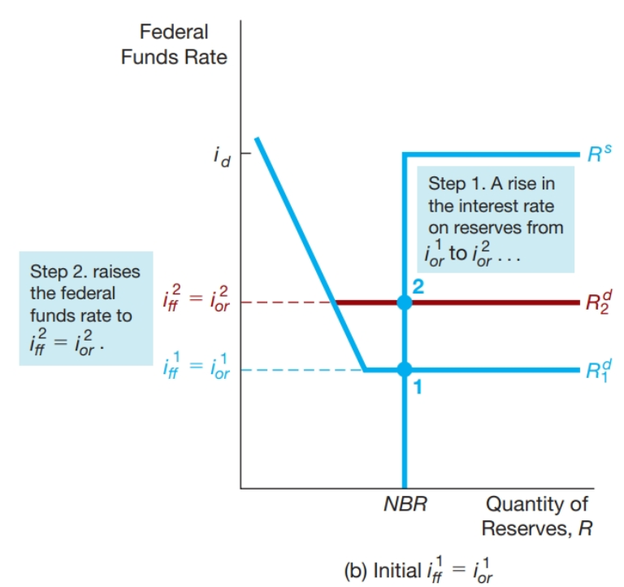
Interest on Excess Reserves (2 of 3)
However, in the aftermath of the global financial crisis, banks have accumulated huge quantities of reserves and,
in this situation, increasing the federal funds rate would require massive amounts of open market operations to remove these reserves from the banking system.
The interest-on-reserves tool can come to the rescue because it can be used to raise the federal funds rate.

Slide 63
Interest on Excess Reserves (3 of 3)
Indeed, this tool of monetary policy was used extensively when the Fed wanted to raise the federal funds rate and exit from the policy of maintaining it at zero in December 2015.

Slide 64
Inside the Fed: Using Discount Policy to Prevent a Financial Panic
To prevent the collapse of the financial sector, the Chairman of the Board of Governors announced before the market opened on Tuesday, October 20, the Federal Reserve System’s “readiness to serve as a source of liquidity to support the economic and financial system.” In addition to this extraordinary announcement, the Fed made it clear that it would provide discount loans to any bank that would make loans to the securities industry. The outcome of the Fed’s timely action was that a financial panic was averted

Slide 65
Relative Advantages of the Different Monetary Policy Tools (1 of 4)
Open market operations are the dominant policy tool of the Fed since
Unlike discount rate, for instance, Fed has complete control over the volume of transactions in OMO
OMO operations are flexible and precise,
Easily reversed, and
Can be quickly implemented (unlike required reserve ratios).

Slide 66
Relative Advantages of the Different Monetary Policy Tools (2 of 4)
Fed rarely uses Required Reserve as tool of monetary policy because:
Changes to reserve requirements take time to implement because
banks must be given advance warning so that they can adjust their computer systems to calculate required reserves.
It is costly to adjust computer systems, reversing a change in reserve requirements is burden-some to banks.
For these reasons, the policy tool of changing reserve requirements does not have much to recommend it, and it is rarely used.

Slide 67
Relative Advantages of the Different Monetary Policy Tools (3 of 4)
The discount rate is less well used as a monetary policy tool since:
Fed does not have full control over discount lending. It also depends on banks’ decision.
The discount window remains of tremendous value given its ability to allow the Fed to act as a lender of last resort.

Slide 68
Relative Advantages of the Different Monetary Policy Tools (4 of 4)
There are two situations in which the other tools have advantages over open market operations:
When the Fed wants to raise interest rates after banks have accumulated large amounts of excess reserves.
In this case, the federal funds rate can be raised by increasing the interest on reserves,
which eliminates the need to conduct massive open market operations to raise the federal funds rate by reducing reserves.
The second situation is when discount policy can be used by the Fed to perform its role as lender of last resort.

Slide 69
On the Failure of Conventional Monetary Policy Tools in a Financial Panic (1 of 3)
When the economy experiences a full-scale financial crisis, conventional monetary policy tools cannot do the job, for two reasons:
First, the financial system seizes up to such an extent that it becomes unable to allocate capital to productive uses, and so investment spending and the economy collapse.
Second, the negative shock to the economy can lead to the zero-lower-bound problem.

Slide 70
On the Failure of Conventional Monetary Policy Tools in a Financial Panic (2 of 3)
Zero-Lower Bound:
The policy rate, such as the federal funds rate, is unlikely to fall below zero because
financial institutions are unwilling to earn a lower return by lending in the federal funds market than they could earn by holding cash, with its zero rate of return.

Slide 71
On the Failure of Conventional Monetary Policy Tools in a Financial Panic (3 of 3)
For both of these reasons, central banks need non–interest-rate tools, known as non-conventional monetary policy tools, to stimulate the economy.
These non-interest rate tools or nonconventional monetary policy tools take four forms:
liquidity provision,
asset purchases,
forward guidance, and
negative interest rates on bank deposits at a central bank.

Slide 72
Nonconventional Monetary Policy Tools: Liquidity Provision (1 of 3)
Liquidity provision: The Federal Reserve implemented unprecedented increases in its lending facilities to provide liquidity to the financial markets
Discount Window Expansion:
At the outset of the crisis, the Fed lowered the discount rate (the interest rate on loans it makes to banks) to 25 basis points (0.25 percentage point) above the federal funds rate target from the normal 100 basis points.
However, because borrowing from the discount window has a “stigma” attached to it (because such borrowing suggests that the borrowing bank is desperate for funds and thus in trouble), use of the discount window was limited during the crisis.

Slide 73
Nonconventional Monetary Policy Tools: Liquidity Provision (2 of 3)
2. Term Auction Facility
Fed made loans at a rate determined through competitive auctions.
The TAF was more widely used than the discount window facility because it enabled banks to borrow at a rate lower than the discount rate,
and the rate was determined competitively rather than being set at a penalty rate.

Slide 74
Nonconventional Monetary Policy Tools: Liquidity Provision (3 of 3)
3. New Lending Programs
The Fed broadened its provision of liquidity to the financial system well beyond its traditional lending to banking institutions.
These actions included lending to investment banks as well as lending to promote purchases of commercial paper, mortgage-backed securities, and other asset-backed securities. In addition, the Fed engaged in lending to J.P. Morgan to assist in its purchase of Bear Stearns and to AIG to prevent its failure.
The number of new programs introduced over the course of the crisis spawned a whole new set of abbreviations, including the TAF, TSLF, PDCF, AMLF, MMIFF, CPFF, and TALF.
These facilities are described in more detail in the Inside the Fed box, “Fed Lending Facilities During the Global Financial Crisis”

Slide 75
Nonconventional Monetary Policy Tools: Large-Scale Asset Purchases (1 of 4)
The Fed’s open market operations normally involve only the purchase of government securities, particularly those that are short-term.
Large-scale asset purchases: During the crisis, the Fed started three new asset purchase programs to lower interest rates for particular types of credit:
Government Sponsored Entities Purchase Program
QE2
QE3

Slide 76
Nonconventional Monetary Policy Tools: Large-Scale Asset Purchases (2 of 4)
Government Sponsored Entities Purchase Program
The Fed set up a Government Sponsored Entities Purchase Program in which the Fed eventually purchased $1.25 trillion of mortgage-backed securities (MBS) guaranteed by Fannie Mae and Freddie Mac.
Through these purchases, the Fed hoped to prop up the MBS market and to lower interest rates on residential mortgages to stimulate the housing market.

Slide 77
Nonconventional Monetary Policy Tools: Large-Scale Asset Purchases (3 of 4)
QE2
the Fed announced that it would purchase $600 billion of long-term Treasury securities at a rate of about $75 billion per month.
This large-scale purchase program, which became known as QE2 (which stands for Quantitative Easing 2), was intended to lower long-term interest rates.
QE2 aimed at stimulating the economy and investment spending by decreasing long-term interest rate as long-term interest rates are more relevant for financing of investment projects.

Slide 78
Nonconventional Monetary Policy Tools: Large-Scale Asset Purchases (4 of 4)
QE3:
in September 2012, the Federal Reserve announced a third large-scale asset-purchase program, which became known as QE3, that combined elements of QE1 and QE2.
However, QE3 differed in one major way from the previous QE programs in that:
its goal was not to increase assets by a fixed dollar amount but instead was open-ended, with the purchase plan set to continue “if the outlook for the labor market does not improve substantially.”

Slide 79
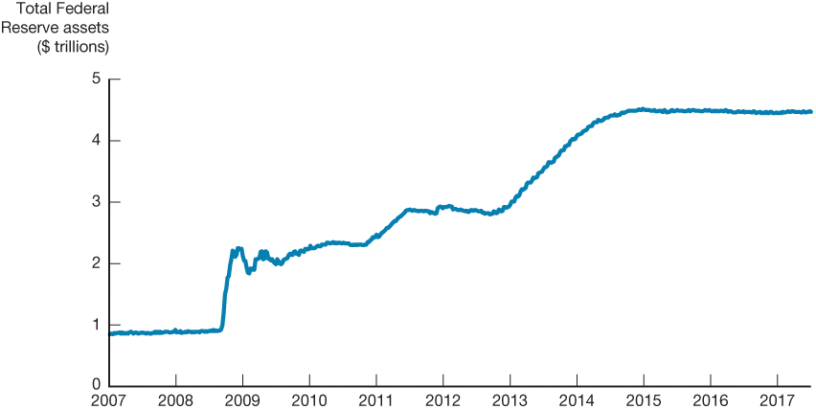
Figure 7 The Expansion of the Federal Balance Sheet, 2007–2014

Slide 80
Quantitative Easing Versus Credit Easing (1 of 5)
The programs introduced by the Fed in response to the GFC led to an unprecedented expansion of the Federal Reserve’s balance sheet from about $900 billion to over $4 trillion by 2017.
This expansion of the balance sheet is referred to as quantitative easing because it leads to a huge increase in the monetary base.
Because such an increase in the monetary base would usually result in an expansion of the money supply, it seems as though such an expansion could be a powerful force in stimulating the economy in the near term and possibly producing inflation down the road.

Slide 81
Quantitative Easing Versus Credit Easing (2 of 5)
There are reasons to be very skeptical of this hypothesis.
The huge expansion in the Fed’s balance sheet and the monetary base did not result in a large increase in the money supply, because most of the increase in the monetary base just flowed into holdings of excess reserves.
Because the federal funds rate had already fallen to the zero lower bound, the expansion of the balance sheet and the monetary base could not lower short-term interest rates any further and thereby stimulate the economy.
An increase in the monetary base does not mean that banks will increase lending, because they can just add to their holdings of excess reserves instead of making loans.

Slide 82
Quantitative Easing Versus Credit Easing (3 of 5)
The Fed Chair at the time, Ben Bernanke, argued that because the Fed’s policies were directed not at expanding the Fed’s balance sheet but rather at credit easing—
that is, altering the composition of the Fed’s balance sheet in order to improve the functioning of particular segments of the credit markets.
Indeed, Bernanke was adamant that the Fed’s policies should not be characterized as quantitative easing.

Slide 83
Quantitative Easing Versus Credit Easing (4 of 5)
Credit Easing, however, have affected the economy:
When the Fed provides liquidity to a particular segment of the credit markets that has seized up, such liquidity can help unfreeze the market and thereby enable it to allocate capital to productive uses, consequently stimulating the economy.
When the Fed purchases particular securities, it increases the demand for those securities and, such an action can lower the interest rates on those securities relative to rates on other securities.
Thus, even if short-term interest rates have hit a floor of zero, asset purchases can lower interest rates for borrowers in particular credit markets and thereby stimulate spending

Slide 84
Quantitative Easing Versus Credit Easing (5 of 5)
II. Purchases of long-term government securities could also lower their interest rates relative to short-term interest rates, and because long-term interest rates are likely to be more relevant to investment decisions, these asset market purchases could boost investment spending.

Slide 85
Nonconventional Monetary Policy Tools: Forward Guidance
By committing to the future policy action of keeping the federal funds rate at zero for an extended period, the Fed could lower the market’s expectations of future short-term interest rates, thereby causing the long-term interest rate to fall.

Slide 86
Nonconventional Monetary Policy Tools: Negative Interest on Bank’s Deposits
Setting negative interest rates on banks’ deposits is supposed to work to stimulate the economy by encouraging banks to lend out the deposits they were keeping at the central bank, thereby encouraging households and businesses to spend more.
However, there are doubts that negative interest rates on deposits will have the intended, expansionary effect.

Slide 87
Inside the Fed: Fed Lending Facilities During the Global Financial Crisis
During the global financial crisis, the Federal Reserve became very creative in assembling a host of new lending facilities to help restore liquidity to different parts of the financial system.
Loans to AIG
Loans to JP Morgan
TAF, TALF, TSLF
PDCF, AMLF, CPFF, MMIFF

Slide 88
Monetary Policy Tools of the European Central Bank
Open market operations
Main refinancing operations
Weekly reverse transactions
Longer-term refinancing operations
Lending to banks
Marginal lending facility/marginal lending rate
Deposit facility
Reserve requirements
2% of the total amount of checking deposits and other short-term deposits
Pays interest on those deposits so cost of complying is low

Slide 89
Copyright

