Slide 1
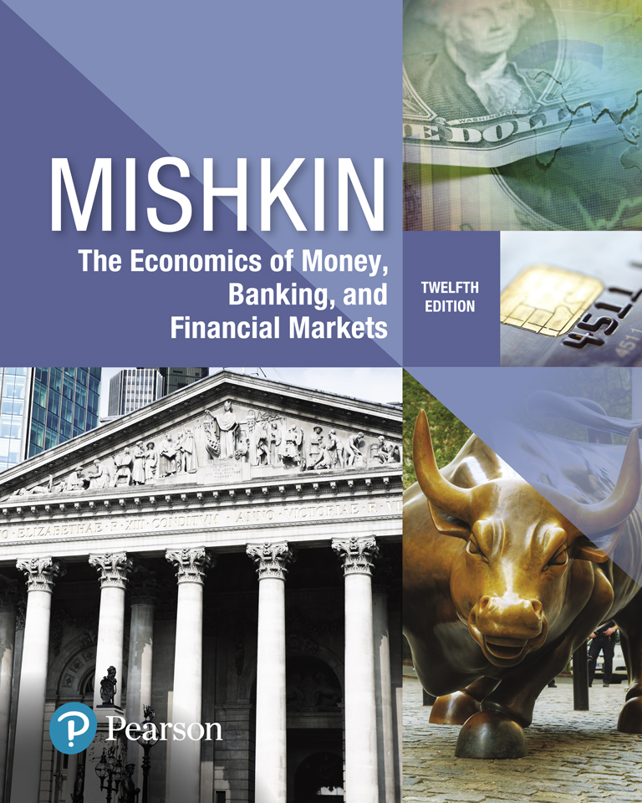
The Economics of Money, Banking, and Financial Markets
Twelfth Edition
Chapter 7
The Stock Market, the Theory of Rational Expectations, and the Efficient Market Hypothesis
Copyright © 2019, 2016, 2013 Pearson Education, Inc. All Rights Reserved.
Notes:
If this PowerPoint presentation contains mathematical equations, you may need to check that your computer has the following installed:
1) MathType Plugin
2) Math Player (free versions available)
3) NVDA Reader (free versions available)

Slide 2
Preview
In this chapter, we examine the theory of rational expectations. When this theory is applied to financial markets, the outcome is the efficient market hypothesis, which has some general implications for how markets in other securities besides stocks operate.

Slide 3
Learning Objectives (1 of 2)
Calculate the price of common stock.
Recognize the impact of new information on stock prices.
Compare and contrast adaptive and rational expectations.
Explain why arbitrage opportunities imply that the efficient market hypothesis holds.

Slide 4
Learning Objectives (2 of 2)
Identify and explain the implications of the efficient market hypothesis for financial markets.
Summarize the reasons why behavioral finance suggestions that the efficient market hypothesis may not hold.

Slide 5
Stocks: Few Definitions
Common stock is the principal medium through which corporations raise equity capital.
Stockholders—those who hold stock in a corporation—own an interest in the corporation equal to the percentage of outstanding shares they own.
This ownership interest gives them the right to vote and to be a residual claimant of all funds flowing into the firm (known as cash flows).
Dividends: stockholders may receive dividends from the net earnings of the corporation. Dividends are payments made periodically, usually every quarter, to stockholders.
The stockholder has the right to sell the stock.

Slide 6
Valuing Stocks (1 of 2)
Chartists:
Some believe they can predict changes in a stock’s price by looking at patterns in its past price movements. Because these people study charts of stock prices
Behavioralists:
Some estimate the value of stocks based on their perceptions of investor psychology and behavior

Slide 7
Valuing Stocks (2 of 2)
Still others estimate stock values based on a detailed study of companies’ financial statements.
In their view, the value of a firm’s stock depends both on its current assets and on estimates of its future profitability—what they call the fundamentals.
Thus, the fundamental value of a stock is based on the timing and uncertainty of the returns it brings.

Slide 8
Basic Principle of Valuation
One basic principle of finance is that the value of any investment is calculated by computing the present value of all cash flows the investment will generate over its life.
Similarly, we value common stock as the value in today’s dollars of all future cash flows.
The cash flows that a stockholder might earn from stock are dividends, the sales price, or both.

Slide 9
One-Period Evaluation Model (1 of 2)
To develop the theory of stock valuation, we begin with the simplest possible scenario:
You buy the stock, hold it for one period to get a dividend, then sell the stock.
To decide whether you should buy a stock or not, you need to determine whether the current price accurately reflects the analyst’s forecast about its expected future price.
To value the stock today, you need to find the present discounted value of the expected cash flows (future payments).

Slide 10
One-Period Evaluation Model (2 of 2)
To calculate present value of future cash flows for stocks, the discount factor used to discount the cash flows is the required return on investments in equity rather than the interest rate.
Discount Factor
Stocks | Bonds
Required Return on Equity | Interest Rate
(ROE) | (YTM)

Slide 11
Computing the Price of Common Stock (1 of 3)
The One-Period Valuation Model:

Slide 12
Stock Price versus Present Value of Future Cash Flows
If stock is currently priced per share at less than the present value of all cash flows from the stock, you would choose to buy it.
However, you should be aware that the stock may be selling for less than the present value, because other investors have placed a greater risk on the cash flows or estimated the cash flows to be less than you did.

Slide 13
Computing the Price of Common Stock (2 of 3)
The Generalized Dividend Valuation Model:

Slide 14
Generalized Dividend Model: Intuition
The generalized dividend model states that the price of a stock is determined only by the present value of the dividends and that nothing else matters.
Many stocks do not pay dividends, so how is it that these stocks have value? Buyers of the stock expect that the firm will pay dividends someday.
Most of the time a firm institutes dividends as soon as it has completed the rapid growth phase of its life cycle.
In this scenario, the generalized dividend valuation model requires that we compute the present value of an infinite stream of dividends.

Slide 15
Computing the Price of Common Stock (3 of 3)
The Gordon Growth Model:

Slide 16
The Gordon Growth (or Dividend-Discount) Model (1 of 3)
This model is useful for finding the value of a stock, given a few assumptions:
Dividends are assumed to continue growing at a constant rate forever.
The growth rate is assumed to be less than the required return on equity.

Slide 17
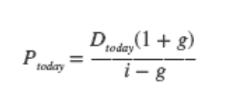
The Gordon Growth (or Dividend-Discount) Model (2 of 3)
This relationship is the dividend-discount model.
Using the concept of present value, together with the simplification that the firm’s dividends will grow at a constant rate g, we have discovered that
the “fundamental” price of a stock is simply the current dividend divided by the interest rate, minus the dividend growth rate.

Slide 18
The Gordon Growth (or Dividend-Discount) Model (3 of 3)
The model tells us that stock prices should be high when dividends (Dtoday) are high, when dividend growth (g) is rapid (that is, when g is large), or when the interest rate (i) is low.
The dividend-discount model is simple and elegant, but we have ignored risk in deriving it.
Stock prices change constantly, making investors’ returns uncertain. Where does this risk come from, and how does it affect a stock’s valuation? We turn now to an analysis of risk.

Slide 19
Why Stocks are Risky? (1 of 2)
Recall that stockholders are the firm’s owners, so they receive the firm’s profits.
But their profits come only after the firm has paid everyone else, including bondholders.
It is as if the stockholders bought the firm by putting up some of their own wealth and borrowing the rest.
This borrowing creates leverage, and leverage creates risk.

Slide 20
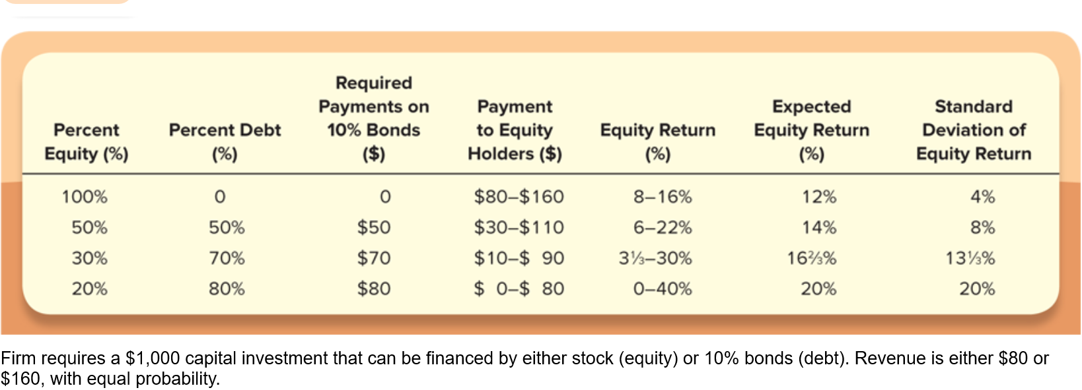
Why Stocks are Risky? (2 of 2)
Table 8.3 shows what happens to the company’s equity returns as its level of debt changes. The more debt, the more leverage and the greater the owners’ risk (as measured by the standard deviation of the equity return).

Slide 21
Risk and the Value of Stocks (1 of 7)
Stockholders require compensation for the risk they face; the higher the risk, the greater the compensation.
$$risk ↑ →return↑$$
To integrate risk into stock valuation, we will return to the simple question we asked earlier:
How will investors with a one-year investment horizon value a stock?

Slide 22
Risk and the Value of Stocks (2 of 7)
One answer is that the stock price equals the present value of the price of the stock in one year’s time plus the dividend payments received in the interim.
But once we recognize the risk involved in buying stock, the answer to this question changes.
The new answer is that an investor will buy a stock with the idea of obtaining a certain return, which includes compensation for the stock’s risk.

Slide 23
Risk and the Value of Stocks (3 of 7)
Here is how the process works:
Buying the stock for an initial price $P_{Today}$ entitles the investor to a dividend next year $D_{Next Year}$ plus the proceeds from the sale of the stock one year later, at $P_{Next Year}$.
The return from the purchase and subsequent sale of the stock equals the dividend plus the difference in the price, both divided by the initial price.

Slide 24
Risk and the Value of Stocks (4 of 7)
Because the ultimate future sale price is unknown, the stock is risky and the investor will require compensation in the form of a risk premium.
We will think of the required return as:
$expectd return= risk free interst rate+risk premimum$(sometimes called the equity risk premium).
We can approximate the risk-free rate as the interest rate on a U.S. Treasury security with a maturity of several months.

Slide 25
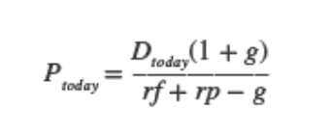
Risk and the Value of Stocks (6 of 7)
Combining this equation with our earlier analysis is straightforward.
All we need to do is recognize that the interest rate used for the present-value calculation in the dividend-discount model is the sum of the risk-free return and a risk premium.
Using this insight, we can rewrite equation as

Slide 26
Risk and the Value of Stocks (7 of 7)
we can see that:
The higher the risk premium investors demand to hold a stock, the lower its price.
$$rp↑−→P↓$$
Similarly, the higher the risk-free return, the lower the stock’s price.
$$rf↑−→P↓$$

Slide 27
How the Market Sets Stock Prices (1 of 2)
The price is set by the buyer willing to pay the highest price.
The market price will be set by the buyer who can take best advantage of the asset.
Superior information about an asset can increase its value by reducing its perceived risk.

Slide 28
How the Market Sets Stock Prices (2 of 2)
Information is important for individuals to value each asset.
When new information is released about a firm, expectations and prices change.
Market participants constantly receive information and revise their expectations, so stock prices change frequently.

Slide 29
Application: Monetary Policy and Stock Prices (1 of 2)
Monetary policy can affect stock prices in two ways.
First, when the Fed lowers interest rates, the return on bonds (an alternative asset to stocks) declines, and investors are likely to accept a lower required rate of return on an investment in equity.
The resulting decline in ke lowers the denominator in the Gordon growth model (Equation 5), leads to a higher value of $P_{o}$, and raises stock prices.

Slide 30
Application: Monetary Policy and Stock Prices (2 of 2)
Second, a lowering of interest rates is likely to stimulate the economy, so the growth rate in dividends, g, is likely to be somewhat higher.
This rise in g also causes the denominator in Equation 5 to decrease, which also leads to a higher $P_{o}$ and a rise in stock prices.

Slide 31
Application: The Global Financial Crisis and the Stock Market
The financial crisis that started in August 2007 led to one of the worst bear markets in 50 years.
Downward revision of growth prospects: ↓g
Increased uncertainty about the U.S. economy and the widening credit spreads caused by the subprime crisis also raised the required return on investment in equity: ↑k_{e}
Gordon model predicts a drop in stock prices.

Slide 32
Expectations and Asset Pricing
The analysis of stock price evaluation we outlined in the previous section depends on people’s expectations—especially expectations of cash flows.
It is difficult to think of any sector of the economy in which expectations are not crucial; this is why it is important to examine how expectations are formed.
We do so by outlining the theory of rational expectations, currently the most widely used theory to describe the formation of business and consumer expectations.

Slide 33
Adaptive Expectations (1 of 3)
Expectations are formed from past experience only.
Changes in expectations will occur slowly over time as data for the variable evolve:
For instance, if inflation had formerly been steady at a 5% rate, expectations of future inflation would be 5%, too.
If inflation rose to a steady rate of 10%, expectations of future inflation would rise toward 10%, but slowly: In the first year, expected inflation might rise only to 6%; in the second year, to 7%; and so on.

Slide 34
Adaptive Expectations (2 of 3)
However, the adaptive expectations hypothesis has been faulted on the grounds that people use more information than just past data on a single variable to form their expectations of that variable.
For instance, heir expectations of inflation will almost surely be affected by their predictions of future monetary policy, as well as by current and past monetary policy.
In addition, people often change their expectations quickly in the light of new information.

Slide 35
Adaptive Expectations (3 of 3)
To address these objections to the validity of adaptive expectations, John Muth developed an alternative theory of expectations, called rational expectations, which can be stated as follows:
Expectations will be identical to optimal forecasts (the best guess of the future) using all available information.

Slide 36
Rational Expectations (1 of 4)
The Gordon growth model shows that investors’ expectations of the future profitability of firms play a crucial role in determining stock prices
Today, most economists are critical of the adaptive expectations approach because it assumes that people ignore information that would be useful in making forecasts

Slide 37
Rational Expectations (2 of 4)
For example, in the late 1970s, the rate of inflation increased each year from 1976 through 1980. Anyone forecasting inflation by looking only at its past values would have expected inflation to be lower than it turned out to be. The rate of inflation declined each year from 1980 through 1983.
During this period, anyone forecasting inflation by looking only at its past values would have expected inflation to be higher than it actually was.
Taking into account additional information, such as Federal Reserve policy, movements in oil prices, or other factors that affect inflation rather than relying only on past values of inflation would have enabled someone to make a more accurate forecast.

Slide 38
Rational Expectations (3 of 4)
In 1961, John Muth of Carnegie Mellon University proposed a new approach he labeled rational expectations.
With rational expectations, people make forecasts using all available information
Muth argued that someone who did not use all available information would not be acting rationally.
That is, the person would not be doing his or her best to achieve the goal of an accurate forecast.

Slide 39
Rational Expectations (4 of 4)
For example, in forecasting the price of a firm’s stock, investors should use not just past prices of the stock but also any other information that is helpful in forecasting the future profitability of the firm.
Such information include the quality of the firm’s management, new products the firm might be developing, and so on.

Slide 40
Rational Expectations: Optimal Forecast
If sufficient number of investors and traders in the stock market have rational expectations, the market price of a stock should equal the best estimate (optimal forecast) of the present value of expected future dividends, which is the stock’s fundamental value.

Slide 41
Rational Expectations: Forecast Error (1 of 4)
Saying that investors have rational expectations is not the same as saying that they can foretell the future.
In other words, the optimal forecast is optimal, but it may be wrong.
To state this concept more exactly, suppose that at the end of trading today on the stock market, $P_{t+1}^{e}$is the optimal forecast of the price of Apple’s stock at the end of trading tomorrow, then it is very unlikely that we will see $P_{t+1}^{e}$= $P_{t+1}^{}$.

Slide 42
Rational Expectations: Forecast Error (2 of 4)
Why?
Because tomorrow, investors and traders are likely to obtain additional information about Apple—perhaps sales of the iPhones during the previous month are below what was forecast—that will change their view of the fundamental value of Apple’s stock.
So, there is likely to be a forecast error, which is the difference between the forecast price of Apple’s stock and the actual price of Apple’s stock.

Slide 43
Rational Expectations: Forecast Error (3 of 4)
But no one can accurately forecast the size of that error ahead of time because
the error is caused by new information that is not available when the forecast is made.
If the information had been available, rational expectations tell us that it would have been incorporated into the forecast of the stock price.
Therefore, the forecast error is unforecastable and follows random walk. To state the point more formally:

Slide 44
Rational Expectations: Forecast Error (4 of 4)
So, when a forecast is made, we can be fairly sure that the forecast will turn out to be lower or higher than the actual value of the variable being forecast.
But forecast errors follow random walk:
we have no way of telling how large the error will be or even whether it will be positive (that is, our forecast was too low) or negative (that is, our forecast was too high).

Slide 45
The Efficient Markets Hypothesis (1 of 4)
The application of rational expectations to financial markets is known as the efficient markets hypothesis
With respect to the stock market, the efficient markets hypothesis states that
when investors and traders use all available information in forming expectations of future dividend payments, the equilibrium price of a stock equals the market’s optimal forecast—the best forecast given available information—of the stock’s fundamental value.

Slide 46
The Efficient Markets Hypothesis (2 of 4)

Slide 47
The Efficient Markets Hypothesis (3 of 4)
At the beginning of the period, we know P_{t} and C.
P_{t+1} is unknown and we must form an expectation of it.
The expected return then is
Expectations of future prices are equal to optimal forecasts using all currently available information so
Supply and Demand analysis states R^{e} will equal the equilibrium return R*, so R^{of} = R*

Slide 48
The Efficient Markets Hypothesis (4 of 4)
$$R^{∗}=R^{of}$$
This equation tells us that the current prices in a financial market will be set so that the optimal forecast of a security’s return using all available information equals the security’s equilibrium return.
In an efficient market, a security’s price fully reflects all available information.

Slide 49
An Example of the Efficient Markets Hypothesis: Microsoft (1 of 2)
Suppose that it is 10:14 Monday morning, and the price of Microsoft stock is $32.10 per share, the company is currently paying an annual dividend of $0.90 per share, and its dividend is expected to grow at a rate of 7% per year.
At 10:15, Microsoft releases new sales information indicating that sales of its latest version of Windows have been much higher than expected, and the firm expects higher sales to continue into the future.

Slide 50
An Example of the Efficient Markets Hypothesis: Microsoft (2 of 2)
This news causes you and other investors to revise upward your forecast of the growth rate of Microsoft’s annual dividend from 7% to 8%.
At this higher growth rate and assuming an RoE of 10%, the present value of Microsoft’s future dividends rises from $32.10 to $48.60.
So, this new information causes you and other investors to buy shares of Microsoft.
This increased demand will cause the price of Microsoft’s shares to keep rising until they reach $48.60, which is the new fundamental value of the stock.

Slide 51
Financial Arbitrage (1 of 5)
Does the efficient markets hypothesis require that all investors and traders have rational expectations?
Actually, it does not- due to arbitrage.
The process of buying and reselling securities to profit from price changes over a brief period of time is called financial arbitrage.
The profits made from financial arbitrage are called arbitrage profits.

Slide 52
Financial Arbitrage (2 of 5)
Investors who have rational expectations can profit by buying or selling a stock when its market price is higher or lower than the optimal forecast of the stock’s fundamental value.
In this way, self-interested actions of even a few informed traders cause available information to be incorporated into market prices.

Slide 53
Financial Arbitrage (3 of 5)
In competing to buy securities where earning arbitrage profits is possible, traders will force prices to the level where investors can no longer earn arbitrage profits.
As long as there are some traders with rational expectations, the arbitrage profits provided by new information will give these traders the incentive to push stock prices to their fundamental values.

Slide 54
Financial Arbitrage (4 of 5)
For instance, in the example just discussed, once the new information on Microsoft becomes available, traders can earn arbitrage profits equal to $16.50 per share.
Arbitrage profit is the difference between the old fundamental value and the new fundamental value.
Competition among even a few well-informed traders will be enough to quickly drive the price up to its new fundamental value.

Slide 55
Financial Arbitrage (5 of 5)
In an efficient Market, all the unexploited profit opportunities will be eliminated.
New Information Become Available:
Scenario 1)
$$P^{∗}>P^{of}→Arbitrage Profit>0 →Investors Sell the Stocks→ P^{∗}↓ →P^{∗}=P^{of}$$
Scenario 2)
$$P^{∗}<P^{of}→Arbitrage Profit<0→Investors Buy the Stocks→ P^{∗}↑ →P^{∗}=P^{of}$$

Slide 56
Stock Prices Are Very Volatile (1 of 2)
Although the efficient markets hypothesis indicates that the price of a share of stock is based on all available information, our Microsoft example shows that the prices of stocks will change day-to-day, hour-to-hour, and minute-to-minute.
Stock prices constantly change as news that affects fundamental values becomes available.
Note that anything that affects the willingness of investors to hold a stock or another financial asset affects the stock’s fundamental value.

Slide 57
Stock Prices Are Very Volatile (2 of 2)
Therefore, we would expect that if new information leads investors to change their opinions about the risk, liquidity, information costs, or tax treatment of the returns from owning a stock, the price of the stock will change because the desired level of RoE will change.

Slide 58
Are Stock Prices Predictable? (1 of 4)
Key implication of the efficient markets hypothesis is that stock prices are not predictable.
To see why, suppose that it is 4:00 p.m., stock trading has closed for the day, Apple stock has closed at a price of $95, and you are trying to forecast the price of Apple’s stock at the close of trading tomorrow.
What is your optimal forecast?
The efficient markets hypothesis indicates that it is $95.

Slide 59
Are Stock Prices Predictable? (2 of 4)
In other words, the best forecast of the price of a stock tomorrow is its price today. Why?
Because the price today reflects all relevant information that is currently available.
While the price of Apple’s stock is unlikely to actually be $95 at the close of trading tomorrow, you have no information today that will allow you to forecast whether it will be higher or lower.

Slide 60
Are Stock Prices Predictable? (3 of 4)
Rather than being predictable, stock prices follow a random walk, which means that
on any given day, they are as likely to rise as to fall.

Slide 61
Are Stock Prices Predictable? (4 of 4)
We can certainly observe stocks that rise for a number of days in a row, but this does not contradict the idea that stock prices follow a random walk.
Even though when we flip a coin it is equally likely to come up heads or tails, we may still flip a number of heads or tails in a row.

