Slide 1
Unit 3
Review of Feasible Sets and Indifference Curves

Slide 2
OUTLINE
Introduction
Production Function
Preferences
Opportunity Cost
Feasible Set
Constrained Choice Problem

Slide 3
A. Introduction

Slide 4
Introduction (1 of 2)
The models that we study here helps us to make decision under scarcity.
Decision making under scarcity is a common problem because we usually have limited means available to meet our objectives.
Economists model these situations by taking two factors into account:
What are the feasible actions? Economists use production function and feasible frontier curve to define feasible sets (or actions).
What are the preferences, or the objectives, of the individuals? Economists use indifference curves to evaluate which of these actions is best, given the objectives (i.e. preferences, utilities).

Slide 5
Introduction (2 of 2)
Opportunity costs describe the unavoidable trade-offs in the presence of scarcity: satisfying one objective more means satisfying other objectives less.
A model of decision making under scarcity can be applied to the question of how much time to spend working, when facing a trade-off between more free time and more income.

Slide 6
B. Production Function

Slide 7
Example: Grades and Study Hours
Source: Plant et al (Contemporary Educational Psychology, 2005).
Students choose how many hours to study, which affects their grade (GPA).
We assume a positive relationship between GPA and the number of hours studied (evidence that this is true, ceteris paribus).

Slide 8
Production Function (1 of 2)
Production function show how inputs (e.g. labor) translate into outputs (e.g. goods and services), holding other factors constant (e.g. production environment)
In other words, the production function is a graphical and/or mathematical representation of the amount of output that can be produced by a given amount of input.
It is the first step toward calculating feasible frontier curve that demonstrates all the feasible actions.

Slide 9
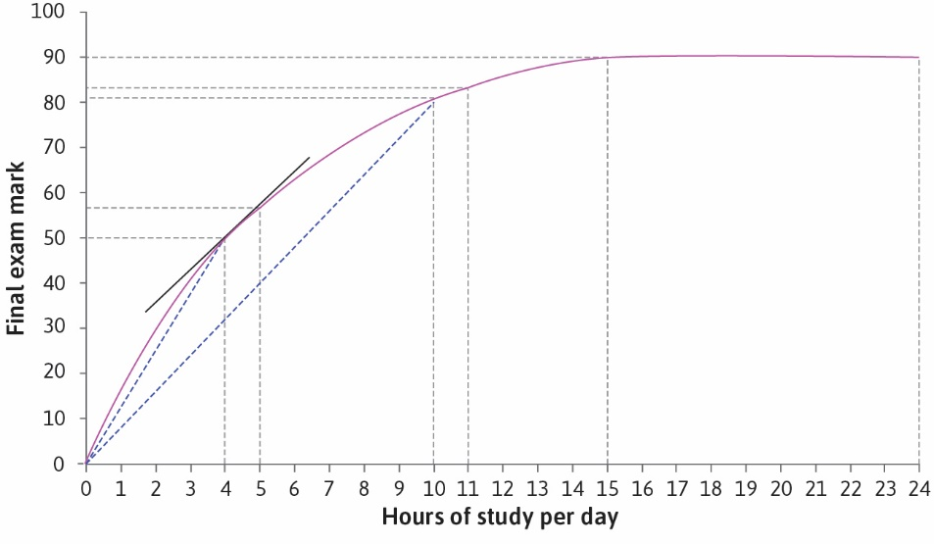
Production Function (2 of 2)
This relationship between study time and final grade is represented in this table:

Slide 10
What Can Production Functions Tell Us? (1 of 2)
Slope = Marginal product (4 hours of study)
Slope = Average product
(4 hours of study)

Slide 11
What Can Production Functions Tell Us? (2 of 2)
Marginal product
The additional amount of output that is produced if a particular input was increased by one unit, while holding all other inputs constant.
More precisely, it is the rate at which output increases as input increases, which corresponds to the slope of the production function.
2. Average product
Total output divided by a particular input= ${Total Output}/{Particular Input}$
For example per worker (divided by the number of workers) or per worker per hour (total output divided by the total number of hours of labor put in).

Slide 12
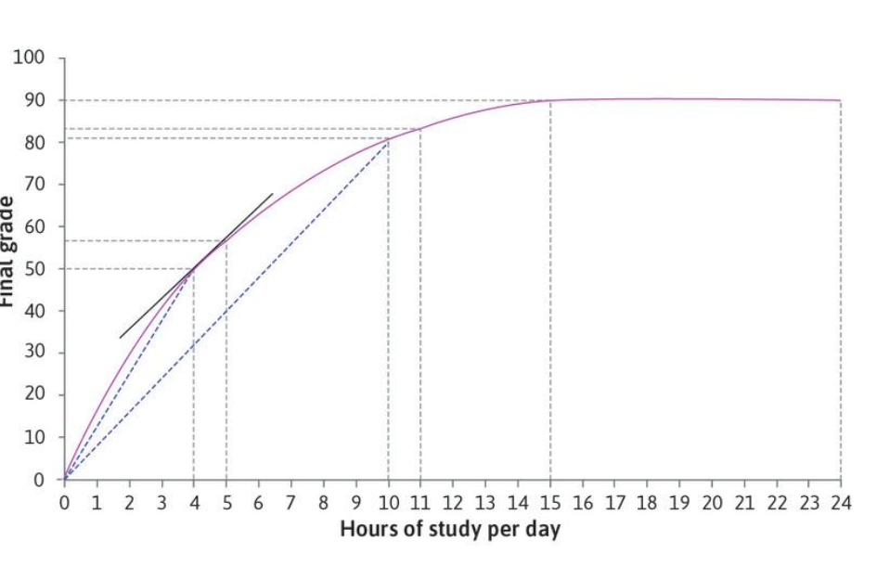
Recap: Slope (1 of 2)

Slide 13
Recap: Slope (2 of 2)

Slide 14
Diminishing Marginal Product
In production function, output increases as the input increases, but the marginal product falls—the function becomes gradually flatter.
A production function with this shape is described as concave.
This means that the marginal product is diminishing.
Diminishing returns: A situation in which the use of an additional unit of a factor of production results in a smaller increase in output than the previous increase.

Slide 15
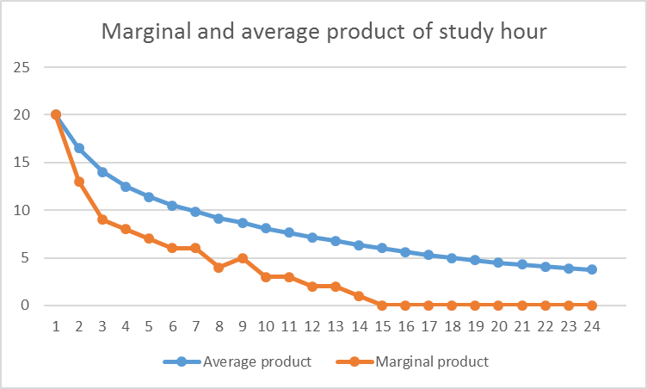
Studying Example
Diminishing marginal product: Studying becomes less productive, the more you study.

Slide 16
C. Preferences

Slide 17
Indifference Curves (1 of 4)
If Alexei has the production function, how many hours per day will he choose to study?
The decision depends on his preferences (objectives)—the things that he cares about.
Preferences is a description of the benefit or cost we associate with each possible outcome.

Slide 18
Indifference Curves (2 of 4)
Choices depend on preferences.
We illustrate objective function, or preferences, using Indifference Curves, with one preferred good (such as free time) on horizontal axis and the other preferred good (such as grade) on vertical axis.
Indifference curves show all combinations of goods that give the same utility (satisfaction). It also shows a trade-off:
how many percentage points is he willing to give up in order to spend time on things other than study?

Slide 19
Indifference Curves (3 of 4)
Importantly, given the production function, not every combination in the indifference curve will be possible, but for the moment we will only consider the combinations that we would prefer (regardless of whether it is possible or not).
Assumptions:
For a given grade, he prefers a combination with more free time to one with less free time.
Similarly, if two combinations both have 20 hours of free time, he prefers the one with a higher grade.
But compare points A and D in the table. Would Alexei prefer D (low grade, plenty of time) or A (higher grade, less time)? One way to find out would be to ask him.
However, we assume he is indifferent between A and D, meaning he would feel equally satisfied with either outcome. This means that these two outcomes would give Alexei the same utility.

Slide 20
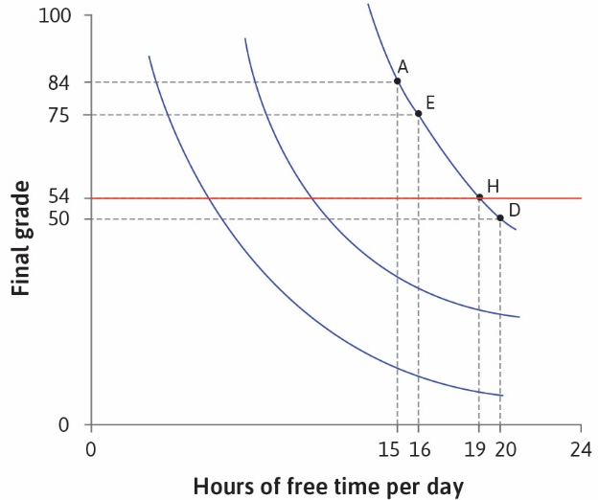
Indifference Curves (4 of 4)
Higher indifference curves correspond to higher utility levels;
Indifference curves slope downward due to trade-offs;
Indifference curves are usually smooth;
Indifference curves do not cross;
As you move to the right along an indifference curve, it becomes flatter.

Slide 21
Marginal Rate of Substitution (1 of 3)
The marginal rate of substitution is
The trade-off that a person is willing to make between two goods.
At any point, it is the slope of the indifference curve, and
It falls as we move to the right along the curve.
It also implies that the indifference curves become gradually flatter.

Slide 22
Marginal Rate of Substitution (2 of 3)
We have drawn the indifference curves as becoming gradually flatter because it seems reasonable to assume that
the more free time and the lower the grade he has ➔
the less willing he will be to sacrifice further percentage points in return for free time ➔
so his MRS will be lower.

Slide 23
Marginal Rate of Substitution (3 of 3)
If he is at A, with 15 hours of free time and a grade of 84, he would be willing to sacrifice 9 percentage points for an extra hour of free time, taking him to E (remember that he is indifferent between A and E).
We say that his marginal rate of substitution (MRS) between grade points and free time at A is nine; it is the reduction in his grade that would keep Alexei’s utility constant following a one-hour increase of free time.

Slide 24
D. Opportunity Cost

Slide 25
Opportunity Cost
Choices are limited by constraints and involve tradeoffs (Studying example: higher grades vs. more free time)
The opportunity cost of an action is the net benefit of the next best alternative action
Compare actions based on economic cost
Economic cost = monetary costs e.g. transport
+ subjective costs e.g. effort of work

Slide 26
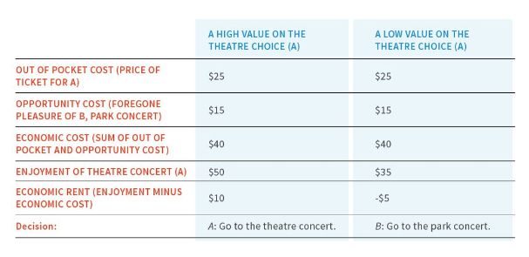
Opportunity Cost: Example
If the benefit from an action exceeds the economic costs, you receive an economic rent from choosing it.

Slide 27
E. Feasible Sets

Slide 28
The Feasible Frontier (1 of 6)
Now we return to Alexei’s problem of how to choose between grades and free time.
To answer this question, we look again at the production function. This time we will show how the final grade depends on the amount of free time, rather than study time.
Feasible frontier curve, shows the relationship between his final grade and hours of free time per day—it is the mirror image of production function.
It is the curve made of points that defines the maximum feasible quantity of one good for a given quantity of the other.

Slide 29
The Feasible Frontier (2 of 6)
Feasible frontier:
Shows the combinations of grade and free time are feasible, and which are not,
The axes are final grade and free time, the two goods that give Alexei utility.
The slope represents the opportunity cost of free time.
It represents the trade-off he must make between grade and free time.
It is a constraint on Alexei’s choices.

Slide 30
The Feasible Frontier (3 of 6)
At any point on the frontier, taking more free time has an opportunity cost in terms of grade points foregone, corresponding to the slope of the frontier.
Another way to express the same idea is to say that the feasible frontier shows the Marginal rate of transformation (MRT):
is the quantity of some good that must be sacrificed to acquire one additional unit of another good.
It is the slope of the feasible frontier, and represents the tradeoffs that an individual faces .

Slide 31
The Feasible Frontier (4 of 6)
By choosing a combination inside the frontier, Alexei would be giving up something that is freely available;
Something that has no opportunity cost.
He could obtain a higher grade without sacrificing any free time, or have more time without reducing his grade.

Slide 32
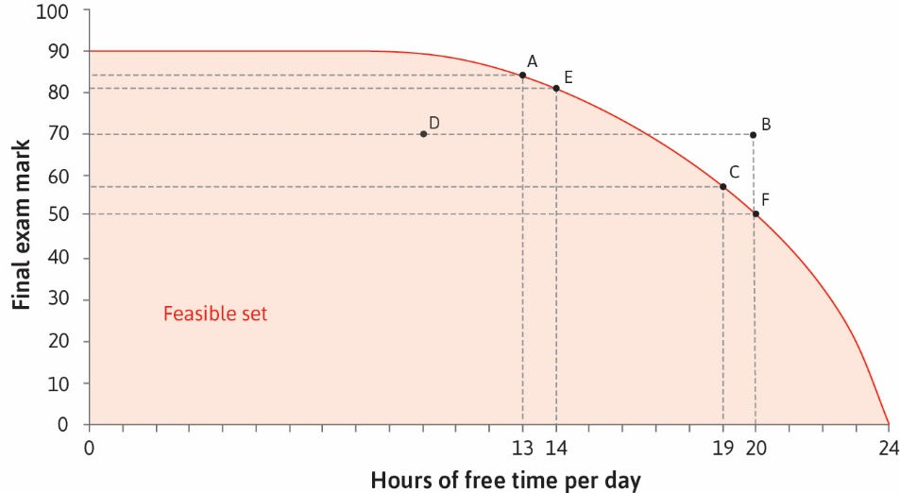
The Feasible Frontier (5 of 6)

Slide 33
The Feasible Frontier (6 of 6)
Note that we have now identified two trade-offs:
The marginal rate of substitution (MRS): In the previous section, we saw that it measures the trade-off that Alexei is willing to make between final grade and free time.
The marginal rate of transformation (MRT): In contrast, this measures the trade-off that Alexei is constrained to make by the feasible frontier.
The choice Alexei makes between his grade and his free time will strike a balance between these two trade-offs.

Slide 34
F. Constrained Choice Problem

Slide 35
Constrained Choice Problem (1 of 5)
The final step in this decision-making process is to determine the combination of final grade and free time that Alexei will choose.
Constrained choice problem:
Model of how individuals choose, given their preferences and the constraints they face, when the things they value are scarce.
Studying example: Free time and exam score are scarce because they are both goods, each with an opportunity cost.
Figure 3.10a brings together his feasible frontier and indifference curves.

Slide 36
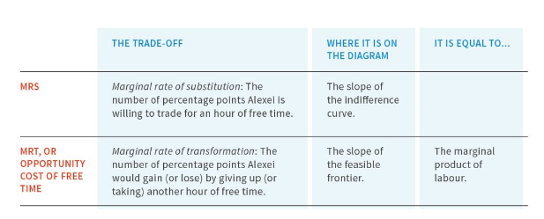
Constrained Choice Problem (2 of 5)
Recall that:
the indifference curves indicate what Alexei prefers, and their slopes shows the trade-offs that he is willing to make;
the feasible frontier is the constraint on his choice, and its slope shows the trade-off he is constrained to make.

Slide 37
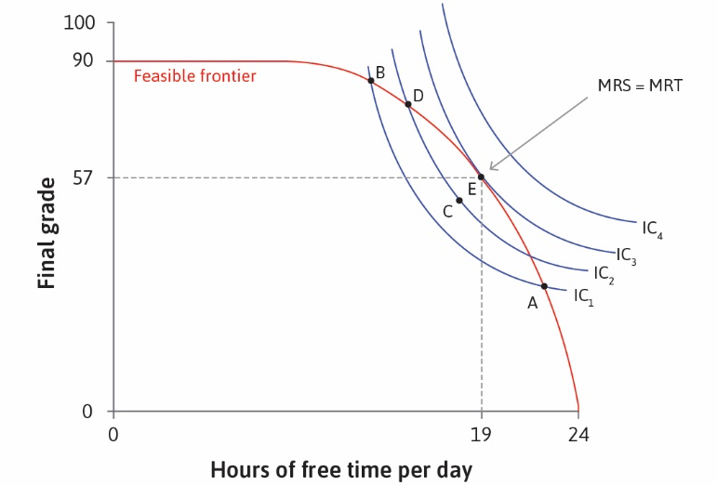
Optimal Decision Making (3 of 5)

Slide 38
Constrained Choice Problem (4 of 5)
We can see from Figure 3.10a that at E, the feasible frontier and the highest attainable indifference curve IC₃ are tangent to each other (they touch but do not cross).
At E, the slope of the indifference curve is the same as the slope of the feasible frontier.
Now, remember that the slopes represent the two trade-offs facing Alexei:
The slope of the indifference curve is the MRS: It is the trade-off he is willing to make between free time and percentage points.
The slope of the frontier is the MRT: It is the trade-off that he is constrained to make between free time and percentage points because it is not possible to go beyond the feasible frontier.

Slide 39
Constrained Choice Problem (5 of 5)
Alexei achieves the highest possible utility where the two trade-offs just balance (E).
The utility-maximising choice- or optimal combination of grade and free time- is where the amount of one good the individual is willing to trade off for the other good (MRS) equals the actual tradeoff between the two goods (MRT)
MRS = MRT

