Slide 1
Unit 17
(An Overview)
THE GREAT DEPRESSION, GOLDEN AGE AND GLOBAL FINANCIAL CRISIS

Slide 2
OUTLINE
Introduction
Economic epochs
The Great Depression
The Golden Age
Stagflation and the financial crisis
Lessons learned

Slide 3
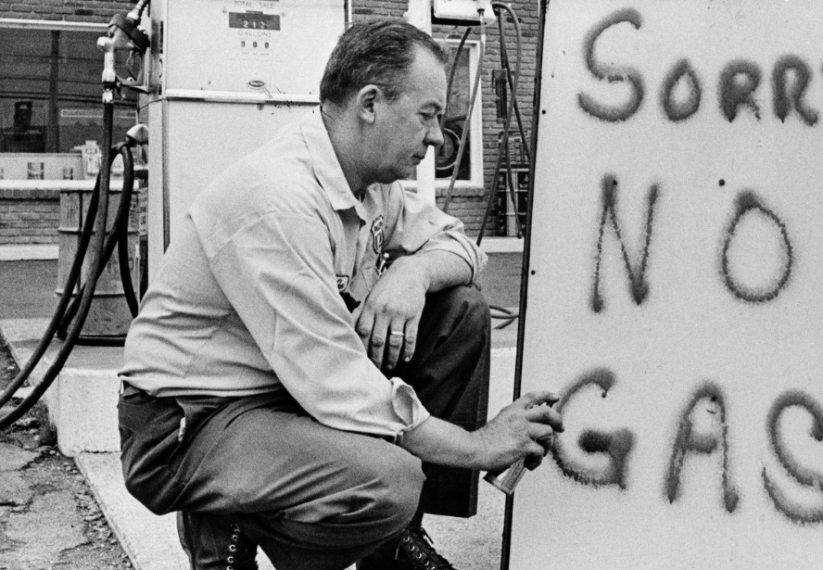

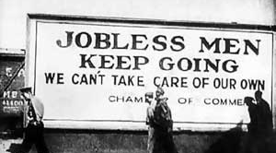
Three Stories: One Big Picture

Slide 4
The great moderation and subsequent
financial crisis of 2008
The roaring twenties and the Great Depression
The golden age of capitalism and stagflation
1921-1941
1948-73 ; 1973- 79
1979-2008 ; 2008-19
2019
How it Ended:
The decline in profits and investment in the late 1960s and early 1970s culminating in the oil shock of 1973,
How it Ended:
And the financial crisis of 2008, respectively
How it Ended:
The stock market crash of 1929,
Today
2019
Epoch 1
Epoch 2
Epoch 3
Institutional Responses and Consequences:
The new institutions marking the golden age of capitalism—increased trade union strength and government spending on social insurance—addressed the aggregate demand problems highlighted by the Great Depression and were associated with rapid productivity growth, investment, and falling inequality.
Institutional Responses and Consequences:
The golden age ended with a crisis of profitability, investment, and productivity, followed by stagflation.
Institutional Responses and Consequences:
The policies adopted in response to the end of the golden age restored high profits and low inflation at the cost of rising inequality, but did not restore the investment and productivity growth of the previous epoch, and made economies vulnerable to debt-fuelled financial booms. One of these booms precipitated a global financial crisis in 2008.
1 day
1 day
1 day

Slide 5
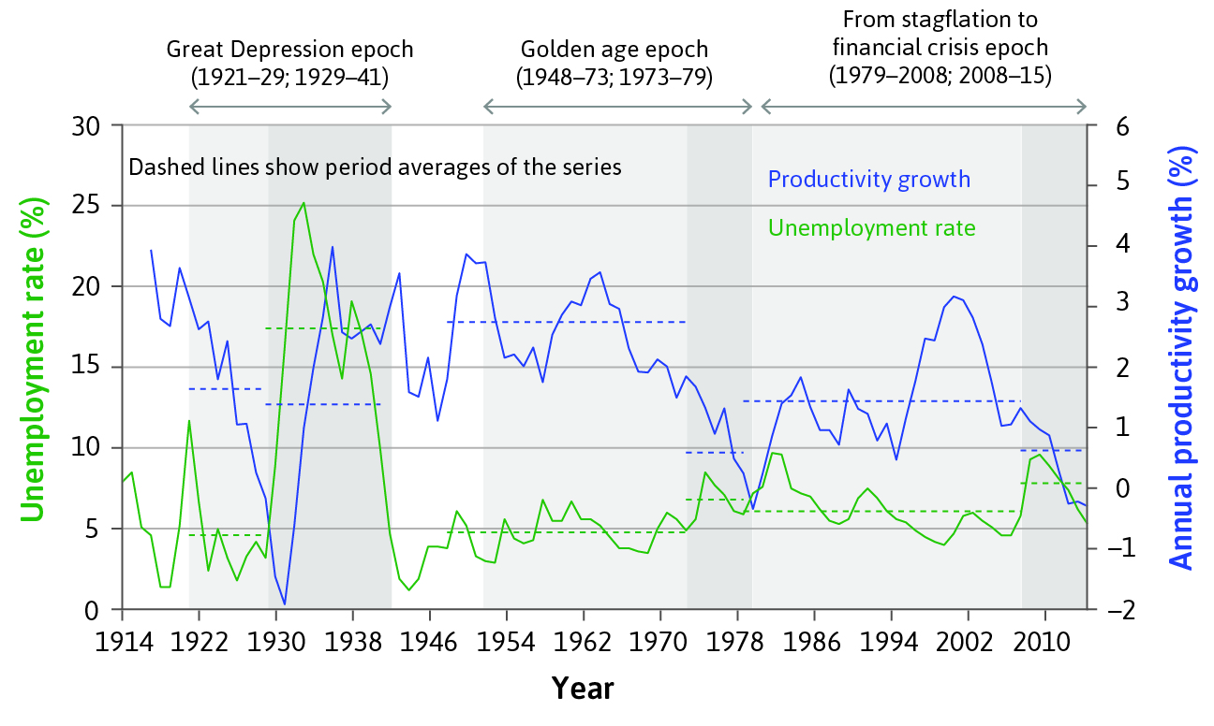
The three economic epochs

Slide 6
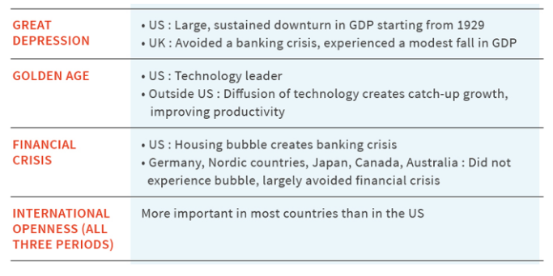
International comparisons
The three epochs of modern capitalism were worldwide phenomena, but some countries experienced them differently compared to the US

Slide 7
What Caused the End of the Most Recent Epoch?
Small Causes With Big Consequence
2007-08 Global Financial Crisis
This began in 2007 with the collapse of house prices in the US,
  leading to the fall in prices of assets based on subprime mortgages and to
  widespread uncertainty about the solvency of banks in the US and Europe, which had borrowed to purchase such assets.
Importantly, subprime mortgages constituted only a small fraction of global financial assets.
The ramifications, nonetheless, were felt around the world, as global trade was cut back sharply.
  Governments and central banks responded aggressively with stabilization policies.

Slide 8
Self-correcting Mechanism and Government Intervention
Although recessions are characteristic of capitalist economies, as we have seen, they rarely turn into episodes of persistent contraction.
This is because of a combination of the economy’s self-correcting properties and successful intervention by policymakers. Specifically:
  Households take preventative measures that dampen rather than amplify shocks (Unit 13).
  Governments create automatic stabilizers (Unit 14).
  Governments and central banks take actions to produce negative rather than positive feedbacks when shocks occur (Units 14 and 15).

Slide 9
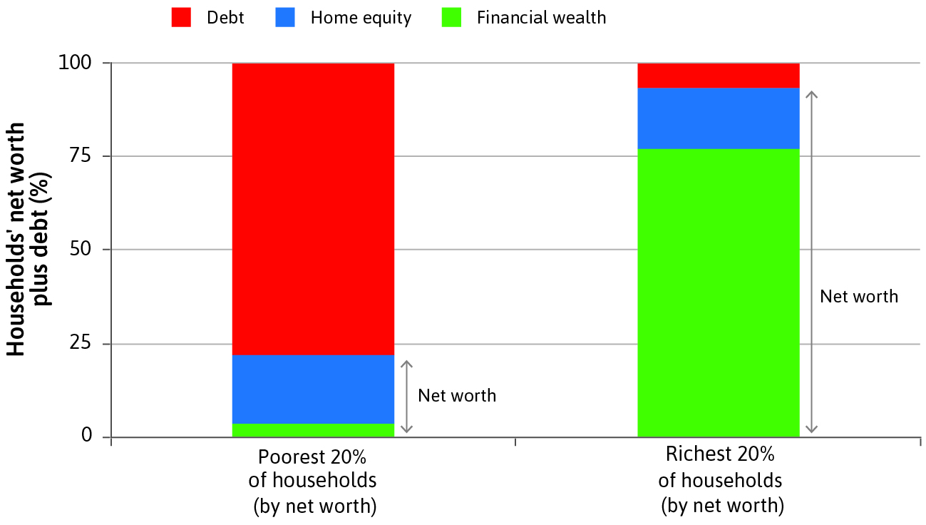
Subprime borrowers
Poor households are normally only able to borrow when they have housing collateral. When house prices are expected to rise, the riskiness of home loans falls. Lenders ask for lower deposits, or even no deposit at all.

Slide 10
How did a small problem in the US housing market send the global economy to the brink of a catastrophe? (1 of 5)
The dry undergrowth:
In Unit 18, you will see that there was rapid growth in the globalization of international capital markets, measured by the amount of foreign assets owned by domestic residents.
At the same time, the globalization of banking was occurring.
Some of the unregulated expansion of lending by global banks ended up financing mortgage loans to so-called subprime borrowers in the US.
Subprime Borrower An individual with a low credit rating and a high risk of default.

Slide 11
How did a small problem in the US housing market send the global economy to the brink of a catastrophe? (2 of 5)
The spark:
Falling real estate prices meant that banks with very high leverage, and therefore with thin cushions of net worth (equity), in the US, France, Germany, the UK and elsewhere quickly became insolvent.
Insolvent: Individuals or businesses are insolvent when they cannot meet financial obligations in a timely way. In other words, the value of their assets is lower than their liabilities (debts).
Leverage: can also refer to the amount of debt (borrowed money) a firm uses to finance assets.
Default: is the failure to repay a debt including interest or principal on a loan or security in timely manner.
Real estate prices fall
Banks with high leverage, and thus thin equity, become insolvent
And could not pay out their debt.

Slide 12
How did a small problem in the US housing market send the global economy to the brink of a catastrophe? (3 of 5)
The positive feedback mechanism:
Fear was transmitted around the world and customers cancelled orders.
Aggregate demand fell sharply.
The high degree of interconnection among global banks and the possibility of massive transactions in a matter of seconds made excessive leverage an increasingly dangerous source of instability.
A positive feedback (process) A process whereby some initial change sets in motion a process that magnifies the initial change.

Slide 13
How did a small problem in the US housing market send the global economy to the brink of a catastrophe? (4 of 5)
The complacent policymakers:
With few exceptions, most policymakers and the economists whose advice they sought still believed that the financial sector was able to regulate itself.
The international central bank for central banks—the Bank for International Settlements in Basel—allowed banks great scope to choose their level of leverage.
Banks could use their own models to calculate the riskiness of their assets.

Slide 14
How did a small problem in the US housing market send the global economy to the brink of a catastrophe? (5 of 5)
They could meet the international regulatory standards for leverage by understating the riskiness of their assets, and by parking these risky assets in what are called shadow banks, which they owned but which were outside the scope of banking regulations.
All of this was entirely legal. Many economists continued to believe that economic instability was a thing of the past, right up to the onset of the crisis itself.

Slide 15
Great Depression: Causes
The Great Depression = The period during the 1930s in which there was a sharp fall in output and employment in many countries.
Caused by 3 simultaneous positive feedback mechanisms in the US:
Pessimism about the future – households reacted to the 1929 stock market crash by saving more, further decreasing consumption
Banking system failure – many banks failed because loans could not be repaid; surviving banks raised interest rates
Deflation – Prices fell due to falling demand

Slide 16
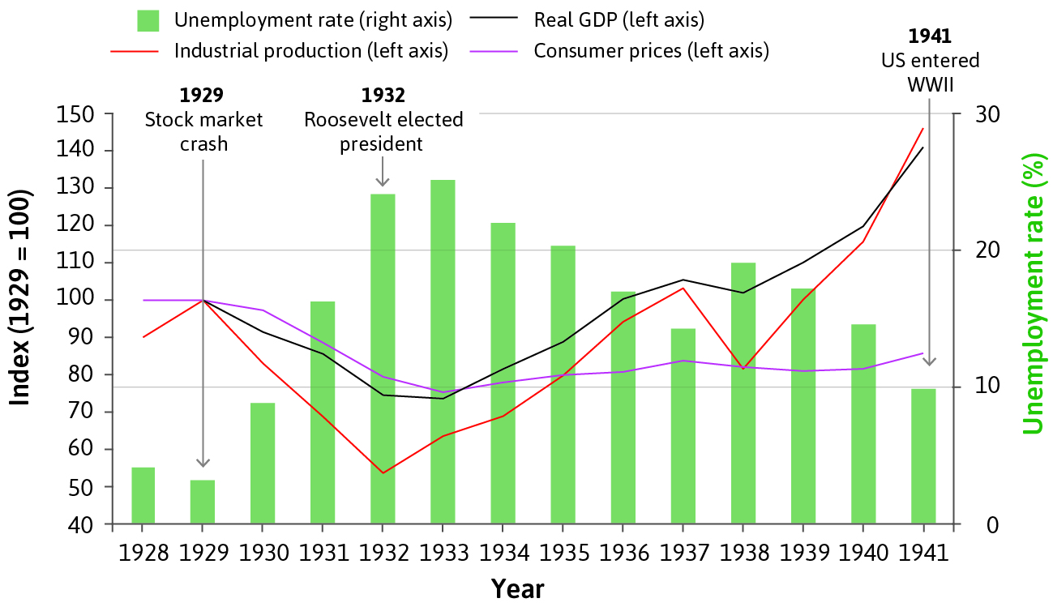
The Great Depression

Slide 17
The problem of deflation (1 of 2)
Deflation affects aggregate demand through several routes:
Increases the real value of debt; this particularly problematic when debt levels were relatively high.
Many debtors become insolvent, which also hurt creditors.
Farmers reacted by producing more to maintain their income, but this reduced prices further.
Households also postponed the purchase of durables, which further reduced aggregate demand.

Slide 18
The problem of deflation (2 of 2)
Deflation affects aggregate demand through several routes:
Household and Businesses Balance Sheet | Route 1 (Debt) | Real value of debt increases. | Financing debt becomes more burdensome Liquidity issue
 | Route 1 (Solvency) | Debtors become insolvent (i.e. liabilities>assets) Solvency issue | It also hurts creditors. It also reduces the creditors willingness/ability to lend.
Businesses Balance Sheet | Route 3 (Income) | Firms produce more to compensate for loss of income. | This reduce prices even further which in turn reduces the price of the assets.
Household Balance Sheet | Route 4 (Consumption) | Consumers keep postponing the purchase of durable goods ( both financial and nonfinancial that can be used as an asset) | This further reduces aggregate demand (i.e. higher unemployment and lower output)
Worsening of liquidity shortage
Worsening of solvency problem
The vicious cycles creates recession.

Slide 19
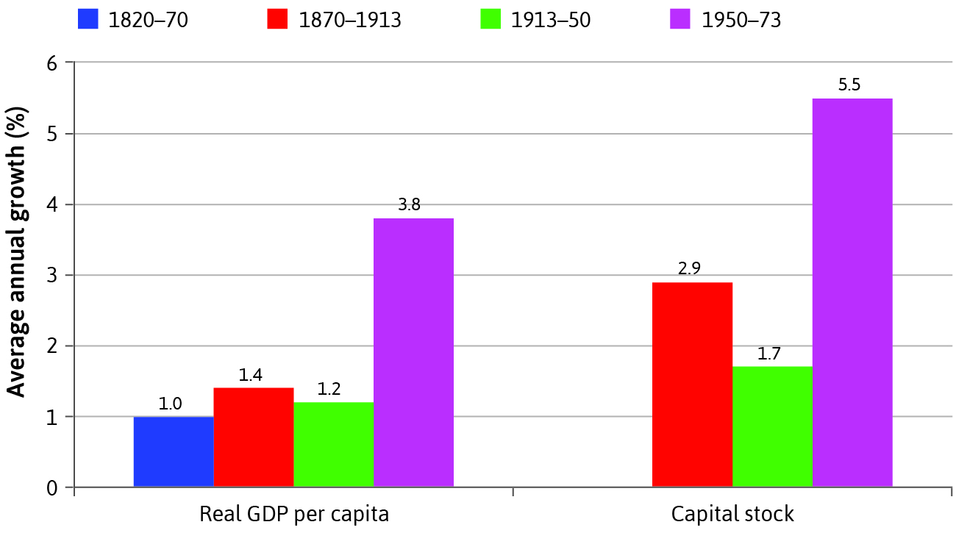
The Golden Age
Golden Age (from the end of the Second World War to the early 1970s) is the period of
High productivity growth,
High employment, and
Stable inflation
Living standards were doubling every 20 years.

Slide 20
Causes
Changes in economic policymaking and regulation
  governments provided reassurance that policy would be used to support aggregate demand if necessary
  The size of governments increased continuously
  Bretton Woods System as a more flexible alternative to Gold Standard
The postwar accord between employers and workers
  Sharing the gains of technological progress provided incentives for firms to innovate

Slide 21
Lessons learned from the last century

Slide 22
Summary
Great depression = demand-side crisis
Golden age = supply-side crisis
Financial crisis = banking crisis
Economists have learned from the successes and the failures of the three epochs.
Successful policies in each epoch did not prevent positive feedback processes that contributed to subsequent crises
No school of thought has policy advice that would have been good in every epoch

