Slide 1
Unit 13
ECONOMIC FLUCTUATIONS AND UNEMPLOYMENT

Slide 2
OUTLINE
Introduction
The business cycle
Measuring the aggregate economy
Economic fluctuations and consumption
Economic fluctuations and investment
Inflation

Slide 3
A. Introduction

Slide 4
The Context for This Unit
Previously looked at how individuals make decisions about saving and consumption.
These decisions also depend on economic conditions (prices, unemployment), and affect firms’ decisions (investment).
How do households and firms respond to economic conditions?
What indicators can we use to measure economic conditions?
(Unit 10)

Slide 5
Key Points
Fluctuations in the total output of a nation (GDP) affect unemployment.
Economists measure the size of the economy using the national accounts: these measure economic fluctuations and growth.
Households respond to shocks by saving, borrowing, and sharing to smooth their consumption of goods and services.
Due to limits on people’s ability to borrow, these strategies are not sufficient to eliminate shocks to their consumption.
Investment spending by firms (on capital goods) and households (on new housing) fluctuates more than consumption.

Slide 6
This Unit
Measuring the size of an economy: GDP
How households smooth fluctuations in their income
The role of firms’ investment decisions in the business cycle
Understanding inflation

Slide 7
B. The business cycle

Slide 8
Growth and Fluctuations
Figure 13.2 UK GDP per capita (1875–2014).
Annual growth rate after 1921
In the right-hand panel, the slope of the line (the dashed black line) represents the average annual growth rate from 1921 to 2014. It was 2.0% per annum.
We can see that growth was steady.

Slide 9
Growth and Fluctuations
Figure 13.2 UK GDP per capita (1875–2014).
Annual growth rate 1875 to 1914
A line drawn through the log series from 1875 to 1914 is flatter than the line from 1921.
The average growth rate in that period was only 0.9% per annum.

Slide 10
Natural Log versus Level
By looking at the graph in levels of GDP per capita in the left-hand panel of Figure 13.2, it is hard to tell whether the economy was growing at a steady pace, accelerating, or decelerating over time.
Transforming the data into natural logs in the right-hand panel allows us to answer the question about the pace of growth more easily.
For a graph in which the vertical axis represents the log of GDP per capita, the slope of the line (the dashed black line) represents the average annual growth rate of the series.

Slide 11
Long- Run Growth versus Fluctuations
Long-run growth is shown as average annual growth rates. Fluctuations represents short-run deviations from it.
Figure 13.2 shows the output growth in the long-run. (Units 16 and 17).
In this unit we focus on fluctuations. These are the deviations from the long-run growth.
In Figure 13.2, it is the deviations from the dotted black line showing the long-run growth rate.
Figure 13.3 shows the deviations from long-run growth- or short term fluctuations.

Slide 12
The Business Cycle
Economic growth is not a smooth process.
Business cycle = The movement from boom, to recession, and back to boom is known as the business cycle. The economy goes from boom to recession and back to boom. See also: short-run equilibrium.
Business cycle Alternating periods of faster and slower (or even negative) growth rates
Recession = period when output is declining or below its potential level
The business cycle affects labour market outcomes.

Slide 13
The Business Cycle
Short run fluctuations are called business cycles.
Since we want to focus on the size of the economy and how it changes from year to year, we will examine total GDP rather than GDP per capita.
Note: When studying short-run fluctuations, we use total GDP rather than GDP per capita. On the other hand, for studying long-run growth, the best measure is log of GDP per capia that measures the growth rate.
Gross Domestic Product (GDP) is a measure of the market value of the output of the economy in a given period

Slide 14
The Business Cycle
Figure 13.3 UK GDP growth and unemployment rate (1875–2014).
UK GDP growth and unemployment
The panels show UK GDP growth and the unemployment rate for the period 1875–2014.

Slide 15
The Business Cycle
Figure 13.3 UK GDP growth and unemployment rate (1875–2014).
Peaks and troughs
The arrows highlight the peak and trough of a business cycle during the late 1980s and early 1990s.

Slide 16
The Business Cycle
Figure 13.3 UK GDP growth and unemployment rate (1875–2014).
The global financial crisis
In the twenty-first century, the 2008 financial crisis followed a period in which fluctuations were limited.

Slide 17
The Business Cycle
Figure 13.3 UK GDP growth and unemployment rate (1875–2014).
Downturns and unemployment
We can see that downturns in the business cycle are associated with rising unemployment. In the business cycle of the early 1990s, unemploy­ment continued to rise for a time after the growth rate began to rise.

Slide 18
Okun’s Law
High Output Growth
Low Unemployment
The relationship between output and unemployment fluctuations is known as Okun’s law:
It is based on an observation that when a country’s output growth was high, unemployment tended to decrease.
Changes in the rate of GDP growth are negatively correlated with the unemployment rate.

Slide 19
Okun’s law for selected economies.
Okun’s coefficient = Degree of correlation

Slide 20
The Relationship Between Output Growth and Unemployment

Slide 21
C. Measuring The Aggregate Economy

Slide 22
Measuring The Aggregate Economy
Aggregate Output (GDP):
The total output in an economy, across all sectors and regions.
The national accounts is the system used for measuring overall output and expenditure in a country.
They are the statistics published by national statistical offices that use information about individual behaviour to construct a quantitative picture of the economy as a whole.

Slide 23
Measuring The Aggregate Economy
National accounts = system used to measure overall output and expenditure in a country.
There are three different ways to estimate GDP:
Total spending on domestic products: The total spent by households, firms, the government, and residents of other countries on the home economy’s products.
Total domestic production (measured as value added): The total produced by the industries that operate in the home economy.
Total domestic income: The sum of all the incomes received, comprising wages, profits, the incomes of the self-employed, and taxes received by the government.

Slide 24
Production
Production is measured by the value added by each industry: this means that the cost of goods and services used as inputs to production is subtracted from the value of output (to prevent double-counting).

Slide 25
Circular Flow Model Shows this Equivalence

Slide 26
Exports, imports, and government
How do we account for international transactions?
Foreign production is domestic consumption (imports); and domestic production is foreign consumption (exports)
→ We include exports and exclude imports, so that GDP includes value added, income from, or consumption of, domestic production.
How do we incorporate government?
→ Treat it as another producer – public services are “bought” via taxes
→ Assume that cost of production captures the value added

Slide 27
Expenditure Is a Key to Understanding Recessions
The fact that expenditure, output (production), and incomes are all equal means that we can use any one of these perspectives to help us understand the others.
We described recessions as periods of negative output growth.
This means they must also be periods of negative expenditure growth (output will only decline if people are buying less).

Slide 28
Components of GDP
Expenditure Approach

Slide 29
Expenditure Is a Key to Understanding Recessions
Often, we can even say that output declines because people are buying less.
This is very useful because we know a lot about what determines expenditure, which in turn helps us to understand recessions.

Slide 30
Consumption
Consumption includes the goods and services purchased by households.
Goods are normally tangible things.
Goods like cars, household appliances, and furniture that last for three years or more are called durable goods;
those that last for shorter periods are non-durable goods.
Services are things that households buy that are normally intangible, such as transportation, housing (payment of rent), gym membership, and medical treatment.

Slide 31
Consumption
Household spending on durable goods like cars and household equipment is counted in consumption in the national accounts.
However, in economic terms the decision to buy these long-lasting items is more like an investment decision.

Slide 32
Investment
This is the spending by firms on new equipment and new commercial buildings; and spending on residential structures (the construction of new housing).
Investment in the unsold output that firms produce is the other part of investment that is recorded as a separate item in the national accounts. It is called the change in inventories or stocks. .
Inventory Goods held by a firm prior to sale or use, including raw materials, and partially-finished or finished goods intended for sale.

Slide 33
Inventories
Including changes in stocks is essential to ensuring that when we measure GDP by the output method (what is produced), it is equal to GDP measured by the expenditure method (what is spent, including investment by firms in unsold inventories).

Slide 34
Government Spending on Goods And Services
This represents the consumption and investment purchases by the government (consisting of central and local government, often called ‘general government’).
Government consumption purchases are of goods (such as office equipment, software, and cars) and services (such as wages of civil servants, armed services, police, teachers, and scientists).
Government investment spending is on the building of roads, schools, and defence equipment.

Slide 35
Government Spending on Goods And Services
Much of government spending on goods and services is for health and education.
When government spending used as a component of aggregate demand, this does not include spending on transfers such as pensions and unemployment benefits.

Slide 36
Trade Balance
Exports (X): Domestically produced goods and services that are purchased by households, firms, and governments in other countries.
Imports (M): Goods and services purchased by households, firms, and governments in the home economy that are produced in other countries.
Net exports (X − M): Also called the trade balance is the difference between the values of exports and imports (X – M).
The trade balance is a deficit if the value of exports minus the value of imports is negative. It is called a trade surplus if it is positive.

Slide 37
Components of GDP: Expenditure Approach
Consumption (C) = Expenditure on consumer goods and services
Investment (I) = Expenditure on newly produced capital goods (incl. equipment, buildings, and inventories = unsold output)
Government spending (G) = Government expenditure on goods and services (excluding transfers to avoid double-counting)
Net exports (trade balance) = Exports (X) minus imports (M)
Trade balance is a deficit if the value of exports minus the value of imports is negative; it is called a trade surplus if it is positive.

Slide 38
Decomposition of GDP
 | US | Eurozone (19 countries) | China
Consumption (C) | 68.4% | 55.9% | 37.3%
Government spending (G) | 15.1% | 21.1% | 14.1%
Investment (I) | 19.1% | 19.5% | 47.3%
Change in inventories | 0.4% | 0.0% | 2.0%
Exports (X) | 13.6% | 43.9% | 26.2%
Imports (M) | 16.6% | 40.5% | 23.8%
In most countries, private consumption makes up the largest share of GDP

Slide 39
A Business Cycle Model
Long-term Trends (as a measure of potential output)
Short-term fluctuations (aka deviations for the LT Trend; Business Cycle)
Recessions- Boom- Moderations
Relationship between business cycle and labor market (Okun’s Law)
Relationship between labor market and inflation (Philips Curve)
Relationship between inflation and monetary policy (Taylor Principle)

Slide 40
GDP Measures Aggregate Demand
To calculate GDP, which is the aggregate demand for what is produced in the country, we add the purchases by those in other countries (exports) and subtract the purchases by home residents of goods and services produced abroad (imports)
Aggregate Demand is the total of the components of spending in the economy, added to get GDP: Y = C + I + G + X – M.
It is the total amount of demand for (or expenditure on) goods and services produced in the economy.

Slide 41
How Much Each Component Of Expenditure Contributes Towards GDP Fluctuations?
The contribution of each component to GDP growth fluctuation (or business cycle) depends on both:
The share of GDP that the component makes up and
Its growth over the previous period.
In most countries, private consumption spending makes up the largest share of GDP and Investment spending accounts for a much smaller share.

Slide 43
Components of GDP growth
Contributions to percentage change in real GDP in the US in 2009
Although consumption makes up about 70% of US GDP, the effect of investment on GDP was more than three times larger.

Slide 44
Contributions of the Components of Expenditure to US GDP Growth
The data is for 2009, in the middle of the recession caused by the global financial crisis. We can see that:
Although investment makes up less than one-fifth of US GDP, it was much more important in accounting for the contraction in the economy than the fall in consumption spending.
2. Although consumption makes up about 70% of US GDP, the effect of investment on GDP was more than three times larger.

Slide 45
Contributions of the Components of Expenditure to US GDP Growth
3. In contrast to consumption and investment, government expenditure contributed positively to GDP growth.
The US government used fiscal stimulus to prop up the economy whilst private sector demand was depressed.
4. Net exports also contributed positively to GDP.
This reflects both the stronger performance of emerging economies in the aftermath of the crisis and the collapse in import demand that accompanied the recession.

Slide 46
Shortcomings of GDP as a Measure
It is a conventional measure of the size of an economy: the concept of green growth accounting should be introduced, which shows how to calculate the size of the economy and its growth taking into account environmental degradation.
Distinguish aggregate GDP from GDP per capita: This is especially important when discussing growth. In this section, the focus has been on GDP and the contributions of the different components of demand to its growth. In other contexts, the relevant concept is a per capita measure.
GDP per capita is a flawed measure of living standards

Slide 47
D. Economic fluctuations and consumption

Slide 48
How Each Sector Derive Economic Fluctuations?
Just as we divided GDP into different components from the expenditure side, we can also divide it into different sectors on the production side.
This helps us understand how each sector derive growth rate of real GDP.
There are three main sectors: agriculture, industry, and services.

Slide 49
How the agricultural sector drove fluctuations in GDP: An Agrarian Economy
GDP growth between 1550 and 1700
The figure shows the growth rate of real GDP and its three main sectors at this time.
The role of agriculture in the fluctuations of the aggregate economy in Britain (1550–1700).

Slide 50
How the agricultural sector drove fluctuations in GDP: An Agrarian Economy
Agriculture
Clearly the agricultural sector is much more volatile than other sectors.

Slide 51
How the agricultural sector drove fluctuations in GDP: An Agrarian Economy
Industry
In this period the average difference in the output of the agricultural sector from one year to the next is three times larger than that of the industrial sector…

Slide 52
How the agricultural sector drove fluctuations in GDP: An Agrarian Economy
Services
… and more than 10 times larger than that of the services sector.

Slide 53
How the agricultural sector drove fluctuations in GDP: An Agrarian Economy
Agriculture drove fluctuations in GDP
Between 1552 and 1553, the agricultural sector expanded by 41% and GDP rose by 17%. In the next year the agricultural sector contracted by 16% and the economy shrank by 8%.

Slide 54
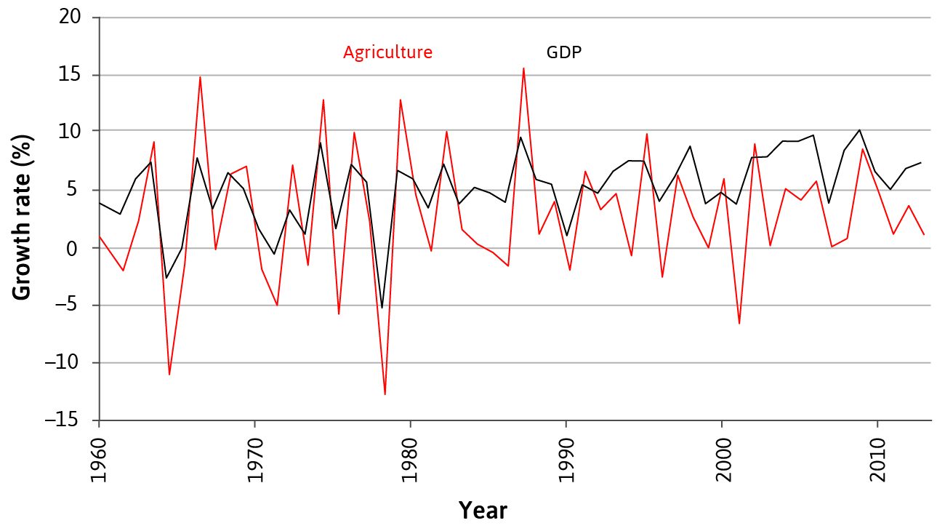
Economic fluctuations
India (1961–2014)
Economies fluctuate between good and bad times. This is true for industrialised as well as agrarian societies.

Slide 55
Costs and Causes of Economic Fluctuations
The term shock is used in economics to refer to an unexpected event, for example, extreme weather or a war, which causes GDP to fluctuate.
Shock is an exogenous change in some of the fundamental data used in a model. It is determined outside the model.
There are two broad types of shocks:
Good or bad fortune strikes the household
Good or bad fortune strikes the entire economy

Slide 56
How Households Cope with Income Shock?
People use two strategies to deal with shocks that are specific to their household:
Self-insurance – saving and borrowing. Other households are not involved.
Co-insurance – support from social network or government.

Slide 57
Income Shock: Self-insurance
Self-insurance
Saving by a household in order to be able to maintain its consumption when there is a temporary fall in income or need for greater expenditure.
Households that encounter an unusually high income in some period will save, so that when their luck reverses, they can spend their savings (Consumption smoothing)
As we saw in Unit 10, they may also borrow in bad times if they can, depending on how credit-constrained they are.
It is called self-insurance because other households are not involved.

Slide 58
Income Shock: Co-insurance
Co-insurance: a means of pooling savings across households in order for a household to be able to maintain consumption when it experiences a temporary fall in income or the need for greater expenditure.
Households that have been fortunate during a particular period can help a household hit by bad luck.
Since the mid-twentieth century, particularly in richer countries, co-insurance has taken the form of citizens paying taxes, which are then used to support individuals who are temporarily out of work, called unemployment benefits.

Slide 59
Consumption Smoothing and Altruism
These strategies reflect two important aspects of household preferences:
People prefer a smooth pattern of consumption: they dislike consumption that fluctuates as a result of bad or good shocks such as injury or good harvests. So they will self-insure.
2. Households are not solely selfish: They are willing to provide support to each other to help smooth the effect of good and bad luck.
Altruistic and reciprocal preferences remain important even when co-insurance takes the form of a tax-supported unemployment benefit, because these are among the motives for supporting the public policies in question.

Slide 60
Economy-wide Shocks
Co-insurance is less effective if the bad shock hits everyone at the same time.
But when these shocks hit, co-insurance is even more necessary. This is the case for an increase in government spending during the crisis.
In farming economies of the past that were based in volatile climates, people practised co-insurance based on trust, reciprocity, and altruism.

Slide 61
Why is Consumption Smooth?

Slide 62
Self-Insurance is a Basic Source of Stability
A basic source of stabilization in any economy comes from the desire of households to keep the level of their consumption of goods and services constant.
Keeping a steady level of consumption means households have to plan:
they save when they have unexpectedly high income and borrow (or dissave) when they lost their income or have an unexpected high expenditure.
They think about what might happen to their income in the future, and they save and borrow to smooth the bumps in income. This is the self-insurance.

Slide 63
Stabilization Measures: Consumption Smoothing
Modern households also try to smooth their consumption. One way to visualize this behaviour is to focus on predictable events:
A young person thinking about life can imagine getting a job, then enjoying a period of working life with income higher than the starting salary, followed by years in retirement when income is lower than during working life. (Permanent Income Hypothesis)
Consumption fluctuates less than income ➔ due to smoothing.

Slide 64
Permanent Income Hypothesis: A Model of Consumption Throughout A Person’s Life
The model of decision making for the individual that we introduced in Unit 3 and Unit 10 is the basis for this model:
The person contemplating a future promotion and planning their spending would be in a position similar to Julia in Unit 10 (Figure 10.2), who had limited funds in the present but knew she would have more later, and consequently was interested in moving some of her future buying power to the present by borrowing.
It predicts that, although income fluctuates throughout our lives, our desired consumption is smoother.

Slide 65
Permanent Income Hypothesis: A Model of Consumption Throughout A Person’s Life
People prefer to smooth their consumption because there are diminishing marginal returns to consumption at any given time.
So having a lot of consumption later and little now, for example, is worse than having some intermediate amount of consumption in the two periods

Slide 66
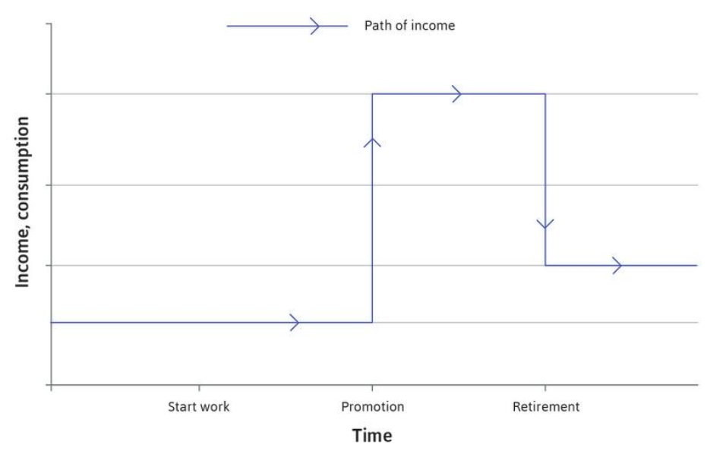
Income over time
The blue line shows the path of income over time: it starts low, rises when the individual is promoted and falls at retirement.

Slide 67
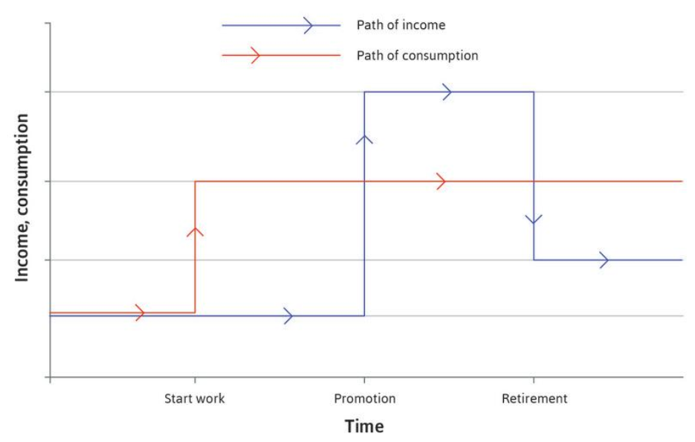
Consumption expenditure
This is the red line. It is smooth (flat) from the point at which the individual first gets a job.

Slide 68
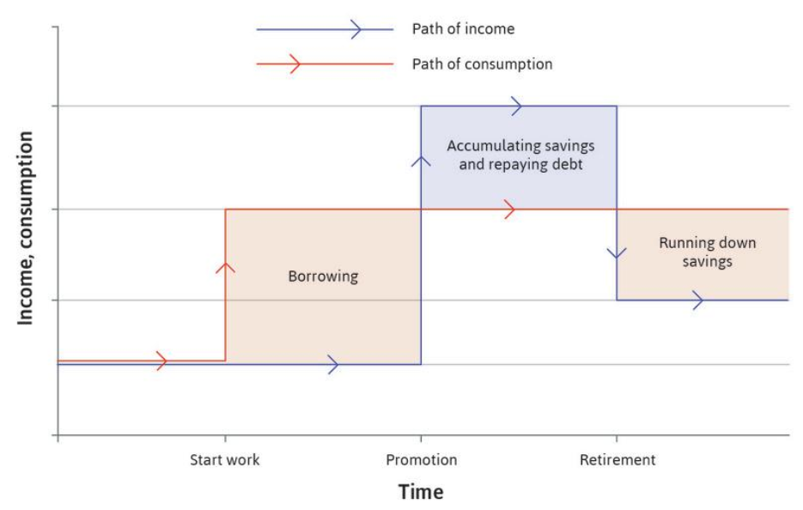
The individual borrows while young
At this time income is low. The individual saves and repays the debt when older and earning more, and finally runs down savings after retirement, when income falls again.

Slide 69
Income Shocks

Slide 70
What If the Individuals Encounters an Unexpected Income Shock?
The consumption-smoothing model suggests that:
The individual will make a judgement to determine whether the shock is temporary or permanent.
If the shock is permanent: We should adjust the red line in Figure 13.10 up or down to reflect the new long-run level of consumption that the individual adopts, consistent with the new pattern of forecast income.
If the shock is temporary: Little will change. A temporary fluctuation in income has almost no effect on the lifetime consumption plan, because it makes only a small change to lifetime income.
Consumption smoothing is a basic source of stabilisation in an economy.

Slide 71
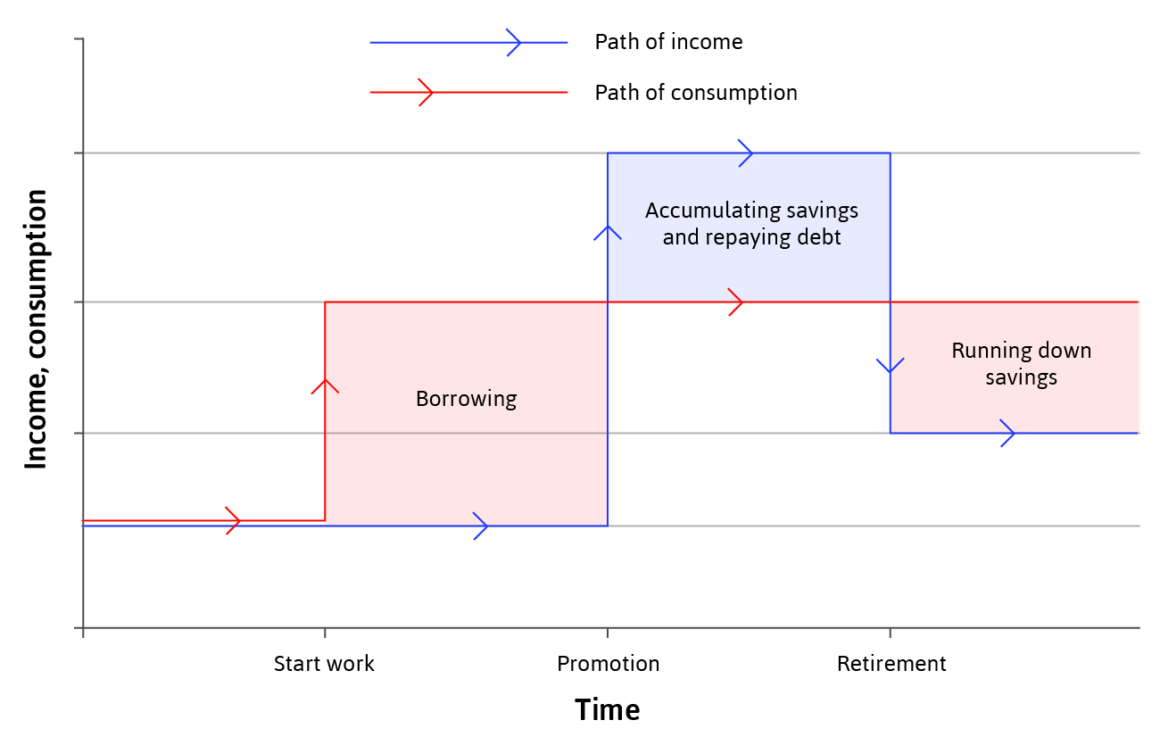
Permanent Income Hypothesis: A Model of Consumption Throughout A Person’s Life
Households make lifetime consumption plans based on expectations about the future, and react to shocks:
Readjust long-run consumption (red line) if shocks are permanent
Do not change long-run consumption if shocks are temporary

Slide 72
Three Things that Constrain Consumption Smoothing During Income Shocks
The first two concern limits on self-insurance, the third is a limit on co-insurance:
Credit constraints or credit market exclusion: This restricts a family’s ability to borrow in order to sustain consumption when income has fallen.
Weakness of will: A characteristic of human behaviour that leads people to be unable to carry out the plans—for example, saving in anticipation of a negative income shock—that they know would make them better off.
Limited co-insurance: So that those with a fall in income cannot expect much support in sustaining their incomes from others more fortunate than them.

Slide 73
Credit Constraints
Households with little money cannot borrow at all, or only at extraordinarily high interest rates.
Figure 13.11 shows the reaction of two different types of households to an anticipated rise in income.
Households that are able to borrow as much as they like are in the top panel.
Credit-constrained households that are unable to get a loan or take out a credit card are in the bottom panel.
How the two households react to two key events:
News is received that income will rise at a predictable time in the future
The household’s income actually rises

Slide 74
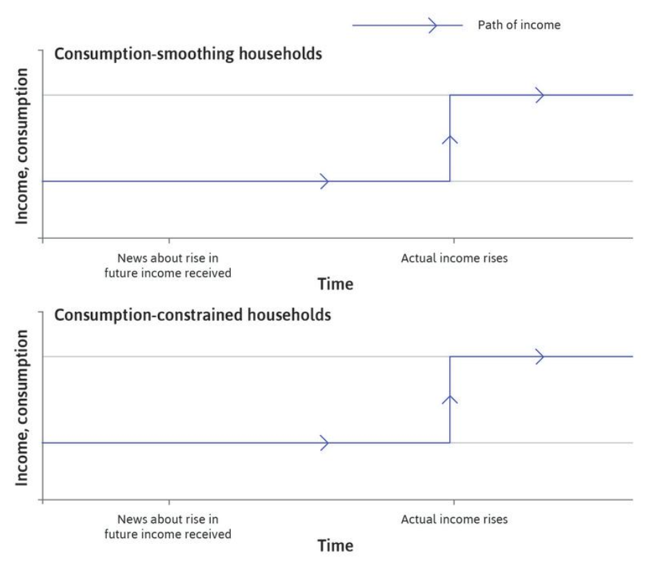
Income Over Time
The blue lines on the figure show that the path of income over time is the same in both households.

Slide 75
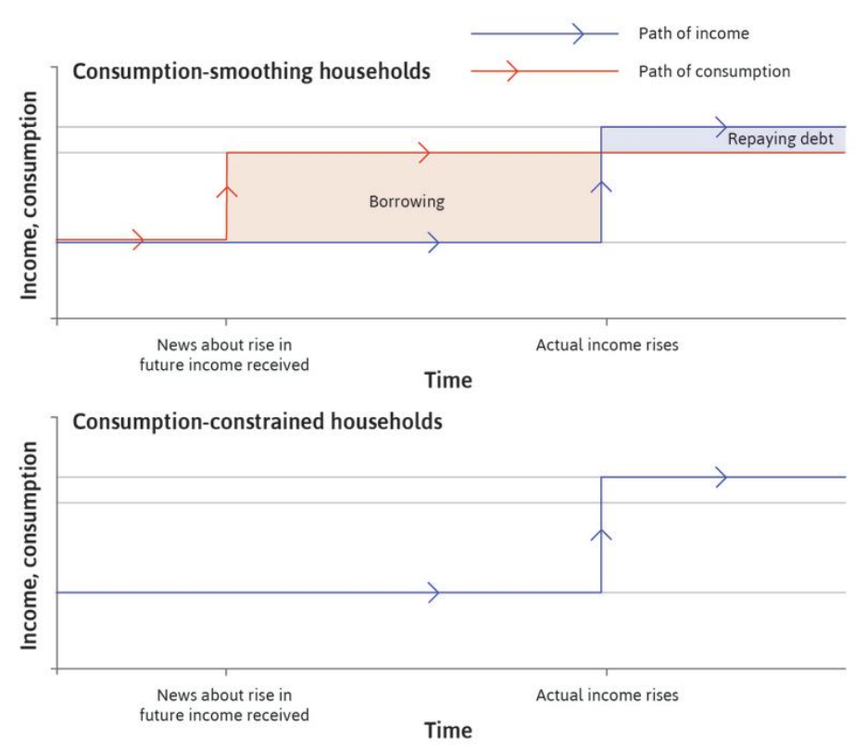
Consumption Smoothing
The red line in the top panel shows that, in a consumption-smoothing household, consumption changes immediately once the household receives the news.

Slide 76
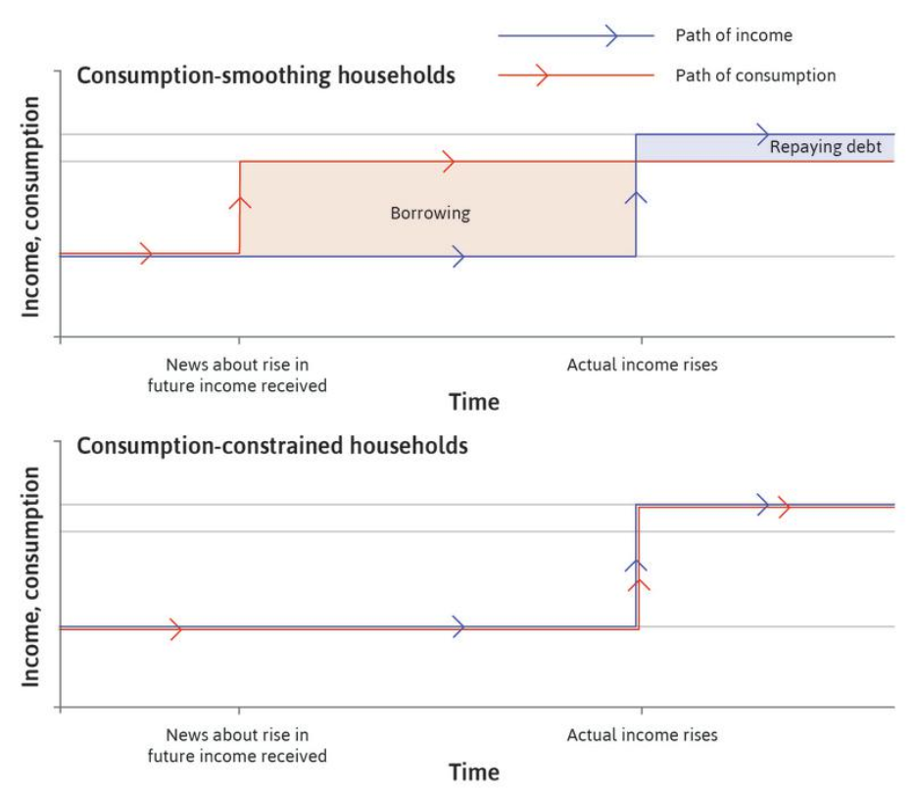
The Effect of Credit Constraints
On the other hand, a credit-constrained household that cannot borrow has to wait until the income arrives before adjusting its standard of living.
Credit constraints – limits on amount borrowed/ability to borrow. The households unable to adjust to a temporary income shock have lower welfare.

Slide 77
Credit-constrained and Unconstrained Households
What happens after a negative income shock?
We can think about these decisions using the two-period model of borrowing and lending.
First consider a household that receives the same income, y, this period and next period.
The interest rate is r so if the household can borrow and save, then it can choose any point on the budget constraint, which has the slope −(1 + r).
The budget constraint is another term for the frontier of the feasible set with the slope of −(1 + r).

Slide 78
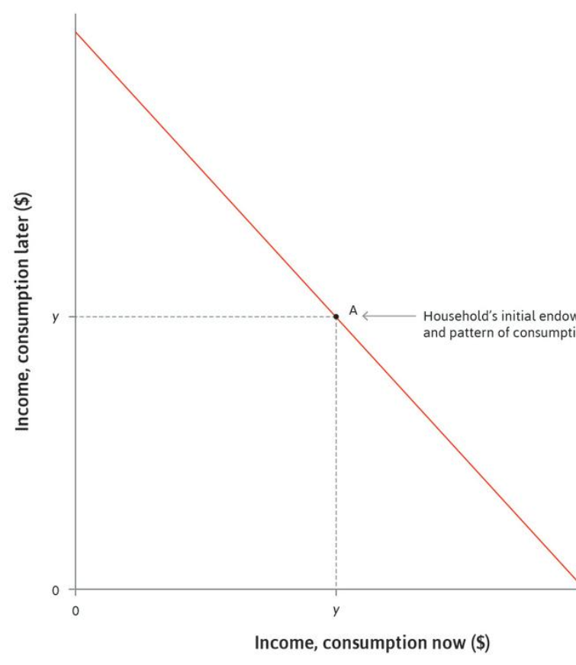
Same Income In Both Periods
Consider a household that receives the same income, y, this period and next period, indicated by the endowment point A.

Slide 79
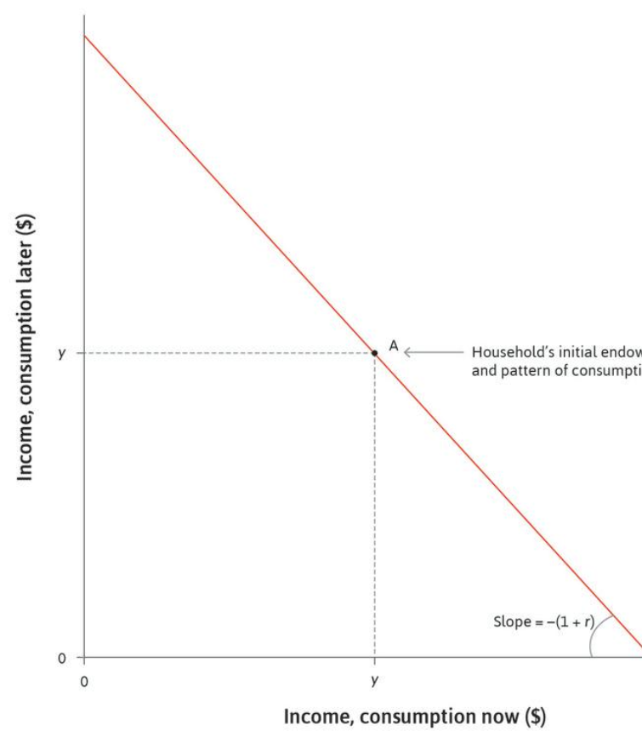
An Unconstrained Household
The interest rate is r so if the household can borrow and save, then it can choose any point on the budget constraint, which has the slope −(1 + r).

Slide 80
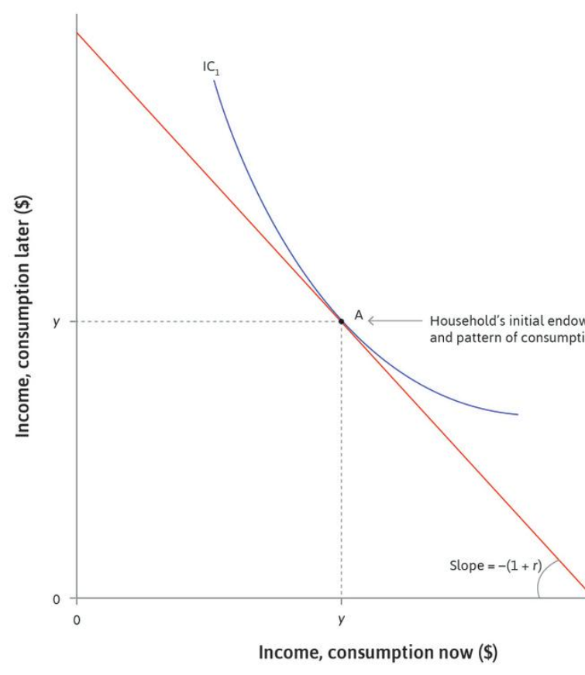
Preference For Smoothing
Assume that the household prefers to consume the same amount each period, shown by the point A where the indifference curve is tangent to the budget constraint.

Slide 81
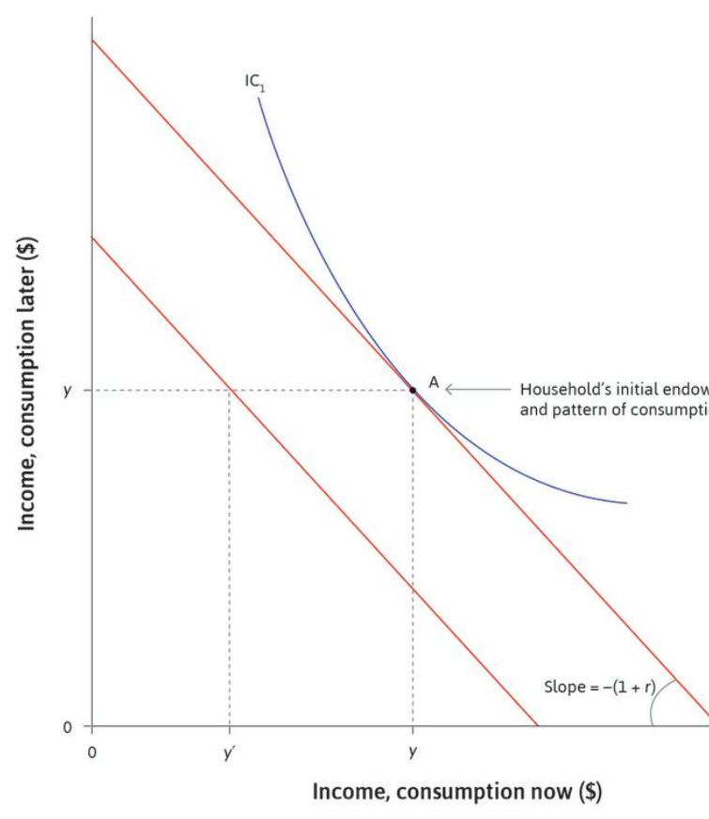
A Negative Shock
Now suppose that the household experiences an unexpected negative temporary shock to its income this year, such as a bad harvest, which lowers this year’s income to y′, leaving expected income next year unaffected at y.

Slide 82
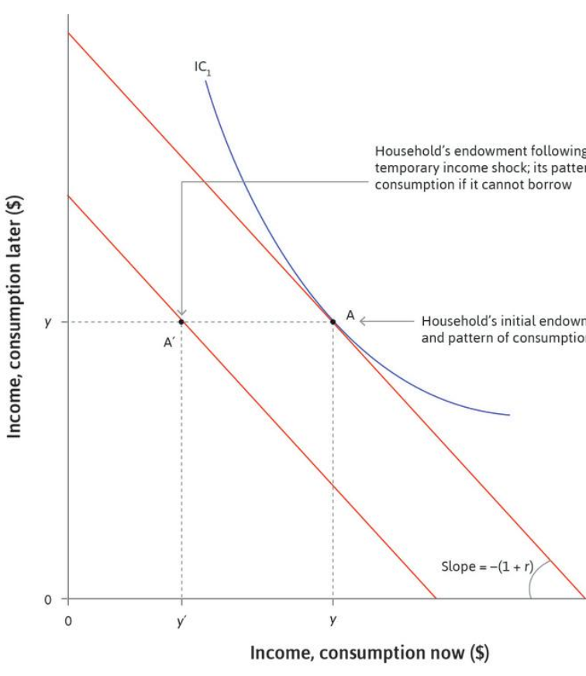
The Budget Constraint
If it can borrow and save, then its budget constraint has a slope of −(1 + r) and passes through point A′.

Slide 83
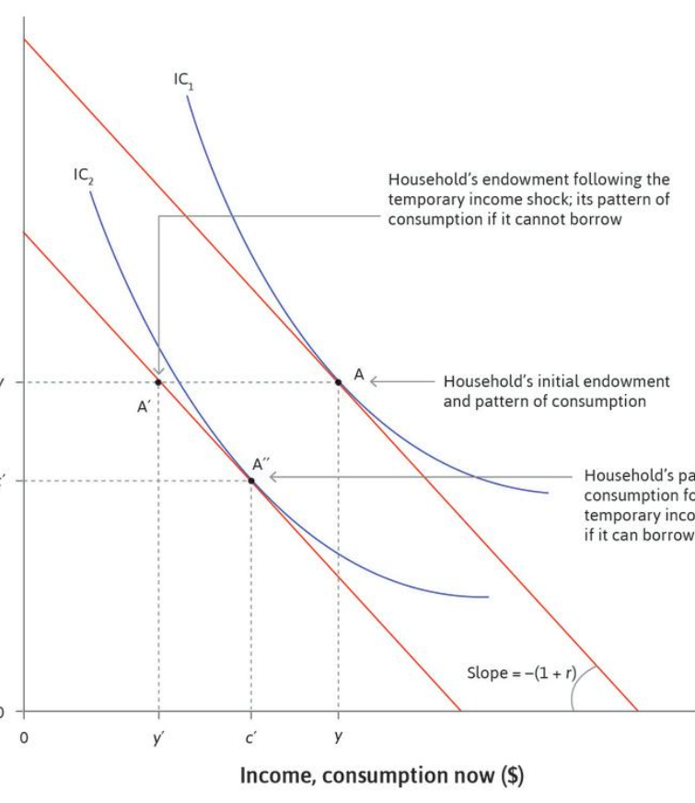
The Highest Indifference Curve
The highest curve that touches this budget constraint does so at point A″, showing that the household prefers to smooth consumption, consuming c′ in both periods. The household borrows c′ − y′ now and repays (1 + r)(c′ − y′) next period following the shock.

Slide 84
We Learn From This Example That:
Without borrowing or lending, the endowment point and pattern of consumption coincide.
Compared with the smoothing household, the credit-constrained household consumes less this period and more next period.
We can also see that the indifference curve that passes through A′ (not shown) is lower than the one that passes through A″. So the household that can smooth consumption by borrowing is better off than the credit-constrained household.
A temporary change in income affects the current consumption of credit-constrained households more than it does that of the unconstrained.

Slide 85
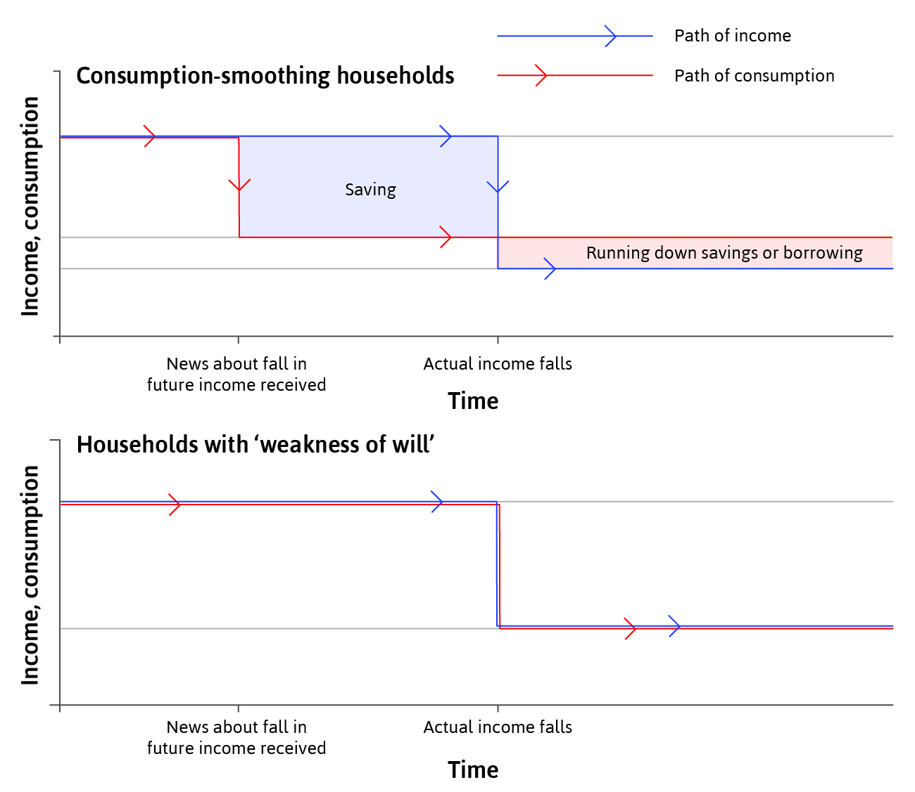
Limitations to smoothing: weakness of will
Weakness of will – inability to commit to beneficial future plans.
A household is able to smooth consumption but doesn’t, and may regret it later.

Slide 86
Limited Co-Insurance
As we have seen, unemployment benefits provide co-insurance—the citizens who turn out to be lucky in one year insure those who are unlucky. But in many societies the coverage of these policies is very limited.
A vivid demonstration of the value of smoothing through co-insurance is the experience of Germany during the drastic reduction in income experienced by that economy in 2009:

Slide 87
German Experience: A Success Story
When the demand for firms’ products fell, workers’ hours of work were cut, but as a result of both government policy and agreements between firms and their employees (due to strong labor unions), very few Germans lost their jobs, and many of those at work were still paid as if they were working many more hours than they did.
The result was that although aggregate income fell, consumption did not—and unemployment did not increase.

Slide 88
E. Economic Fluctuations And Investment

Slide 89
Investors Behavior is Different from Consumers
Households tend to smooth their consumption spending when they can, but there is no similar motivation for a firm to smooth investment spend­ing.
Firms increase their stock of machinery and equipment and build new prem­ises whenever they see an opportunity to make profits.
But, unlike eating and most other consumption expenditures, investment expenditures can be postponed.

Slide 90
Investment Occurs In Waves
There are several reasons why this is likely to produce clusters of investment projects at some times, while few projects at other times:
Introduction of new technologies (innovation)
Credit Constraint

Slide 91
Investment Occurs In Waves: Technological Innovation
firms using the new technology ➔ can produce output at lower cost ➔
or produce higher-quality output ➔ expand their share of the market
Firms that fail to follow may be forced out of business because they are unable to make a profit using the old technology.
But new technology means that firms must install new machines. As firms do this, there is an investment boom:
This will be amplified if the firms producing the machinery and equipment need to expand their own production facilities to meet the extra demand expected.

Slide 92
Investment Occurs In Waves: Technological Innovation
In this case, investment by one firm pushes other firms to invest:
If they don’t, they may lose market share or even be unable to cover their costs and eventually have to leave the industry.
But investment by one firm can also pull other firms to invest by helping to increase their market and potential profits.

Slide 93
Investment In New Technologies And The Dotcom Bubble (1991–2015).
An example of push investment is the hi-tech investment boom in the US. From the mid-1990s, new information and communications technology (ICT) was introduced into the US economy on a large scale.
Figure 13.14 shows the sustained growth of investment in new technologies through the second half of the 1990s.

Slide 94
Irrational Exuberance
Investment in new technology can lead to a stock market bubble and over-investment in machinery and equipment.
The index rose strongly from the mid-1990s to an all-time peak in 1999 as stock market investors’ confidence in the profitability of new tech firms grew.
Investment in IT equipment (the red line) grew rapidly as a result of this confidence, but dropped sharply following the collapse in confidence that caused the fall of the stock market index.
This suggests that over-investment in machinery and equipment had occurred:
Robert Shiller, the economist, argued that the Nasdaq index was driven high by what he called ‘irrational exuberance’; the psychological basis of a speculative bubble

Slide 95
Investment Occurs In Waves: Credit Constraint
2) Credit constraints are another reason for the clustering of investment projects and the volatility of aggregate investment.
In a buoyant economy:
profits are high ➔ firms can use these profits to finance investment projects ➔ access to external finance from sources outside the firm is also easier:
In the US hi-tech boom, for example, the expansion of the Nasdaq exchange reflected the appetite of investors to provide finance by buying shares (stocks) in firms in the emerging ICT industries.

Slide 96
How One Firm’s Investment Can Induce Another Firm To Invest: A Game Theory Approach
To understand how one firm’s investment can induce another firm to invest, think of a local economy comprising of just two firms:
Firm A’s machinery and equipment are not fully used, so the firm can produce more if it hires more employees. But there is not enough demand to sell the products it would produce.
This situation is called low capacity utiliz­ation.
The owners of Firm A have no incentive to hire more workers or to install additional machinery (that is, to invest).
Firm B has the same problem. Because of low capacity utilization, profits are low for both.

Slide 97
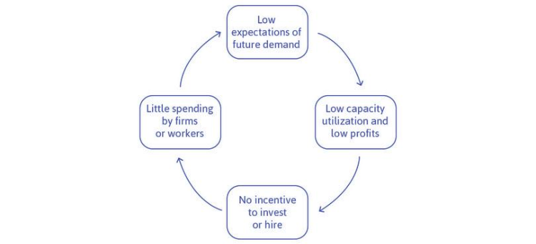
Negative Expectations Of Future Demand Create A Vicious Circle
Thus when we think about both firms together we have a vicious circle:

Slide 98
How One Firm’s Investment Can Induce Another Firm To Invest: A Game Theory Approach
If the owners of both A and B decide to invest and hire at the same time, they would:
employ more workers ➔ who would spend more ➔ increasing the demand for the products of both firms ➔ the profits of both would rise.

Slide 99
Positive Expectations Of Future Demand Create A Virtuous Circle

Slide 100
Capacity Utilization Rate
Capacity Utilization Rate
is a measure of the extent to which a firm, industry, or entire economy is producing as much as
the stock of its capital goods and
current knowledge would allow.

Slide 101
How One Firm’s Investment Can Induce Another Firm To Invest: A Game Theory Approach
These two circles highlight the role of expectations of future demand, which depend on the behavior of other actors.
A game can illustrate how to get out of the vicious circle and into the virtuous one. As in every game, we specify:
The actors: The two firms.
The actions that they can take: Invest, or do not invest.
The information they have: They decide simultaneously, so they do not know what the other has done.
The payoff: The profits resulting from each of the four pairs of actions that they could possibly take.

Slide 102
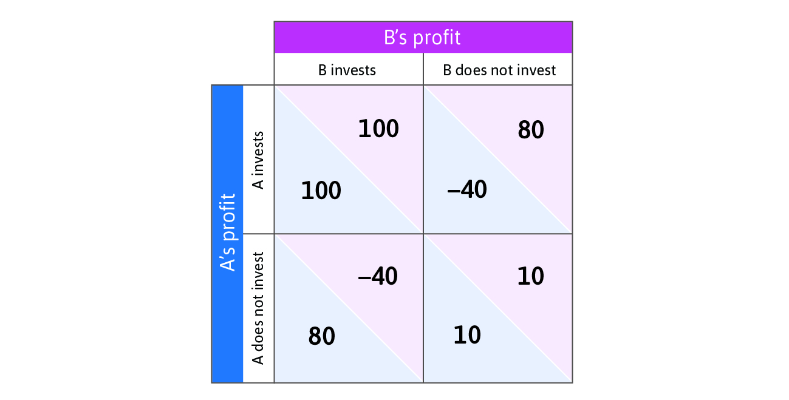
Investment: A Coordination Game
Investment is the best response to other firms’ investment (coordination game).

Slide 103
Investment: A Coordination Game
Game 1
Game 2 & 3
If Firm A invests and B does not (the upper-right cell in the figure) then:
A pays to install new equipment and premises, ➔
but because the other firm did not invest ➔
there is no demand for the products that the new capacity could produce; so A makes a loss.
2. But had B known that A would invest:
then B would have made higher profits by investing as well (getting 100 rather than only 80) ➔
3. On the other hand, had B known that A was not going to invest ➔
then it would have done better to also not invest.

Slide 104
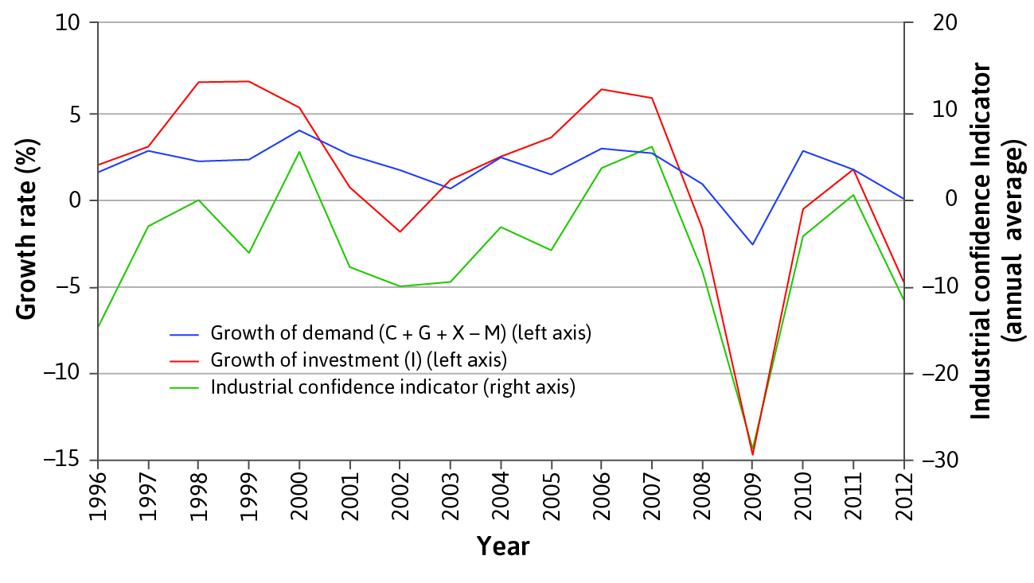
Business confidence
Business confidence coordinates firms to invest at the same time.

Slide 105
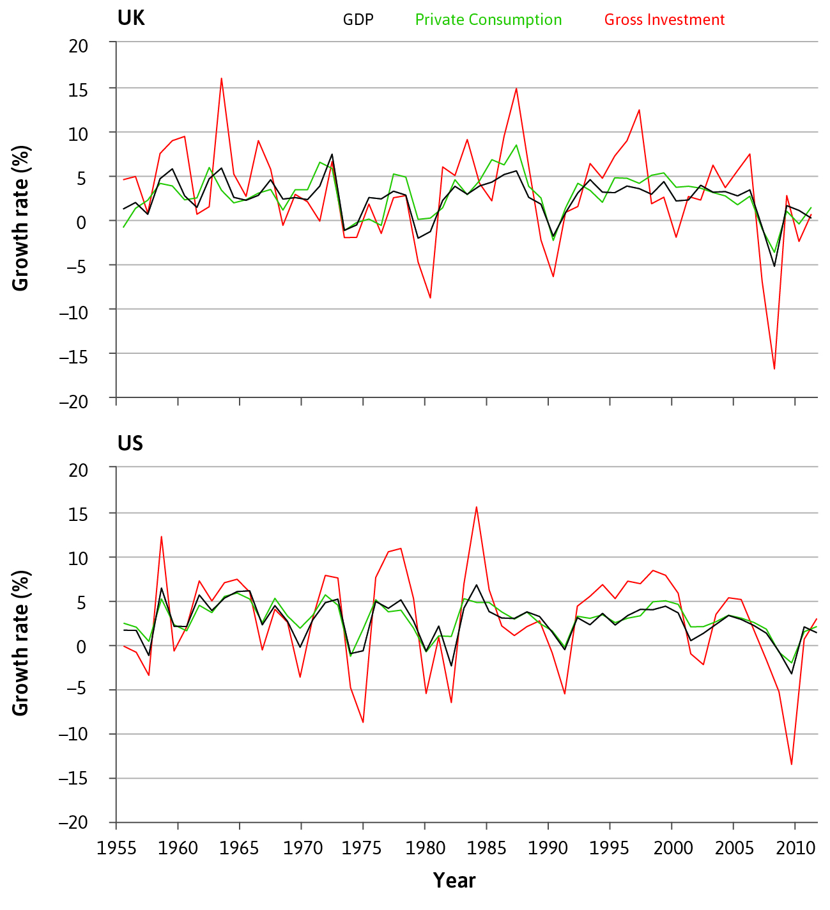
Investment and the aggregate economy
The benefits of coordinating investment makes cycles self-reinforcing.
Firms respond positively to the growth of demand in the economy.
This is why investment is more volatile than GDP.

Slide 106
Other components of GDP
Government spending is less volatile than investment
(does not depend on business confidence)
Exports depend on demand from other countries, so will fluctuate according to the business cycles of major export markets.

Slide 107
F. Inflation

Slide 108
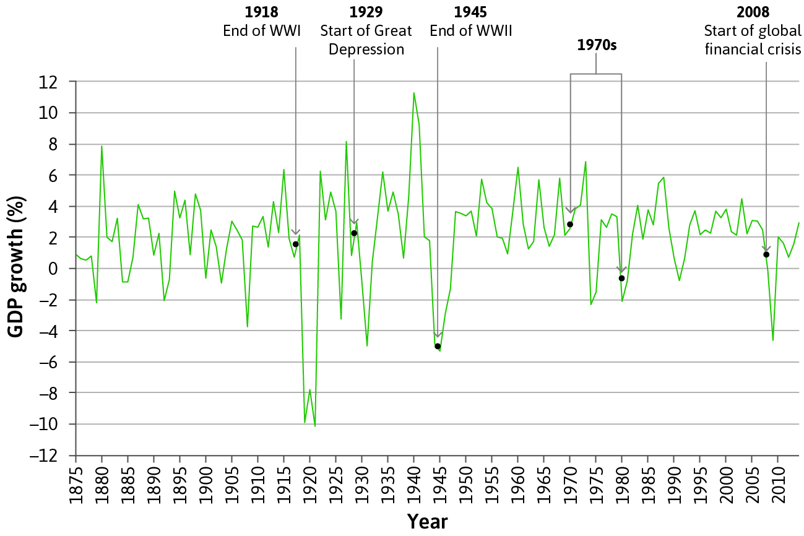
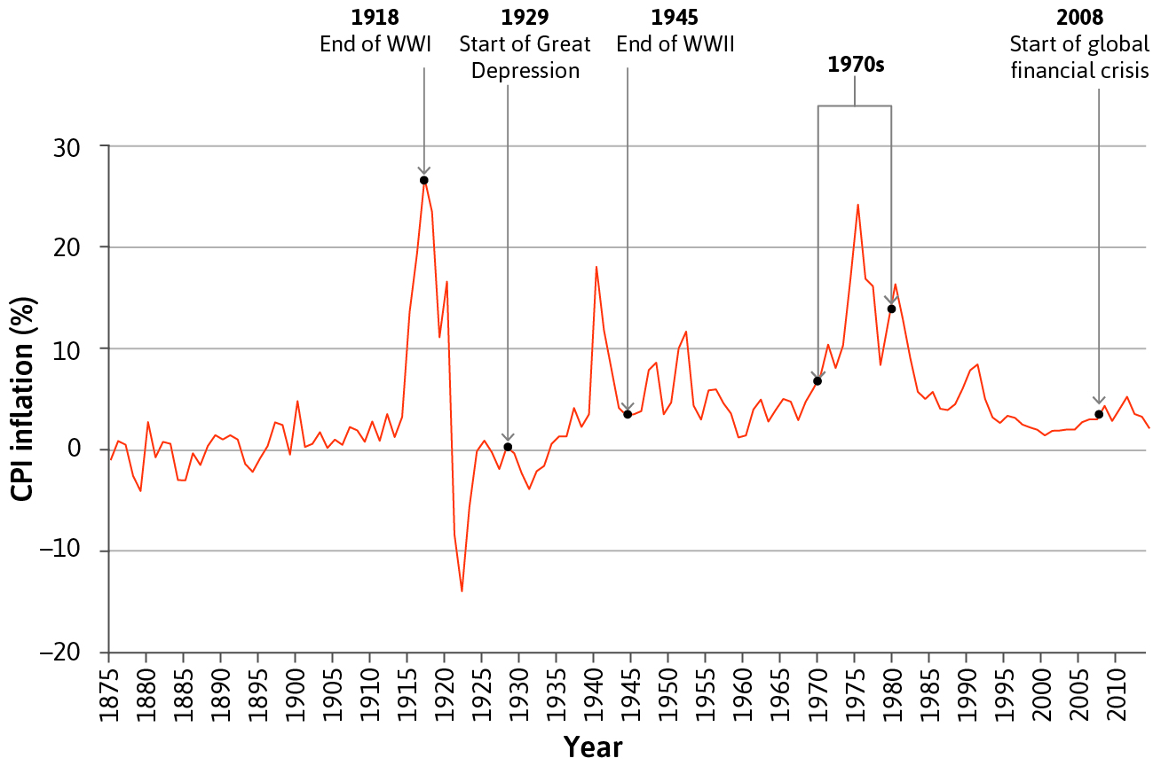
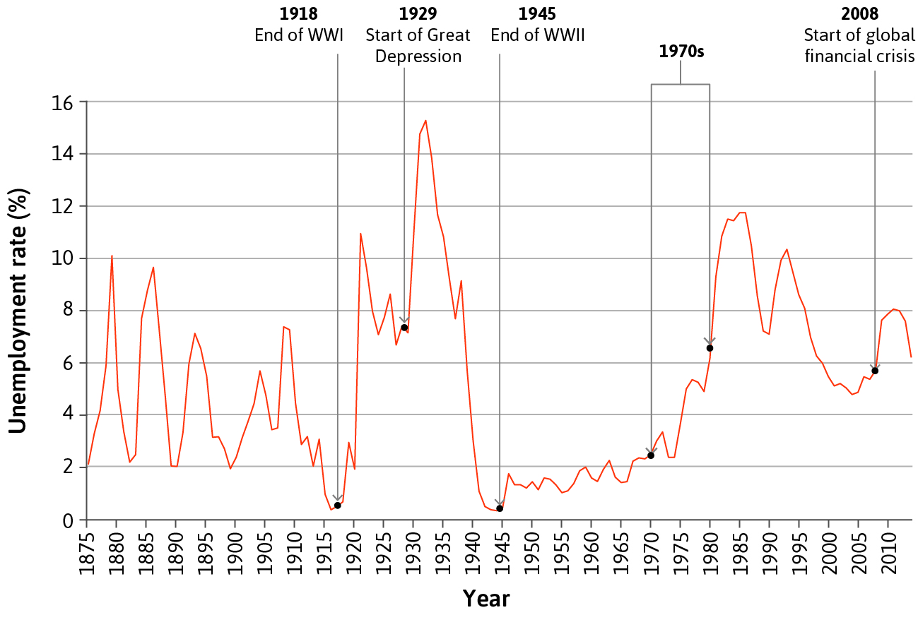
Inflation, GDP, and Unemployment
Inflation = an increase in the general price level in the economy
Inflation tends to be lower during recessions (high unemployment)

Slide 109
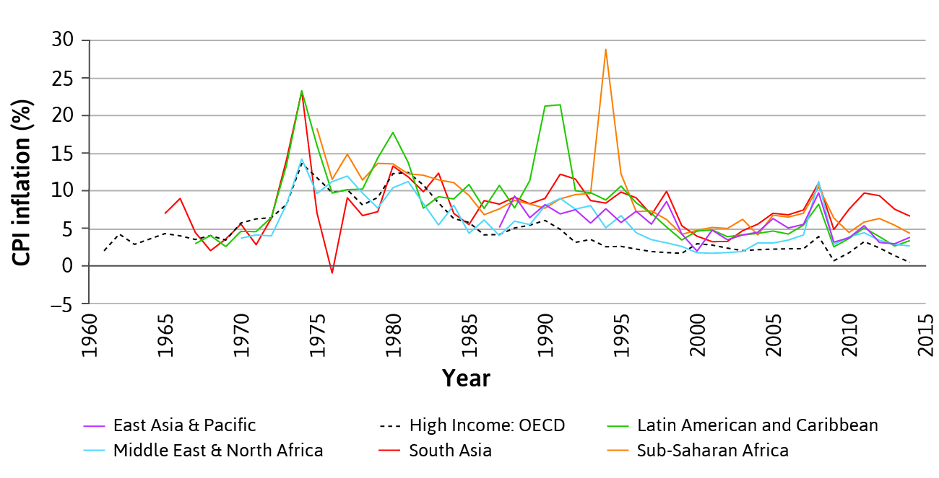
Trends in inflation
Upward spikes in inflation during economic crises
general downward trend since 1970s
inflation tends to be higher in poor than in rich countries

Slide 110
Measuring inflation
The Consumer Price Index (CPI) measures the general level of prices that consumers have to pay for goods and services, including consumption taxes
Based on a representative bundle of consumer goods – “cost of living”
Common measure of inflation = change in CPI
GDP deflator = A measure of the level of prices for domestically produced output (ratio of nominal to real GDP)
Tracks prices of components of GDP (C, I, G, NX)
Allows GDP to be compared across countries and over time

Slide 111
Summary
Economic growth is not a smooth process – the economy goes through a business cycle
Households try to smooth their consumption over the business cycle (problem: credit constraints)
Investment is more volatile than GDP; the outcome of a self-reinforcing coordination game
Inflation moves with the business cycle
System of national accounts to measure the economy
GDP = C + I + G + X – M
Measuring GDP as income, spending, production

Slide 112
In the next unit
The multiplier process: How limits on households’ ability to save, borrow, and share risks affect GDP
Fiscal policy: How government spending can help stabilize the economy
Limitations of fiscal policy: The consequences of being part of the world economy

