Slide 1
Unit 10
BANKS, MONEY, AND THE CREDIT MARKET

Slide 2
OUTLINE
Introduction
Income, borrowing and saving
Balance sheet
Banks and money
Credit rationing

Slide 3
A. Introduction

Slide 4
The Context for This Unit
Markets for goods and services allow parties to interact in mutually beneficial ways.
In most markets, money is the medium of exchange.
How do banks create money?
How do banking systems affect individual consumption choices and economic outcomes?
What are the limitations of the banking system?
(Units 6-9)

Slide 5
This Unit
Model how individuals borrow, save, and invest
Understand the role of commercial banks and the central bank in the economy
Explain how banks make money and the risks they face and pose

Slide 6
Money And Trust Are Closely Related (1 of 2)
Lenders are wary of the borrowers’ creditworthiness.
As a result, they usually require collateral in order to make new loans:
Collateral is an asset (such as financial securities, and a house) that a borrower pledges to a lender as a security for a loan.
If the borrower is not able to make the loan payments as promised, the lender becomes the owner of the asset.

Slide 7
Money And Trust Are Closely Related (2 of 2)
A careful assessment made by the moneylenders make default rare.
Economically speaking, lenders’ robust risk management reduces “credit risk” or the risk of defaults.
In countries with less developed financial system, the cost of monitoring is usually very high and lending is not a very profitable business.
However, in financially developed countries, with the existence of credit rating and credit monitoring agencies, this cost is much less:
This increases the incentives to make loans and
Reduces the interest rate.

Slide 8
Bank Lending: A Balance Sheet Approach
Lending Bank Other Banks,
Borrower (JP Morgan) (Wells Fargo)
asset liabilities asset liabilities asset liabilities
+ house +30-yr mortgage + 30-yr mortgage +O/N interbank +O/N interbank + Fed loans
(%15) (%15) loan loan
( %2.75) (%2.75)
Lending Cost Financing Cost

Slide 9
Bank Lending: A Cost and Benefit Analysis
Given the interest rate, is lending by JP Morgan likely to be exceptionally profitable?
It depends. The cost to the lender bank (or the creditor), JPMorgan, includes
The costs of financing which is %2.75 in this case. (liquidity risk).
The cost of monitoring and further screening of the debtors (or the borrowers). (Credit Risk)
If these costs exceed the profit (which is the interest rate the charge the borrowers, and %15 in this case), then this business is not profitable.

Slide 10
Elasticity and Discipline of Credit
What happens when trust evaporates in an economy? Will anyone accept any form of credit?
When Confidence is high … | When confidence is low….
Bank expand credit by approving more loans, credit card applications, etc. | Banks are more cautious and less credit and loan applications will be approved.
More businesses accepted credit card, and other forms of credit as a means of payments | Businesses prefer debit card or cash and do not accept credit card.
Payment system works more smoothly | There will be defaults in payment.
Expansion of Credit | Contraction of Credit
Economic Boom | Economic Bust

Slide 11
B. Income, borrowing and saving

Slide 12
Time Has Value
Borrowing and lending money, and the trust that makes this possible, are about shifting consumption and production over time
The moneylender offers funds to the farmer to purchase fertilizer now, and he will pay back after the crop matures, as long as it was not destroyed by a drought.
The passage of time is an essential part of concepts such as money, income, wealth, consumption, savings, and investment:
Borrowing and lending transfer the purchasing power (money, income, wealth) from the lender (saver) to the borrower (consumer, investor) today.

Slide 13
What is Money? (1 of 2)
Money is a medium of exchange:
Consisting of bank notes and bank deposits (M1), or
Anything else that can be used to purchase goods and services,
And is accepted as payment
because others can use it for the same purpose.
For money to do its work, everyone else must trust that others will accept your money as payment.
Governments (money is a legal tender), central banks (central banks liquidity provision and backstop), and banks (by exchanging deposits with currency at par) usually provide this trust.

Slide 14
What is Money? (2 of 2)
V. Money allows purchasing power to be transferred among people
so that they can exchange goods and services,
even when payment takes place at a later date (for example, through the clearing of a cheque or settlement of credit card or trade credit balances).
Banks are the main providers of clearing and settlement system.
Clearing
The process of transmitting, and in some cases, confirming transactions prior to settlement.
Settlement
The transfer of ownership involving the exchange of securities and payments.

Slide 15
Money versus Credit
However, this definition fails to distinguish:
between money (means of final settlement) and credit (promise to pay money, means of delaying final settlement).
In a sense, monetary system is hierarchical:
Credit is a means of postponing the payment, it is the promise to pay money.

Slide 16
Monetary System is Hierarchical
Money is the ultimate form of payment. It obtains it value by being the legal tender (Fiat currency). Its value will be backstopped by central bank.
Money
Credit is a promise to pay money.
Credit

Slide 17
What is Credit?
An important way to understand money is by understanding payment system.
In modern economy, payment system functions based on the availability of credit:
Credit is elastic, meaning it can be expanded and contracted (or tapered).
Credit is ultimately a promise to pay money (i.e. reserves at the central bank).
Credit involves postponing the final payment, and promising to pay in future.
The system is therefore highly vulnerable to default- the failure to fulfil this promise (liquidity risk).

Slide 18
Wealth
Wealth (Capital) = Stock of things owned or value of that stock. It is the maximum amount that you could consume without borrowing.
= buildings, land, machinery, capital goods – debts owed + debts owed to you
Balance Sheet
asset liabilities
Buildings Net Debt (Debts owed – Debt owed to you)
Land
Machinery
Capital goods
Capital (Wealth)

Slide 19
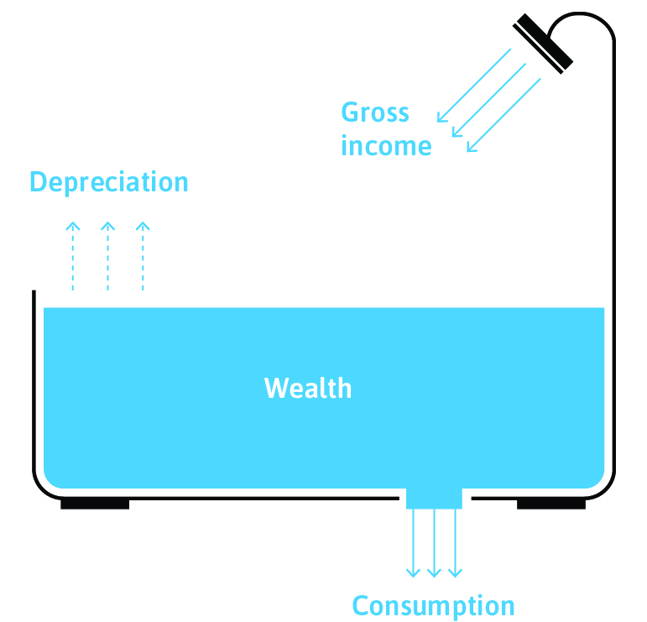
Income
Inflow
Outflow
Income = The amount of money one receives over some period of time (flow).
from market earnings, investments, government.
Income means after-tax income or disposable income.
Outflow

Slide 20
Flow versus Stock
Flow A quantity measured per unit of time, such as annual income or hourly wage.
The inflow is measured by litres (or gallons) per minute.
Stock A quantity measured at a point in time. Its units do not depend on time.
The stock of water is measured by litres (or gallons) at a particular moment in time.

Slide 21
Other Key Concepts
Depreciation = Reduction in the value of a stock of wealth over time (it is a flow variable).
Gross income (Inflow) = is the amount of money you receive over some period of time, whether from market earnings (i.e. wages, salaries, and other income from labour), investments, or from the government.
Net income = The maximum amount that one could consume and leave your wealth unchanged.
Net income = gross income – depreciation
Expenditure (Ourflow)= Expenditure on consumer goods including both short-lived goods and services and long-lived goods, which are called consumer durables.
Savings = An individual (or household) saves when consumption is less than net income, so wealth increases. Wealth is the accumulation of past and current saving.
Investment = Expenditure on newly produced capital goods.

Slide 22
Net Income
Wealth
Expenditure
Inflow
Outflow

Slide 23
Consumption Over Time
There is a trade-off between consuming goods now and later.
The opportunity cost of having more goods now is having fewer goods later.
Borrowing and lending allow us to rearrange our capacity to buy goods and services across time

Slide 24
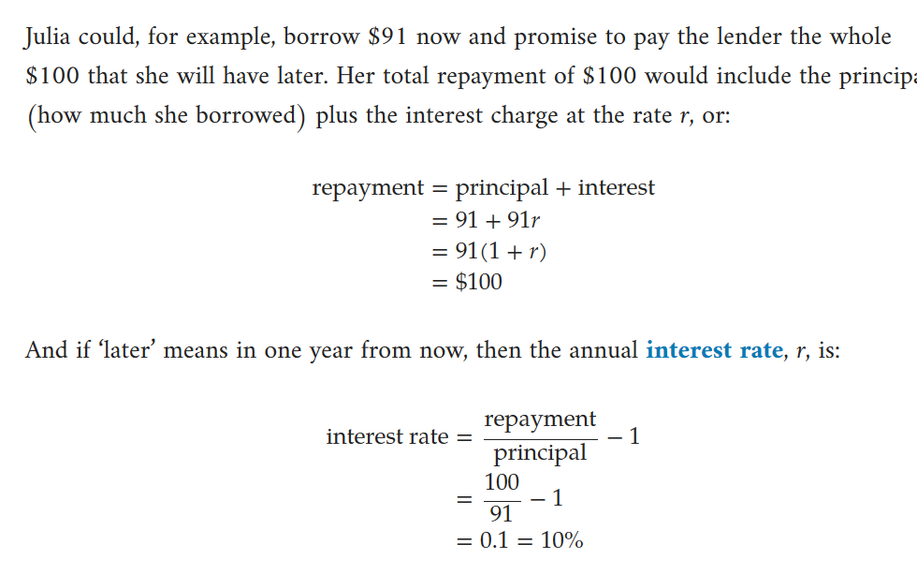
How to Calculate Interest Rate on a Simple Loan?
$$Interest rate$$
$$= \frac{repayment−principle}{\begin{aligned}\begin{aligned}principle \\ \\ \end{aligned} \\ \end{aligned}}=\frac{Interest Payment}{Principle}$$

Slide 25
The Meaning of Interest Rate
Interest rate is the price of bringing some buying power forward in time.
It is an opportunity cost of consuming today:
With an interest rate of r = 10%, the opportunity cost of spending one dollar now is that Julia will have to spend 1.10 = 1 + r dollars less later.
(1+r)=Tradeoff between current and future consumption (MRT)

Slide 26
Borrowing, the Interest Rate, and the Feasible Set

Slide 27
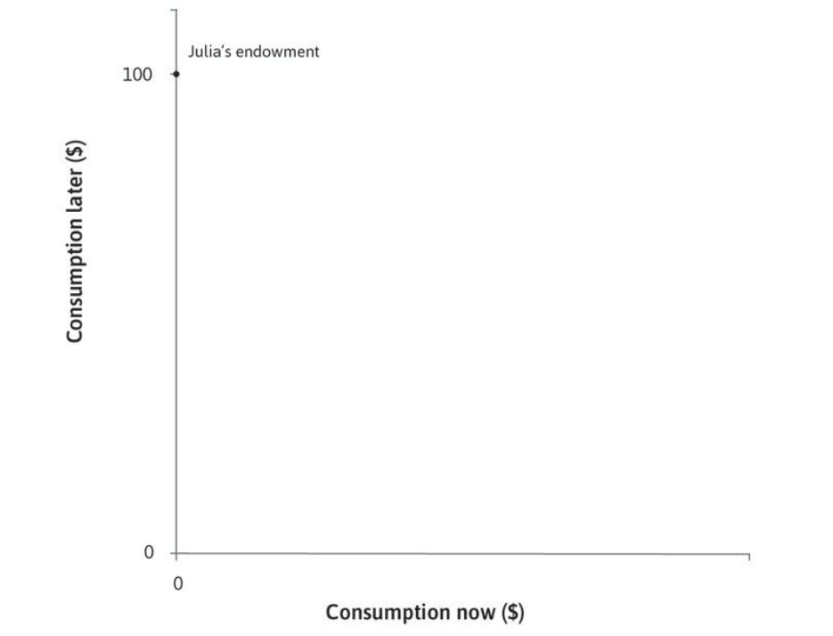
Julia Has Nothing
Julia has no money now, but she knows that in the next period she will have $100.

Slide 28
Bringing Future Income To The Present
Julia could, for example, borrow $91 now and promise to pay the lender the $100 that she will have later.
The interest rate would be 10%.

Slide 29
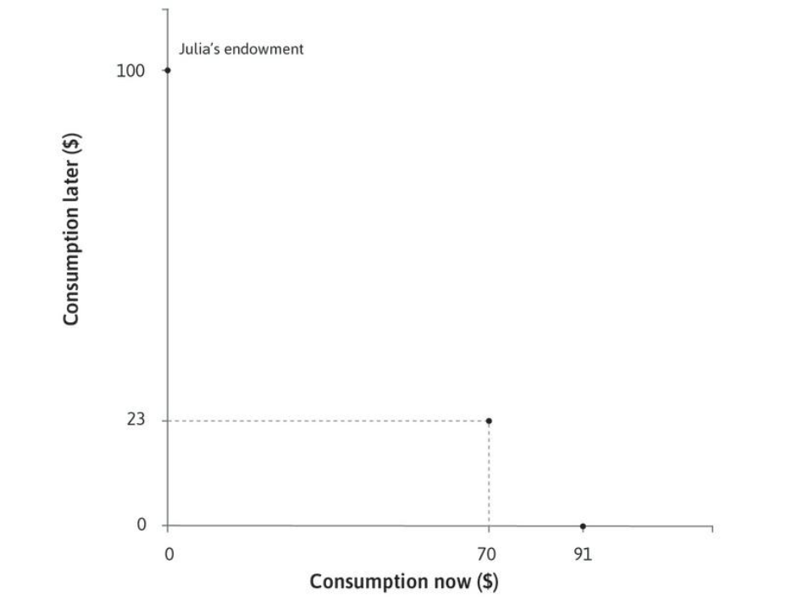
Borrowing Less
At the same interest rate (10%), she could also borrow $70 to spend now, and repay $77 at the end of the year.
In that case she would have $23 to spend next year.

Slide 30
Borrowing Even Less
At the same interest rate (10%), she could also borrow $30 to spend now, and repay $33 at the end of the year.
In that case she would have $67 to spend next year.

Slide 31
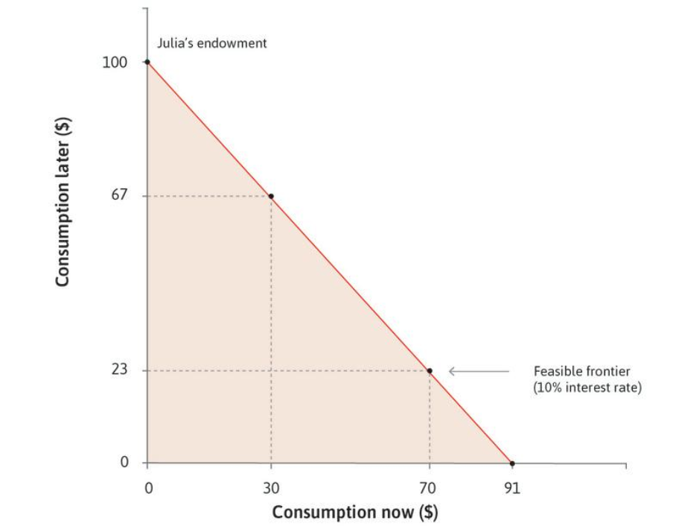
Julia’s Feasible Set
The boundary of Julia’s feasible set is her feasible frontier, shown for the interest rate of 10%.
(1+r)=Tradeoff between current and future consumption (MRT)
It is the slope of feasible fet.

Slide 32
Julia’s Feasible Frontier
Juila can borrow now and choose any combination on her feasible frontier.

Slide 33
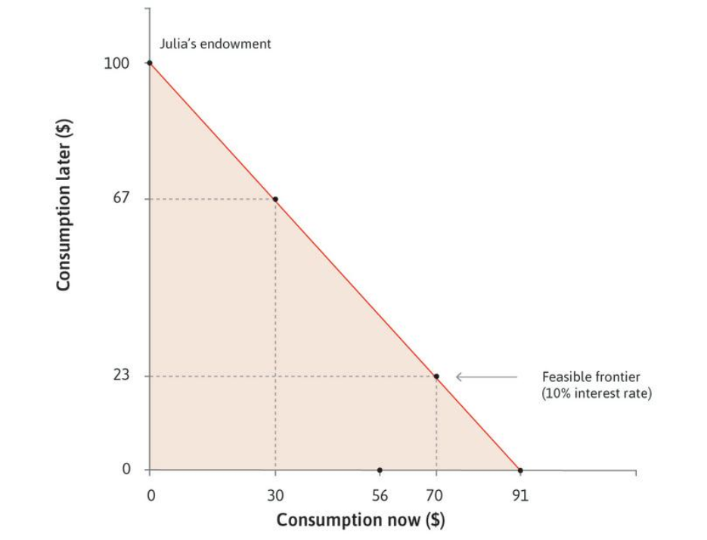
A higher interest rate
If, instead of 10%, the interest rate is 78%, Julia can only borrow a maximum of $56 now.

Slide 34
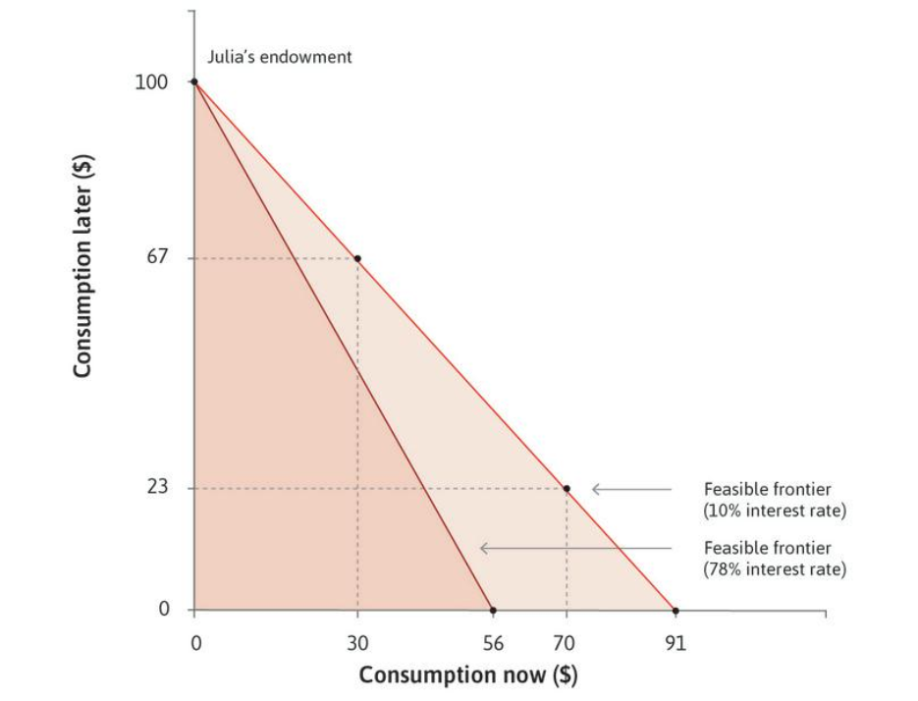
Borrowing
The feasible set with the interest rate of 78% is the dark shaded area, while the feasible set with an interest rate of 10% is the dark shaded area plus the light shaded area.

Slide 35
Consumption Smoothing: Diminishing Marginal Utility

Slide 36
Preferences for consumption
Borrowing allows us to bring consumption forward
How much consumption an individual will bring forward depends on:
consumption smoothing :
She prefers to smooth out her consumption instead of consuming everything later and nothing now.
She would like to smooth her consumption because she enjoys an additional unit of something more when she has not already consumed a lot of it.
impatience

Slide 37
What does the Slope of Feasible Set Represent?
The slope of feasible set is Marginal Rate of Transformation (MRT).
MRT represents the opportunity cost of bringing purchasing power forward in time from future to present.
Borrowing enable Julia to choose any combinations in feasible curve. Each combination shows different capacities to consume in present and in future.
Feasible set represents the maximum capacities to consume now and in future.
If interest rate is r, the MRT or opportunity cost of consuming $1 unit of good today is $\$1×r\$1$units of goods that we should give up in future.

Slide 38
What does the Slope of Indifference Curve Represent?
The slope of indifference curve is Marginal Rate of Substitution (MRS).
MRS represents Julia’s desire to smooth out her consumption by bringing her purchasing power from future to present.
Since MRS is falling, the desire to bring purchasing power forward in time is falling as we move along the curve to the right. This represents the diminishing marginal returns to consumptions or diminishing marginal utility.
Diminishing marginal utility suggests that the more goods she consumes in the present, the less satisfaction she gets from consuming an additional one now relative to more in the future, and hence her desire to bring purchasing power forward in time falls as well.
Diminishing marginal utility in each period mean that a consumer would like to smooth her consumption, to avoid consuming a lot in one period and little in the other.

Slide 39
Summary: Different Interpretations of MRS
1) represents the consumption smoothing desire to shift
purchasing power from future to present.
MRS 2) is the utility that the individual receives by increasing her
consumption by one unit.
3) represents the trade off - in terms of the purchasing power
she is willing to give up in future- that the individual is
willing to take in order to increase her consumption today
by one unit.

Slide 40
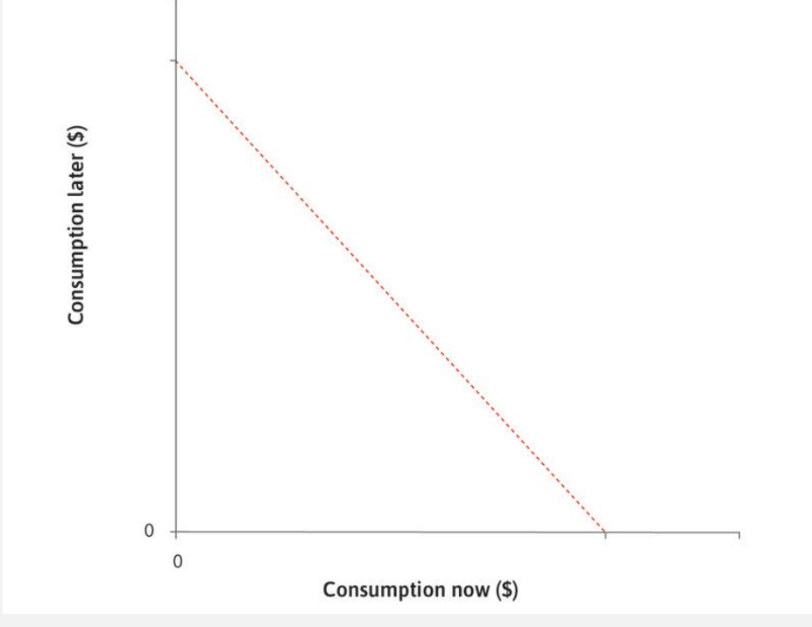
Julia’s choices
The dashed line shows the combinations of consumption now and consumption later from which Julia can choose.

Slide 41
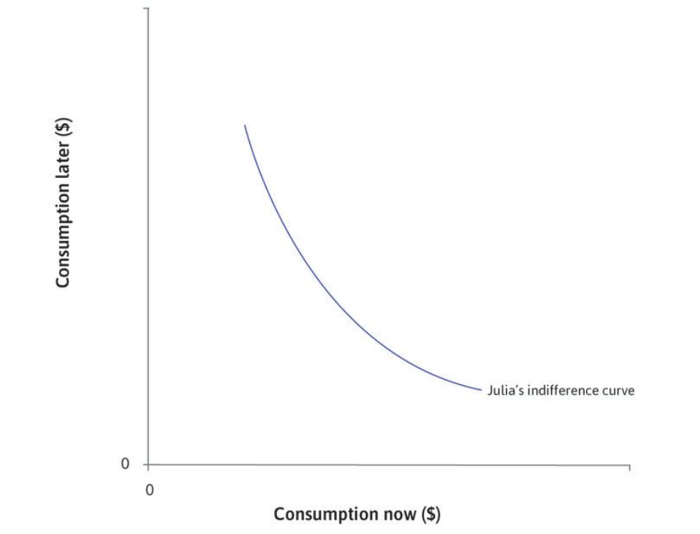
Diminishing marginal returns to consumption
MRS represents Julia’s desire to smooth out her consumption by shift her purchasing power from future to present.
The fact that MRS is falling represents this reality that as Julia consumes more good in present, her desire to shift purchasing power forward in time falls, as the utility she gets from consuming an additional unit of goods now falls as she consumes a lot of it.
Julia’s indifference curve is bowed toward the origin as a consequence of diminishing marginal returns to consumption (or diminishing marginal utility) in each period:
The more of the good the consumer already has, the lower the marginal utility provided by an extra unit of that good.
The slope of the indifference curve is the marginal rate of substitution (MRS) between consumption now and consumption later. It is diminishing.

Slide 42
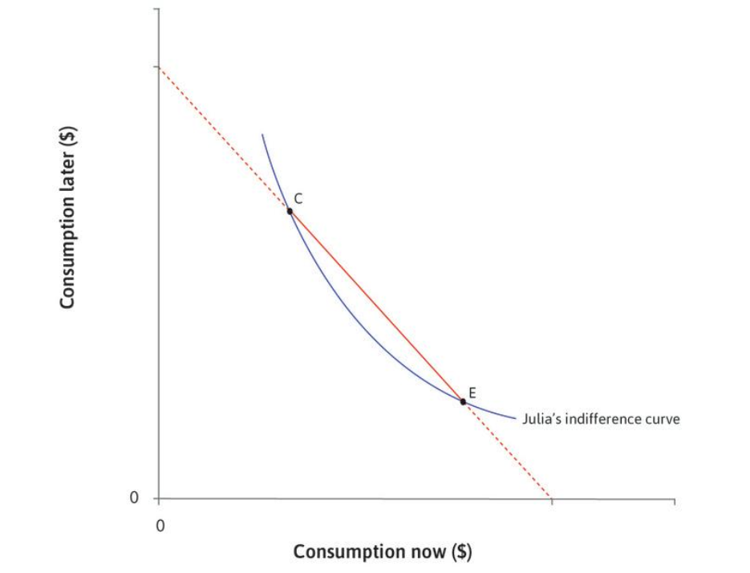
What choices would Julia make?
At C, $MRS>MRT$: MRS represents Julia’s desire to shift some of her purchasing power from future to present. When MRS is greater than MRT, it means that Julia’s desire to consume more in present exceeds the opportunity cost of it. She has little consumption now and a lot later, so diminishing marginal returns mean that she would like to move some consumption to the present.
Diminishing marginal utility in each period mean that Julia would like to smooth her consumption, that is, to avoid consuming a lot in one period and little in the other.
One plus the interest rate (1 + r) is the marginal rate of transformation of goods from the future to the present, because to have one unit of the good now you have to give up 1 + r goods in the future.
At E, $MRS<MRT,$
Julia’s desire to bring purchasing power forward in time is less than the opportunity cost of it. She has a lot of consumption now and a few later, so diminishing marginal utility suggest that she would like to move some consumption to the future by consuming less now. So she will choose a point between C and E.

Slide 43
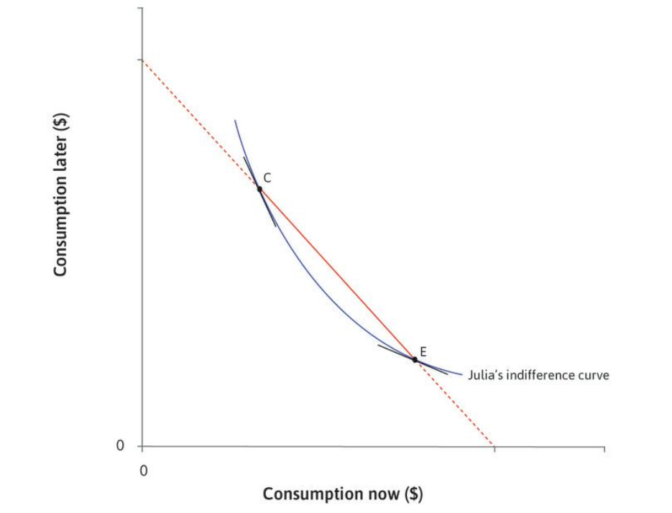
MRS Falls
We can see that the MRS is falling as we move along the indifference curve from C to E: the slope is steeper at C than at E.
This shows the diminishing marginal utility: the fact that the value from an additional unit of consumption declines as the consumption increases.

Slide 44
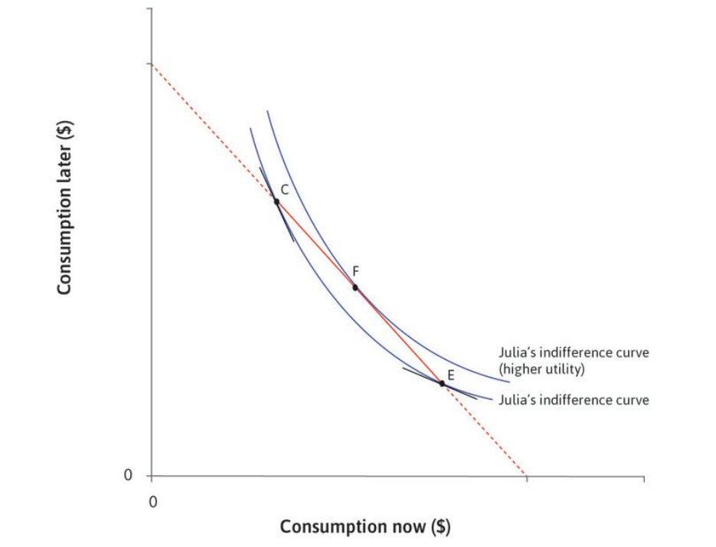
Julia’s Optimal Choice
Given the choice shown by the line CE, Julia will choose point F.
It is on the highest attainable indifference curve.
She prefers to smooth consumption between now and later.
An individual smoothes their consumption to avoid consuming a lot in one period and little in the other.

Slide 45
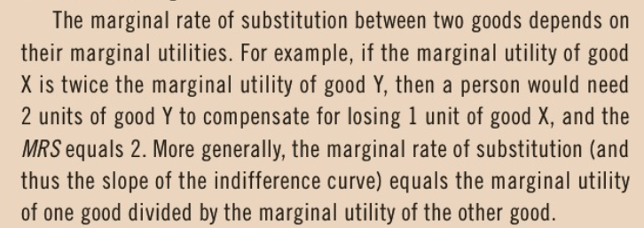
Marginal Rate of Substitution and Marginal Utility are Closely Related

Slide 46
Pure impatience
Consumption smoothing may appear as being impatient.
However, we differentiate it from pure impatience = being impatient as a person.
Myopia (short-sightedness): People experience the present satisfaction more strongly than the same satisfaction later
Prudence: People know that they may not be around in the future, and so they want to consume now
How much more do you value a good now than later, if your endowments are the same in both periods?

Slide 47
Optimal Decision-Making to Borrow: Moving consumption over time by borrowing

Slide 48
Discount Rate and Optimal Decision-Making
Discount rate (ρ) = a measure of a person's impatience.
It is the slope of the indifference curve minus one,
which is a measure of how much Julia values an extra unit of consumption now, relative to an extra unit of consumption later.
Individual borrows at the point where discount rate = interest rate
MRS = MRT
1+ρ = 1+r

Slide 49
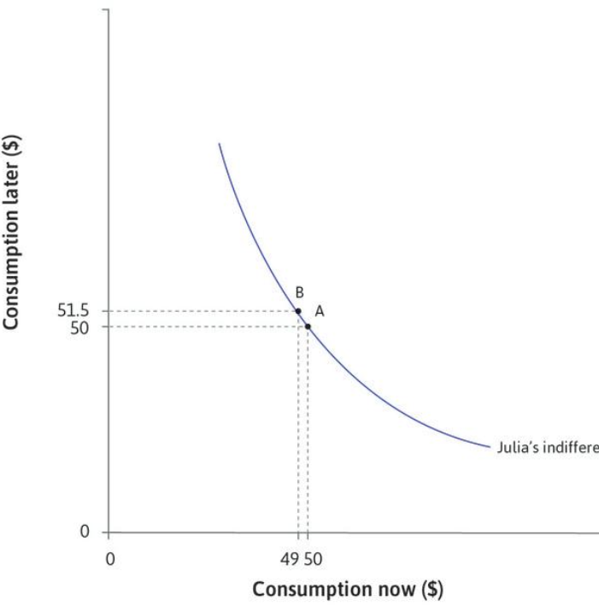
The slope of the indifference curve of 1.5 (in absolute value) at point A.
This means that she values an extra unit of consumption now 1.5 times as much as an extra unit of consumption later.
ρ = 50% at point A because an extra unit of consumption today was worth 1.5 extra units later.
This means that Julia borrows just enough so that:
Discount Rate
slope of the indifference curve (MRS)=slope of the feasible frontier (MRT)

Slide 50
Optimal Decision Making
1) her desire to smooth consumption
discount rate ρ
depends on both 2) and on her degree of pure impatience.
The point is that Julia decides to borrow when her discount rate – the rate that determines how much she values 1 extra unit of consumption now relative to an extra unit of consumption later- is equal to interest rate- her cost of borrowing.
$ρ$ is determined by the individual while $r$ is given to her.

Slide 51
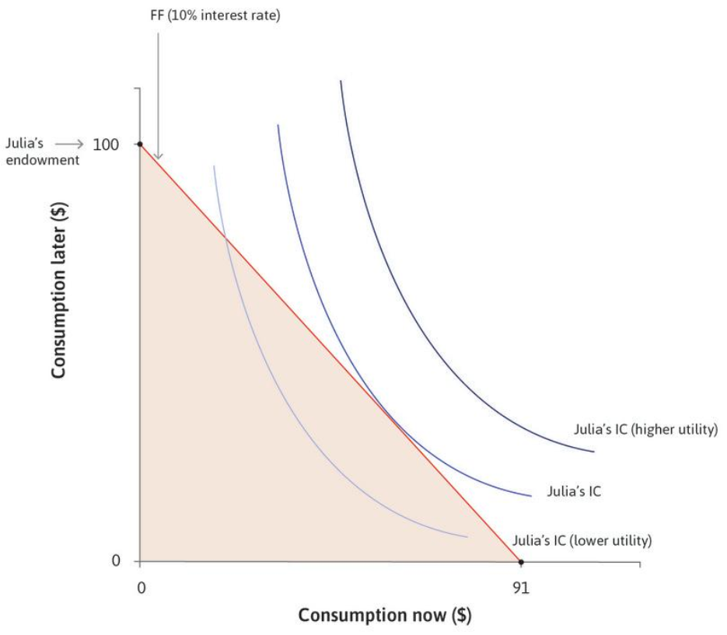
Feasible Frontier
Julia wishes to get to the highest indifference curve but is limited by her feasible frontier.
Recap: Julia’s desire to smooth out her consumption is demonstrated through the indifference curve.
The fact that the slope of MRS is falling shows that Julia’s behavior is following diminishing marginal utility pattern where Julia’s utility to consume an additional unit of goods today drops as she consumes more.

Slide 52
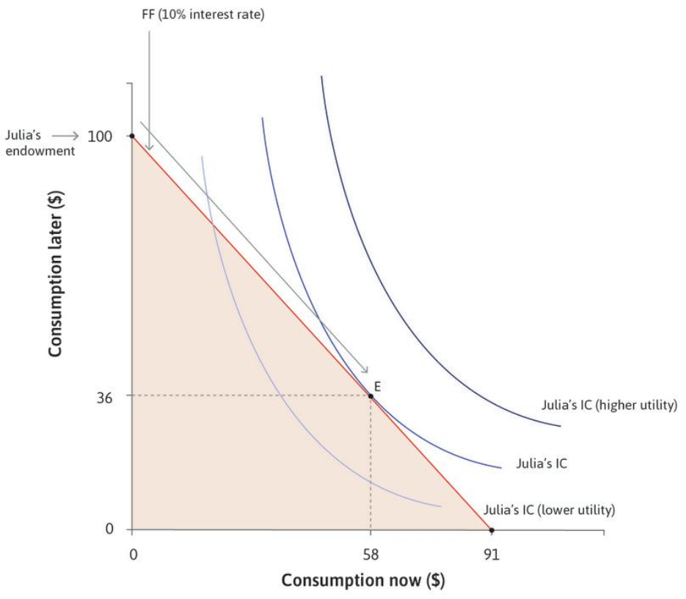
Best Option
When the interest rate is 10%, the highest attainable indifference curve will be the one that is tangent to the feasible frontier shown as point E.

Slide 53
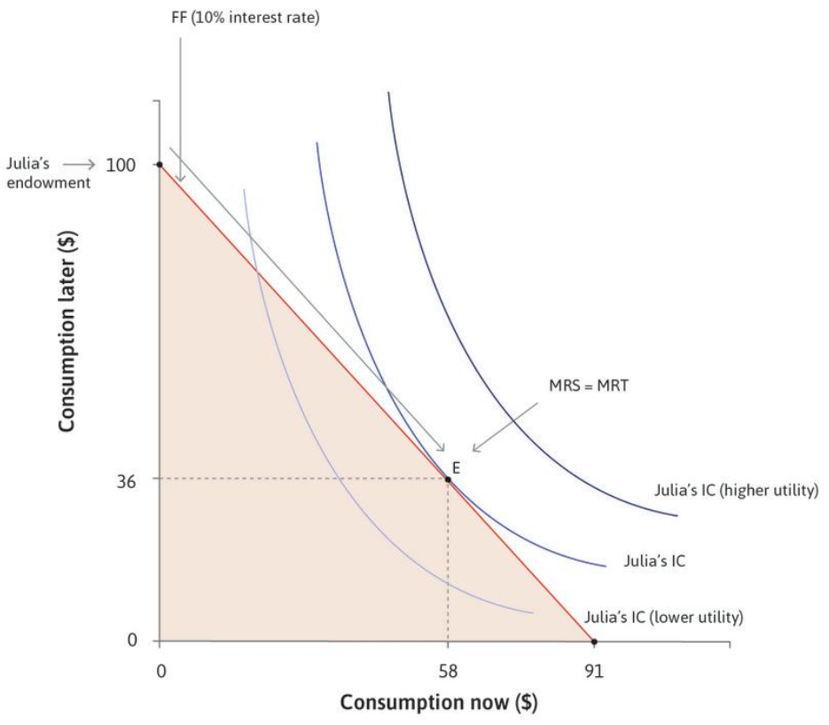
MRS and MRT
At this point, MRS = MRT.

Slide 54
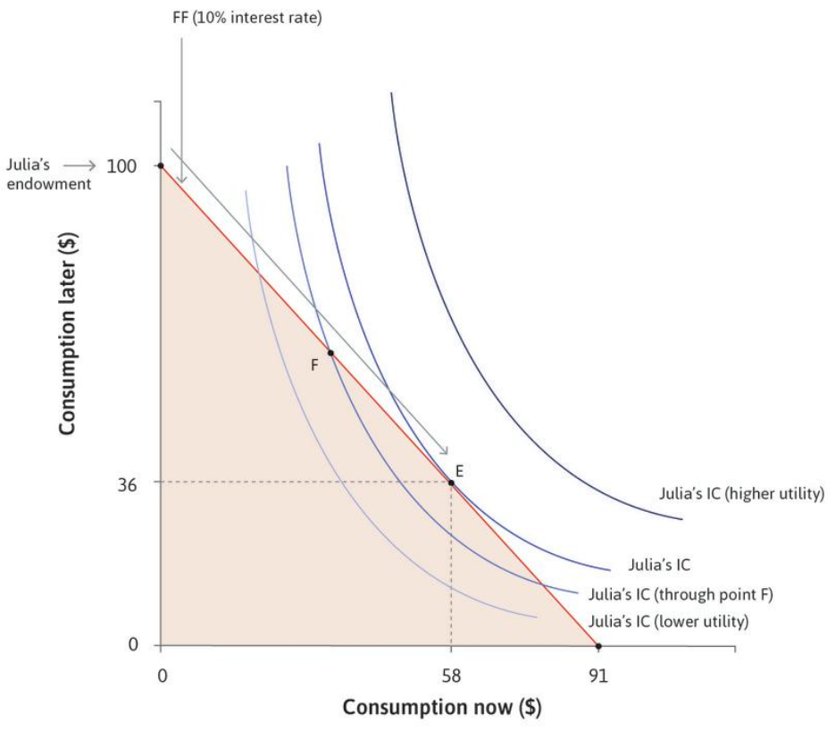
The Decision To Borrow
At point F, Julia values one extra unit of consumption today relative to one extra unit of consumption later more than the cost of financing it. Thus, she decides to consume more today and increase her borrowing.
At point F, her discount rate, ρ, exceeds r, the interest rate, so she would like to bring consumption forward in time.
Similar reasoning eliminates all points on the feasible frontier except E.

Slide 55
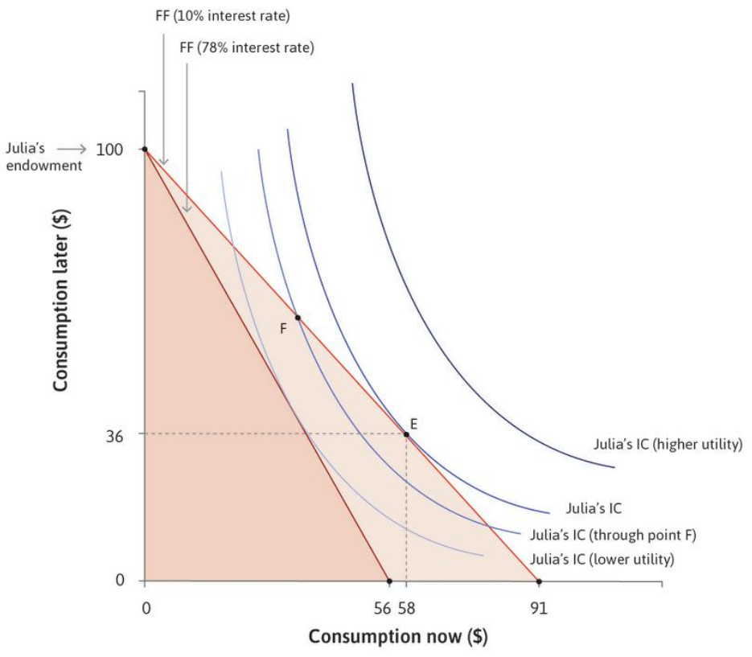
An Increase in the Interest Rate
If the interest rate at which she can borrow increases, the feasible set gets smaller.

Slide 56
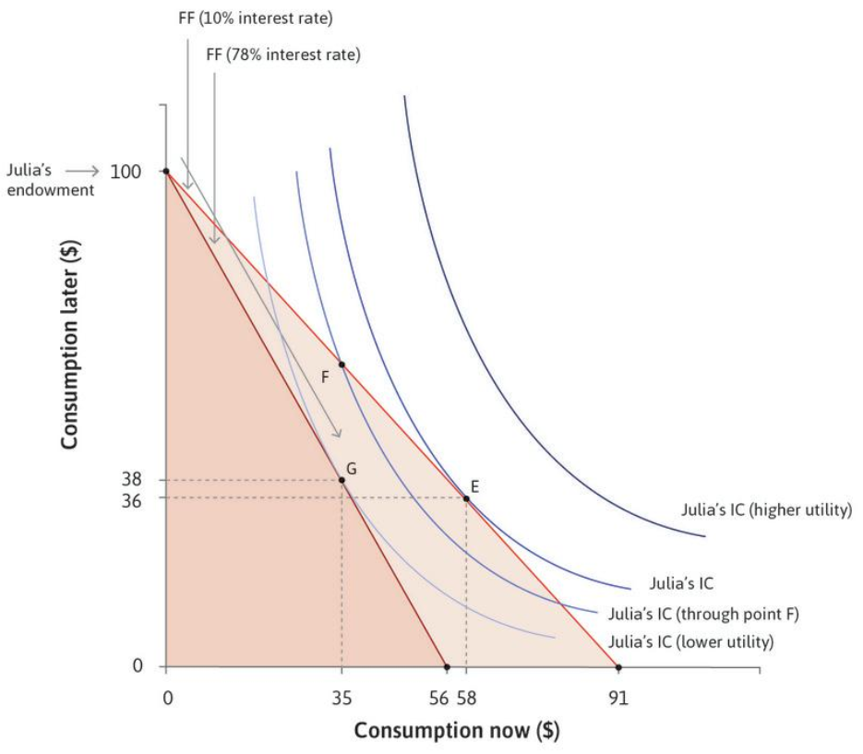
The Effect of a Higher Interest Rate
The best Julia can do now is to borrow less ($35 instead of $58), as shown by point G

Slide 57
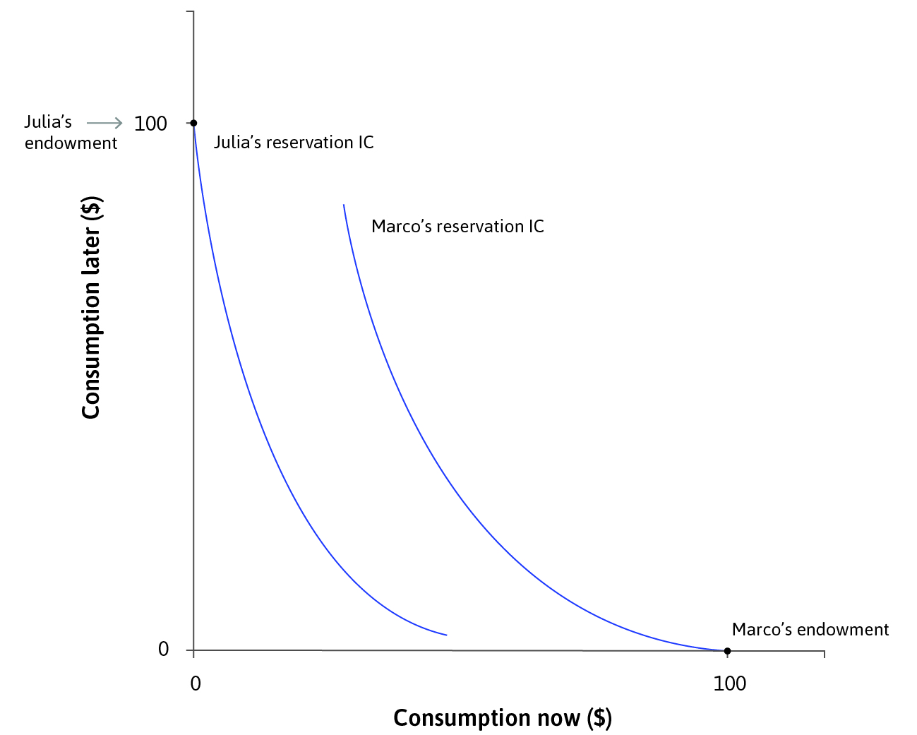
Borrowers and savers
Reservation indifference curve = it is made of all of the points at which Julia would be just as well off as at her reservation position, which is her endowment with no borrowing or lending.
The borrower and the saver have different indifference curves because they have different endowments.

Slide 58
Smoothing Consumption By Storing (or Saving) and Lending

Slide 59
Lenders and Borrowers
Macro (the lender) has the same preference as Julie (the borrower)- they both want to smooth out their consumption.
They, however, have different situation: the lender wants to shift some of her purchasing power from present to future and the borrower prefers to transfer her purchasing power from future to present.
Since MRS shows the desire to shift consumption from future to present, the borrower’s MRS is high while the lender’s MRS is low.

Slide 60
Saving and Lending
The (potential) lender has several ways of smoothing her consumption:
Storing (Saving): the problem with storing (saving) is that wealth will be depreciated over time. So, the lender’s purchasing power in future will be lower than her purchasing power today simply due to depreciation.
Lending: she will earn interest on her wealth. However, she will be exposed to credit risk of the borrower.

Slide 61
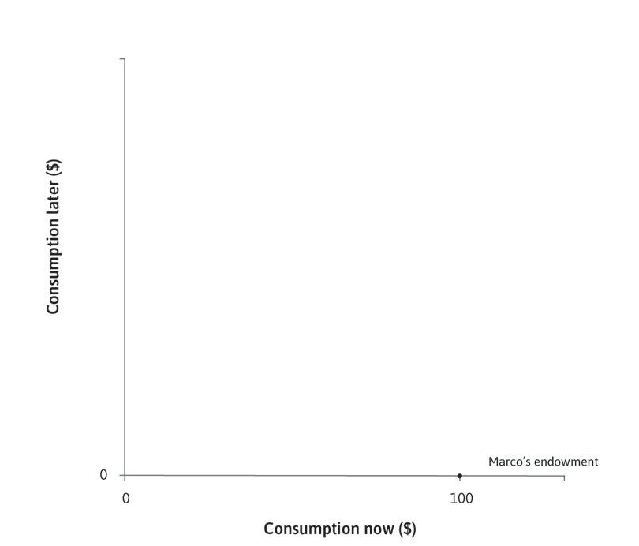
Marco Has Wealth Today
Marco has $100 of grain available now.

Slide 62
Marco’s Feasible Frontier
The dark line shows Marco’s feasible frontier using storage, and the shaded area shows his feasible set.

Slide 63
Marco’s Preferences
Marco’s reservation indifference curve goes through his endowment.

Slide 64
Marco’s Decision to Store (or Save)
Point H on Marco’s indifference curve denotes the amount of storage that he will choose.
$\left(\$100−\$68\right)×\left(1−0.2\right)=\$25.6$;
$$(endowment −consumption today)×(1−depreciation rate)$$

Slide 65
Marco’s Decision to Lend
$$\$100×\left(1+0.1\right)=\$110;$$
$$Principal ×(1+interest rate)$$
The light line shows the feasible frontier when Marco lends at 10%.
In a modern economy, there are a variety of financial instruments that Marco can use to shift consumption to the future by lending such as term deposits, or bonds issued by companies or by the government.

Slide 66
The Effect of the Decision to Lend
Marco is now able to reach a higher indifference curve.

Slide 67
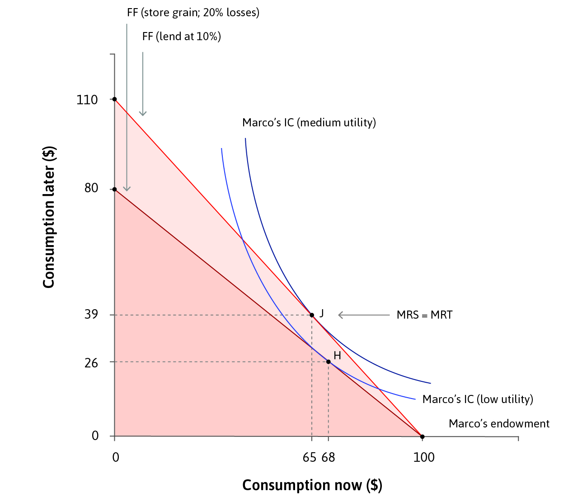
Saving And Lending
A saver smoothes his consumption by postponing it into the future.
Lending money at interest expands the saver’s feasible set, compared to simply storing it.

Slide 68
Investment: A Path to Smooth Out the Consumption

Slide 69
Investing in a High-Return Project
The return on investment
If Marco were to invest all of his grain, he could harvest $150 worth of grain later.

Slide 70
Investing in a High-Return Project
The return on investment
The slope of the red line is −1.5, where the absolute value (1.5) is 1 plus the rate of return on the investment.

Slide 71
Investing in a High-Return Project
Marco’s optimal choice
Marco chooses to consume $60 now and $60 later, as shown by point K.
At this point, the feasible frontier is tangent to an indifference curve.

Slide 72
Invest All Plan
If Marco could get a loan at 10%, he would quickly see that he would be better off with an entirely new plan:
invest everything he has, with a harvest next year of $150, but also borrow now in order to be able to consume more both now and in the future.

Slide 73
Borrowing To Invest In A High-return Project
Marco’s optimal choice when he can invest
His optimal choice when he can invest is at point K.

Slide 74
Borrowing To Invest In A High-return Project
Marco gets a loan
If he could get a loan at 10%, he would be better off by investing everything he has. This expands his feasible set, as shown by the dotted red line

Slide 75
Borrowing To Invest In A High-return Project
Optimal choice after getting a loan
Marco ends up consuming at point L, with $80 now and $62 in the future.

Slide 76
How The ‘Invest-it-all And Borrow’ Plan Works Compared To The Other Options.

Slide 77
The Feasible Sets For All Of Marco’s Options

Slide 78
Summary: A Few Key Points
Three differences between Marco and Julia explain the disparity in their outcomes.
Marco starts with an asset while Julia starts with nothing: Julia has the prospect of a similar asset later, but this puts the two on opposite sides of the credit market.
Marco has a productive investment opportunity while Julia does not.

Slide 79
Summary: A Few Key Points
Marco and Julia may face different interest rates:
The less-obvious difference is that if Marco (after investing his entire asset at a 50% return) wants to move his buying power forward in time, he borrows against his future income at a rate of 10%. Julia, lacking assets may have no alternative but to borrow at the higher rate of 78%.
The paradox is that Marco can borrow at a low interest rate because he does not need to borrow.

Slide 80
Summary: A Few Key Points
Borrowing, lending, storing, and investing are ways of moving goods consumption forward (to the present) or backwards (to the future) in time.
People engage in these activities because:
They can increase their utility by smoothing consumption: Or, if they have pure impatience, by moving consumption to the present.
They can increase their consumption in both periods: By lending, or investing.

Slide 81
Summary: A Few Key Points
People differ in which of these activities they engage (some borrowing, some lending) because:
They have differences in their situation: For example, having an income now or later will affect their discount rates and their opportunities. Also, some have investment opportunities (like Marco), while others do not.
They differ in their level of pure impatience.

Slide 82
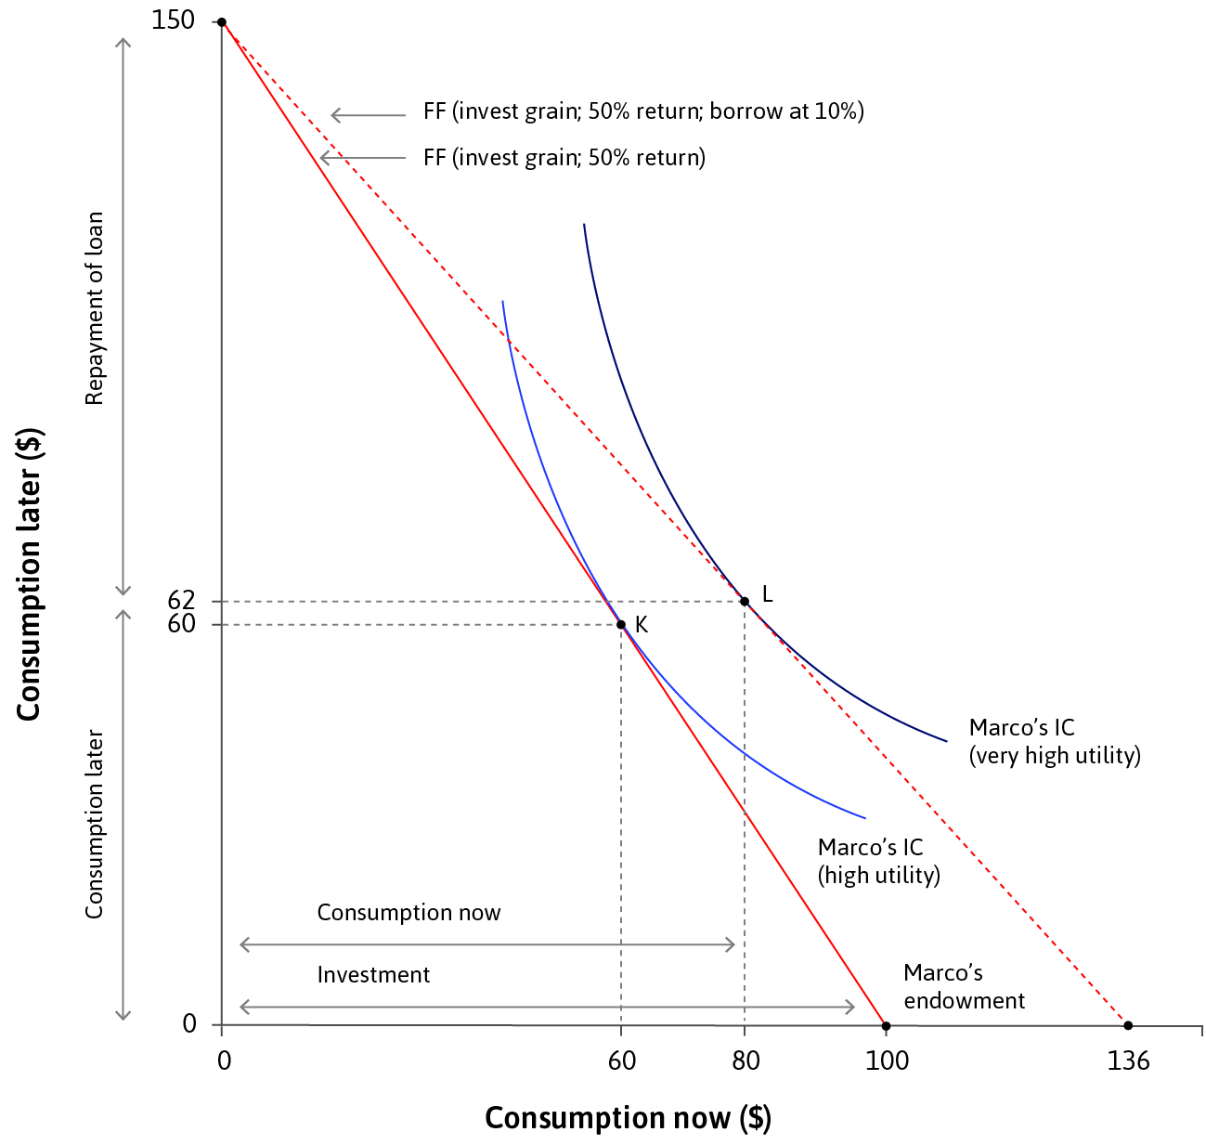
Investment
Investment is another way to move consumption to the future
Combination of investing and borrowing can increase consumption in both periods
An individual’s situation e.g. wealth and income affects their opportunities to engage in these activities, and their interest rates

Slide 83
Central Bank Policy Can Affect Spending

Slide 84
Interest Rates And Consumption Spending
Julia has no wealth now
She expects to receive $100 in one year.

Slide 85
Interest Rates And Consumption Spending
The moneylender’s interest rate
At the moneylender’s interest rate of 78%, she borrowed in order to spend $35 now (point G).

Slide 86
Interest Rates And Consumption Spending
A lower interest rate
At the interest rate of 10% she would borrow and spend $58 now (point E).

Slide 87
Interest Rates And Consumption Spending
As the interest rate falls …
The right-hand panel of the figure traces out Julia’s consumption spending now as the interest rate falls, with G and E corresponding to the same points in the left-hand panel.

Slide 88
Interest Rates And Consumption Spending
Optimal choice after getting a loan
Marco ends up consuming at point L, with $80 now and $62 in the future

Slide 89
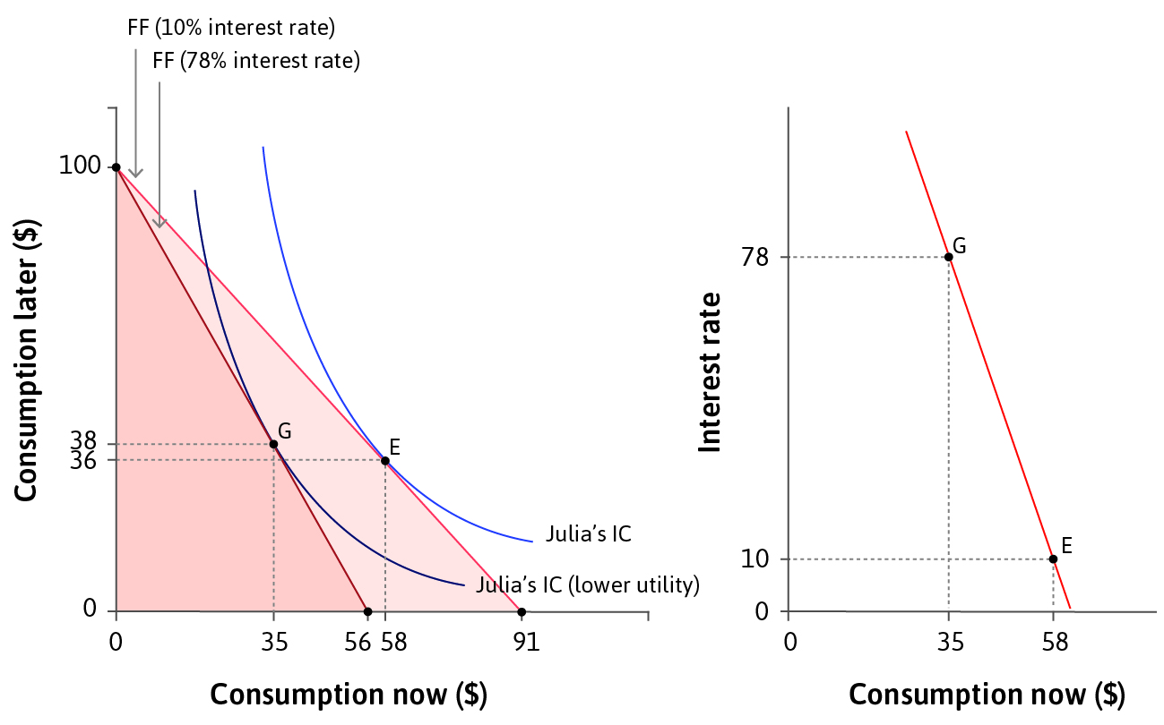
Policy rate and the economy
The central bank’s policy rate affects the level of spending in the economy, because households and firms borrow to spend.
higher interest rate → low spending today

