Slide 1
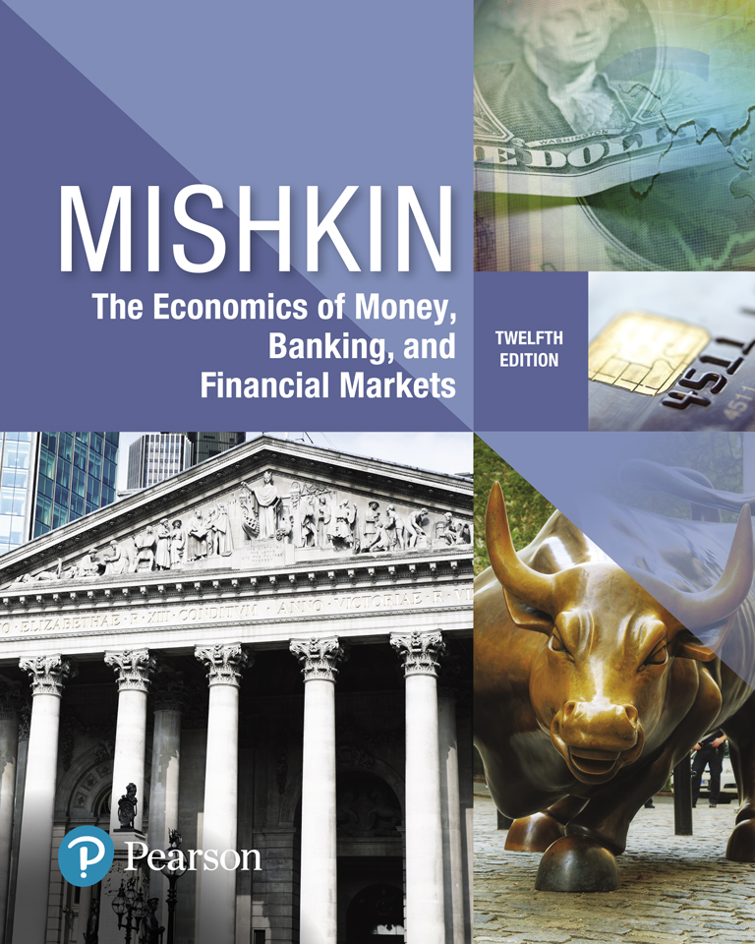
The Economics of Money, Banking, and Financial Markets
Twelfth Edition
Chapter 24
The Role of Expectations in Monetary Policy
Copyright © 2019, 2016, 2013 Pearson Education, Inc. All Rights Reserved.
Notes:
If this PowerPoint presentation contains mathematical equations, you may need to check that your computer has the following installed:
1) MathType Plugin
2) Math Player (free versions available)
3) NVDA Reader (free versions available)

Slide 2
Preview
This chapter examines the analysis behind the rational expectations revolution.

Slide 3
Learning Objectives
Summarize the Lucas critique.
because expectations are an important part of economic behavior, it may be quite difficult to predict what the outcome of a discretionary policy will be. W
Compare and contrast the use of policy rules versus discretionary policy.
Summarize and illustrate the benefits of a credible central bank.
Identify the ways in which central banks can establish and maintain their credibility.

Slide 4
Adaptive Expectations (1 of 3)
Expectations are formed from past experience only.
Changes in expectations will occur slowly over time as data for the variable evolve:
For instance, if inflation had formerly been steady at a 5% rate, expectations of future inflation would be 5%, too.
If inflation rose to a steady rate of 10%, expectations of future inflation would rise toward 10%, but slowly: In the first year, expected inflation might rise only to 6%; in the second year, to 7%; and so on.

Slide 5
Adaptive Expectations (2 of 3)
However, the adaptive expectations hypothesis has been faulted on the grounds that people use more information than just past data on a single variable to form their expectations of that variable.
For instance, heir expectations of inflation will almost surely be affected by their predictions of future monetary policy, as well as by current and past monetary policy.
In addition, people often change their expectations quickly in the light of new information.

Slide 6
Adaptive Expectations (3 of 3)
To address these objections to the validity of adaptive expectations, John Muth developed an alternative theory of expectations, called rational expectations, which can be stated as follows:
Expectations will be identical to optimal forecasts (the best guess of the future) using all available information.

Slide 7
Rational Expectations (1 of 4)
Today, most economists are critical of the adaptive expectations approach because it assumes that people ignore information that would be useful in making forecasts

Slide 8
Rational Expectations (2 of 4)
For example, in the late 1970s, the rate of inflation increased each year from 1976 through 1980. Anyone forecasting inflation by looking only at its past values would have expected inflation to be lower than it turned out to be. The rate of inflation declined each year from 1980 through 1983.
During this period, anyone forecasting inflation by looking only at its past values would have expected inflation to be higher than it actually was.
Taking into account additional information, such as Federal Reserve policy, movements in oil prices, or other factors that affect inflation rather than relying only on past values of inflation would have enabled someone to make a more accurate forecast.

Slide 9
Rational Expectations (3 of 4)
In 1961, John Muth of Carnegie Mellon University proposed a new approach he labeled rational expectations.
With rational expectations, people make forecasts using all available information
Muth argued that someone who did not use all available information would not be acting rationally.
That is, the person would not be doing his or her best to achieve the goal of an accurate forecast.

Slide 10
Rational Expectations (4 of 4)
For example, in forecasting the price of a firm’s stock, investors should use not just past prices of the stock but also any other information that is helpful in forecasting the future profitability of the firm.
Such information include the quality of the firm’s management, new products the firm might be developing, and so on.

Slide 11
Rational Expectations: Optimal Forecast
If sufficient number of investors and traders in the stock market have rational expectations, the market price of a stock should equal the best estimate (optimal forecast) of the present value of expected future dividends, which is the stock’s fundamental value.

Slide 12
Rational Expectations: Forecast Error (1 of 4)
Saying that investors have rational expectations is not the same as saying that they can foretell the future.
In other words, the optimal forecast is optimal, but it may be wrong.
To state this concept more exactly, suppose that at the end of trading today on the stock market, $P_{t+1}^{e}$is the optimal forecast of the price of Apple’s stock at the end of trading tomorrow, then it is very unlikely that we will see $P_{t+1}^{e}$= $P_{t+1}^{}$.

Slide 13
Rational Expectations: Forecast Error (2 of 4)
Why?
Because tomorrow, investors and traders are likely to obtain additional information about Apple—perhaps sales of the iPhones during the previous month are below what was forecast—that will change their view of the fundamental value of Apple’s stock.
So, there is likely to be a forecast error, which is the difference between the forecast price of Apple’s stock and the actual price of Apple’s stock.

Slide 14
Rational Expectations: Forecast Error (3 of 4)
But no one can accurately forecast the size of that error ahead of time because
the error is caused by new information that is not available when the forecast is made.
If the information had been available, rational expectations tell us that it would have been incorporated into the forecast of the stock price.
Therefore, the forecast error is unforecastable and follows random walk. To state the point more formally:

Slide 15
Rational Expectations: Forecast Error (4 of 4)
So, when a forecast is made, we can be fairly sure that the forecast will turn out to be lower or higher than the actual value of the variable being forecast.
But forecast errors follow random walk:
we have no way of telling how large the error will be or even whether it will be positive (that is, our forecast was too low) or negative (that is, our forecast was too high).

Slide 16
Lucas Critique of Policy Evaluation
Macro-econometric models: Collections of equations that describe statistical relationships among economic variables. They are used by economists to forecast economic activity and to evaluate the potential effects of policy options.
In his famous paper “Econometric Policy Evaluation: A Critique,” Robert Lucas argued that econometric models are unreliable for evaluation policy options if they do not incorporate rational expectations.
According to Lucas, when policies change, public expectations will shift as well, and such changing expectations (as we seen in previous chapters but ignored by conventional econometric models at the time) can have a real effect on economic behavior and outcomes.

Slide 17
Econometric Policy Evaluation (1 of 3)
To understand Lucas’s argument, we must first understand how econometric policy evaluation is done.
For example, let’s assume the Federal Reserve wants to evaluate the potential effects of changes in the federal funds rate from the existing level of, say, 5%.
Using conventional methods, the Fed economists would feed different fed funds rate options—say, 4% and 6%—into a computer version of a model. The model would then predict how unemployment and inflation would change under the different scenarios. Then, the policymakers would select the policy that the model predicted would have the most desirable outcomes.

Slide 18
Econometric Policy Evaluation (2 of 3)
When policies change, public expectations shift as well
For example, if the Fed raises the federal funds rate to 6%, this action might change the way the public forms expectations about where interest rates will head in the future.
Those changing expectations, as we’ve seen, can have a real effect on economic behavior and outcomes.

Slide 19
Econometric Policy Evaluation (3 of 3)
Econometric models that do not incorporate rational expectations ignore the effects of changing expectations and thus are unreliable for evaluating policy options.
Relying on rational expectations theory, Lucas identified faulty reasoning in this approach if the model did not incorporate rational expectations.

Slide 20
Implications of Lucas Critique for Keynesian Economics (1 of 9)
Despite the battles between Keynesians and monetarists, macroeconomics at around 1970 looked like a successful and mature field. It appeared to successfully explain events and guide policy choices. Most debates were framed within a common intellectual framework.
But within a few years, the field was in crisis. This crisis had two sources:
One was events. By the mid-1970s, most countries were experiencing stagflation, a word created at the time to denote the simultaneous existence of high unemployment and high inflation. Macroeconomists had not predicted stagflation.

Slide 21
Implications of Lucas Critique for Keynesian Economics (2 of 9)
After the fact and after a few years of research, a convincing explanation was provided, based on the effects of adverse supply shocks on both inflation and output. But it was too late to undo the damage to the discipline’s image.
2. The other was ideas. In the early 1970s, a small group of economists—Robert Lucas from Chicago; Thomas Sargent, then from Minnesota and now at New York University; and Robert Barro, then from Chicago and now at Harvard—led a strong attack against mainstream macroeconomics.

Slide 22
Implications of Lucas Critique for Keynesian Economics (3 of 9)
Lucas and Sargent’s main argument was that Keynesian economics had ignored the full implications of the effect of expectations on behavior.
The way to proceed, they argued, was to assume that people formed expectations as rationally as they could, based on the information they had.

Slide 23
Implications of Lucas Critique for Keynesian Economics (4 of 9)
In a 1978 paper, Lucas and Sargent stated:
“That the predictions [of Keynesian economics] were wildly incorrect, and that the doctrine on which they were based was fundamentally flawed, are now simple matters of fact, involving no subtleties in economic theory. The task which faces ­contemporary students of the business cycle is that of sorting through the wreckage, determining what features of that remarkable intellectual event called the Keynesian Revolution can be salvaged and put to good use, and which others must be discarded.”

Slide 24
Implications of Lucas Critique for Keynesian Economics (5 of 9)
Thinking of people as having rational expectations had three major implications, all highly damaging to Keynesian macroeconomics.
The first implication was that existing macroeconomic models could not be used to help design policy (Lucas Critique).
Although these models recognized that expectations affect behavior, they did not incorporate expectations explicitly.
All variables were assumed to depend on current and past values of other variables, including policy variables.
Thus, what the models captured was the set of relations between economic variables as they had held in the past, under past policies.
Were these policies to change, Lucas argued, the way people formed expectations would change as well, making estimated relations—and, by implication, simulations generated using existing macroeconometric models—poor guides to what would happen under these new policies.

Slide 25
Implications of Lucas Critique for Keynesian Economics (6 of 9)
2. The second implication was that when rational expectations were introduced in Keynesian models, these models actually delivered very un-Keynesian conclusions.
For example, the models implied that deviations of output from its natural level were short lived, much more so than Keynesian economists claimed.
This argument was based on a reexamination of the aggregate supply relation. In Keynesian models, the slow return of output to the natural level of output came from the slow adjustment of prices and wages through the Phillips curve mechanism.
An increase in money, for example, led first to higher output and to lower unemployment. Lower unemployment then led to higher nominal wages and to higher prices. The adjustment continued until wages and prices had increased in the same proportion as nominal money, until unemployment and output were both back at their natural levels.

Slide 26
Implications of Lucas Critique for Keynesian Economics (7 of 9)
But this adjustment, Lucas pointed out, was highly dependent on wage setters’ backward-looking expectations of inflation.
In these model, for example, wages responded only to current and past inflation and to current unemployment.
But once the assumption was made that wage setters had rational expectations, the adjustment was likely to be much faster. Changes in money, to the extent that they were anticipated, might have no effect on output.
For example, anticipating an increase in money of 5% over the coming year, wage setters would increase the nominal wages set in contracts for the coming year by 5%. Firms would in turn increase prices by 5%. The result would be no change in the real money stock, and no change in demand or output.
Within the logic of the Keynesian models, Lucas therefore argued, only unanticipated changes in money should affect output.
More generally, if wage setters had rational expectations, shifts in demand were likely to have effects on output for only as long as nominal wages were set—a year or so. Even on its own terms, the Keynesian model did not deliver a convincing theory of the long-lasting effects of demand on output.

Slide 27
Implications of Lucas Critique for Keynesian Economics (8 of 9)
3. The third implication was that if people and firms had rational expectations, it was wrong to think of policy as the control of a complicated but passive system. Rather, the right way was to think of policy as a game between policy makers and the economy.
The right tool was not optimal control, but game theory. And game theory led to a different vision of policy.
A striking example was the issue of time inconsistency discussed by Finn Kydland and Edward Prescott (then at Carnegie Mellon, now at Arizona State University), an issue that we discussed.
Good intentions on the part of policy makers could ­actually lead to disaster.

Slide 28
Implications of Lucas Critique for Keynesian Economics (9 of 9)
To summarize:
When rational expectations were introduced,
Keynesian models could not be used to determine policy;
Keynesian models could not explain long-lasting deviations of output from the natural level of output;
the theory of policy had to be redesigned, using the tools of game theory.

Slide 29
Application: The Term Structure of Interest Rate (1 of 6)
Let’s now apply Lucas’s argument to a concrete example involving only one equation typically found in econometric models: the term structure equation.
Term structure of interest rate argues that the long-term interest rate is related to an average of expected future short-term interest rates.
However, the equation that estimates the term structure relates the long-term interest rate to current and past values of the short-term interest rate.

Slide 30
Application: The Term Structure of Interest Rate (2 of 6)
Formation of expectations in past periods:
Suppose that in the past, when the short-term rate rose, it quickly fell back down again; that is, any increase was temporary.
Rational expectations theory suggests that any rise in the short-term interest rate is expected to be only temporary:
such a rise should have only a minimal effect on the average of expected future short-term rates.
Therefore, the rise in the short-term rate should cause the long-term interest rate to rise by only a negligible amount.

Slide 31
Application: The Term Structure of Interest Rate (3 of 6)
Suppose the Fed wants to evaluate the effects on the economy of a policy that is likely to raise the short-term interest rate from its existing level of, say, 5% to a higher level of 6% for the foreseeable future.
The term structure relationship as estimated using past data thus indicates that changes in the short-term interest rate will have only a weak effect on the long-term interest rate.

Slide 32
Application: The Term Structure of Interest Rate (4 of 6)
However, if the public expects that the short-term rate is rising to a permanently higher level, rational expectations theory indicates that people will no longer expect a rise in the short-term rate to be temporary.
Instead, when they see the interest rate rise to 6%, they will expect the average of future short-term interest rates to rise substantially,
and so the long-term interest rate will rise greatly, not minimally as suggested by the term structure equation.
You can see that using an econometric model to evaluate the likely outcome of the change in Fed policy can lead to highly misleading information.

Slide 33
Application: The Term Structure of Interest Rate (5 of 6)
The term structure application demonstrates an important aspect of the Lucas critique:
The effects of a particular policy depend critically on the public’s expectations about the policy.
One attractive feature of the term structure example is that it deals with expectations in the financial market,
a sector of the economy for which the empirical evidence supporting rational expectations is much stronger.

Slide 34
Application: The Term Structure of Interest Rate (6 of 6)
The Lucas critique should also apply, however, to sectors of the economy with regard to which rational expectations theory is more controversial,
because the basic principle of the Lucas critique is not that expectations are always rational but rather that the formation of expectations changes when the behavior of a forecasted variable changes.
This less stringent principle is supported by the evidence in sectors of the economy other than financial markets. In fact, Lucas uses examples of consumption and investment equations in his paper.

Slide 35
Policy Conduct: Rules or Discretion? (1 of 2)
The Lucas critique exposed the need for new policy models that reflected the insights of rational expectations theory.
Policy rules are binding plans that specify how policy will respond (or not respond) to a particular data such as unemployment and inflation.
Policy discretion is applied when policy makers make no commitment to future actions, but instead make what they believe in that moment to be the right decision for the situation.
Finn Kydland, Edward Prescott, and Guillermo Calvo argued that discretionary policy is subject to the time-inconsistency problem
the tendency to deviate from good long-run plans when making short-run decisions.

Slide 36
Policy Conduct: Rules or Discretion? (2 of 2)
Policy makers are always tempted to pursue expansionary policy to boost output in the short run, but the best policy is not to pursue it:
Unexpected expansionary policy will raise workers, and firms’ expectations about inflation, thus driving up wages and prices, and the end results will be higher inflation but no increase in output.
The time-inconsistency problem implies that a policy will have better inflation performance in the long run if it does not try to surprise people with an unexpectedly expansionary policy, but instead sticks to a certain rule.

Slide 37
Types of Rules (1 of 3)
There are two type of rules:
Nonactivist such as monetarist rules:
Rules of this type are deemed nonactivist because they do not “react” to economic conditions.
Activist rules such as Taylor Rules
Activist rules, in contrast, specify that monetary policy should react to the level of output as well as to inflation.

Slide 38
Types of Rules (2 of 3)
Nonactivist rules, which do not react to economic activity, are essentially automatic.
They include
Milton Friedman’s constant-money-growth-rate rule, in which the money supply is kept growing at a constant rate regardless of the state of the economy.
Variants of the Friedmans rule, as proposed by other monetarists such as Bennett McCallum and Alan Meltzer, allow the rate of money supply growth to be adjusted for shifts in velocity, nominal income divided by the quantity of money.

Slide 39
Types of Rules (3 of 3)
Activist rules, which specify that monetary policy reacts to changes in economic activity, such as the level of output and to inflation.
The most famous rule of this type is the Taylor rule. It specifies that the Fed should set its federal funds rate target by using a formula that considers both the output gap($Y−Y^{P}$) and the inflation gap ($π−π^{T}$).

Slide 40
The Case for Rules (1 of 3)
Solving time-inconsistency problem
One argument for rules is that they lead to desirable long-run outcomes because commitment to a policy rule solves the time-inconsistency problem
If monetary policymakers operate with discretion, they will be tempted to pursue overly expansionary monetary policies that will boost employment in the short run but generate higher inflation (but not higher employment) in the long run.
Rule does not allow policy makers to exercise discretion and try to exploit the short-run tradeoff between inflation and employment.

Slide 41
The Case for Rules (2 of 3)
Friedman and Schwartz: Policymakers are not trustworthy
Another argument for rules is that policy makers and politicians cannot be trusted as they have strong incentives to pursue policies that will help them win the next election:
They are therefore more likely to focus on increasing employment in the short run without worrying that their actions might lead to higher inflation further down the road.

Slide 42
The Case for Rules (3 of 3)
Their advocacy for expansionary policies can lead to a so-called political business cycle, in which fiscal and monetary policy are expansionary right before elections, with higher inflation following later.
The paper that launched research on the political business cycle was William Nordhaus, “The Political Business Cycle,” Review of Economic Studies 42 (1975): 169–190. He won Noble Prize in 2018.

Slide 43
The Political Business Cycle and Richard Nixon
There is some argument that prior to the 1972 Presidential election the Nixon administration took steps to ensure a landslide victory—the largest in U.S. history to that point in time. Among other things, it imposed wage and price controls on the economy, which temporarily lowered the inflation rate. After the election, those same actions contributed to a surge in inflation. Nixon also pursued expansionary fiscal policy by cutting taxes. And it has been rumored that the chair of the Federal Reserve at the time, Arthur Burns, succumbed to direct pressure from Nixon to maintain low interest rates through election day.

Slide 44
Drawbacks of Policy Rules
Lack of flexibility
Inability to incorporate judgment
Reliance on the hypothetical “true” model
Disregarding Structural changes (Lucas Critique)

Slide 45
The Case for Discretion (1 of 3)
Flexibility: Rules can be too rigid because they cannot foresee every contingency
For example, the unprecedented steps taken by the Fed during this crisis to prevent it from causing a depression could not have been written into a policy rule ahead of time.
Judgment: Rules do not easily incorporate the use of judgment because monetary policy makers need to look at a wide range of information and some of this information is not easily quantifiable
Monetary policy is as much an art as it is a science.

Slide 46
The Case for Discretion (2 of 3)
The right model: No one really knows what the true model of the economy is and so any policy rule that is based on a particular model will prove to be wrong if the model is not correct
Discretion avoids the straightjacket that would lock in the wrong policy if the model that was used to derive the policy rule proved to be a poor one.

Slide 47
The Case for Discretion (3 of 3)
Structural Changes: Even if the model were correct, structural changes in the economy would lead to changes in the coefficients of the model (the Lucas critique).
Example, structural economic change occurred in the 1980s, when the relationship between monetary aggregates, such as M1 and M2, and aggregate spending broke down as a result of financial innovation.
Following a rule that assumed a constant growth rate in one of these aggregates would have produced bad outcomes.

Slide 48
The Demise of Monetary Targeting in Switzerland (1 of 3)
1975 Adoption of Monetary Targeting
In 1975, the Swiss National Bank adopted monetary targeting in which it announced a growth rate target for the monetary aggregate M1.
1980 Change in Growth Target Rate
In 1980, the Swiss switched their growth rate target to an even narrower monetary aggregate, the monetary base.
Although monetary targeting had been quite successful in Switzerland for many years, the Swiss economy ran into serious problems with the introduction of
New inter-bank payment system, the Swiss Interbank Clearing (SIC), and
Wide-ranging revision of commercial banks’ liquidity requirements in 1988.

Slide 49
The Demise of Monetary Targeting in Switzerland (2 of 3)
1988 Introduction of a New Inter-bank Payment system (Financial Innovation)
These structural changes caused a severe drop in banks’ desired holdings of deposits at the Swiss National Bank, and these holdings were the major component of the monetary base.
Recap (Irving Fisher’s Quantity Theory of Money)
If people use charge accounts and credit cards to conduct their transactions, as they often do today, and consequently use money less often when making purchases, less money is required to conduct the transactions generated by nominal income ($M$ falls relative to $P × Y$), and so velocity $(P × Y )/M$ increases.

Slide 50
The Demise of Monetary Targeting in Switzerland (3 of 3)
A smaller amount of the monetary base was now needed to conduct transactions, altering the relationship between the monetary base and aggregate spending, and so the 2% target growth rate for the monetary base was suddenly far too expansionary.
Inflation subsequently rose to over 5%, well above that in other European countries.
1999s Swiss abandoned its Monetary Targeting and Adopted a flexible Framework for the Conduct of Monetary Policy.
(A classic Speech by Eugenio Domingo Solans, Member of the Governing Council and of the Executive Board of the European Central Bank, in 13 February 2003.)

Slide 51
Constrained Discretion (1 of 2)
Elasticity Versus Discipline
Both rules and discretion are subject to problems, and so the dichotomy between rules and discretion may be too simple to capture the realities that macroeconomic policymakers face.
Discretion can be a relatively undisciplined approach that leads to policies that change with the personal views of policymakers or with the direction of political winds,
or
It might operate within a more clearly articulated framework in which the general objectives and tactics of the policymakers—although not their specific actions—are committed to in advance.

Slide 52
Constrained Discretion (2 of 2)
Discretion can be a matter of degree
Constrained discretion, developed by Ben Bernanke and Frederic Mishkin, imposes a conceptual structure and inherent discipline on policy makers, but without eliminating all flexibility.
The idea is to combine some of the advantages ascribed to rules with those ascribed to discretion.

Slide 53
The Role of Credibility and a Nominal Anchor (1 of 2)
An important way to constrain discretion is by committing to a nominal anchor—a nominal variable that ties down the price level or inflation to achieve price stability.
If the commitment to a nominal anchor has credibility—it is believed by the public—it will have the following benefits:
First, the nominal anchor can help overcome the time-inconsistency problem by providing an expected constraint on discretionary policy.

Slide 54
The Role of Credibility and a Nominal Anchor (2 of 2)
Second, a credible commitment to a nominal anchor helps to anchor inflation expectations, which leads to smaller fluctuations in inflation.
Such a commitment thus contributes to price stability and also helps stabilize aggregate output.
A credible nominal anchor helps make monetary policy more efficient.
The credibility of a commitment to a nominal anchor is therefore a critical element in enabling monetary policy to achieve both of its objectives, price stability and stabilization of economic activity.

Slide 55
Credibility and Aggregate Demand Shocks (1 of 3)
Let’s first look at what happens in the short run when a positive aggregate demand shock occurs.
For example, suppose businesses suddenly get new information that makes them more optimistic about the future, and so they increase their investment spending.
AD curve moved to the right and there will be both positive output gap
( $Y>Y^{P}$) and inflation gap ($π> π^{T}$)
The next step is to look what happens to the short-run aggregate supply curve
The change in expected inflation ($π^{e}$) will shift AS curve.

Slide 56
Credibility and Aggregate Demand Shocks (2 of 3)
Short-run aggregate supply curve:
If the commitment to the nominal anchor is credible, then expected inflation $π^{e}$ will remain unchanged so that the short-run AS curve (as represented by the above equation) will not shift.
The appropriate policy response is to tighten monetary policy so that the short-run AD curve shifts back while inflation falls back down to the inflation target of $πT$.

Slide 57
Credibility and Aggregate Demand Shocks (3 of 3)
Positive aggregate demand shocks (the AD curve shifts to the right so that inflation rises above π^{T}).
If monetary policy is not credible, the public will worry that the monetary authorities are willing to accept a higher inflation rate than $π^{T}$ and are not willing to drive the short-run aggregate demand curve back to AD1 quickly.
Even if the central bank tightens monetary policy by shifting the AD curve back, inflation would have risen more than it would have if the central bank had credibility.
Monetary policy credibility has the benefit of stabilizing inflation in the short run when faced with positive demand shocks.

Slide 58
Credibility and Negative Demand Shocks
Negative aggregate demand shocks (the AD curve shifts to the left so that aggregate output falls below $YP$).
If the central bank’s credibility is weak, the public will see an easing of monetary policy as the central bank’s losing its commitment to the nominal anchor and so it will pursue inflationary policy in the future.
The result is rising inflation expectations, so that the short-run AS curve will shift up to the left, so that aggregate output falls even further.
Monetary policy credibility has the benefit of stabilizing economic activity in the short run when faced with negative demand shocks.

Slide 59
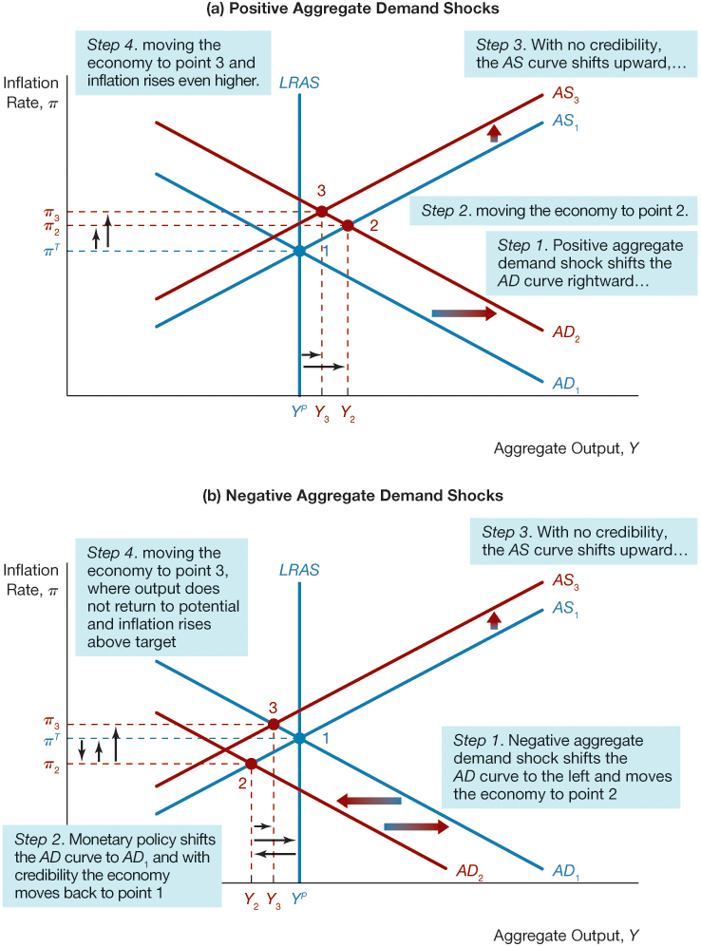
Figure 1 Credibility and Aggregate Demand Shocks

Slide 60
Credibility and Aggregate Supply Shocks (1 of 2)
Negative aggregate supply shocks (the short-run AS curve shifts to the left).
How much the aggregate supply curve will shift, however, depends on the amount of credibility monetary authorities have.
If the credibility of the nominal anchor is credible, inflation expectations will not rise, so the short-run AS curve will not shift further.

Slide 61
Credibility and Aggregate Supply Shocks (2 of 2)
If the credibility of the nominal anchor is weak, then inflation expectations will rise, so the short-run AS curve will shift further up and to the left, causing even higher inflation and lower output.
Monetary policy credibility has the benefit of producing better outcomes on both inflation and output in the short run when faced with negative supply shocks.

Slide 62
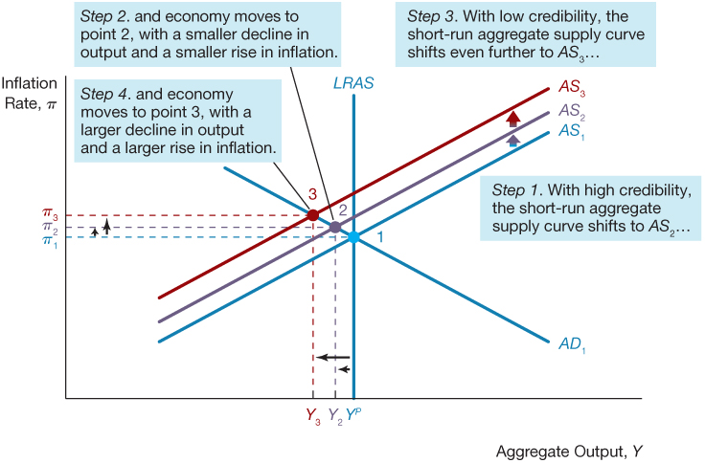
Figure 2 Credibility and Aggregate Supply Shocks

Slide 63
Credibility and Anti-Inflation Policy
Suppose the economy has settled into a sustained 10% inflation rate. Now suppose a new Federal Reserve chair is appointed who decides that inflation must be stopped. The new chair convinces the FOMC to autonomously tighten monetary policy:
The greater the credibility of the central bank as an inflation fighter, the more rapid the decline in inflation and the lower the loss of output to achieve the inflation objective.
If the central bank has very little credibility, then the public will not be convinced that the central bank will stay the course to reduce inflation, and they will not revise their inflation expectations.

Slide 64
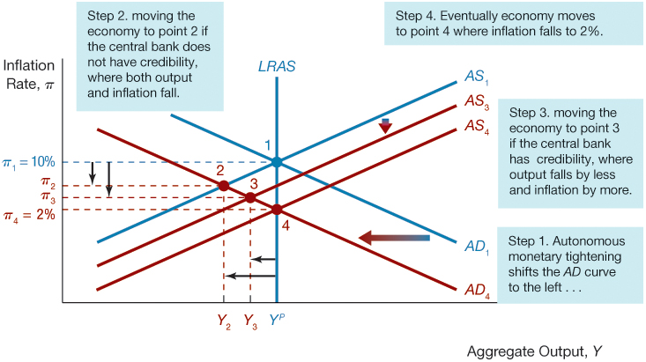
Figure 4 Credibility and Anti-Inflation Policy

Slide 65
The History of Federal Reserve Credibility
The history of Federal Reserve policymaking suggests that the Fed has not always done what it set out to do. In fact, during the 1970s, the chair of the Federal Reserve.
Board at the time, Arthur Burns, repeatedly announced that the Fed would pursue a vigorous anti-inflation policy, yet instead of raising real interest rates when inflation rose, he actually lowered them.
Such episodes reduced the credibility of the Federal Reserve in the eyes of the public.
The resulting lack of credibility had serious consequences:
The reduction of inflation that occurred from 1981 to 1984 was bought at a very high cost; the 1981–1982 recession that helped bring down the inflation rate was one of the most severe recessions of the post–World War II period.

Slide 66
Application: Credibility and the Reagan Budget Deficits
The Reagan administration was strongly criticized for creating huge budget deficits by cutting taxes in the early 1980s.
Although many economists agree that the Fed’s anti-inflation program lacked credibility, not all agree that the Reagan budget deficits were the cause of that lack of credibility.
The conclusion that the Reagan budget deficits helped create a more severe recession in 1981–1982 is controversial.

Slide 67
Approaches to Establishing Central Bank Credibility (1 of 1)
Inflation Targeting is a strategy that involves:
Public announcement of medium-term inflation targets
An institutional commitment to price stability as the primary, long-run goal of monetary policy
An information-inclusive approach in which policy makers use many variables in making decisions about policy (rational expectations)
Increased transparency of the monetary policy strategy through communication with the public and the markets
Increased accountability of the central bank for attaining its inflation objectives

Slide 68
Approaches to Establishing Central Bank Credibility (2 of 3)
Exchange Rate Targeting
Some countries have successfully kept inflation under control by pegging their currency’s exchange rate to the currency of an anchor country that already has a strong nominal anchor.
Nominal GDP Targeting
the central bank announces an objective of hitting a particular level of nominal GDP growth

Slide 69
Approaches to Establishing Central Bank Credibility (3 of 3)
Critics cite two major weaknesses of nominal GDP targeting:
First, nominal GDP targeting requires accurate estimates of potential GDP growth, which are not easy to achieve.
Second, nominal GDP targeting is more complicated to explain to the public than inflation targeting and thus the public might be confused about the objectives of the central bank.
At this time, no central bank has adopted nominal GDP targeting, but this may change in the future.

Slide 70
Appoint “Conservative” Central Bankers
Kenneth Rogoff of Harvard University suggested that another way to establish policy credibility is for the government to appoint central bankers who have a strong aversion to inflation.
He characterized these central bankers as “conservative,” although a better description would be “tough” or “hawkish on inflation.”
The public will then expect that the “conservative” central banker will be less tempted to pursue expansionary monetary policy and will try to keep inflation under control.
The problem with this approach is that it is not clear what it will work over time.

Slide 71
Inside the Fed: The Appointment of Paul Volcker, Anti-Inflation Hawk
Paul Volcker is known as an inflation hawk and thus his appointment as the chairman of the Fed in October 1979 is good example of the appointment of a “conservative” central banker.
Shortly after he took the helm of the Fed, the federal funds rate rose by 8% points to nearly 20% by April 1980.
Despite the unemployment rate rose to nearly 10% in 1982, the federal funds rate remained at around 15% until the inflation rate began to fall in July 1982.

Slide 72
Copyright

