Slide 1
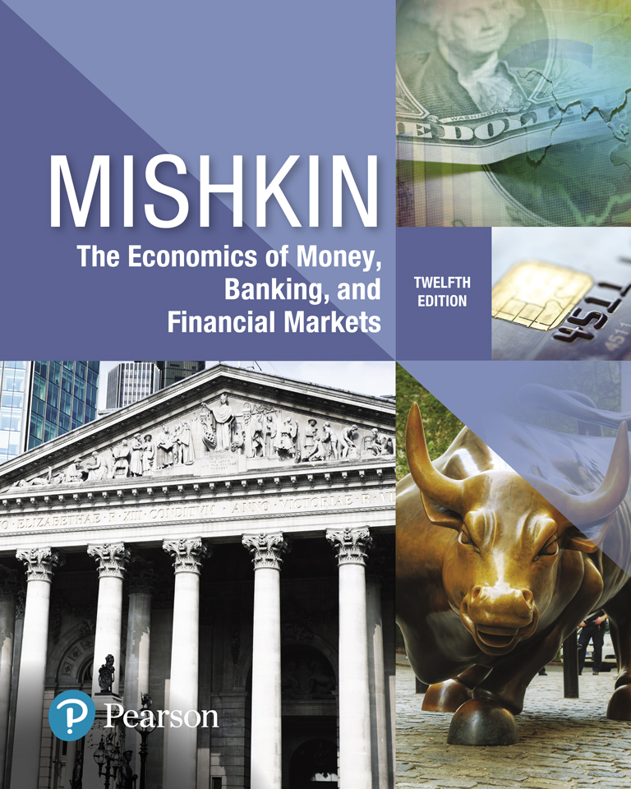
The Economics of Money, Banking, and Financial Markets
Twelfth Edition
Chapter 17
The Foreign Exchange Market
Instructor:
Elham Saeidinezhad
elham@ucla.edu
Copyright © 2019, 2016, 2013 Pearson Education, Inc. All Rights Reserved.
Notes:
If this PowerPoint presentation contains mathematical equations, you may need to check that your computer has the following installed:
1) MathType Plugin
2) Math Player (free versions available)
3) NVDA Reader (free versions available)

Slide 2
Preview
This chapter outlines how the foreign exchange market functions and how the value of different currencies is determined.

Slide 3
Learning Objectives
Explain why exchange rates are so volatile by examining the financial markets in which currencies are traded.
Identify the main factors that affect exchange rates in the long run.
Draw the demand and supply curves for foreign exchange market and interpret the equilibrium in the market for foreign exchange.
List and illustrate the factors that affect the exchange rates in the short run.

Slide 4
Why Is Exchange Rate Important?
The exchange rate affects the economy and our daily lives.
When the U.S. dollar falls, foreign goods become more expensive for Americans and vice versa.
Fluctuations in the exchange rate also affects both inflation and output, and concerns monetary policymakers:
When U.S dollar falls in value, the higher price of imported goods feed directly into a higher price level, and inflation.
Also, a declining U.S. dollar, which makes U.S. goods cheaper for foreigners, leads to higher production and output.

Slide 5
Foreign Exchange Market (1 of 4)
Trade between countries involves mutual exchange of different currencies (or more typically, bank deposits denominated in different currencies.)
The trading of currencies, and bank deposits denominated in particular currency, takes place in foreign exchange market (FX Market), where banks are the main players.
Exchange rate: transactions in FX market determines the price of one currency in terms of another. (FX rates publishes daily in websites such as Yahoo Finance)

Slide 6
Foreign Exchange Market (2 of 4)
There are two kinds of exchange rate transactions:
1) Spot transaction: immediate (two-day) exchange of bank deposits
Spot exchange rate
2) Forward transaction: the exchange of bank deposits at some specified future date (such as one month, three months, and six months in future)
Forward exchange rate

Slide 7
Foreign Exchange Market (3 of 4)
Appreciation: a currency rises in value relative to another currency
Depreciation: a currency falls in value relative to another currency (Example)
Transactions conducted in FX market determines the cost of purchasing foreign goods and financial assets

Slide 8
Foreign Exchange Market (4 of 4)
Exchange rates affect the relative prices of domestic and foreign goods.
When a country’s currency appreciates, the country’s goods become more expensive to foreigners and foreign goods in that country become less expensive to domestic economic agents (holding domestic prices constant in the two countries). Thus:
Depreciation of domestic currency makes it easier for domestic industries to sell their products abroad and decreases the competitiveness of foreign producers in domestic market.
However, it hurts consumers….

Slide 9
How is Foreign Exchange Traded? (1 of 2)
Currencies are not traded on centralized locations such as exchanges to buy/sell currencies.
Over-the-Counter (OTC): the foreign exchange market is organized as an over-the-counter market.
Most transactions in this market involve several hundred dealers (mostly banks) stand ready to buy and sell bank deposits denominated in foreign currencies.

Slide 10
How is Foreign Exchange Traded? (2 of 2)
The volume in this market is massive, exceeding $5 trillion per day.
Wholesale market: is the market that determines the exchange rates. Trades in the foreign exchange market consist of transactions in excess of $1 million.
Retail market: the market we would buy foreign currency for a trip abroad from dealers, such as American Express, and banks.
Retail prices are higher than wholesale prices.

Slide 11
Exchange Rates in the Long Run (1 of 8)
Theory of Purchasing Power Parity (PPP) is one of the most prominent theories in determining exchange rate in long run.
Theory of Purchasing Power Parity assumptions:
All goods are identical in both countries
Trade barriers and transportation costs are low
Many goods and services are not traded across borders
One way of thinking about PPP is through the law of one price.

Slide 12
Exchange Rates in the Long Run (3 of 8)
Law of one price states that assuming that there were no transportation costs and barriers to trade, the exchange rate between any two countries’ currencies is determined so that a basket of goods and services, wherever it is produced, costs the same in both countries.

Slide 13
Exchange Rates in the Long Run (2 of 8)
Intuition behind law of one price
Cost of a basket of goods in the U.S. $ 100
Cost of the same basket in Japan ¥ 10,000
Suppose that there is no transactions costs or barrier to trade.
Then, the law of one price states the exchange rate in the long-run ensures that regardless of where the goods are produced, prices are consistent across the two countries:
Exchange Rate (¥/$) = 10,000 /100 = 100 (i.e. 1 USD = 100 Yen)
Exchange rate ($/¥) = 100/ 10,000 = 0.10 (i.e. 1 Yen = 0.01 USD)

Slide 14
Exchange Rates in the Long Run (4 of 8)
The theory of PPP can also be described in terms of the real exchange rate:
The real exchange rate is the rate at which domestic goods can be exchanged for foreign goods.
In effect, it is the price of domestic goods relative to the price of foreign goods denominated in the domestic currency.

Slide 15
Exchange Rates in the Long Run (5 of 8)
The intuition behind real exchange rate
Cost of a basket of goods in New York $50
Cost of the same basket in Tokyo ¥ 7,500
Exchange rate (from previous slides) 100 (¥/$) or 0.01 ($/¥)
Then, the cost of the same basket of goods in Japan in $
¥ 7,500 * $0.01 per yen = $75
The real exchange rate, i.e. the relative price is therefore:
$50/$75= 0.66
The real exchange rate here is below 1.0, indicating that it is cheaper to buy basket of goods in U.S. than in Japan.

Slide 16
Exchange Rates in the Long Run (6 of 8)
Describing PPP in terms of real exchange rate
PPP predicts that in the long run the real exchange rate is always equal to 1.0, so that the purchasing power of the dollar is the same as that of other currencies, such as the yen or the euro.
$$Real exchange rate=\frac{price level in foreign country denominated in domestic currency}{price level in domestic currency demoniated in domestic currency}$$

Slide 17
Exchange Rates in the Long Run (7 of 8)
What happens if one country’s price level changes relative to another’s?
Assume that price of Japanese goods in Japan increase by %10 to ¥11,000 and the U.S. good prices stay unchanged to $100 in the U.S.
For PPP to hold*, the exchange rate (¥/$) would have to change to 110, so that:
Cost of U.S. basket in Japan $100 * ¥ 110 per $= ¥11,000
Cost of Japanese basket in U.S. ¥11,000* $0.009 per ¥ = $100
Thus, according to the theory of PPP, if the price level in Japan rises 10% relative to the U.S. price level, the exchange rate increases by 10%, and the dollar appreciates by 10%.
Notes:
* Here for PPP to hold means for the Japanese and U.S. basket of goods to cost the same regardless of the country it’s being sold in.

Slide 18
Exchange Rates in the Long Run (8 of 8)
Our U.S./Japanese example demonstrates the key insight of the theory of PPP:
If one country’s price level rises relative to another’s by a certain percentage, then the other country’s currency appreciates by the same percentage.
Because one currency’s appreciation is the other currency’s depreciation, there is an equivalent way of stating this result:
If a country’s price level rises relative to another’s by a certain percentage, then its currency should depreciate by the same percentage.

Slide 19
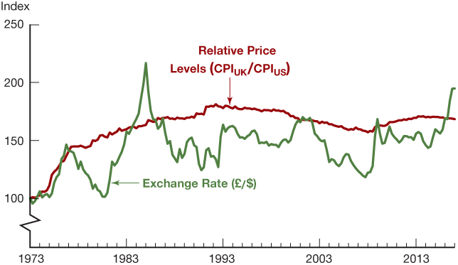
Figure 1 Purchasing Power Parity, United States/United Kingdom, 1973–2017 (Index: March 1973 = 100.)
Source: Federal Reserve Bank of St. Louis FRED database: https://fred.stlouisfed.org/series/GBRCPIALLMINMEIT; https://fred.stlouisfed.org/series/CPIAUCNS; https://fred.stlouisfed.org/series/EXUSUK.
Notes:
Over the whole period shown, the rise in the British price level relative to the U.S. price level is associated with depreciation of the British pound and increase in the exchange rate, i.e. rise in the value of the dollar, as predicted by PPP. However, the PPP relationship does not hold over shorter periods.

Slide 20
Factors That Affect Exchange Rates in the Long Run
Relative price levels
Trade barriers
Preferences for domestic versus foreign goods
Productivity

Slide 21
Factors That Affect Exchange Rates in the Long Run
The general rule:
Anything that increases the demand for domestically produced goods that are traded relative to foreign traded goods, tends to appreciate the domestic currency because:
the domestic goods will continue to sell well even when the value of domestic currency is higher. In order words, the domestic demand for domestic goods is independent from the value of domestic currency,

Slide 22
Summary Table 1 Factors That Affect Exchange Rates in the Long Run
Factor | Change in Factor | Response of the Exchange Rate, E*
Domestic price level† | ↑ | ↓
Trade barriers† | ↑ | ↑
Import demand | ↑ | ↓
Export demand | ↑ | ↑
Productivity† | ↑ | ↑
*Units of foreign currency per dollar: ↑ indicates domestic currency appreciation; ↓, depreciation.
†Relative to other countries.
Note: Only increases (↑) in the factors are shown; the effects of decreases in the variables on the exchange rate are the opposite of those indicated in the “Response” column.

Slide 23
Exchange Rates in the Short Run: A Supply and Demand Analysis (1 of 5)
An exchange rate is the price of domestic assets (denominated in domestic currency) in terms of foreign assets (the same assets denominated in foreign currency).
The natural way to investigate the short-run determination of exchange rates is with a supply and demand analysis that uses an asset market approach.
Asset market analysis relies heavily on the theory of portfolio choice developed in Mishkin’s Chapter 5.

Slide 24
Exchange Rates in the Short Run: A Supply and Demand Analysis (2 of 5)
Flows of Imports and Export: In the past, supply and demand approaches to exchange rate determination emphasized the role of of the flows of imports and exports over short periods.
Stocks of Assets: however, the more modern asset market approaches emphasizes stocks of assets as the flow of export and import transactions are small relative to the amount of domestic and foreign assets held at any given time.
Thus, over short periods, decisions to hold domestic or foreign assets have a much greater role in exchange rate determination than the demand for exports and imports does.

Slide 25
Exchange Rates in the Short Run: A Supply and Demand Analysis (3 of 5)
Supply curve: assumes the amount of domestic assets, i.e. the quantity supplied, is fixed at any current exchange rate.
The quantity of dollar assets supplied is primarily the quantity of bank deposits, bonds, and equities in the U.S.
This implies that the supply curve, S, is vertical.

Slide 26
Exchange Rates in the Short Run: A Supply and Demand Analysis (4 of 5)
The demand curve shows the quantity of domestic (dollar) assets demanded at each current exchange rate ($E_{t})$ by holding everything else constant, particularly the expected future value of the exchange rate ${(E}_{t+1}^{e}$).
Relative expected return: on domestic assets is the most important determinant of the demand curve (theory of portfolio choice).
The greater the expected future value of the dollar (appreciation), the higher is the relative expected return on dollar (domestic) assets.

Slide 27
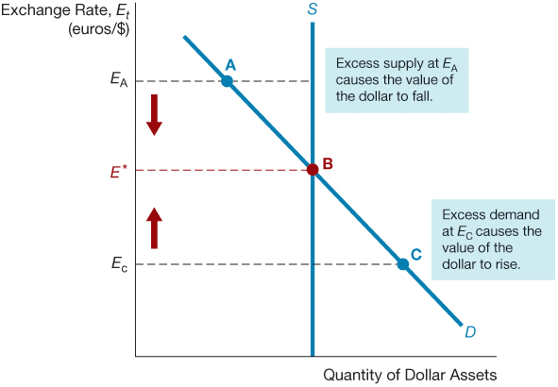
Figure 2 Equilibrium in the Foreign Exchange Market

Slide 28
Exchange Rates in the Short Run: A Supply and Demand Analysis (5 of 5)
Fall in exchange rate (€/$)
The expected appreciation of U.S. dollar (domestic Currency)
Higher expected return on U.S. assets
Greater quantity demanded for U.S. assets

Slide 29
Demand and Supply Curve
The demand curve is downward-sloping, indicating that at lower current values of the dollar (everything else being equal), the quantity demanded of dollar assets is higher.
Excess supply is when more people want to sell dollar assets than want to buy them.
Similarly, excess demand is the condition that the quantity of dollar assets demanded will exceed the quantity supplied.

Slide 30
Explaining Changes in Exchange Rates (1 of 3)
Supply curve is fixed.
Demand curve: to see how exchange rate change over time, we need to determine the factors that shift quantity demanded, holding the current exchange rate, $E_{t}$, constant, when other factors change.
Insight into the direction of change in demand curve
As an investor considering putting funds into either domestic or foreign assets, when a factor changes, you must decide whether you would earn a lower or higher expected return on domestic assets versus foreign assets.

Slide 31
Explaining Changes in Exchange Rates (3 of 3)
In summary, holding the current exchange rate constant:
If the relative expected return on dollar assets rises, the demand curve will shift to the right.
Similarly, if the relative expected return falls, the demand curve will shift to the left.

Slide 32
Explaining Changes in Exchange Rates (2 of 3)
Factors that shift relative expected return, and thus the demand for domestic assets:
Domestic interest rate
Foreign interest rate
Expected future exchange rate

Slide 33
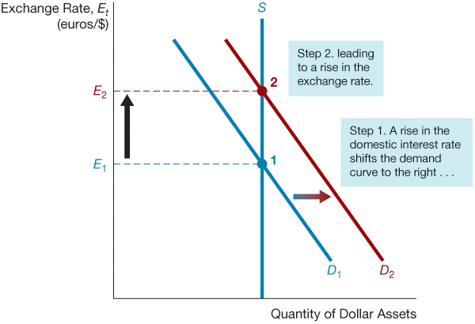
Figure 3 Response to an Increase in the Domestic Interest Rate, i^{D}

Slide 34
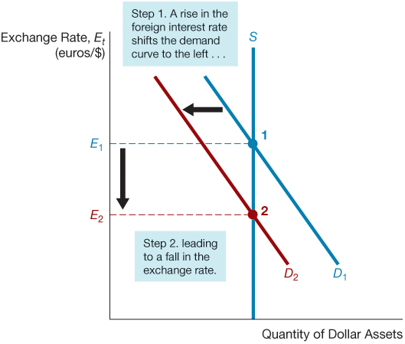
Figure 4 Response to an Increase in the Foreign Interest Rate, i^{F}

Slide 35
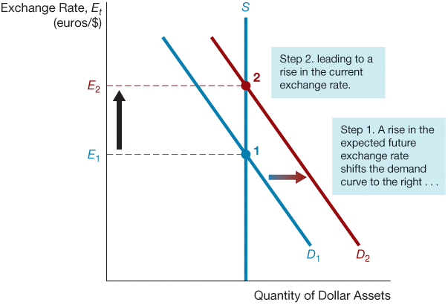
Figure 5 Response to an Increase in the Expected Future Exchange Rate, E^{e}_{t+1}

Slide 36
What Connects Long-Run and Short-Run Exchange Rates? (1 of 2)
Expected future exchange rate plays an important role in shifting the current demand curve in short-term.
The factors that determine long-term exchange rates have the tendency to affect the expected future exchange rate in the same direction, and thus shift the demand curve in the short-term.
These factors are: relative price level, relative trade barrier, import and export demand, relative productivity.

Slide 37
What Connects Long-Run and Short-Run Exchange Rates?(2 of 2)
The following factors raise expected future exchange rate:
expectations of a fall in relative domestic price level;
expectations of higher domestic relative trade barriers
expectations of lower domestic import demand;
expectations of higher foreign demand for domestic exports; and
expectations of higher relative domestic productivity.

Slide 38
Summary: Long-Run and Short-Run Exchange Rate
Factors that appreciate exchange rate in the long-run (using PPP theory)
Increase relative expected future return on domestic assets
Shifts demand curve for domestic assets to the right (Step 1)
Raises the spot exchange rate (Step 2)
Raise expected future exchange rate

Slide 39
Why Short-Term Exchange Rate is Volatile?
Many factors affect expectations: expectations about the price level, inflation, trade barriers, productivity, import demand, export demand, and monetary policy play important roles in determining the exchange rate as they change expected return on domestic assets, and hence expected future exchange rate.
The expectations about these variables change very often, with every little piece of information or news.

Slide 40
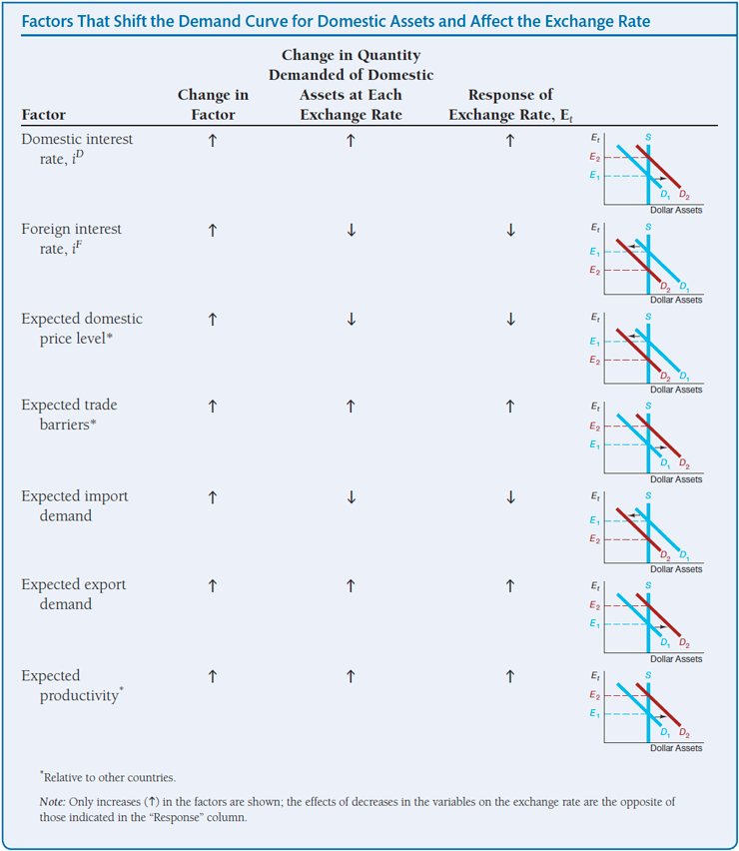
Summary Table 2 Factors That Shift the Demand Curve for Domestic Assets and Affect the Exchange Rate

Slide 41
Application: Effects of Changes in Interest Rates on the Equilibrium Exchange Rate
Changes in Interest Rates
When domestic real interest rates raise, the domestic currency appreciates.
When domestic interest rates rise due to an expected increase in inflation, the domestic currency depreciates.
Changes in the Money Supply
A higher domestic money supply causes the domestic currency to depreciate.

Slide 42
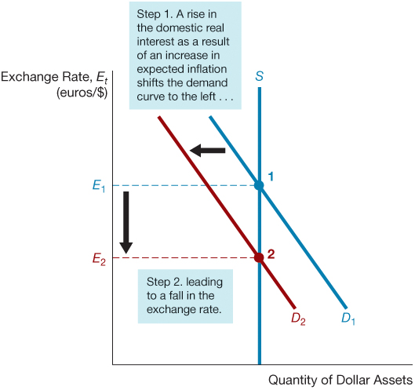
Figure 6 Effect of a Rise in the Domestic Interest Rate as a Result of an Increase in Expected Inflation

Slide 43
Application: The Global Financial Crisis and the Dollar
With the start of the global financial crisis in August 2007, the dollar began an accelerated decline in value, falling by 9% against the euro until mid-July of 2008. After hitting an all-time low against the euro on July 11, the value of the dollar suddenly shot upward, by over 20% against the euro by the end of October. What is the relationship between the global financial crisis and these large swings in the value of the dollar?

Slide 44
Application: Brexit and the British Pound
As noted in the introduction, the Brexit vote in the United Kingdom on June 23, 2016, led to nearly a 10% depreciation in the British pound, from $1.48 to the pound on June 23, just before the vote, to $1.36 per pound on June 24. What explains the large one-day decline in the exchange rate for the pound?

Slide 45
Appendix: The Interest Parity Condition (1 of 3)
Comparing Expected Returns on Domestic and Foreign Assets
Since the vast majority of real-world transactions in currency markets involve economic agents buying and selling currencies based on their value as assets, one must develop an understanding of how these assets are valued.
From the perspective of an American economic agent, the expected return on dollar-denominated assets is equal to the domestic rate of interest.

Slide 46
Appendix: The Interest Parity Condition (2 of 3)
For a foreign economic agent, Francois the Foreigner, the expected return on dollar-denominated assets is equal to the rate of interest associated with those same assets, adjusted for an expected appreciation or depreciation in the value of the U.S. dollar relative to the Euro.
If foreign and American bank deposits can be considered perfect substitutes for one another and capital mobility exists, then parity should exist between the interest rate on dollar-denominated bank deposits and the interest rate on Euro-denominated bank deposits.

Slide 47
Appendix: The Interest Parity Condition (3 of 3)
This notion is summarized in the following equation.
This equation is known as the interest parity condition.

Slide 48
Application: Burgernomics: Big Macs and PPP
Since 1986, The Economist magazine has published the Big Mac index as a “light- hearted guide to whether currencies are at their ‘correct’ level based on the theory of purchasing power parity.” Big Macs are sold by McDonald’s all around the world and are supposed to taste the same wherever they are sold. The Economist collects prices (in the local currency) of Big Macs sold in 56 different regions and countries, then uses these prices to compare the exchange rate implied by PPP and the Big Mac index.

Slide 49
Copyright

