Slide 1
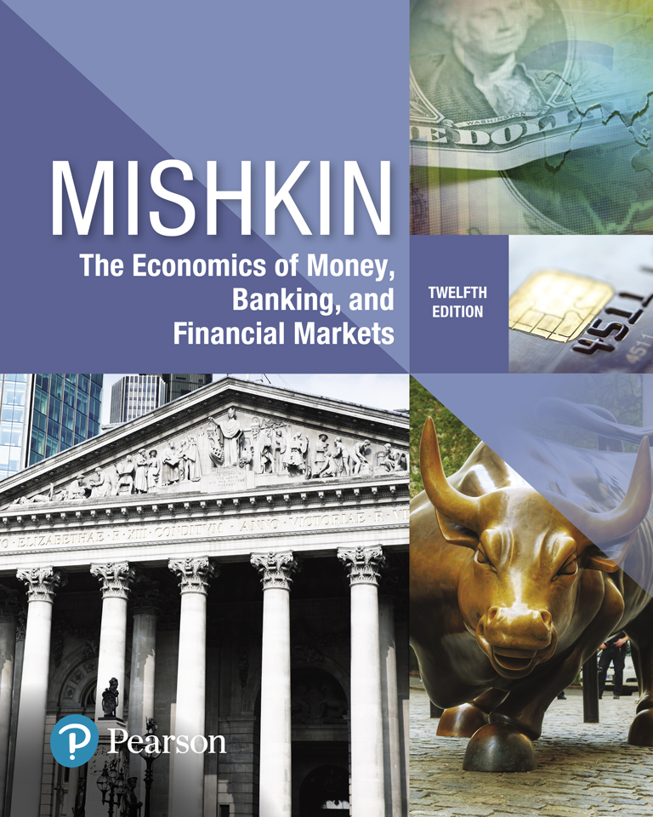
The Economics of Money, Banking, and Financial Markets
Twelfth Edition
Chapter 5
The Behavior of Interest Rates
Copyright © 2019, 2016, 2013 Pearson Education, Inc. All Rights Reserved.
Notes:
If this PowerPoint presentation contains mathematical equations, you may need to check that your computer has the following installed:
1) MathType Plugin
2) Math Player (free versions available)
3) NVDA Reader (free versions available)

Slide 2
Preview
In this chapter, we examine how the overall level of nominal interest rates is determined and which factors influence their behavior.

Slide 3
Learning Objectives (1 of 2)
Identify the factors that affect the demand for assets.
Draw the demand and supply curves for the bond market and identify the equilibrium interest rate.
List and describe the factors that affect the equilibrium interest rate in the bond market.

Slide 4
Learning Objectives (2 of 2)
Describe the connection between the bond market and the money market through the liquidity preference framework.
List and describe the factors that affect the money market and the equilibrium interest rate.
Identify and illustrate the effects on the interest rate of changes in money growth over time.

Slide 5
Why Study Bond Prices?
Interest rates are negatively related to the price of bonds, so
if we can explain why bond prices change, we can also explain why interest rates fluctuate.
In this chapter, we make use of supply and demand analysis for bond markets and markets for money to examine how interest rates change.
In later weeks, we examine another approach to understand bond markets which is called “Treynor Model”.
This model studies securities prices by studying the economics of dealers’ function who make the market for these assets and set securities prices in the process.

Slide 6
Bond Market Equilibrium and Interest Rates
Demand for Assets
To derive a demand curve for assets such as money or bonds, the first step in our analysis, we must first understand what determines the demand for these assets.
We do this by examining portfolio theory, an economic theory that outlines criteria that are important when deciding how much of an asset to buy.
After deriving supply curves for these assets, we develop the concept of market equilibrium, which is defined as the point at which the quantity supplied equals the quantity demanded.
Then we use this model to explain changes in equilibrium interest rates.

Slide 7
Determinants of Asset Demand (1 of 2)
Interest rates on different securities tend to move together.
In this chapter we will proceed as if there were only one type of security and one interest rate in the entire economy.
Economic agents hold a variety of different assets. What are the primary assets you hold?
Store of Value
An asset is anything that can be owned and has value.

Slide 8
Determinants of Asset Demand (2 of 2)
Wealth: the total resources owned by the individual, including all assets
Expected Return: the return expected over the next period (i.e. the average return) on one asset relative to alternative assets
Risk: the degree of uncertainty associated with the return on one asset relative to alternative assets
Liquidity: the ease and speed with which an asset can be turned into cash relative to alternative assets.

Slide 9
Expected Return (1 of 2)
The return on an asset (such as a bond) measures how much we gain from holding that asset.
When we make a decision to buy an asset, we are influenced by what we expect the return on that asset to be.
For example, if an ExxonMobil bond, has a return of 15% half the time and 5% the other half, its expected return (which you can think of as the average return) is 10% $(= 0.5 × 15\% + 0.5 × 5\%).$

Slide 10
Expected Return (2 of 2)
If expected return on a bond rises relative to expected returns on alternative assets, then, holding everything else constant, it becomes more desirable to purchase the that bond, and the quantity demanded increases.
This can occur in either of two ways:
when the expected return on the bond A rises while the return on an alternative asset remains unchanged or
when the return on the alternative asset falls while the return on bond A remains unchanged.

Slide 11
Risk
Risk is the degree of risk or uncertainty of an asset’s returns.
Consider two assets, stocks in company Apple and stock in company Microsoft:
Suppose that Apple stock has a return of 15% half the time and 5% the other half, making its expected return 10%, while Microsoft stock has a fixed return of 10%.
Apple stock has uncertainty associated with its returns and so has greater risk than Microsoft stock, whose return is a sure.
A risk-averse person prefers stock in Microsoft (the sure thing) to Apple (the riskier asset), even though the stocks have the same expected return, 10%.

Slide 12
Risk-Free Assets, Flight to Safety, and Negative Treasury Rates (1 of 2)
The fact that the quantity of assets demanded depends on riskiness of one asset relative to alternative assets explains the concepts of risk free assets (also called safe havens), flights to safety and why investors are willing to accept negative yield.
Securities that are issued by U.S. government such as Treasury Bond and T-Bill are considered risk free assets. They earn risk-free rate which is closely related to the fed funds rate.
To understand this connection, think of depositing money at the Fed or in the banks as an alternative to investing in U.S. Treasury bonds.

Slide 13
Risk-Free Assets, Flight to Safety, and Negative Treasury Rates (2 of 2)
When the level of risk in financial market increases (determination of financial condition), flight to safety or flight to quality occurs.
Flight to quality is the action of investors moving their capital away from riskier investments to safer ones such as US Treasury bonds.
In some cases, this will increase the price of T-bonds or other safe assets which sometimes push treasury rate into negative territory.

Slide 14
Liquidity
Another factor that affects the demand for an asset is how quickly it can be converted into cash at low costs—its liquidity.
An asset is liquid if the market in which it is traded has depth and breadth, that is, if the market has many buyers and sellers.
For instance, a house is not a very liquid asset because it may be hard to find a buyer quickly; if a house must be sold to pay off bills, it might have to be sold for a much lower price.
And the transaction costs associated with selling a house (broker’s commissions, lawyer’s fees, and so on) are substantial.
A U.S. Treasury bill, by contrast, is a highly liquid asset. It can be sold in a well-organized market with many buyers, and so it can be sold quickly at low cost.

Slide 15
Market Liquidity versus Funding Liquidity (1 of 4)
Market Liquidity (is Determined in Capital Market)
It is the ability to buy and sell financial assets, fast, at low cost without moving the price very much.
Funding Liquidity (is Determined in Money Market)
It is the ability to have access to sources of funding such as central banks liquidity facilities, interbank market or short term money market instruments such as repos.

Slide 16
Market Liquidity versus Funding Liquidity (2 of 4)
Securities Dealers in the capital market make the market for financial securities and create market liquidity in the process.
Global Money Market Dealers provides funding liquidity and makes the market for “funding”.
“Market Liquidity and Funding Liquidity are Closely Related”

Slide 17
Market Liquidity versus Funding Liquidity (3 of 4)
The securities dealer supplies market liquidity by quoting prices to buy and sell, and absorbing the resulting imbalances onto his balance sheet.
The consequent positions, long and/or short, have to be financed:
This means that the dealer is a demander of funding liquidity and a supplier of market liquidity.
Dealer’s ability to continue her function depends on her access to funding liquidity.

Slide 18
Market Liquidity versus Funding Liquidity (4 of 4)
In standard economic theories, such as the ones we see in Chapter 5, we assume supply and demand forces determine asset prices.
The implicit assumption here is that assets are always, and all the time, can be sold quickly, cheaply and without moving the prices.
In effect, we are ignoring the role of dealers and assuming that the market liquidity is provided for free.
However, dealers create market liquidity not for free but to earn spreads.
This assumption is as unrealistic as to think that Merrill Lynch or Bank of New York Mellon are making the market for U.S. Treasuries or Apple Bonds for Free!

Slide 19
Theory of Portfolio Choice
All the determining factors we have just discussed can be assembled into the theory of portfolio choice,
which tells us how much of an asset people will want to hold in their portfolios.
Holding all other factors constant:

Slide 20
Recap: Coupon Bonds (1 of 3)
The basic financial terms of a corporate bond include its price, face value (also called par value), maturity, coupon rate, and yield to maturity.
A rise in the interest rate, as measured by the yield to maturity, means that the price of the bond must fall because
the rise in interest rate lowers the present value of all future cash flow payments for this bond.
Another way to explain is to consider that
a higher interest rate implies that the future coupon payments and final payment are worth less when discounted back to the present; hence the price of the bond must be lower.

Slide 21
Recap: Coupon Bonds (2 of 3)
A bond often trades at a premium or discount to its face value.
This can happen when market interest rates rise or fall relative to the bond’s coupon rate:
If the coupon rate is higher than market interest rates, for example, then the bond will likely trade at a premium.
If the coupon rate is lower than market interest rates, for example, then the bond will likely trade at a discount.

Slide 22
Recap: Coupon Bonds (3 of 3)
Two Important Facts about Bond Market
Coupon Rate (current interest rate) is equal to Yield to Maturity when:
Bond’s price is equal to the face value (Bond is traded at par).
$$P=F ⇒i_{c}=YTM$$
Yield to Maturity is equal to Rate of Return when:
Maturity time is equal to holding period (i.e. the resale price is similar to face value and there is no capital gain or loss).
$Maturity Time=Holding Period⇒YTM=RET$

Slide 23
Demand in the Bond Market
The first step in our analysis is to obtain a bond demand curve,
which shows the relationship between the quantity demanded and the price when all other economic variables are held constant (that is, values of other variables are taken as given).
At lower prices (higher interest rates), because the expected return is higher, with all other economic variables (such as wealth, expected returns on other assets, risk, and liquidity) held constant, the quantity demanded of these bonds will be higher, as predicted by portfolio theory.
Demand Curve is downward sloping.

Slide 24
Example: Demand Curve
Let’s consider a demand for a one-year discount bond
with $Face value = \$1000$
$P_{1}$= $ 950 ➔${RET}_{1}=i_{1}=\frac{F−P}{P}$ =$\frac{1000−950}{950}=\%5.3$
$P_{2}$=$ 900 ➔${RET}_{2}=i_{2}=\frac{1000−900}{900}$ =$\%11.1$
Because the expected return is higher, with all other economic variables (such as wealth, expected returns on other assets, risk, and liquidity) held constant, the quantity demanded of these bonds will be higher, as predicted by “portfolio theory”
$P_{1}$= $ 950 ➔ $i_{1}$= %5.3 ➔$Q_{1}$= $100bn
$P_{2}$= $ 900 ➔ $i_{2}$= %11.1 ➔$Q_{1}$= $200bn

Slide 25
Supply in the Bond Market
An important assumption behind the demand and supply curve for bonds is that all other economic variables besides the bond’s price and interest rate are held constant.
When the price of the bond increases ($P↑$), the interest rate on that bond falls ($YTM ↓$).
At this new interest rate it is now less costly to borrow by issuing bond, and the supply of bond increases ($B^{S}↑$):
The $B^{S}$curve has the usual upward slope found in supply curves, indicating that as the bond price increases (everything else being equal), the cost of borrowing falls, and the quantity supplied increases.

Slide 26
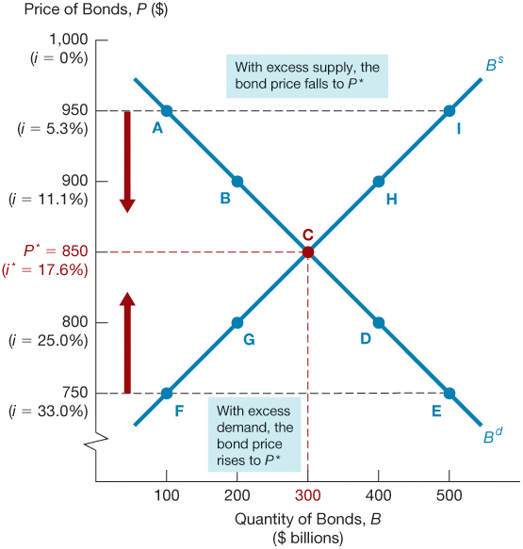
Figure 1 Supply and Demand for Bonds

Slide 27
Market Equilibrium
Occurs when the amount that people are willing to buy (demand) equals the amount that people are willing to sell (supply) at a given price.
$Bd = Bs$defines the equilibrium (or market clearing) price and interest rate.
The concepts of market equilibrium and equilibrium price or interest rate are useful because the market tends to head toward them:
When $Bd > Bs$, there is excess demand, price will rise and interest rate will fall.
When $Bd < Bs$, there is excess supply, price will fall and interest rate will rise.

Slide 28
Supply and Demand Analysis
We will now use the supply and demand framework for bonds to analyze why interest rates change.
Because the interest rate that corresponds to each bond price is also marked on the vertical axis, Figure 1 allows us to read the equilibrium interest rate, giving us a model that describes the determination of interest rates.
An important feature is that supply and demand are always described in terms of stocks (amounts at a given point in time) of assets, not in terms of flows.

Slide 29
Changes in Equilibrium Interest Rates (1 of 2)
Movements Along a Demand (Or Supply) Curve | Shifts In a Demand (Supply) Curve
When quantity demanded (or supplied) changes as a result of a change in the price of the bond or, equivalently, a change in the interest rate, we have a movement along the demand (or supply) curve. | A shift in the demand (supply) curve, by contrast, occurs when the quantity demanded (supplied) changes at each given price (or interest rate) of the bond in response to a change in some other factor besides the bond’s price or interest rate.

Slide 30
Changes in Equilibrium Interest Rates (2 of 2)
6 factors Shift the demand for bonds:
Wealth: in an expansion with growing wealth, the demand curve for bonds shifts to the right
Expected Returns on stock and other assets: Bond prices are connected to stock prices
Expected Interest Rate: higher expected interest rates in the future lower the expected return for long-term bonds, shifting the demand curve to the left
Expected Inflation: an increase in the expected rate of inflations lowers the expected return for bonds, causing the demand curve to shift to the left
Risk: an increase in the riskiness of bonds causes the demand curve to shift to the left
Liquidity: increased liquidity of bonds results in the demand curve shifting right
Relative Expected Return on Bonds

Slide 31
Expected Return*
$$Expected$$ $$Interest$$ $$Rate$$ | $$Expected Future Interes Rate↑⇒Prices ↓more than expected⇒Capital Loss⇒Rate of Return ↓ ⇒Demand for bonds ↓$$
$$Expected$$ $$Inflation$$ | $$Expected Inflation ↑ ⇒Real Return ↓ ⇒Demand for Bonds ↓$$ Alternatively $$Expected Inflation ↑ ⇒Return on real assets such as real estate ↑ ⇒Expected returns on bonds relative to real assets↓ ⇒Demand for Bonds ↓$$
Expected Return on other assets | $$Expected Return on other asstets ↑ ⇒Demand for bonds ↓$$

Slide 32
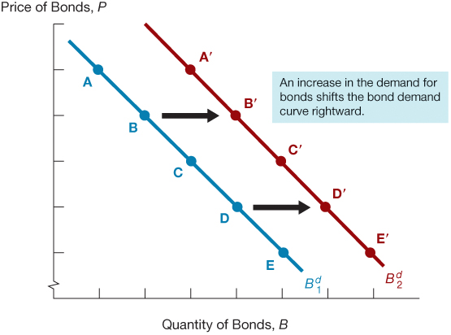
Figure 2 Shift in the Demand Curve for Bonds

Slide 33
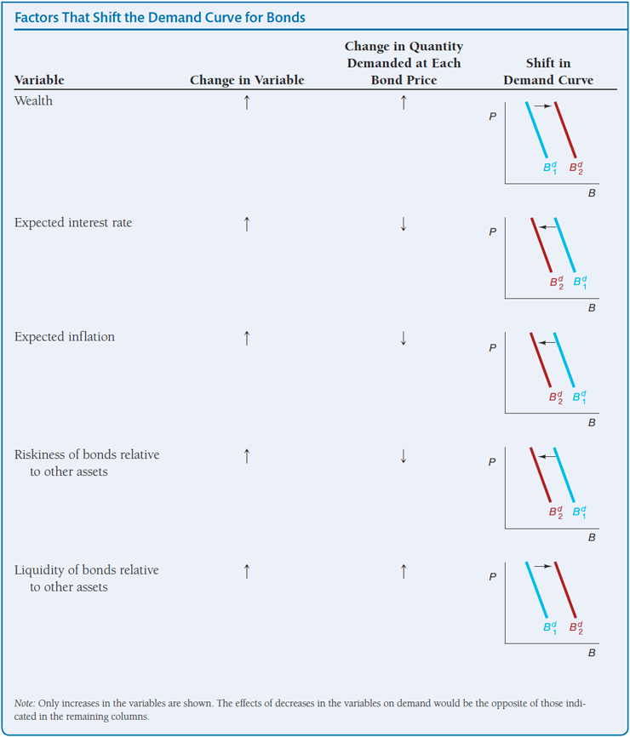
Shifts in the Demand for Bonds
Summary Table 2

Slide 34
Shifts in the Supply of Bonds (1 of 2)
Shifts in the supply for bonds:
Expected profitability of investment opportunities: in an expansion, the supply curve shifts to the right
Expected inflation: an increase in expected inflation lowers the real costs of borrowing, shifts the supply curve for bonds to the right
Government budget: increased budget deficits, financed by government bonds, shift the supply curve to the right

Slide 35
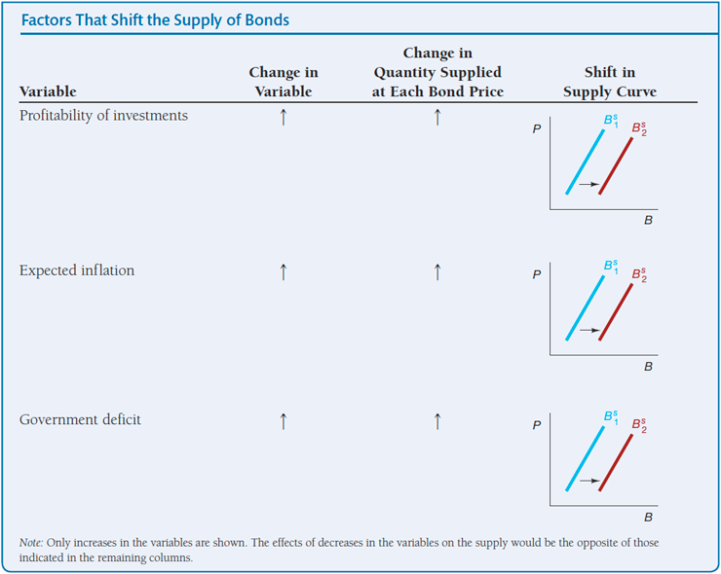
Shifts in the Supply of Bonds (2 of 2)
Summary Table 3

Slide 36
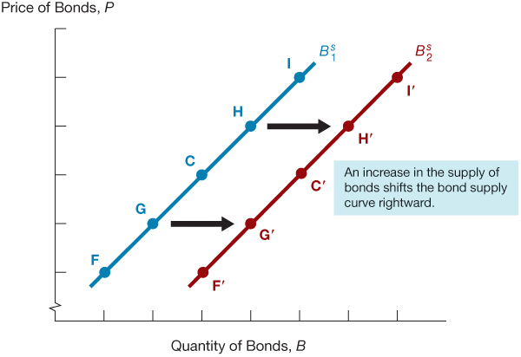
Figure 3 Shift in the Supply Curve for Bonds

Slide 37
Interest Rate Behavior
We now can use our knowledge of how supply and demand curves shift to analyze how the equilibrium interest rate can change.
The best way to do this is to pursue several applications (such as the response to expected inflation and business cycle) that are particularly relevant to our understanding of how monetary policy affects interest rates.
In studying these applications, keep two things in mind:
When we examine the effect of a variable change, remember we are assuming that all other variables are unchanged; that is, we are making use of the ceteris paribus assumption.
Remember that the interest rate is negatively related to the bond price, so when the equilibrium bond price rises, the equilibrium interest rate falls and vice versa.

Slide 38
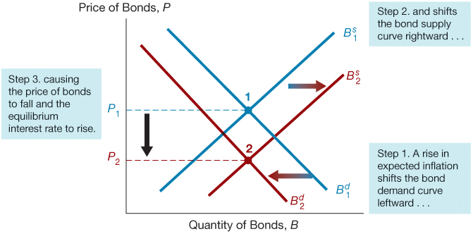
Figure 4 Response to a Change in Expected Inflation (The Fisher Effect)

Slide 39
Expected Inflation and Interest Rate: Fisher Effect
Expected Inflation and Demand
If expected inflation rises, the expected return on bonds relative to real assets falls for any given bond price and interest rate. As a result, the demand for bonds falls, and the demand curve shifts to the left.
Expected Inflation and Supply
The rise in expected inflation also shifts the supply curve. At any given bond price and interest rate, the real cost of borrowing declines, causing the quantity of bonds supplied to increase and the supply curve to shift.
Fisher Effect
When expected inflation rises, interest rates will rise.
Consequently, many economists recommend that inflation must be kept low if we want to keep nominal interest rates low.

Slide 40
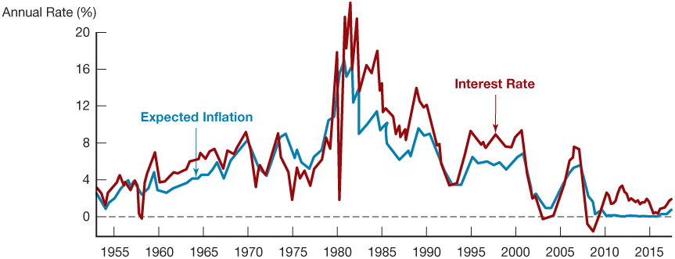
Figure 5 Expected Inflation and Interest Rates (Three-Month Treasury Bills), 1953–2017
Sources: Federal Reserve Bank of St. Louis FRED database: https://fred.stlouisfed.org/series/TB3M; https://fred.stlouisfed.org/series/CPIAUCSL.S. Expected inflation calculated using procedures outlined in Frederic S. Mishkin, “The Real Interest Rate: An EmpiricalInvestigation,” Carnegie-Rochester Conference Series on Public Policy 15 (1981): 151–200. These procedures involve estimating expected inflation as a function of past interest rates, inflation, and time trends.

Slide 41
Business Cycle and Interest Rate (1 of 3)
In a business cycle expansion, the amounts of goods and services being produced in the economy increase, so national income rises.
Supply of Bonds
When this occurs, businesses are more willing to borrow because they are likely to have many profitable investment opportunities for which they need financing.
Hence, at a given bond price, the quantity of bonds that firms want to sell (that is, the supply of bonds) will increase.

Slide 42
Business Cycle and Interest Rate (2 of 3)
Demand for Bonds
Expansion in the economy also affects the demand for bonds. As the economy expands, wealth is likely to increase, and the theory of portfolio choice tells us that the demand for bonds will rise as well.
Business cycle expansion leads both the supply and demand curves to shifted to the right.
Depending on whether the supply curve shifts more than the demand curve or vice versa, the new equilibrium interest rate can either rise or fall.

Slide 43
Business Cycle and Interest Rate (3 of 3)
The supply and demand analysis used here gives us an ambiguous answer to the question of what happens to interest rates in a business cycle expansion.
In Figure 6, the shift in the supply curve is greater than the shift in the demand curve, causing the equilibrium bond price to fall and interest rate to rise.
This is the outcome we mostly see in the data.
Empirical evidences suggest that the interest rate tends to rise during business cycle expansions and fall during recessions.

Slide 44
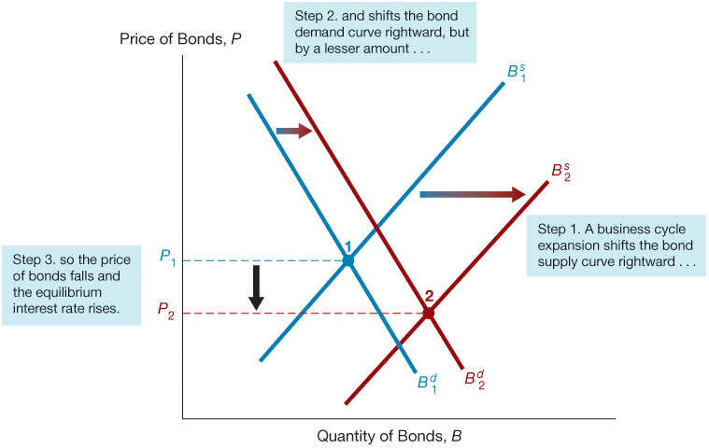
Figure 6 Response to a Business Cycle Expansion

Slide 45
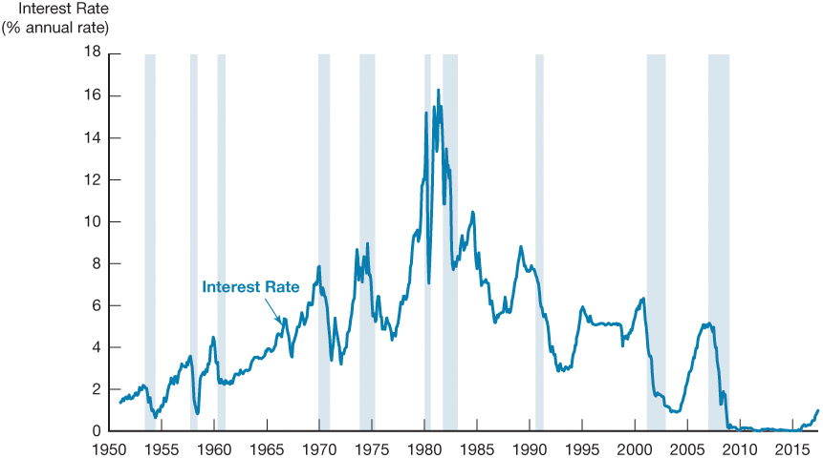
Figure 7 Business Cycle and Interest Rates (Three-Month Treasury Bills), 1951–2017
Source: Federal Reserve Bank of St. Louis FRED database: https://fred.stlouisfed.org/series/TB3MS

Slide 46
Changes in Interest Rate: Supply and Demand of Bond Framework
 | Increase in Expected Inflation | Economic Expansion
Bond Price | Decrease | Ambiguous
(Interest Rate) | (Increase) | (Ambiguous)
Quantity of Bonds | Ambiguous | Increase

Slide 47
Supply and Demand in the Market for Money: The Liquidity Preference Framework (1 of 3)
An alternative model for determining the equilibrium interest rate, developed by John Maynard Keynes, is known as the liquidity preference framework.
This framework determines the equilibrium interest rate in terms of the supply of and demand for money rather than the supply of and demand for bonds.
The term market for money refers to the market for the medium of exchange, money.
This market differs from the money market referred to by finance practitioners, which is the financial market in which short-term debt instruments are traded.

Slide 48
Supply and Demand in the Market for Money: The Liquidity Preference Framework (2 of 3)
There are two main categories of assets that people use to store their wealth: money and bonds.
𝑇𝑜𝑡𝑎𝑙 𝑤𝑒𝑎𝑙𝑡ℎ 𝑖𝑛 𝑡ℎ𝑒 𝑒𝑐𝑜𝑛𝑜𝑚𝑦 = $B^{s}+M^{s}=B^{d}+M^{d}$
Rearranging:
$$B^{S}−B^{d}=M^{d}−M^{s}$$
If the market for money is in equilibrium ($M^{s}=M^{d}$), then the bond market is also in equilibrium ($B^{s}=B^{d}$).

Slide 49
Supply and Demand in the Market for Money: The Liquidity Preference Framework (3 of 3)
Thus, the liquidity preference framework, which analyzes the market for money, is equivalent to a framework analyzing supply and demand in the bond market.
In practice, the approaches differ because, by assuming there are only two kinds of assets, money and bonds, the liquidity preference approach implicitly ignores any effects on interest rates that arise from changes in the expected returns on real assets such as automobiles and houses.

Slide 50
Two Frameworks: Comparative Advantages
Liquidity Preference Framework | Bond Supply and Demand Framework
The liquidity preference framework is easier to use when analyzing the effects caused by changes in income, the price level, and the supply of money | The bond supply and demand framework is easier to use when analyzing the effects caused by changes in expected inflation

Slide 51
The Liquidity Preference Framework: Rate of Return
Money
Because the definition of money used by Keynes includes currency (which earns no interest) and checking account deposits (which in his time typically earned little or no interest), he assumed that money has a zero rate of return.
Bonds:
The only alternative asset to money in Keynes’s framework, have an expected return equal to the interest rate.

Slide 52
Money Demand and Interest Rate: An Inverse Relationship
Portfolio Choice Theory
As this interest rate rises (holding everything else unchanged):
the expected return on money falls relative to the expected return on bonds, causing a fall in the quantity of money demanded, as predicted by the theory of portfolio choice.
Opportunity Cost:
We can also show that the quantity of money demanded and the interest rate should be negatively related by using the concept of opportunity cost
which is the amount of interest (expected return) sacrificed by not holding the alternative asset—in this case, a bond.
This implies that money demand curve is downward sloping.

Slide 53
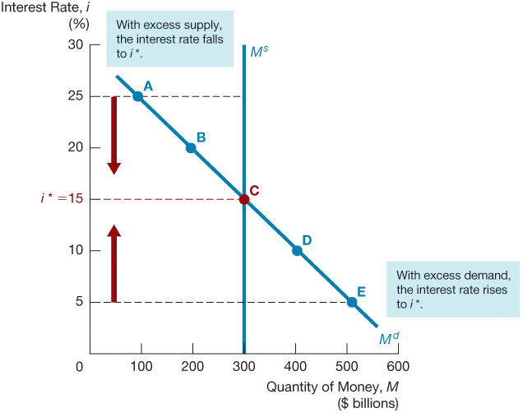
Figure 8 Equilibrium in the Market for Money

Slide 54
Changes in Equilibrium Interest Rates in the Liquidity Preference Framework (1 of 5)
In Keynes’s liquidity preference analysis, two factors cause the demand curve for money to shift: income and the price level:
Income Effect: a higher level of income causes the demand for money at each interest rate to increase and the demand curve to shift to the right
Price-Level Effect: a rise in the price level causes the demand for money at each interest rate to increase- as people care about the amount of money they hold in real term- and the demand curve to shift to the right

Slide 55
Changes in Equilibrium Interest Rates in the Liquidity Preference Framework (2 of 5)
Shifts in the supply of money:
Assume that the supply of money is controlled by the central bank.
An increase in the money supply engineered by the Federal Reserve will shift the supply curve for money to the right.

Slide 56
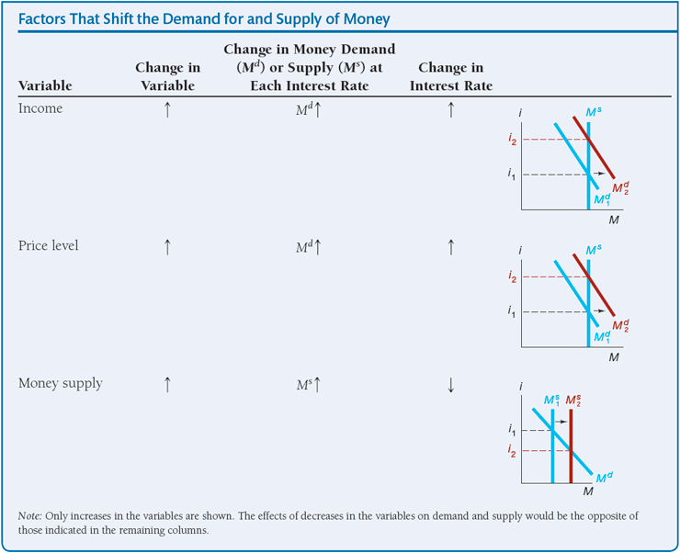
Changes in Equilibrium Interest Rates in the Liquidity Preference Framework (3 of 5)
Summary Table 4

Slide 57
Changes in Equilibrium Interest Rates in the Liquidity Preference Framework (4 of 5)
To see how we can use the liquidity preference framework to analyze the movement of interest rates, we will again look at several applications that will help us evaluate the effect of monetary policy on interest rates:
Changes in Income
When income is rising during a business cycle expansion, interest rates will rise.
This conclusion is unambiguous, unlike the conclusion we reached using the bond demand and supply framework.

Slide 58
Changes in Equilibrium Interest Rates in the Liquidity Preference Framework (5 of 5)
Price Level
when the price level increases, with the supply of money and other economic variables held constant, interest rates will rise.
Money Supply
When the money supply increases (everything else remaining equal), interest rates will decline.

Slide 59
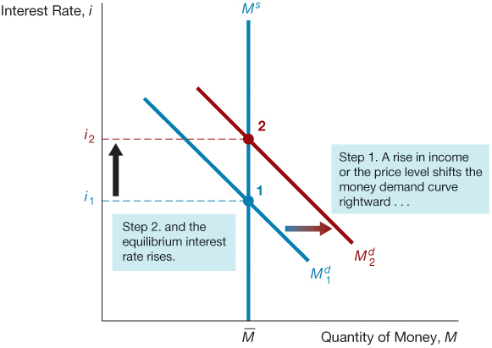
Figure 9 Response to a Change in Income or the Price Level

Slide 60
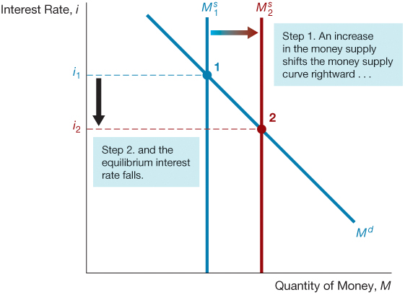
Figure 10 Response to a Change in the Money Supply

Slide 61
Money and Interest Rates
A one time increase in the money supply will cause prices to rise to a permanently higher level by the end of the year. The interest rate will rise via the increased prices.
Price-level effect remains even after prices have stopped rising.
A rising price level will raise interest rates because people will expect inflation to be higher over the course of the year. When the price level stops rising, expectations of inflation will return to zero.
Expected-inflation effect persists only as long as the price level continues to rise.

Slide 62
Does a Higher Rate of Growth of the Money Supply Lower Interest Rates? (1 of 2)
Liquidity preference framework leads to the conclusion that an increase in the money supply will lower interest rates: the liquidity effect.
Income effect finds interest rates rising because increasing the money supply is an expansionary influence on the economy (the demand curve shifts to the right).

Slide 63
Does a Higher Rate of Growth of the Money Supply Lower Interest Rates? (2 of 2)
Price-Level effect predicts an increase in the money supply leads to a rise in interest rates in response to the rise in the price level (the demand curve shifts to the right).
Expected-Inflation effect shows an increase in interest rates because an increase in the money supply may lead people to expect a higher price level in the future (the demand curve shifts to the right).

Slide 64
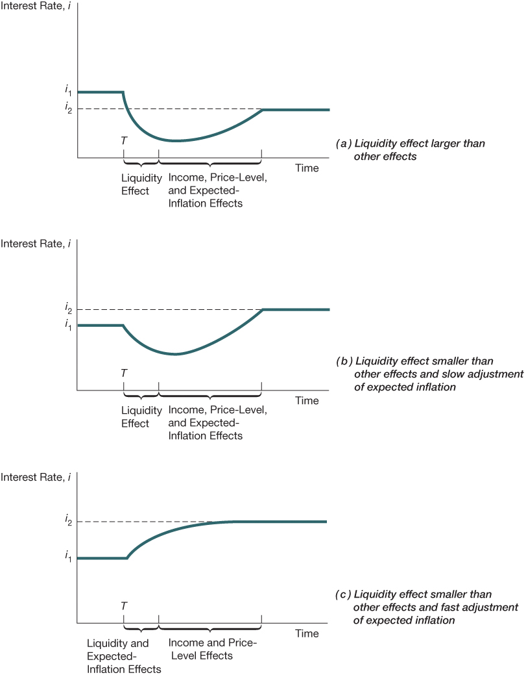
Figure 11 Response over Time to an Increase in Money Supply Growth

Slide 65
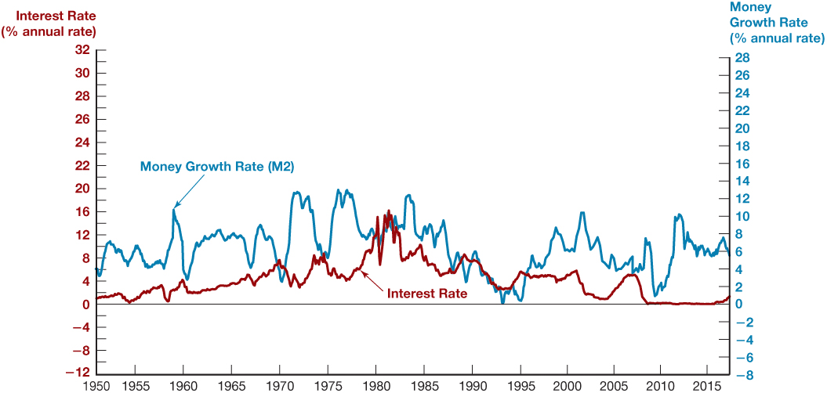
Figure 12 Money Growth (M2, Annual Rate) and Interest Rates (Three-Month Treasury Bills), 1950–2017
Source: Federal Reserve Bank of St. Louis FRED database: https://fred.stlouisfed.org/series/M2SL; https://fred.stlouisfed.org/series/TB3MS

Slide 66
Copyright

