Slide 1
The Expansionary Lower Bound: Contractionary Monetary Easing and the Trilemma
Marjan + Haniyyah + Anthony

Slide 2
Introduction
Question:
Can EMs retain monetary independence while having open capital accounts
Departure from:
Mundell’s Trilemma
Concern:
Doubts on if MP in EMs can balance the pressures of volatile international capital flows

Slide 3
Thesis
Theory:
Free capital mobility can hinder monetary policy independence in emerging markets
Even under flexible XR regime
Predicts:
The existence of an ELB
2 Models show how ELB arises:

Slide 4
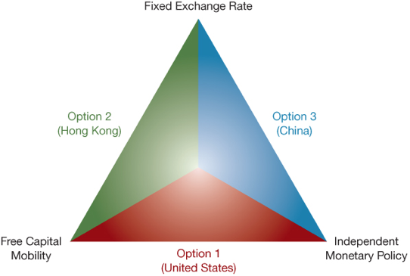
Mundell’s Trilemma
Mundell: can't have all 3 enforced in an economy
Trilemma not holding in EMs:
Financial conditions in EMs affected by volatile intern. capital flows
MP can generate swings on capital flows
Interest rate (recession) to stimulate econ. could cause cap. outflows (weakens AD)
Notes:
“All of this is a crucial departure from Mundell’s Trilemma”
Even after controlling for expected inflation and output gap: monetary authorities tend to hike up policy rates when the VIX or US policy rates increase (driven by desire to limit capital outflows and depreciation of the XR)

Slide 5
Expansionary Lower Bound
Interest rate threshold below which easing, by conventional monetary policy, becomes contractionary
Places constraint of MP to stimulate output
Places an upper bound on the level of output achievable through the easing of monetary policy
Can occur with positive interest rates
Even tighter constraint for MP
Notes:
The ELB constraints the ability of monetary policy to stimulate aggregate demand, placing an upper bound on the level of output achievable through monetary stimulus.

Slide 6
Expansionary Lower Bound
EMs strongly affected by global monetary and financial conditions
Pushes EMs into a recession while central banks are forced to raise policy rates
Rise of ELB:
Negative interaction between capital flows and collateral constraints

Slide 7
ELB
ZLB
Affects ability of central bank to support economy through monetary accommodations
Requires unconventional MP to correct
i > 0
Flexible, affected by global monetary and financial conditions
i = 0
Fixed
Forward Guidance effective
Forward guidance ineffective

Slide 8
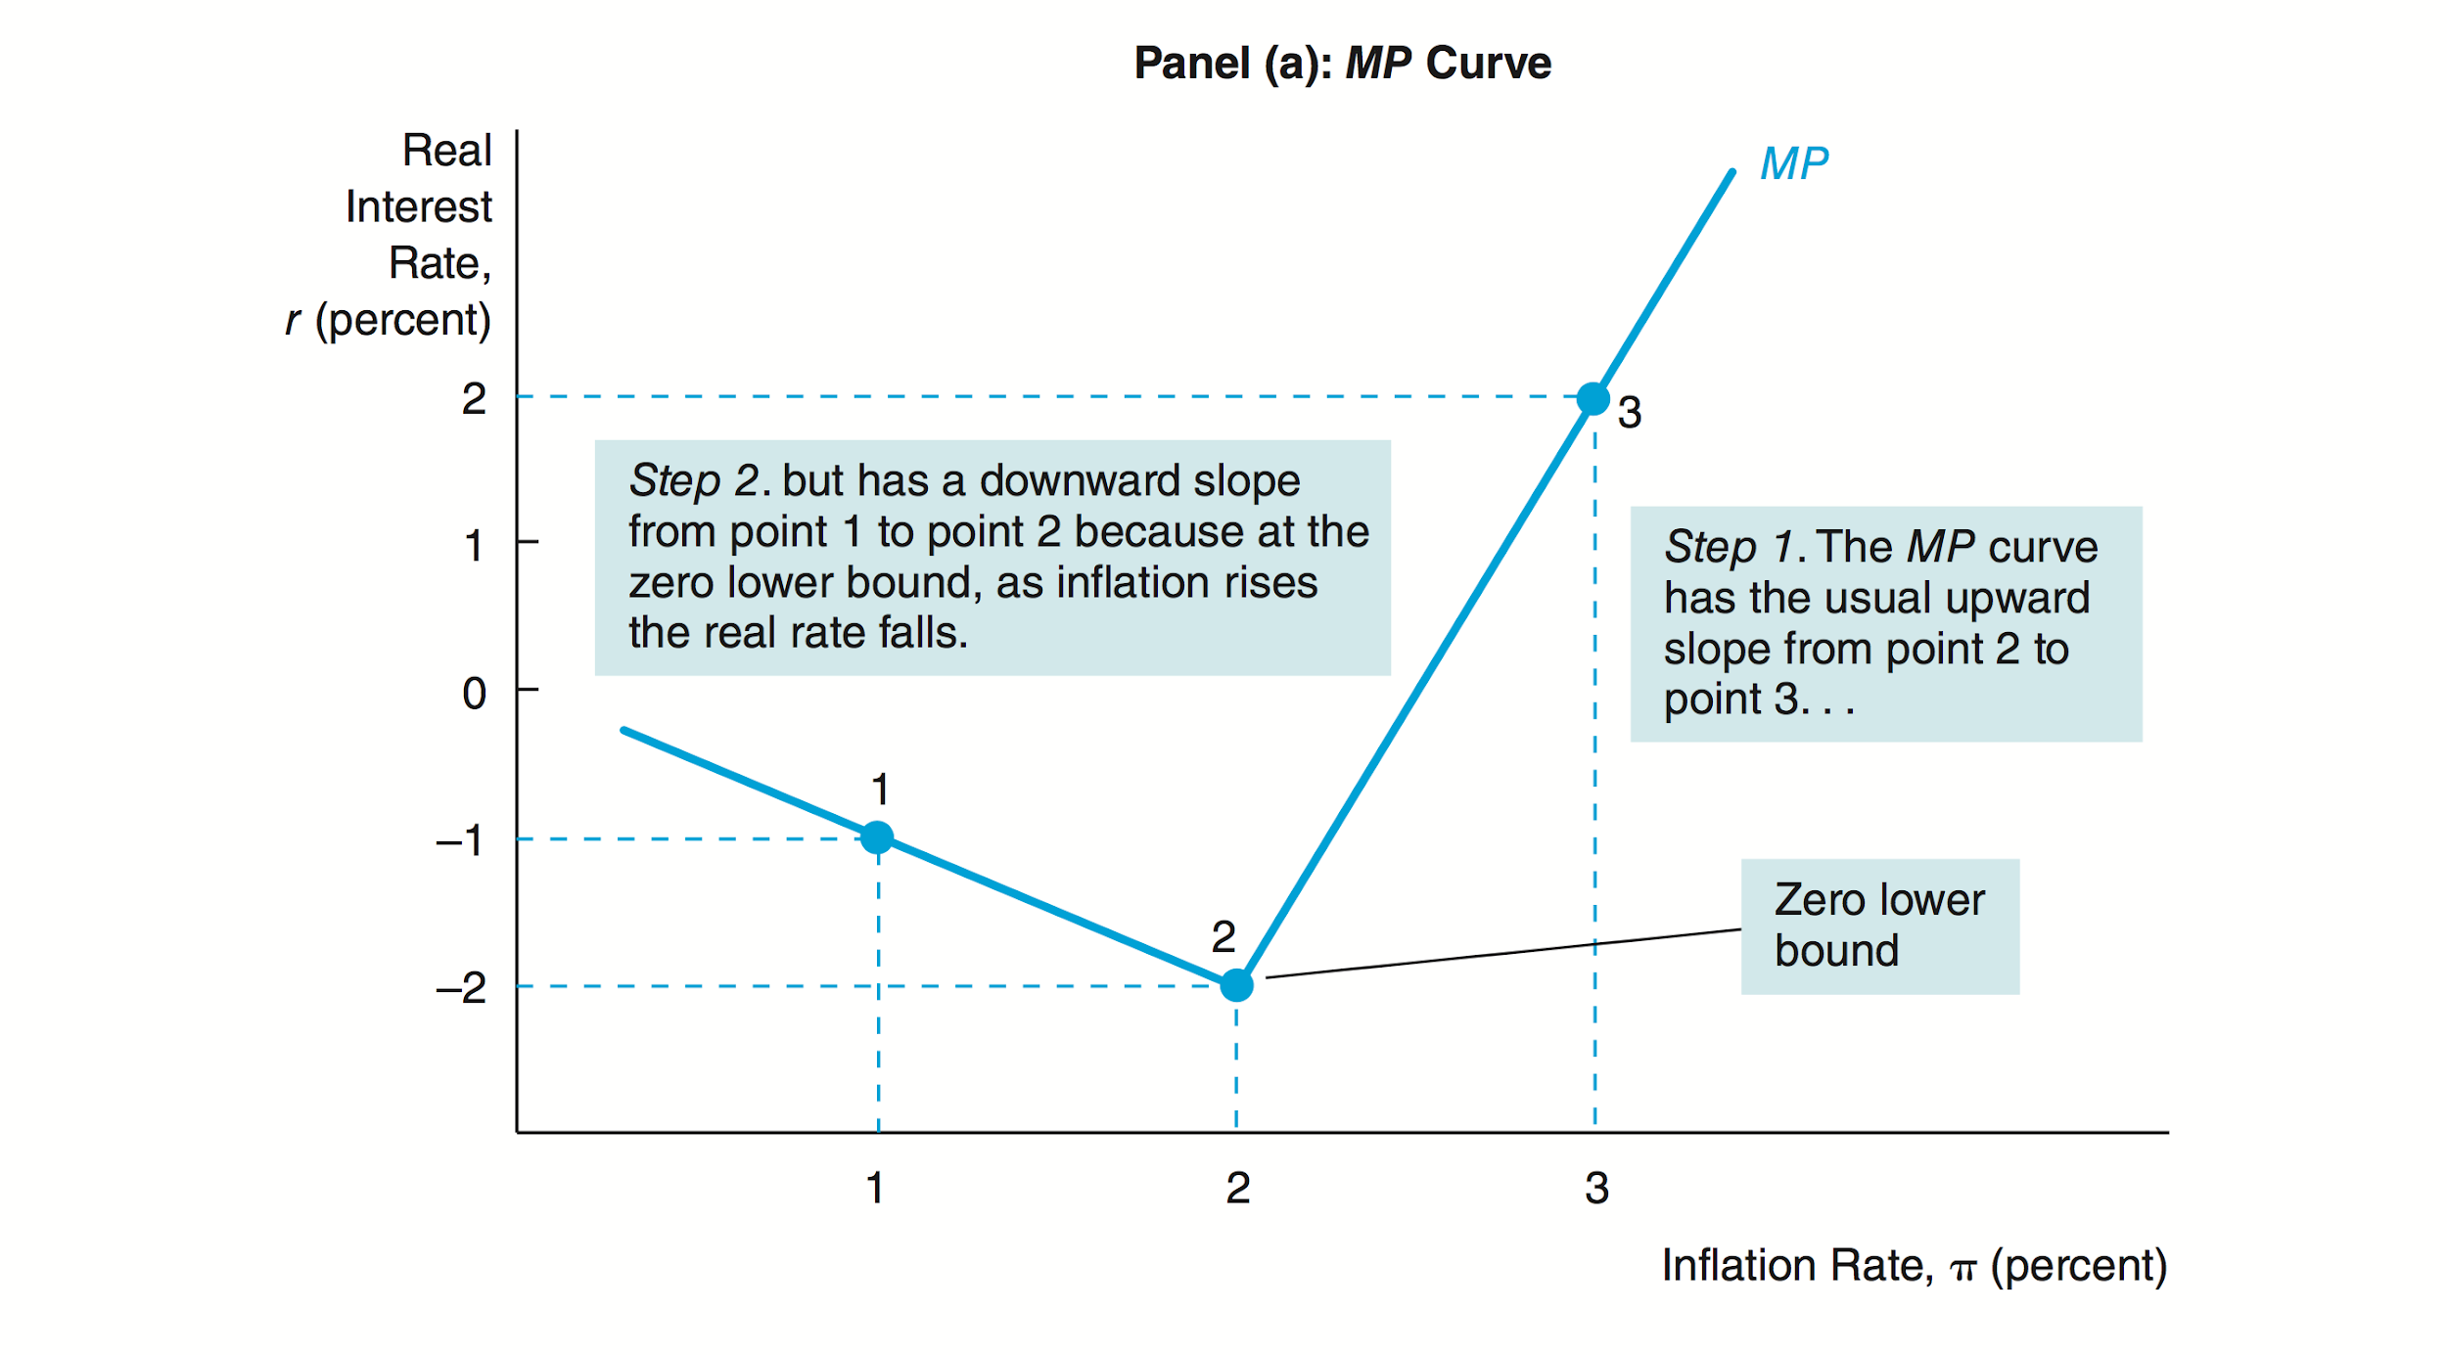
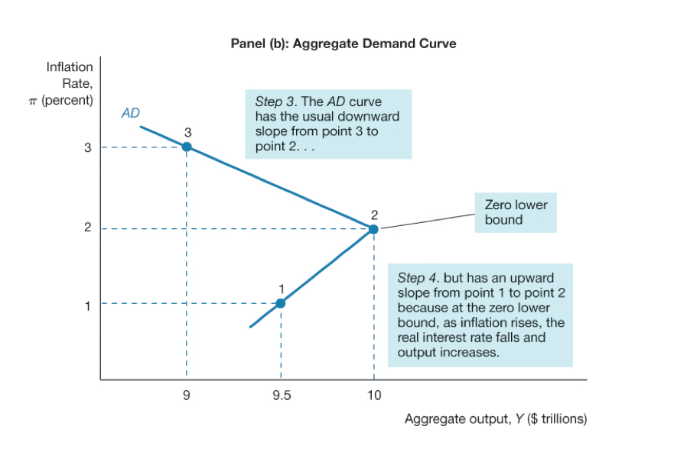
Graphs for the ZLB
Notes:
ANTHONY

Slide 9
Model 1: Effects of MP on carry-trade capital flows
Monetary easing: excess returns on domestic bonds
Triggers capital outflow
Weakens AD
Notes:
Monetary easing reduces returns on domestic bonds. This in turn triggers capital outflows as investors sell these bonds and cash out, looking at other countries for better interest rates.
This could push domestic banks against their leverage constraint (not enough capital)
Further easing can then become contractionary because to absorb the bonds liquidated, they have to reduce private credit by increasing lending rates.
This all causes a decrease in investments and therefore a decrease in output

Slide 10
Model 2: Effects of currency mismatch on collateral constraints
Domestic banks borrow internationally in foreign currency and lend domestically in local currency
Means that cost of bond varies with the XR
Monetary easing: depreciation of XR
Push banks against leverage constraint
Increase in lending rates
Weakens AD
Notes:
Common concern for EMs that have accumulated large amounts of US dollar debt attracted by low US rates
From this point on, if foreign currency debt is sufficiently large, additional monetary easing becomes contractionary (since banks can no longer freely intermediate foreign capital to provide domestic loans)
2nd: ELB arises with an increase in foreign MP rate due to depreciation of the XR

Slide 11
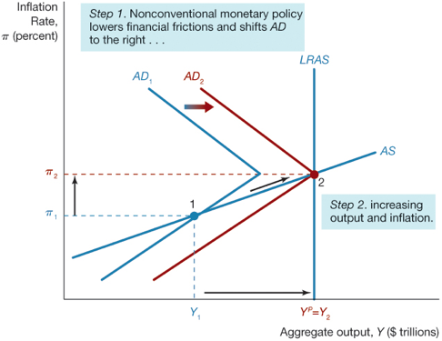
Unconventional Monetary Policy Tools
Quantitative easing
Expansion of the balance sheet through asset purchases
Effective for ELB
Effective for ZLB only if able to lower real interest rate for investments
Credit easing
Notes:
for quantitative easing, Mishkin talks about it as the expansion of the balance sheet through engagements such as liquidity provisions or asset purchases. When having quantitative easing, the huge increases in liquidity in the economy are able to be a powerful force in stimulating the economy in the near term and possibly producing inflation down the road. However, Mishkin says that this might not be enough to stimulate the economy. For the zero lower bound, it isn’t effective because unless it lowers the real interest rates for investments (credit easing), they won’t have an impact on the aggregate demand curve and hence no impact on output and inflation. in comparison to that, they actually are effective in overcoming the ELB due to carry-trade flows since they support credit supply by reducing the amount of government bonds held by banks.

Slide 12
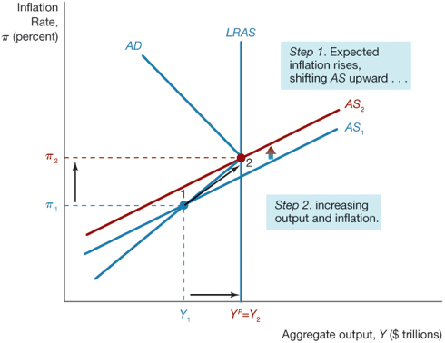
Unconventional Monetary Policy Tools
Forward guidance
Central bank commits to keeping policy rate low for a long period of time
Effective in overcoming ZLB
Unable to ease constraints imposed by ELB
Notes:
Forward guidance has the opposite effect. So forward guidance is when the central bank commits to keeping policy rates low for a long period of time. In terms of ZLB, it is effective because by committing to keep the policy rate low for a long period of time, it can lead to an increase in investments and an increase in the expectations of inflation, which causes a rightward shift in the aggregate demand curve and a shift in the short run aggregate supply curve. When it comes to the ELB, forward guidance becomes ineffective because the promise of a looser future monetary stance leads to an immediate depreciation of the exchange rate that tightens the bank leverage constraint

Slide 13
Proposal
Level of ELB affected by the MP stance in previous periods
Run economy below potential by keeping a tighter monetary stance
Allows for greater monetary space to offset possible shocks
Notes:
Tighter ex-ante monetary conditions tend to lower the ELB and thus create more monetary space to offset possible shocks. This observation has important normative implications since it calls for keeping a somewhat tighter monetary stance when global conditions are supportive to lower the ELB in the future.
A tighter monetary policy can help with the existence of ELB

Slide 14
Questions
Why would conventional monetary policy tools not work on the ELB and ZLB?
It seems that ELB is highly dependent on the world’s primary reserve currency. If that shifts away from the USD will the US be subjected to an ELB instead of a ZLB? Discuss.
Notes:
BONUS: Give a reason on why the trilemma holds in the US but does not in EMs (free capital mobility and independent MP)

