Slide 1
Essential Hybridity:
A money view of FX
Colette, Austin, & Kawan

Slide 2
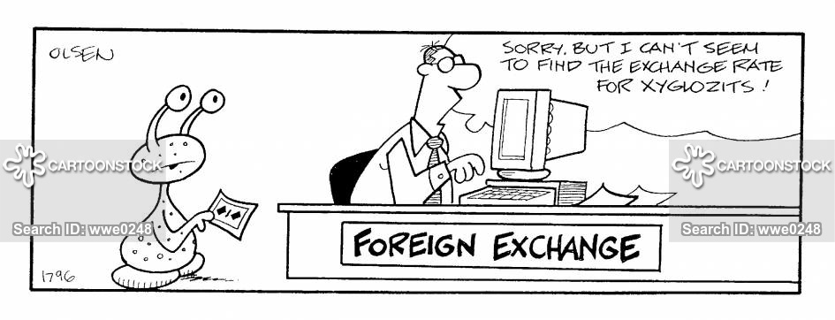
An Overview
Economics and Finance: Exchange rate = relative price of goods and assets
Money view: Exchange rate = relative price of money. A price that is determined in the dealer markets by the order flow facing private profit-seeking dealers and stability seeking central banks..
CB’s role in this fluid and hybrid hierarchical FX system

Slide 3
Thesis: hybrid character of money
The essentially hybrid character of money: it is part state and part market.
Base money (currency) is issued by the state
Bank money (and non-bank “shadow” money) is a creation made by private profit seeking players.
Quantitatively base money and bank money are equal, BUT they have significant qualitative differences.

Slide 4
CB Role in equating base money to bank money
Key players: Central Banks who are hybrid entities, serve both as the government bank and the bankers’ bank.
Bankers’ Bank: When banks need to convert bank money into base money, the CB accepts this bank money and pays out base money. (CB stands ready to lend)
Government bank: CB focuses on maintaining the market for govt debt. (CB stands ready to buy)
Recall: MS = C + D; if everyone wants to hold currency, then there will a run on the banks

Slide 5
Central Bank Extremes
(1): Agents of the state: CBs set the exchange rate as a policy tool by quoting buy and sell prices in terms of the international reserve currency and absorbing the resulting order flow on their own balance sheet.
(2): Laissez-faire policy: Hands off approach which allows the private profit maximizing dealers to determine the exchange rate by quoting their own buy and sell prices.
Agents of the State
Hybrid
Laissez Faire

Slide 6
Hybrid Case: Dealer of Last Resort
Private dealers conduct majority of the day-to-day trading
CB functions as “dealer of last resort.”
Key to understanding how the exchange rate is set:
Must understand the relationship between the foreign exchange dealer and the central bank
View the CB as a stability seeking FX dealer (rather than profit maximizer)

Slide 7
Treynor Model Review
“Economics of Dealer Function” : security dealers who make equity markets by setting the “inside spread,” re-adjusting their quotes as their inventories fluctuate.
NO NEED for the dealer to appraise the fundamental value of the security. Only concerned with the “outside spread” set by the “deep pockets” (Warren Buffets) who set the price that they are willing to take excess inventory off of the dealers’ books. (Liquidity of last resort)
Short inventory position = maximum price
Long inventory position = minimum price

Slide 8
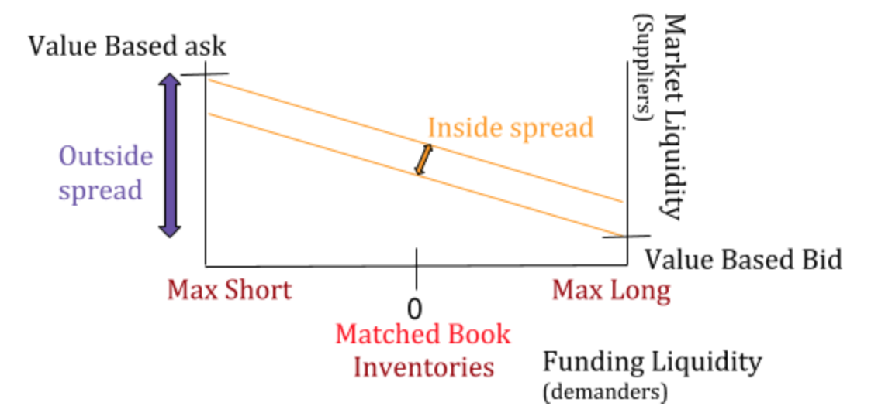
Treynor Diagram

Slide 9
Recall Differences from EMH
The standard economic theory of Efficient Market Hypothesis assumes that the inside spread should be ZERO ⇒ Liquidity is a free good (this is NOT the case in reality)
Often prices are not equal to their fundamental value
The amount of liquidity in the market fluctuates based on the dealers’ balance sheet
Adaptation of Treynor’s model to understand how the exchange rate is determined.

Slide 10
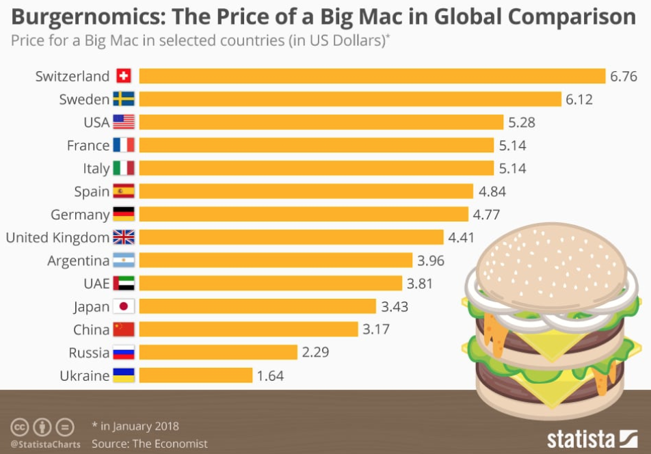
Economics view on FX
“Economics view” : Exchange rate = relative price of tradable goods (and services) in two countries. (Think “Big Mac Index”).
Standard theory: Purchasing Power Parity = tradable good trade at the same price globally.
P=sP*
P, P* : dollar and foreign price
s : exchange rate

Slide 11
Finance view on FX
“Finance view” : exchange rate as the relative price of tradable financial assets in two countries. (including physical capital and land)
New information about the future happens randomly, which shifts expectations, and thereby fluctuates asset prices as well as exchange rates.
Forward Interest Parity : return on a dollar invested at home = a dollar that is converted into foreign currency, invested in foreign assets, and then converted back into dollars (otherwise, arbitrage opportunity)
f = s(1 + R)/(1 + R*)
Notes:
R, R* = dollar and foreign interest rate for a given term T, s = spot exchange rate, f = forward exchange rate for date T

Slide 12
Role of Money
ECONOMICS and FINANCE: view trade conceptually as “sophisticated barter where one set of items is swapped for another” but overlook the concrete mechanism of trade which is where the role of money comes in.
Standard view requires: current account and capital account to sum to zero “equilibrium” (purchases are paid for by sales) ignores temporary imbalances in money.
Mehrling: exchange rate = the relative price of currencies ⇒ focus on the money flows involved, and INTERNATIONAL PAYMENTS SYSTEM (gross flow of payments in and out)

Slide 13
A “money view”
Survival constraint (reserve constraint) = the requirement that deficit countries find a way to settle with surplus countries in money. Deficit country needs to acquire dollars in the world foreign exchange market.
Otherwise, the deficit country will be unable to complete its purchase, and the transactions will have to be reversed

Slide 14
Private FX Dealing System
Surplus Country
FX Dealer
Deficit Country
Assets | Liabilities | Assets | Liabilities | Assets | Liabilities
$10 due from |  |  |  |  | $10 due to
-$10 due from +$10 spot |  | +$10/s FX spot | +$10 spot | -$10/s FX spot | -$10 due to
 |  | +$10 term | +$10/s FX term
 |  | +$10 term | +$10 term

Slide 15
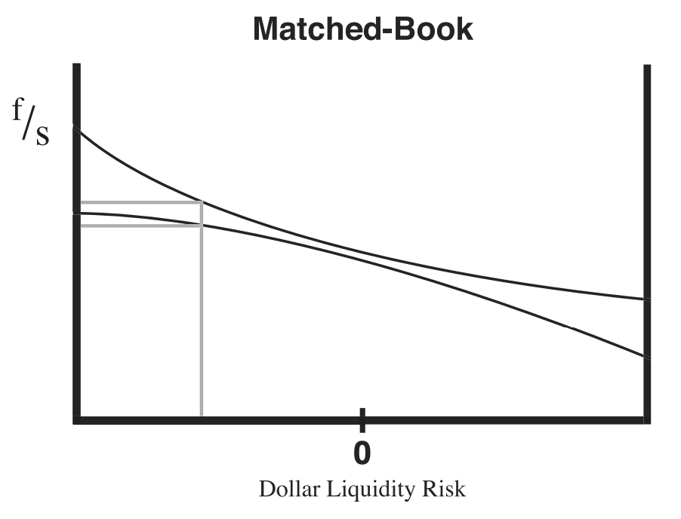
Matched-Book Treynor Diagram
Short dollar liquidity position causes dealer to widen the bid-ask spread and to push up the forward spread over spot, relative to a neutral position
Price effect is compensation for bearing liquidity risk by profit seeking dealers
Due to forward interest parity, a change in dealer exposure (credit expansion on balance sheet) can push term interest rates around independent of central bank policy

Slide 16
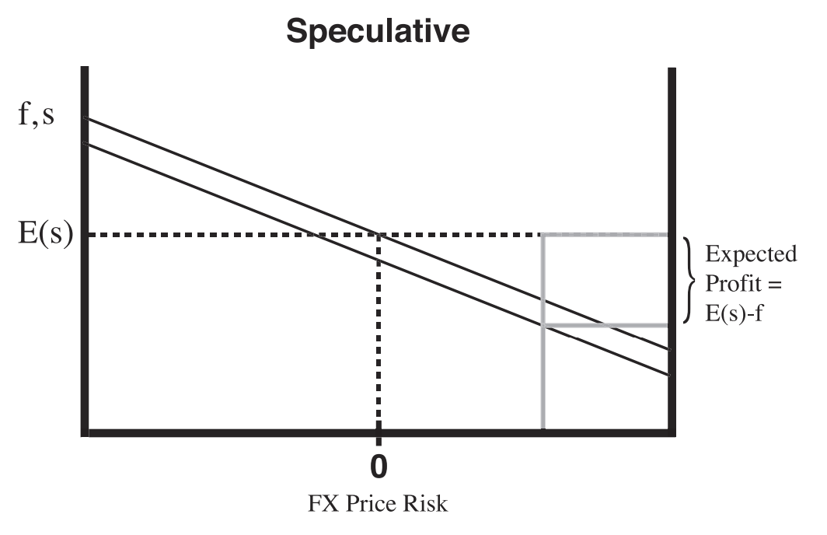
Speculative Treynor Diagram
Long forward FX position pushes forward rates below expected spot
This price effect is compensation for bearing foreign exchange risk

Slide 17
Taking Both Dealers Together
Private dealer system is business that profits from absorbing imbalance payments across countries of different currencies
Concept of equilibrium exchange rates is a simple model that assumes dealers work for free
Liquidity is never a free good

Slide 18
Liquidity Premium
Liquidity premium is the compensation charged for exposure to liquidity risk and exchange rate risk, measured as distortion from equilibrium
Assumption of free liquidity does make sense only if imbalances are small, quickly reversed, and negligible price distortions from equilibrium
If imbalances persist and risk inventories build up, dealers can hit position limits and this is where central banks come in

Slide 19
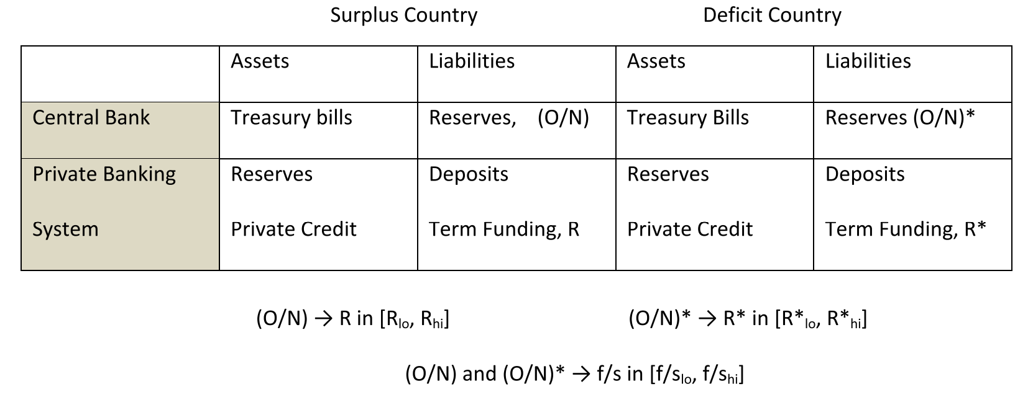
Central Banking and Private FX Dealer
Central Banks - government securities and reserves, manage balance sheets to target official short term interest rate (O/N)
Private Banks - credit instruments, deposits, and term funding instruments (R)

Slide 20
FX Dealer of Last Resort
Central banks targeting overnight interest rates translates to foreign exchange dealers of last resort
Only the deficit country’s central bank serves as dealer of last resort when private dealers reach max long or short positions
In reality, a deficit country’s central bank is not guaranteed a loan from surplus country’s central bank so must have other options

Slide 21
FX Dealer of Last Resort
Facilitate private-book dealing by serving as a speculative dealer
Removing the price risk from the private dealer
Facilitate direct term dollar borrowing to its private citizen
Offering forward hedges directly
Key: The deficit country central bank needs to shoulder FX price risk as a dealer of last resort.

Slide 22
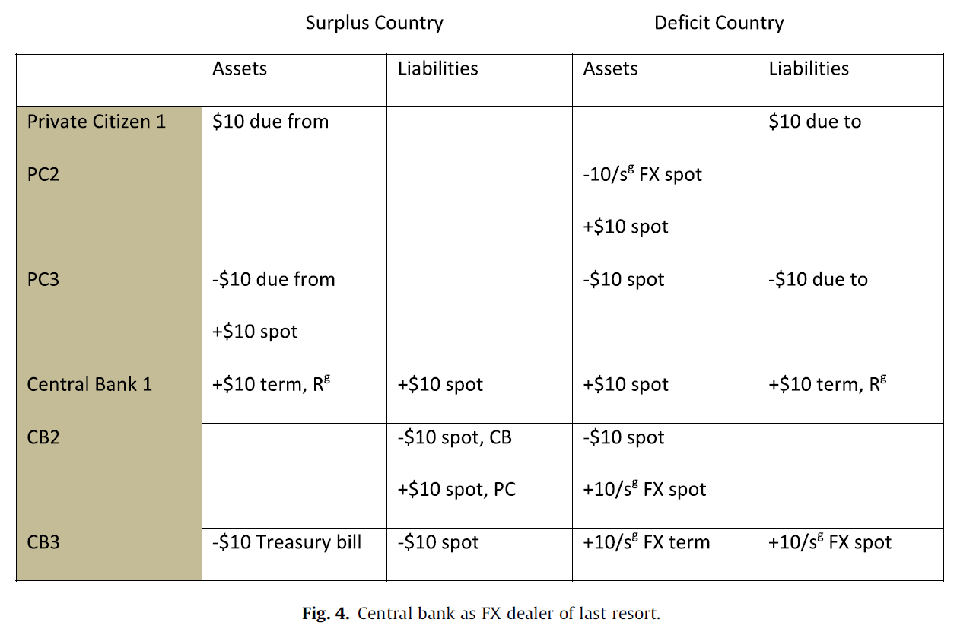
Central Bank - Dealer of Last Resort

Slide 23
Implications as Dealer of Last Resort
Forward position by the deficit central bank
Speculative Dealer of Last Resort
Not seeking profit
Policy Rate
R ≠ Rg
A non-commercial relationship between central banks internationally
FX spot ≠ FX spot g
A non-commercial relationship between private citizen domestically

Slide 24
The hierarchy of International Money
According to BIS number, 51% trade volume in the FX market involves major currency and 84.9% trade volume has dollar as one leg.
“The foreign exchange market is largely the price of dollar”
Major Currency Pair: high volume, liquid market, and tight bid-ask price, have the dollar as one leg.
EUR/USD
GBP/USD
AUD/USD
Minor Currency Pair: have the major currency as one leg.

Slide 25
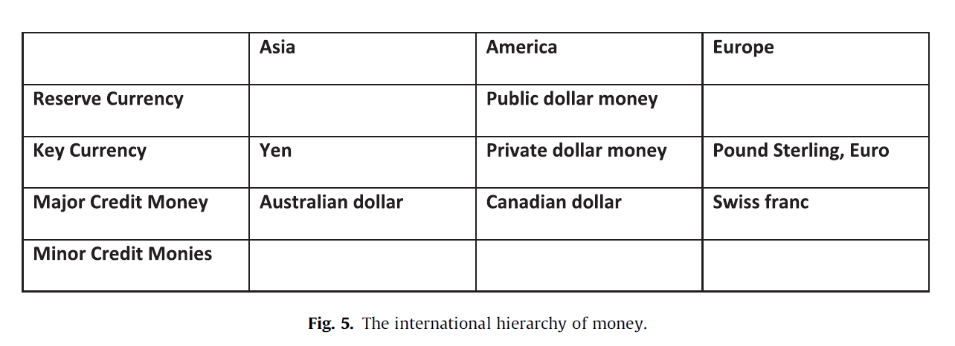
Hierarchy of monies

Slide 26
What determines the hierarchy?
From “Money View” Perspective:
“Survival Constraint”
Difference in the cash flow
A surplus country with strong demand on goods or assets has no pressure on the end day clearing.
It also has the power to determine the acceptable currency for the trade, its own currency.
As the rest of the world use the surplus currency to settle their payment and this will level up the surplus currency’s hierarchy level internationally.
It also gains the power to offer treatment to other monies who cannot enjoy a payment surplus.

Slide 27
Acceptance of Deferred Payments
The degree of national financial development.
Friction presents to all level of money-credit hierarchy, but it is especially more important for the top of the hierarchy, the central bank.
Public System
Government focuses on maintain its government debt by standing ready to buy.
Private System
Banker’s bank focuses on maintain the private banks liability by standing ready to buy.
The balance between central bank and banker’s bank changes over time.
Financial Underdeveloped Country
Financial Developed Country

Slide 28
Conclusion
FX market is about the exchangeability of one currency into another, and the price of the exchange.
Hierarchy of money shows up in price, but usually be treated as risk premium rather than the price liquidity.
Economics or Finance View Vs. “Money View”
Price distortion Vs. the liquidity premium.

Slide 29
Analysis
Agree with Merhling that looking at only an economics or only a finance view is often:
Too simple: assumptions such as liquidity being a free good
Abstracts from reality by considering only limit cases
Viewing money as a hybrid entity allows us to understand how both national financial systems and state systems of two countries confront one another
Helps us to define the quality of different currencies through a hierarchical system that is fluid and ever changing

Slide 30
Questions
What does the private dealer wish to maximize, and what does the central bank wish to maximize (when functioning as a speculative dealer)
In what circumstances can we consider liquidity a free good? (examined through the “economic” and “finance” views)

