Slide 1
The Economics of Money, Banking, and Financial Markets
Twelfth Edition
Chapter 6
The Risk and Term Structure of Interest Rates
Copyright © 2019, 2016, 2013 Pearson Education, Inc. All Rights Reserved.
Notes:
If this PowerPoint presentation contains mathematical equations, you may need to check that your computer has the following installed:
1) MathType Plugin
2) Math Player (free versions available)
3) NVDA Reader (free versions available)

Slide 2
Preview
In this chapter, we examine the sources and causes of fluctuations in interest rates relative to one another and look at a number of theories that explain these fluctuations.

Slide 3
Learning Objectives
Identify and explain three factors explaining the risk structure of interest rates.
List and explain the three theories of why interest rates vary across maturities.

Slide 4
Risk Structure and Term Structure of Interest Rate
Bonds with the same term to maturity have different interest rates.
The relationship among these interest rates is called the risk structure of interest rates, although risk, liquidity, and income tax rules all play a role in determining the risk structure.
A bond’s term to maturity also affects its interest rate, and
the relationship among interest rates on bonds with different terms to maturity is called the term structure of interest rates.

Slide 5
Risk Structure of Interest Rates (1 of 2)
Figure 1 shows us three important predictions of interest-rate behavior for bonds of the same maturity:
Lower-rated bonds will have higher yields.
Interest rates on a variety of bonds will move together although they differ from one another in any given year.
The spread (or difference) between the interest rates varies over time

Slide 6
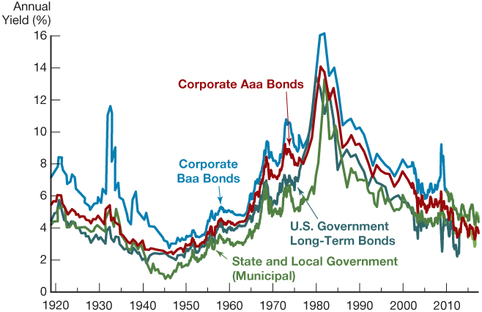
Figure 1 Long-Term Bond Yields, 1919–2017
Sources: Board of Governors of the Federal Reserve System, Banking and Monetary Statistics, 1941–1970; Federal Reserve Bank of St. Louis FRED database: http://research.stlouisfed.org/fred2

Slide 7
Risk Structure of Interest Rates (2 of 2)
Bonds with the same maturity have different interest rates due to:
Default risk
Liquidity
Tax considerations

Slide 8
Risk Structure of Interest Rates: Default Risk (1 of 3)
Default risk: probability that the issuer of the bond is unable or unwilling to make interest payments or pay off the face value
U.S. Treasury bonds are considered default free or benchmark bonds (government can raise taxes).
Risk Premium or Risk Spread:
The spread between interest rates on bonds with default risk and interest rates on default-free bonds, both of the same maturity, is called the risk premium.

Slide 9
Risk Structure of Interest Rates: Default Risk (2 of 3)
The risk premium indicates how much additional interest people must earn to be willing to hold the risky bond.
If bond ratings properly reflect the probability of default, then the lower the rating of the issuer, the higher the default-risk premium.
Prediction i: lower-rated bonds will have higher yields

Slide 10
Risk Structure of Interest Rates: Default Risk (3 of 3)
We can think of any bond yield as the sum of two parts:
the yield on the benchmark U.S. Treasury bond plus
a default-risk premium, sometimes called a risk spread.
$$Bond Yield=U.S Treasury Yield+Default Risk Premimum$$
Prediction ii, when Treasury yields move, all other yields move with them.

Slide 11
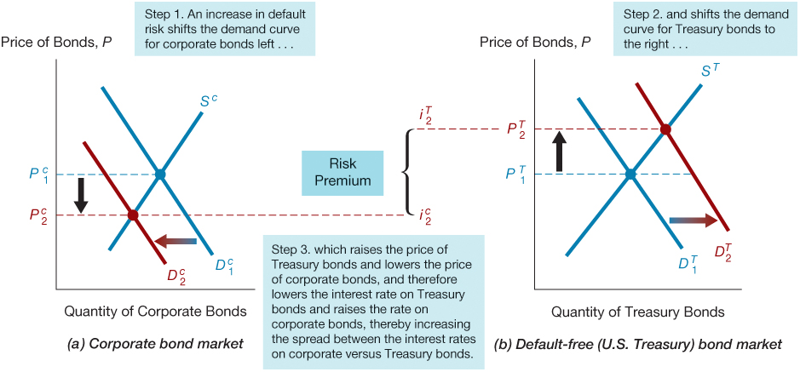
Figure 2 Response to an Increase in Default Risk on Corporate Bonds

Slide 12
Table 1 Bond Ratings by Moody’s, Standard and Poor’s, and Fitch (1 of 2)
Moody’s | Rating Agency S&P | Fitch | Definitions
Aaa | AAA | AAA | Prime Maximum Safety
Aa1 | AA+ | AA+ | High Grade High Quality
Aa2 | AA | AA | Blank
Aa3 | AA– | AA– | Blank
A1 | A+ | A+ | Upper Medium Grade
A2 | A | A | Blank
A3 | A– | A– | Blank
Baa1 | BBB+ | BBB+ | Lower Medium Grade
Baa2 | BBB | BBB | Blank
Baa3 | BBB– | BBB– | Blank
Ba1 | BB+ | BB+ | Noninvestment Grade

Slide 13
Table 1 Bond Ratings by Moody’s, Standard and Poor’s, and Fitch (2 of 2)
Moody’s | Rating Agency S&P | Fitch | Definitions
Ba2 | BB | BB | Speculative
Ba3 | BB– | BB– | Blank
B1 | B+ | B+ | Highly Speculative
B2 | B | B | Blank
B3 | B– | B– | Blank
Caa1 | CCC+ | CCC | Substantial Risk
Caa2 | CCC | — | In Poor Standing
Caa3 | CCC– | — | Blank
Ca | — | — | Extremely Speculative
C | — | — | May Be in Default
— | — | D | Default

Slide 14
Bonds Ratings
Investment Grade Bonds:
Bonds with relatively low risk of default are called investment-grade securities and have a rating of Baa (or BBB) and above.
Junk Bonds:
Bonds with ratings below Baa (or BBB) have higher default risk and have been aptly dubbed speculative-grade or junk bonds.
Because these bonds always have higher interest rates than investment-grade securities, they are also referred to as high-yield bond.

Slide 15
Interest Rate on Corporate Bond and Treasury Bond
Corporate bonds always have higher interest rates than U.S. Treasury bonds because they always have some risk of default, whereas U.S. Treasury bonds do not.
Because Baa-rated corporate bonds have a greater default risk than the higher-rated Aaa bonds, their risk premium is greater, and the Baa rate therefore always exceeds the Aaa rate.
Both default risks and risk premiums for corporate bonds rose after 1970, widening the spread between interest rates on corporate bonds and those on Treasury bonds.

Slide 16
The Global Financial Crisis and the Baa–Treasury Spread: Fight to Quality
Starting in August 2007, the collapse of the subprime mortgage market led to large losses among financial institutions.
As a consequence, many investors began to doubt the financial health of corporations with low credit ratings such as Baa and even the reliability of the ratings themselves.
Treasury bonds relatively more attractive and shifted the demand curve for these securities to the right—an outcome described by some analysts as a “flight to quality.”
The perceived increase in default risk for Baa bonds made them less desirable at any given price.

Slide 17
Risk Structure of Interest Rates: Liquidity Risk
Liquidity: the relative ease with which an asset can be converted into cash
Cost of selling a bond
Number of buyers/sellers in a bond market
The differences between interest rates on corporate bonds and Treasury bonds (that is, the risk premiums) reflect not only the corporate bonds’ default risk but also their lesser liquidity.
This is why a risk premium should more accurately be called a “risk and liquidity premium.”

Slide 18
Risk Structure of Interest Rates: Income Tax Consideration (1 of 2)
Income tax considerations
Interest payments on municipal bonds are exempt from federal income taxes.
A factor that has the same effect on the demand for municipal bonds as an increase in their expected return.

Slide 19
Risk Structure of Interest Rates: Income Tax Consideration (2 of 2)
Treasury Bond
Income tax %40 YTM= Coupon Rate= %10
Face Value $1000 After Tax Income= $100-$40= $60
Resale Price $1000 Actual Return= %6
Coupon Payment $100
Municipal Bond
Income tax %0 YTM= Coupon Rate= %8
Face Value $1000 Tax- Exempt Income= $80
Resale Price $1000 Actual Return= %8
Coupon Payment $80

Slide 20
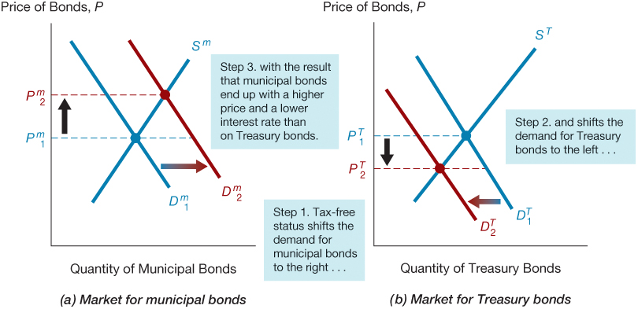
Figure 3 Interest Rates on Municipal and Treasury Bonds

Slide 21
Summary
Risk structure of interest rates (the relationships among interest rates on bonds with the same maturity) is explained by three factors:
default risk, liquidity, and the income tax treatment of a bond’s interest payments.
As a bond’s default risk increases, the risk premium on that bond (the spread between its interest rate and the interest rate on a default-free Treasury bond) rises.
The greater liquidity of Treasury bonds also explains why their interest rates are lower than those on less liquid bonds.
If a bond has a favor-able tax treatment, as do municipal bonds, whose interest payments are exempt from federal income taxes, its interest rate will be lower.

Slide 22
Effects of the Obama Tax Increase on Bond Interest Rates
In 2013, Congress approved legislation favored by the Obama administration to increase the income tax rate on high-income taxpayers from 35% to 39%. Consistent with supply and demand analysis, the increase in income tax rates for wealthy people helped to lower the interest rates on municipal bonds relative to the interest rate on Treasury bonds.

Slide 23
Term Structure of Interest Rates (1 of 4)
We have seen how risk, liquidity, and tax considerations (collectively embedded in the risk structure) can influence interest rates.
Another factor that influences the interest rate on a bond is its term to maturity:
Bonds with identical risk, liquidity, and tax characteristics may have different interest rates because the time remaining to maturity is different.

Slide 24
Term Structure of Interest Rates (2 of 4)
Yield curve: a plot of the yield on bonds with differing terms to maturity but the same risk, liquidity, and tax considerations.
Upward-sloping: long-term rates are above short-term rates
Flat: short- and long-term rates are the same
Downward-sloping (Inverted): long-term rates are below short-term rates
Yield curve describes the term structure of interest rates for particular types of bonds, such as government bonds.

Slide 25
Yield Curve (January 2019)
Notes:
Source: US Treasury
https://www.treasury.gov/resource-center/data-chart-center/interest-rates/pages/textview.aspx?data=yield

Slide 26
Yield Curve (March 2007)

Slide 27
Yield Curve (One Day Before and After Lehman’s Collapse)
The day after the collapse of Lehman Brothers, Fed suddenly reduced short-term interest rate to nearly zero percent.

Slide 28
Term Structure of Interest Rates (3 of 4)
The theory of the term structure of interest rates must explain the following facts:
Interest rates on bonds of different maturities move together over time.
When short-term interest rates are low, yield curves are more likely to have an upward slope; when short-term rates are high, yield curves are more likely to slope downward and be inverted.
Yield curves almost always slope upward.

Slide 29
Term Structure of Interest Rates (4 of 4)
Three theories have been put forward to explain the term structure of interest rates—that is, the relationships among interest rates on bonds of different maturities reflected in yield curve patterns:
Expectations theory explains the first two facts but not the third.
Segmented markets theory explains the third fact but not the first two.
Liquidity premium theory combines the two theories to explain all three facts.

Slide 30
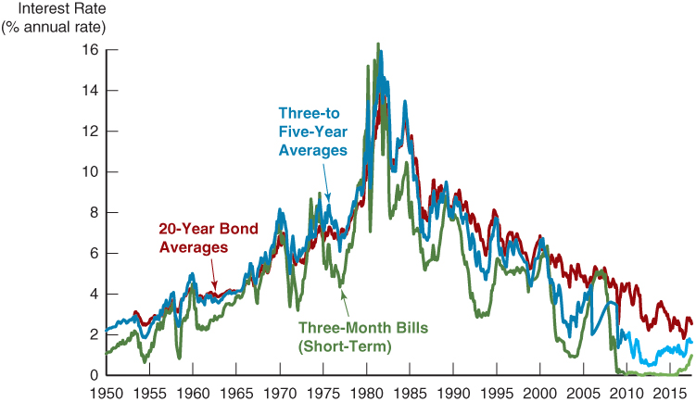
Figure 4 Movements over Time of Interest Rates on U.S. Government Bonds with Different Maturities
Sources: Federal Reserve Bank of St. Louis FRED database: http://research.stlouisfed.org/fred2/

Slide 31
Expectations Theory (1 of 8)
The interest rate on a long-term bond will equal an average of the short-term interest rates that people expect to occur over the life of the long-term bond.
The expectations theory predicts that interest rates on bonds of different maturities differ because short-term interest rates are expected to have different values at future dates.

Slide 32
Expectations Theory (2 of 8)
key Assumption
Buyers of bonds do not prefer bonds of one maturity over another,
so they will not hold any quantity of a bond if its expected return is less than that of another bond with a different maturity.
Bonds that have this characteristic are said to be perfect substitutes.
In practice, this means that if bonds with different maturities are perfect substitutes, then the expected returns on those bonds must be equal.

Slide 33
Expectations Theory (3 of 8)
An example:
let us consider the following two investment strategies:
Purchase a one-year bond, and when it matures in one year, purchase another one-year bond.
Purchase a two-year bond and hold it until maturity
Let the current rate on one-year bond be 6%.
You expect the interest rate on a one-year bond to be 8% next year.
Then the expected return for buying two one-year bonds averages (6% + 8%)/2 = 7%.
The interest rate on a two-year bond must be 7% for you to be willing to purchase it.

Slide 34
Expectations Theory (4 of 8)
Recap:
$Future Value when i does not change=FV=PV ×{(1+i)}^{n}$
$Future Value when i change in different period =FV=$
$$PV×{(1+t_{1}^{})}^{1}{×(1+t_{2}) }^{2}×…×{(1+t_{n}^{})}^{n}$$
$Expected Return for Discount Bond=FV −PV=PV[{\left(1+i\right)}^{n}−1]$

Slide 35
Expectations Theory (5 of 8)

Slide 36
Expectations Theory (6 of 8)

Slide 37
Expectations Theory (7 of 8)

Slide 38
Expectations Theory (8 of 8)
If the one-year interest rates over the next five years are expected to be 5%, 6%, 7%, 8%, and 9%, then the interest rate on two-year bond will be:
$$i_{2t}=\frac{i_{t}+i_{t+1}}{2}=\frac{5\%+6\%}{2}=\%5.5$$
$$i_{3t}=\frac{i_{t}+i_{t+1}+i_{t+2}}{3}=\frac{5\%+6\%+7\%}{3}=\%6$$
$$i_{4t}=\frac{i_{t}+i_{t+1}+i_{t+2}+i_{t+3}}{4}=\frac{5\%+6\%+7\%+8\%}{4}=\%6.5$$
$$i_{5t}=\frac{i_{t}+i_{t+1}+i_{t+2}+i_{t+3}+i_{t+4}}{5}=\frac{5\%+6\%+7\%+8\%+9\%}{5}=\%7$$

Slide 39
Expectations Theory: Changes in Yield Curve (1 of 2)
The expectations theory is an elegant theory that explains why the term structure of interest rates (as represented by yield curves) changes at different times:
When the yield curve is upward-sloping, in which the long-term rate is currently higher than the short-term rate, the expectations theory suggests that short-term interest rates are expected to rise in the future.

Slide 40
Expectations Theory: Changes in Yield Curve (2 of 2)
When the yield curve is inverted (slopes downward), the average of future short-term interest rates is expected to be lower than the current short-term rate, implying that short-term interest rates are expected to fall, on average, in the future.
Only when the yield curve is flat does the expectations theory suggest that short-term interest rates are not expected to change, on average, in the future.

Slide 41
Expectations Theory: Fact 1
The expectations theory also explains fact 1, which states that interest rates on bonds with different maturities move together over time.
Historically, short-term interest rates have shown the following trend:
If they increase today, they will tend to be higher in the future.
Hence a rise in short-term rates will raise people’s expectations of future higher short-term rates.
Because long-term rates are the average of expected future short-term rates, a rise in short-term rates will also raise long-term rates, causing short-and long-term rates to move together.

Slide 42
Expectations Theory: Fact 2 (1 of 2)
The expectations theory also explains fact 2, which states that yield curves tend to have an upward slope when short-term interest rates are low and be inverted when short-term rates are high.
When short-term rates are low
People generally expect them to rise to some normal level in the future, and the average of future expected short-term rates is high relative to the current short-term rate.
Therefore, long-term interest rates will be substantially higher than current short-term rates, and the yield curve will have an upward slope.

Slide 43
Expectations Theory: Fact 2 (2 of 2)
When short-term rates are high
People usually expect them to come back down.
Long-term rates will then drop below short-term rates because the average of expected future short-term rates will be lower than current short-term rates, and the yield curve will slope downward and become inverted.

Slide 44
Expectations Theory (7 of 7)
Expectations theory explains:
Why the term structure of interest rates changes at different times.
Why interest rates on bonds with different maturities move together over time (fact 1).
Why yield curves tend to slope up when short-term rates are low and slope down when short-term rates are high (fact 2).
Cannot explain why yield curves usually slope upward (fact 3)

Slide 45
Segmented Markets Theory (1 of 3)
Bonds of different maturities are not substitutes at all.
The segmented markets theory of the term structure sees markets for different-maturity bonds as completely separate and segmented.
The interest rate on a bond of a particular maturity is then determined by the supply of and demand for that bond and is not affected by expected returns on other bonds with other maturities.

Slide 46
Segmented Markets Theory (2 of 3)
The key assumption of the segmented markets theory is that bonds of different maturities are not substitutes at all:
the expected return from holding a bond of one maturity has no effect on the demand for a bond of another maturity.
This theory of the term structure is the opposite extreme of the expectations theory, which assumes that bonds of different maturities are perfect substitutes.

Slide 47
Segmented Markets Theory (3 of 3)
The argument for why bonds of different maturities are not substitutes is that investors have very strong preferences for bonds of one maturity as opposed to another, so they are concerned only with the expected returns on bonds of the maturity they prefer.
In the segmented markets theory, differing yield curve patterns are accounted for by supply and demand differences associated with bonds of different maturities.

Slide 48
Segmented Market Theory: Fact 3
If, as seems sensible, risk-averse investors have short desired holding periods and generally prefer bonds with shorter maturities that have less interest-rate risk, the segmented markets theory can explain fact 3, which states that yield curves typically slope upward.
Because the demand for long-term bonds is typically relatively lower than that for short-term bonds, long-term bonds will have lower prices and higher interest rates, and hence the yield curve will typically slope upward.

Slide 49
Liquidity Premium & Preferred Habitat Theories (1 of 2)
The interest rate on a long-term bond will equal an average of short-term interest rates expected to occur over the life of the long-term bond plus a liquidity premium that responds to supply and demand conditions for that bond.
Bonds of different maturities are partial (not perfect) substitutes.

Slide 50
Liquidity Premium & Preferred Habitat Theories (1 of 2)
The liquidity premium theory’s key assumption is that bonds of different maturities are substitutes,
which means that the expected return on one bond does influence the expected return on a bond of a different maturity.
However, the theory allows investors to prefer one bond maturity over another.
In other words, bonds of different maturities are assumed to be substitutes, but not perfect substitutes.

Slide 51
Liquidity Premium & Preferred Habitat Theories (1 of 2)
Investors tend to prefer shorter-term bonds because these bonds bear less interest-rate risk.
For this reason, investors must be offered a positive liquidity (term) premium to induce them to hold longer-term bonds.
Thus the expectations theory is modified by adding a positive liquidity (term) premium to the equation that describes the relationship between long-and short-term interest rates.
Term premium is a) always positive and b) increases with the term of maturity of bond.

Slide 52
Liquidity Premium Theory

Slide 53
Liquidity Premium Theory: Fact 1
It explains fact 1, which states that interest rates on different-maturity bonds move together over time:
A rise in short-term interest rates indicates that short-term interest rates will, on average, be higher in the future, and the first term in Equation 3 then implies that long-term interest rates will rise along with them.

Slide 54
Liquidity Premium Theory: Fact 2 (1 of 2)
The liquidity and preferred habitat theories also explain why yield curves tend to have an especially steep upward slope when short-term interest rates are low and to be inverted when short-term rates are high (fact 2).
Because investors generally expect short-term interest rates to rise to some normal level when they are low, the average of future expected short-term rates will be high relative to the current short-term rate.
With the additional boost of a positive liquidity (term) premium, long-term interest rates will be substantially higher than current short-term rates, and the yield curve will have a steep upward slope.

Slide 55
Liquidity Premium Theory: Fact 2 (2 of 2)
Conversely, if short-term rates are high, people usually expect them to come back down.
Long-term rates will then drop below short-term rates because the average of expected future short-term rates will be far below current short-term rates, despite positive liquidity premiums, and so the yield curve will slope downward.

Slide 56
Liquidity Premium Theory: Fact 3
The liquidity premium and preferred habitat theories explain fact 3, which states that yield curves typically slope upward,
by recognizing that the liquidity premium rises with a bond’s maturity because of investors’ preferences for short-term bonds.
Even if short-term interest rates are expected to stay the same, on average, in the future, long-term interest rates will be above short-term interest rates, and yield curves will typically slope upward.

Slide 57
Liquidity Premium Theory: Inverted Yield Curve
It must be that short-term interest rates are expected to fall so much in the future that the average of the expected short-term rates is well below the current short-term rate.
Even when the positive liquidity premium is added to this average, the resulting long-term rate is still lower than the current short-term interest rate.

Slide 58
Liquidity Premium Theory: Slope of Yield Curve and Market Expectations (1 of 2)
A particularly attractive feature of the liquidity premium is that it shows what the market is predicting about future short-term interest rates just from the slope of the yield curve.

Slide 59
Liquidity Premium Theory: Slope of Yield Curve and Market Expectations (2 of 2)
Slope of Yield Curve | Market Expectations
A steeply rising yield curve, as in panel (a) | short-term interest rates are expected to rise in the future.
A moderately steep yield curve, as in panel (b), | short-term interest rates are not expected to rise or fall much in the future.
A flat yield curve, as in panel (c), | short-term rates are expected to fall moderately in the future.
An inverted yield curve, as in panel (d) | short-term interest rates are expected to fall sharply in the future.

Slide 60
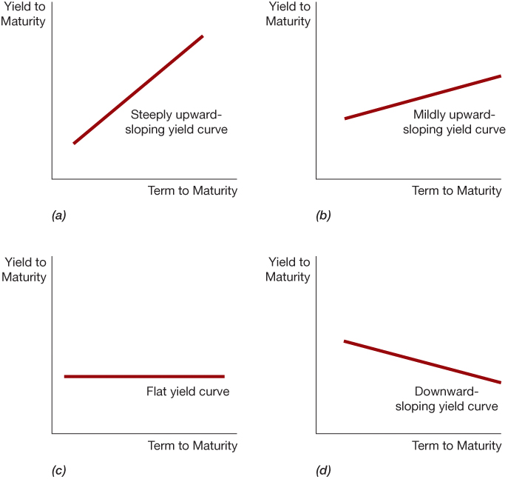
Figure 6 Yield Curves and the Market’s Expectations of Future Short-Term Interest Rates According to the Liquidity Premium (Preferred Habitat) Theory

Slide 61
Preferred Habitat Theory
Investors have a preference for bonds of one maturity over another.
They will be willing to buy bonds of different maturities only if they earn a somewhat higher expected return.
Investors are likely to prefer short-term bonds over longer-term bonds.

Slide 62
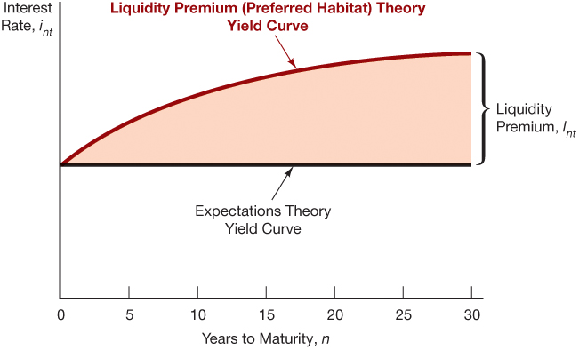
Figure 5 The Relationship Between the Liquidity Premium (Preferred Habitat) and Expectations Theory

Slide 63
Liquidity Premium & Preferred Habitat Theories (2 of 2)
Interest rates on different maturity bonds move together over time; explained by the first term in the equation
Yield curves tend to slope upward when short-term rates are low and to be inverted when short-term rates are high; explained by the liquidity premium term in the first case and by a low expected average in the second case
Yield curves typically slope upward; explained by a larger liquidity premium as the term to maturity lengthens

Slide 64
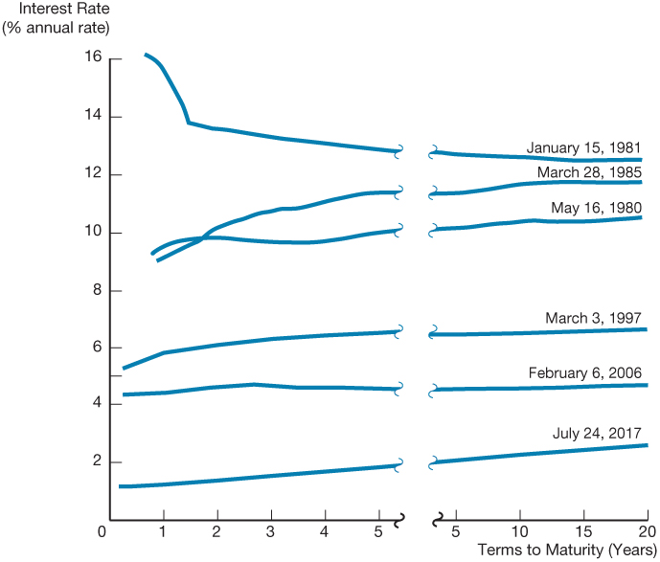
Figure 7 Yield Curves for U.S. Government Bonds

Slide 65
Copyright

