Slide 1
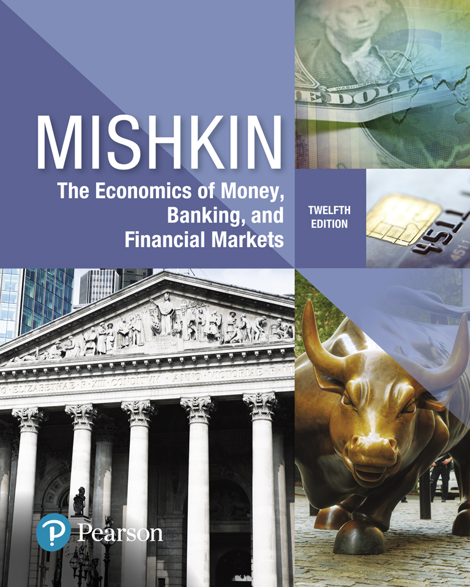
The Economics of Money, Banking, and Financial Markets
Twelfth Edition
Chapter 21
The Monetary Policy and Aggregate Demand Curves
Copyright © 2019, 2016, 2013 Pearson Education, Inc. All Rights Reserved.
Notes:
If this PowerPoint presentation contains mathematical equations, you may need to check that your computer has the following installed:
1) MathType Plugin
2) Math Player (free versions available)
3) NVDA Reader (free versions available)

Slide 2
Preview
This chapter develops an explanation for why monetary policy makers put upward pressure on interest rates when inflation increases.
This relationship is then used to develop the monetary policy curve.
The monetary policy curve is then used in conjunction with the IS schedule to derive an aggregate demand curve, which shall be used in the discussions that follow.

Slide 3
Learning Objectives
Recognize the impact of changes in the nominal federal funds rate on short-term real interest rates.
Define and illustrate the monetary policy (MP) curve and explain shifts in the MP curve.
Explain why the aggregate demand (AD) curve slopes downward and explain shifts in the AD curve.

Slide 4
Bank Lending Channel of Monetary Policy
The Federal Reserve controls the federal funds rate by varying the reserves it provides to the banking system.
When it provides more reserves, banks have more money to lend to each other, and this excess liquidity causes the federal funds rate to fall
$$Reserve ↑ →Liquidity↑→Bank Lending↑→i ↓$$
When the Fed drains reserves from the banking system, banks have less to lend, and the lack of liquidity leads to a rise in the federal funds rate.
$Reserve ↓ →Liquidity ↓→Bank Lending ↓→i ↑$

Slide 5
How Can Federal Reserve Control Real Interest Rate? (1 of 2)
How does the Federal Reserve’s control of the federal funds rate enable it to control the real interest rate, through which monetary policy impacts the economy?
The federal funds rate is a nominal interest rate, but it is the real interest rate that affects net exports and business spending, thereby determining the level of equilibrium output.
The real interest rate, $r$, is the nominal interest rate, $i$, minus expected inflation, $π^{e}$
$r=i − π^{e}$

Slide 6
How Can Federal Reserve Control Real Interest Rate? ( 2of 2)
Changes in nominal interest rates can change the real interest rate only if actual and expected inflation remain unchanged in the short run.
Because prices typically are slow to move—that is, they are sticky—changes in monetary policy will not have an immediate effect on inflation and expected inflation in the short run.
When the Federal Reserve lowers the federal funds rate, real interest rates fall; when the Federal Reserve raises the federal funds rate, real interest rates rise.

Slide 7
How Monetary Policy Reacts to Inflation? The Monetary Policy Curve
The monetary policy (MP) curve shows the relationship between the real interest rate set by the central bank and the inflation rate, π.
In other words, MP shows how $r$reacts to $π.$
The MP curve is upward sloping. Real interest rates rise when the inflation rate rises.

Slide 8
Autonomous Real Interest Rate
In the MP curve, $\overline{r}$ is the autonomous (exogenous) component of the real interest rate set by the monetary policy authorities, which is unrelated to the current level of the inflation rate or any other variable in the model.
$ℶ$ is the responsiveness of the real interest rate to the inflation rate.

Slide 9
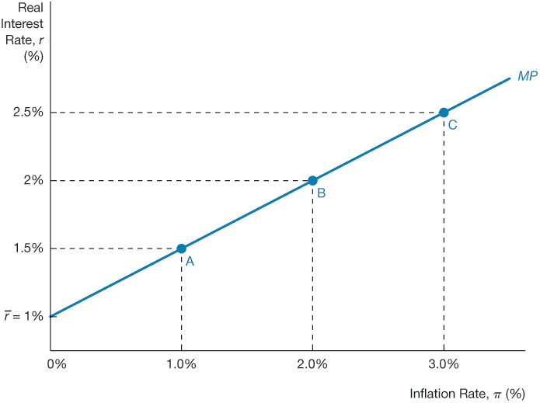
Figure 1 The Monetary Policy Curve

Slide 10
The Taylor Principle: Why the Monetary Policy Curve Has an Upward Slope
The key reason for an upward sloping MP curve is that central banks seek to keep inflation stable.
To stabilize inflation, monetary policymakers tend to follow the Taylor principle
Taylor principle: To stabilize inflation, central banks π must raise nominal interest rates by more than any rise in expected inflation, so that r rises when rises.
Schematically, if a central bank allows r to fall when π rises, then (Y^{ad} = AD):
$π↑ →r ↓→ Y^{ad} ↑→π↑→r↓ → Y^{ad} ↑ →π ↑$

Slide 11
Shifts in the MP Curve (1 of 4)
The Federal Reserve is said to “tighten” monetary policy when it raises real interest rates and to “ease” it when it lowers real interest rates.
It is important, however, to distinguish between
changes in monetary policy that shift the monetary policy curve, which we call autonomous changes, and
the Taylor principle–driven changes that are reflected in movements along the monetary policy curve, which are called automatic adjustments to interest rates.

Slide 12
Shifts in the MP Curve (2 of 4)
Central banks may make autonomous changes to monetary policy for various reasons:
They may wish to change the inflation rate from its current value.
For example, if they want to lower inflation (autonomous tightening of monetary policy):
$$at any given leevel ofπ: \overline{r}↑ →r ↑→ Y^{ad} ↓ → π↓$$

Slide 13
Shifts in the MP Curve (3 of 4)
2. The central banks may have other information, unrelated to inflation, suggesting that interest rates must be adjusted to achieve good economic outcomes.
For example, if the economy is going into a recession, monetary policymakers will want to lower real interest rates at any given inflation rate, an autonomous easing of monetary policy, in order to stimulate the economy and to prevent inflation from falling.
$$Any given level of π: \overline{r}↓ →r ↑→ Y^{ad} ↑ →π↑$$

Slide 14
Shifts in the MP Curve (4 of 4)
Two types of monetary policy actions that affect interest rates:
Automatic (Taylor principle) changes as reflected by movements along the MP curve (2004–2006)
Autonomous changes that shift the MP curve
Autonomous tightening of monetary policy that shifts the MP curve upward (in order to reduce inflation)
Autonomous easing of monetary policy that shifts the MP curve downward (in order to stimulate the economy as the Fed was doing in the period leading up to the global financial crisis)

Slide 15
Movements Along the Monetary Policy Curve (1 of 2)
Movements along the MP curve should be viewed as a central bank’s normal response (also known as an endogenous response) of raising interest rates when inflation is rising.
Thus we can think of a movement along the MP curve as an automatic response of the central bank to a change in inflation.
Such an automatic response does not involve a shift in the MP curve.

Slide 16
Movements Along the Monetary Policy Curve (2 of 2)
On the other hand, when the central bank raises interest rates at a given level of the inflation rate, this action is not an automatic response to higher inflation.
Instead, it is an autonomous tightening of monetary policy that shifts the MP curve up.

Slide 17
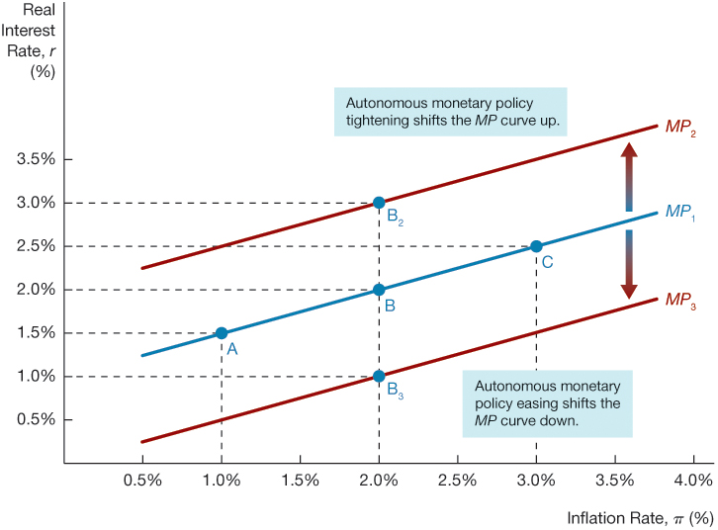
Figure 2 Shifts in the Monetary Policy Curve

Slide 18
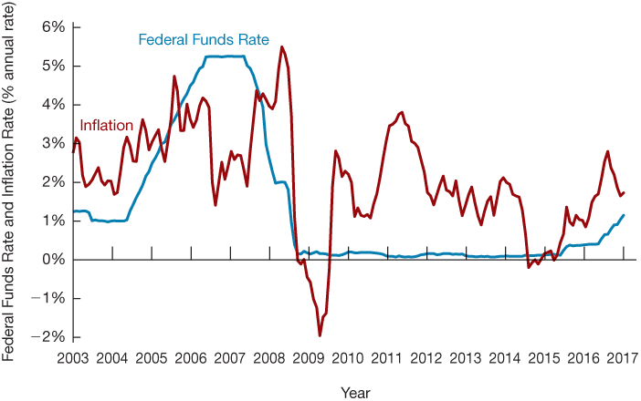
Figure 3 The Federal Funds Rate and Inflation Rate, 2003–2017

Slide 19
The Aggregate Demand Curve (1 of 2)
The aggregate demand curve is the relationship between the inflation rate and aggregate output when the goods market is in equilibrium:
The MP curve demonstrates how central banks respond to changes in inflation by changing the interest rate in line with the Taylor principle.
The IS curve showed that changes in real interest rates, in turn, affect equilibrium output.
With these two curves, we can now link the quantity of aggregate output demanded with the inflation rate, given the public’s expectations of inflation and the stance of monetary policy.

Slide 20
The Aggregate Demand Curve (2 of 2)
The aggregate demand curve is central to the aggregate demand and supply analysis we will develop further in the next chapter, which will enable us to explain short-run fluctuations in both aggregate output and inflation.

Slide 21
Deriving the Aggregate Demand Curve Graphically
The AD curve is derived from:
The MP curve
The IS curve
“The aggregate demand curve, AD, indicates the level of aggregate output corresponding to different level of real interest rates consistent with equilibrium in the goods market for any given inflation rate.”
The AD curve has a downward slope: As inflation rises, the real interest rate rises, so that spending and equilibrium aggregate output fall.

Slide 22
Deriving the Aggregate Demand Curve Algebraically
$$IS Curve:$$
$$Y=\left[\overline{C}+\overline{I}−d\overline{f}+\overline{G}+\overline{NX}−mpc×\overline{T}\right]×\frac{1}{1−mpc}−\frac{x+d}{1−mpc}×r$$
$$MP Curve:$$
$$r=\overline{r}+γπ$$
By replacing $r$ with MP Curve:
$$AD Curve:$$
$$Y=\left[\overline{C}+\overline{I}−d\overline{f}+\overline{G}+\overline{NX}−mpc×\overline{T}\right]×\frac{1}{1−mpc}−\frac{x+d}{1−mpc}×\overline{r}+γπ$$

Slide 23
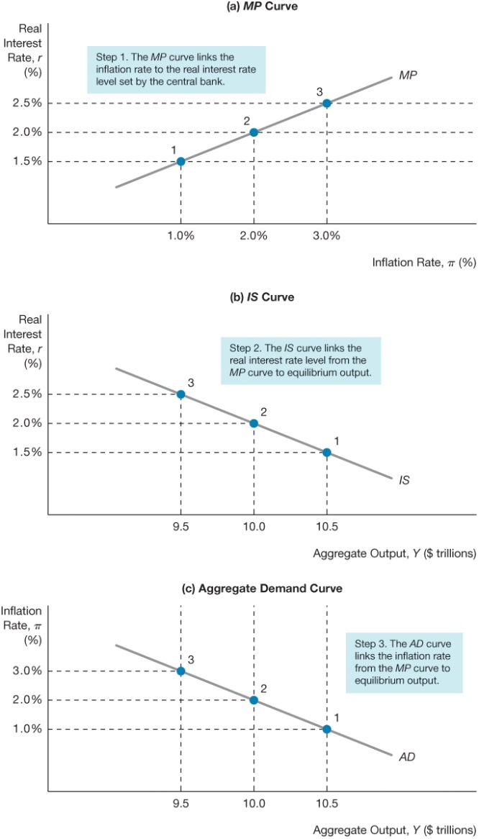
Figure 4 Deriving the AD Curve

Slide 24
Factors That Shift the Aggregate Demand Curve
Shifts in the IS curve
Autonomous consumption expenditure
Autonomous investment spending
Government purchases
Taxes
Autonomous net exports
Any factor that shifts the IS curve shifts the aggregate demand curve in the same direction.

Slide 25
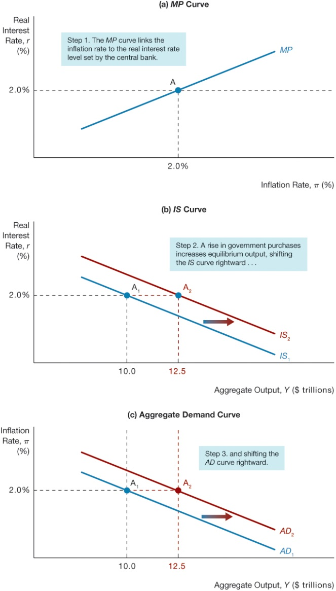
Figure 5 Shift in the AD Curve from Shifts in the IS Curve

Slide 26
Factors That Shift the Aggregate Demand Curve
Shifts in the MP curve
An autonomous tightening of monetary policy, that is a rise in real interest rate at any given inflation rate, shifts the aggregate demand curve to the left
Similarly, an autonomous easing of monetary policy shifts the aggregate demand curve to the right

Slide 27
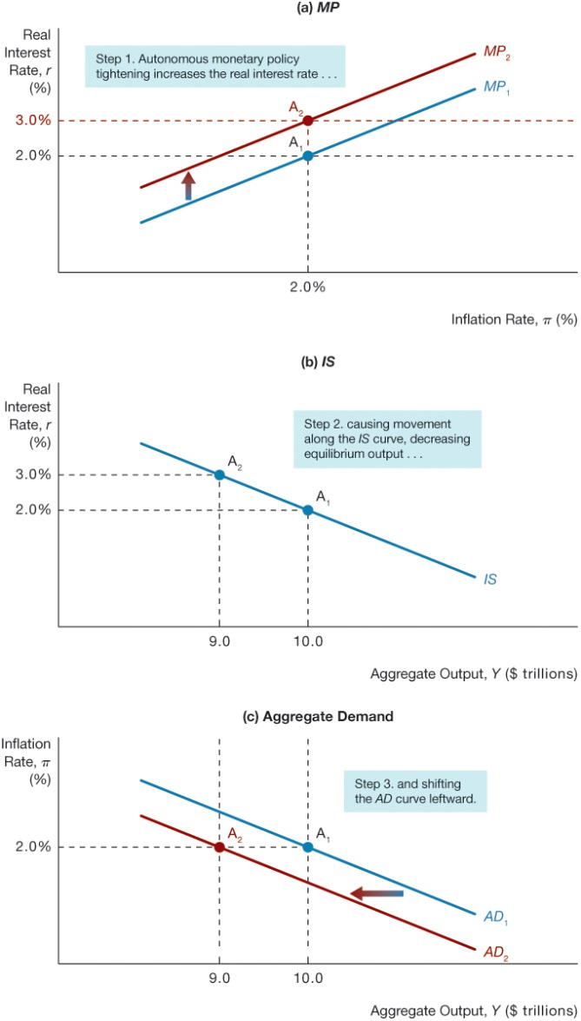
Figure 6 Shift in the AD Curve from Autonomous Monetary Policy Tightening

Slide 28
Copyright

